Slide 1
A Shapelet Transform for Time Series Classification
Jason Lines, Luke M. Davis, Jon Hills, Anthony Bagnall, Proceedings of the 18th International Conference on Knowledge Discovery in Data and Data Mining P.289-P.297,2012
Presenter: Wen-Chuan Ho
Date:2015/04/07

Slide 2
Abstract(1/2)
The problem of time series classification (TSC), where we consider any real-valued ordered data a time series, presents a specific machine learning challenge as the ordering of variables is often crucial in finding the best discriminating features. One of the most promising recent approaches is to find shapelets within a data set. A shapelet is a time series subsequence that is identified as being representative of class membership. The original research in this field embedded the procedure of finding shapelets within a decision tree.

Slide 3
Abstract(2/2)
We propose disconnecting the process of finding shapelets from the classification algorithm by proposing a shapelet transformation. We describe a means of extracting the k best shapelets from a data set in a single pass, and then use these shapelets to transform data by calculating the distances from a series to each shapelet. We demonstrate that transformation into this new data space can improve classification accuracy, whilst retaining the explanatory power provided by shapelets.

Slide 4
Time Series Classification
A time series is a sequence of data that is typically recorded in temporal order at fixed intervals of time.
T = { T₁, T₂, …, T_{n} }
T_{i} =< t_{i1}, t_{i2}, …, t_{im} >
A class value c_{i}
m

Slide 5
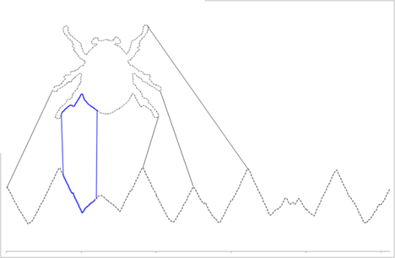
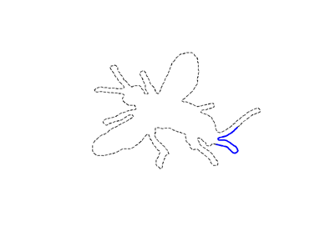
Shapelets(1/2)
A shapelet is a time series subsequence that is identified as being representative of class membership

Slide 6
Shapelets(2/2)
A subsequence S ,length = l
A time series T , length = m
W_{i,l} :The set of all subsequences of length l for series T_{i}
W_{l} : The set of all subsequences of length l for data set T
W_{l} = {W_{1,l}, W_{2,l},….., W_{n,l} }
W : The set of all candidate shapelets for data set T
W = {W_{min},W_{min+1},…,W_{max}}

Slide 7
Measuring Distances
l
dist(S,R) = Ʃ(s_{i},r_{i})²
D_{S} =< d_{1,S}, d_{2,S},…, d_{n,s} >
i=1

Slide 8
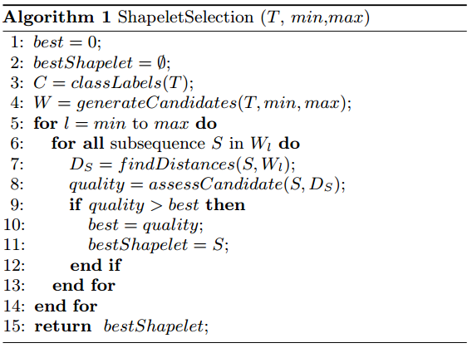
The generic shapelet finding algorithm

Slide 9
Shapelet Generation
Step1. Store all candidates for a given time series along with their associated quality measures
Step2. Sort all candidates of a series in order of fitness
Step3.Remove self-similar shapelets
Step4.Merge current best shapelets and retain the top k

Slide 10
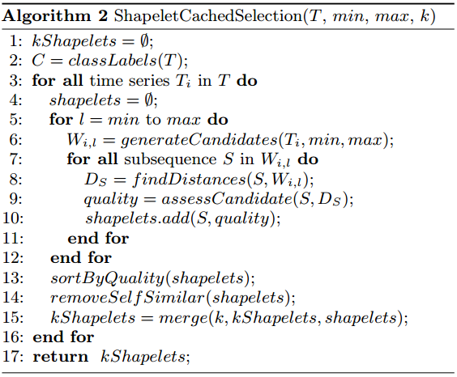
Shapelet Generation Algorithm

Slide 11
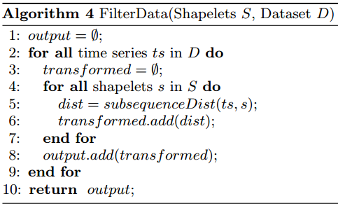
Data Transformation

Slide 12
Shapelet Selection
2 strategies for selecting the number of shapelets:
Use n/2 shapelets
Selects the number of shapelets to use based on the results of a 5-fold cross-validation experiment

Slide 13
5-Fold Cross-Validation Experiment
Step1. Partition the training data into 5 equal parts
Step2. Use the data as a testing set and combine the four other folds to form a set of training data
Step3. Pass the training data into filtering algorithm and produce n shapelets
Step4. Create n different sets of transformed training data and transformed testing data
n shapelets

Slide 14
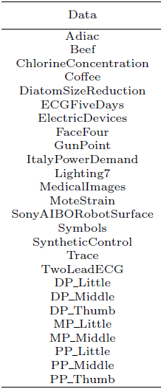
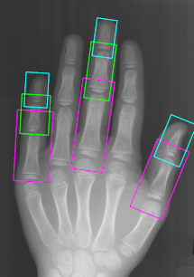
Experimental
26 data sets:
18 data sets from the UCR time
series repository
8 data sets from hand x-rays
845Testing
200Training

Slide 15
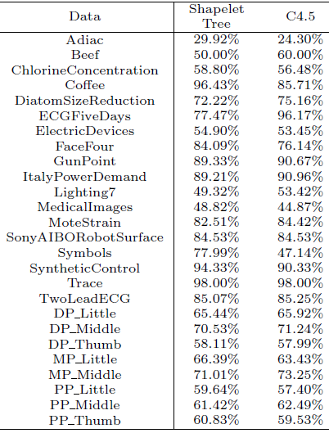
Results(1/5)
Shapelet
Shapelet decision tree Classication
C4.5 decision tree classication
Shapelet tree classication:13
C4.5 classication:12

Slide 16
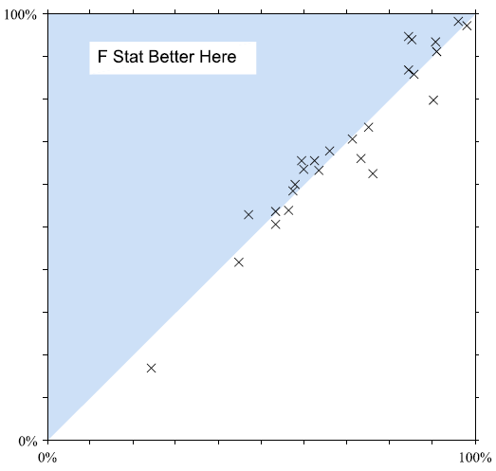
Results(2/5)
Shapelet selection
Information Gain:
F-Statistic

Slide 17
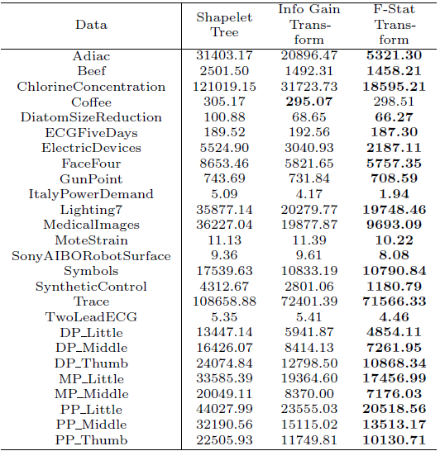
The build time for the shapelet tree
The information gain shapelet transform
The F-statistic shapelet transform

Slide 18
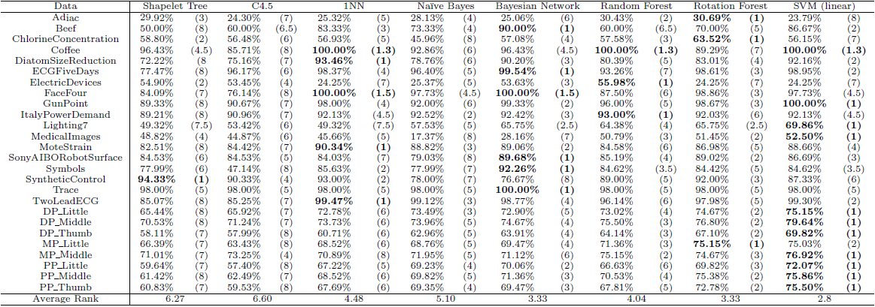
Testing accuracy and ranks of 8 classiers constructed on the shapelet transform with n=2 shapelets.

Slide 19
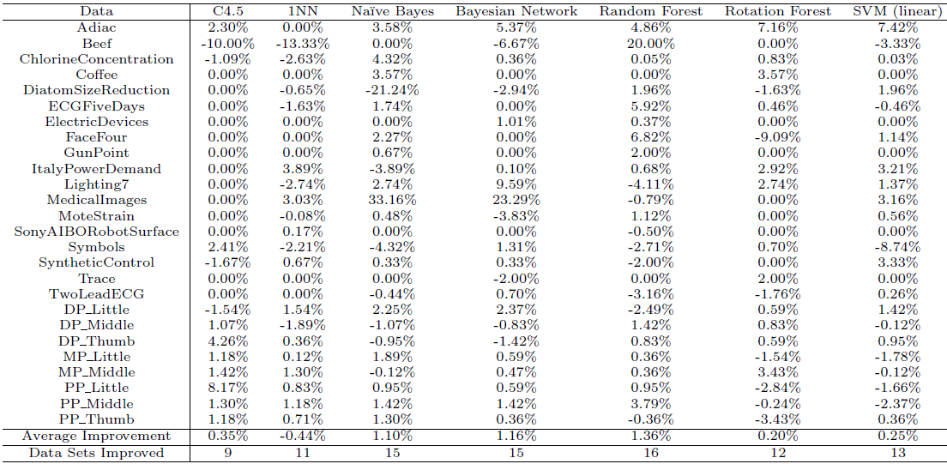
Relative accuracies of the classiers when trained with an automatically selected number of shapelets through cross-validation vs. using n=2 shapelets

