Slide 1
Beam search for the longest common subsequence problem
Christian Blum, Maria J. Blesa, Manuel López-Ibáñez
Computers and Operations Research, Volume 36, pp. 3178-3186 (2009)
Presenter: Shian-Liang Lin

Slide 2
Abstract
The longest common subsequence problem is a classical string problem that concerns finding the common part of a set of strings.
It has several important applications, for example, pattern recognition or computational biology. Most research efforts up to now have focused on solving this problem optimally. In comparison, only few works exist dealing with heuristic approaches.
In this work we present a deterministic beam search algorithm. The results show that our algorithm outperforms the current state-of-the-art approaches not only in solution quality but often also in computation time.

Slide 3
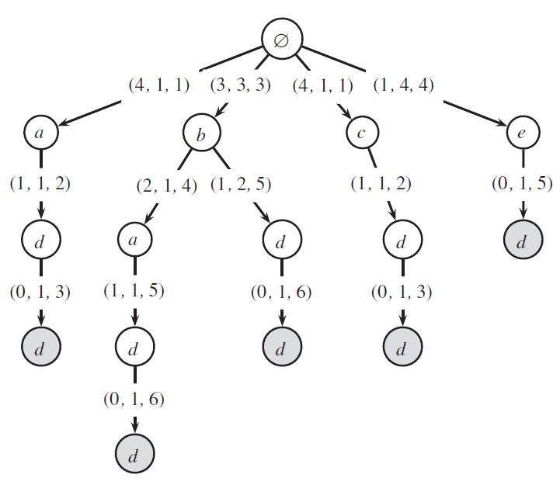
BS Algorithm
 | 1 | 2 | 3 | 4 | 5 | 6 | 7
S₁ | b | c | a | d | c | d | c
S₂ | c | a | a | b | a | d | d
S₃ | b | a | c | d | d | c | d
K_{bw}=2(beam width)
u=1.5
Extension limit=3
Notes:
#Extension limits is only for these nodes which has the same father

Slide 4
Non-domination relation(1/2)
 | 1 | 2 | 3 | 4 | 5 | 6 | 7
S₁ | b b | c c | a a | d d | c c | d d | c c
S₂ | c c | a a | a a | b b | a a | d d | d d
S₃ | b b | a a | c c | d d | d d | c c | d d
K_{bw}=2(beam width)
u=1.5
Extension limit=3

Slide 5
Non-domination relation(2/2)
 | 1 | 2 | 3 | 4 | 5 | 6 | 7
S₁ | b b | c c | a a | d d | c c | d d | c c
S₂ | c c | a a | a a | b b | a a | d d | d d
S₃ | b b | a a | c c | d d | d d | c c | d d

Slide 6
Choose Extensions
 | 1 | 2 | 3 | 4 | 5 | 6 | 7
S₁ | b | c | a | d | c | d | c
S₂ | c | a | a | b | a | d | d
S₃ | b | a | c | d | d | c | d
4
5
5
ŋ₁(a)=min{ (7-3), (7-2), (7-2) }= 4
S₁ S₂ S₃
ŋ₁(b)=3
ŋ₁(c)=4
ŋ₁(d)=1
=>remove d
K_{bw}=2(beam width)
u=1.5
Extension limit=3

Slide 7

Upper bound
 | 1 | 2 | 3 | 4 | 5 | 6 | 7
S₁ | b | c | a | d | c | d | c
S₂ | c | a | a | b | a | d | d
S₃ | b | a | c | d | d | c | d
2
2
3
UB(a)= 1 + 0 + 0 + 2 =3
|a| d’s occurrences
UB(b)=4
UB(c)=3
=>remove c
( c is lexicographically greater than a )
K_{bw}=2(beam width)
u=1.5
Extension limit=3

Slide 8
 | 1 | 2 | 3 | 4 | 5 | 6 | 7
S₁ | b | c | a | d | c | d | c
S₂ | c | a | a | b | a | d | d
S₃ | b | a | c | d | d | c | d
Run1:
Init()
{ }->{ a, b, c ,d }
Check domination()
->{a, b ,c }
Choose extentions(ŋ₁ ,3)
->{a, b ,c}
Reduce(2)
->{ a, b}
LCS: b a d d

Slide 9
 | 1 | 2 | 3 | 4 | 5 | 6 | 7
S₁ | b | c | a | d | c | d | c
S₂ | c | a | a | b | a | d | d
S₃ | b | a | c | d | d | c | d
Run2:
Produce_extention()
{ a,b }->{ ad ,ba ,bd }
Check domination()
->{ ba }
Choose extentions(ŋ₁ ,3)
->{ ba }
Reduce(2)
->{ ba }
LCS: b a d d

Slide 10
 | 1 | 2 | 3 | 4 | 5 | 6 | 7
S₁ | b | c | a | d | c | d | c
S₂ | c | a | a | b | a | d | d
S₃ | b | a | c | d | d | c | d
Run4:
Produce_extention()
{ bad }->{ badd }
Check domination()
->{ badd }
Choose extentions(ŋ₁ ,3)
->{ badd }
Reduce(2)
->{ badd }
LCS: b a d d

Slide 11
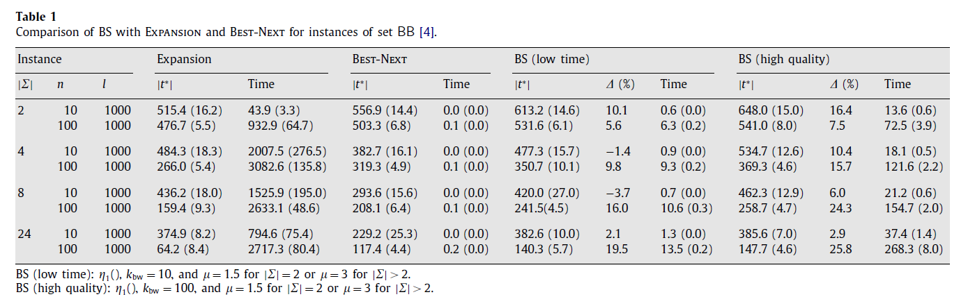
Experiments(for set BB)
∆(%) : (100 · X/Y) − 100,
where X is the result obtained by BS,
Y is the best result between Expansion and Best-Next.
Set BB
1.Base string of length l was created by randomly generating letters from ∑ .
2.Each of the n strings was produced by traversing the base string and deleting each
Letter with aprobability of 0.1.
3. Ten instances were generated for each of the combinations of | ∑ | .

Slide 12
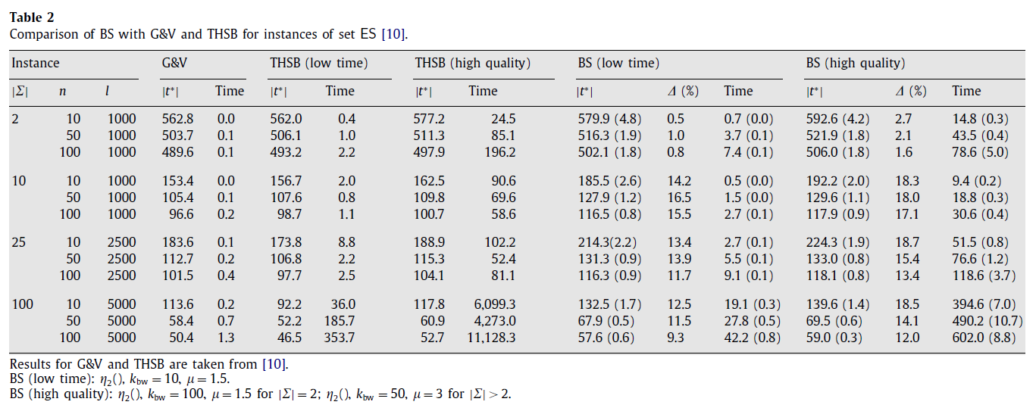
Experiments(for set ES)
∆(%) : (100 · X/Y) − 100,
where X is the result obtained by BS,
Y is the result of THSB(high quality).
Set ES
1.It is composed of 50 instances per combination of |∑|, n, and l.
2.These instances were created by sequentially generating each letter with a probability of 1/|∑|.

Slide 13
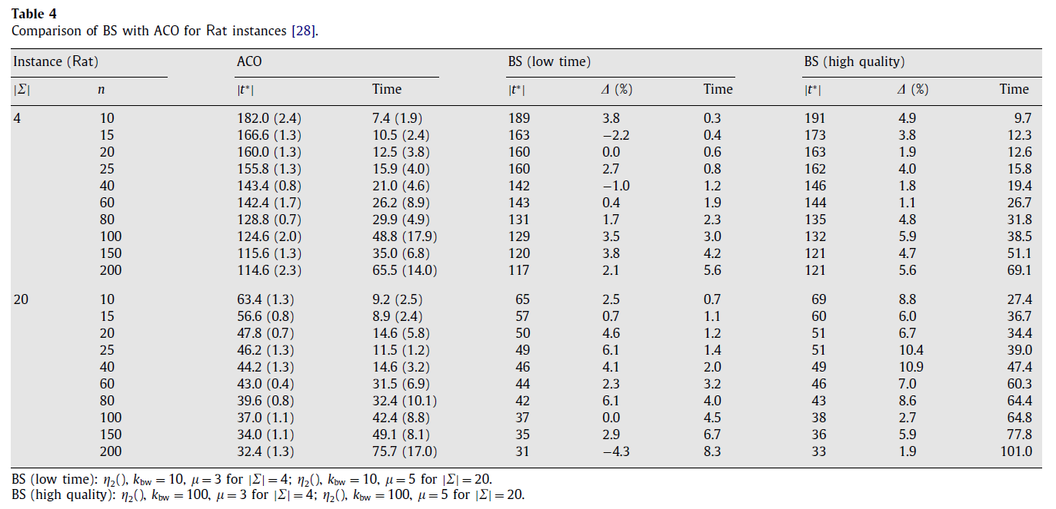
Experiments (for set ST)
∆(%) : (100 · X/Y) − 100,
where X is the result obtained by BS,
Y is the result of ACO
Set ST
Instances are biologically inspired, and thus they consider an alphabet of size |∑| = 4(DNA), or of size |∑| = 20(protien)
ACO:Ant Colony Optimization

Slide 14
Thanks for listening

