Slide 1
INSIGHT: Efficient and Effective Instance Selection for Time-Series Classification
Krisztian Buza, Alexandros Nanopoulos, and Lars Schmidt-Thieme
Proceedings of the 15th Pacific-Asia Conference on Advances in Knowledge Discovery and Data Mining pp. 149-160 (2011)
Presenter：Guan-Cheng Guo Date：2015/4/21

Slide 2
Abstract
Time-series classification is a widely examined data mining task with various scientific and industrial applications. Recent research in this domain has shown that the simple nearest-neighbor classifier using Dynamic Time Warping (DTW) as distance measure performs exceptionally well, in most cases outperforming more advanced classification algorithms. Instance selection is a commonly applied approach for improving efficiency of nearest-neighbor classifier with respect to classification time. This approach reduces the size of the training set by selecting the best representative instances and use only them during classification of new instances.

Slide 3
Abstract
In this paper, we introduce a novel instance selection method that exploits the hubness phenomenon in time-series data, which states that some few instances tend to be much more frequently nearest neighbors compared to the remaining instances. Based on hubness, we propose a framework for score-based instance selection, which is combined with a principled approach of selecting instances that optimize the coverage of training data. We discuss the theoretical considerations of casting the instance selection problem as a graph-coverage problem and analyze the resulting complexity. We experimentally compare the proposed method, denoted as INSIGHT, against FastAWARD, a state-of-the-art instance selection method for time series. Our results indicate substantial improvements in terms of classification accuracy and drastic reduction (orders of magnitude) in execution times.

Slide 4
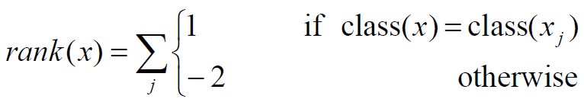
FastAWARD Algorithm
Training set T
Naïve Rank Reduction:
leave-one-out 1-NN classification on T
Rank the instances according to the score function:
Keep the n highest ranking instances in S as the training set for future classification.

Slide 5
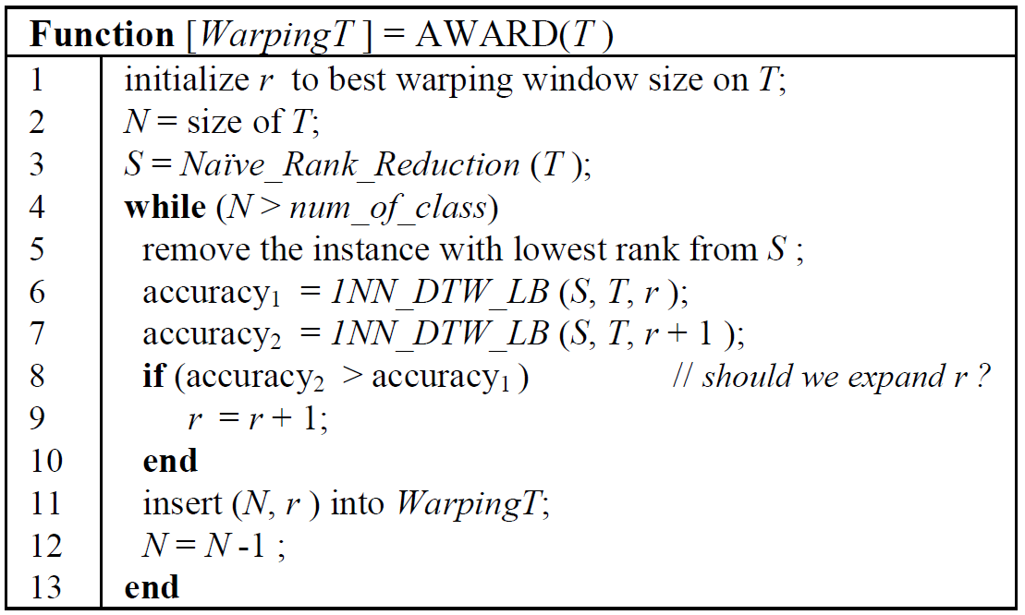
FastAWARD Algorithm

Slide 6
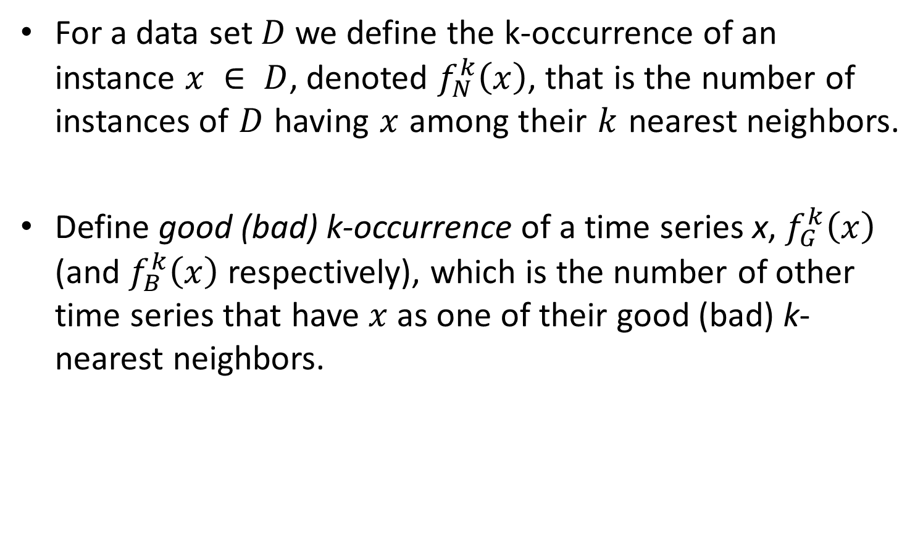
Score Functions
For a data set $D$ we define the k-occurrence of an instance $x ∈ D$, denoted $f_{N}^{k}\left(x\right)$, that is the number of instances of $D$ having $x$ among their $k$ nearest neighbors.
Define good (bad) k-occurrence of a time series x, $f_{G}^{k}\left(x\right)$ (and $f_{B}^{k}\left(x\right)$ respectively), which is the number of other time series that have $x$ as one of their good (bad) k-nearest neighbors.

Slide 7

Score Functions
Good 1-occurrence score: $f_{G}\left(x\right)=f_{G}^{1}\left(x\right)$
Relative score: $f_{R}\left(x\right)=\frac{f_{G}^{1}\left(x\right)}{f_{N}^{1}\left(x\right)+1}$
Xi’s score: $f_{Xi}\left(x\right)=f_{G}^{1}\left(x\right)−2f_{B}^{1}\left(x\right)$

Slide 8
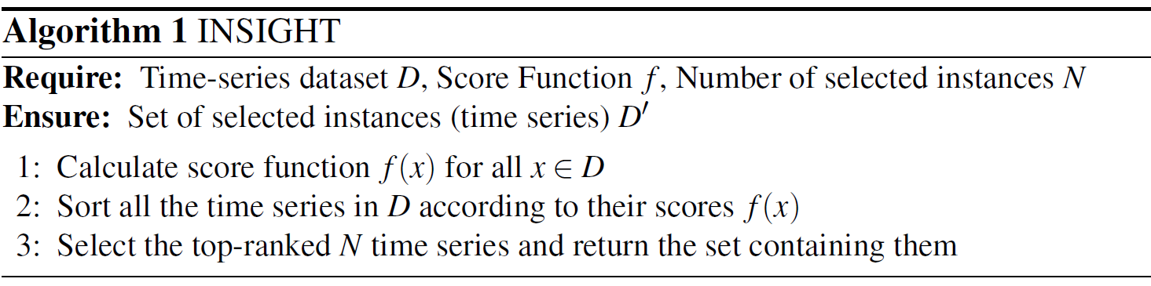
INSIGHT Algorithm
Instance Selection based on Graph-coverage and Hubness for Time-series (INSIGHT).

Slide 9
INSIGHT Algorithm
x

Slide 10
Experiments
Examine the performance of INSIGHT algorithm with the FastAWARD.
The number of selected instances is equal to 10% of the size of the training set.

Slide 11
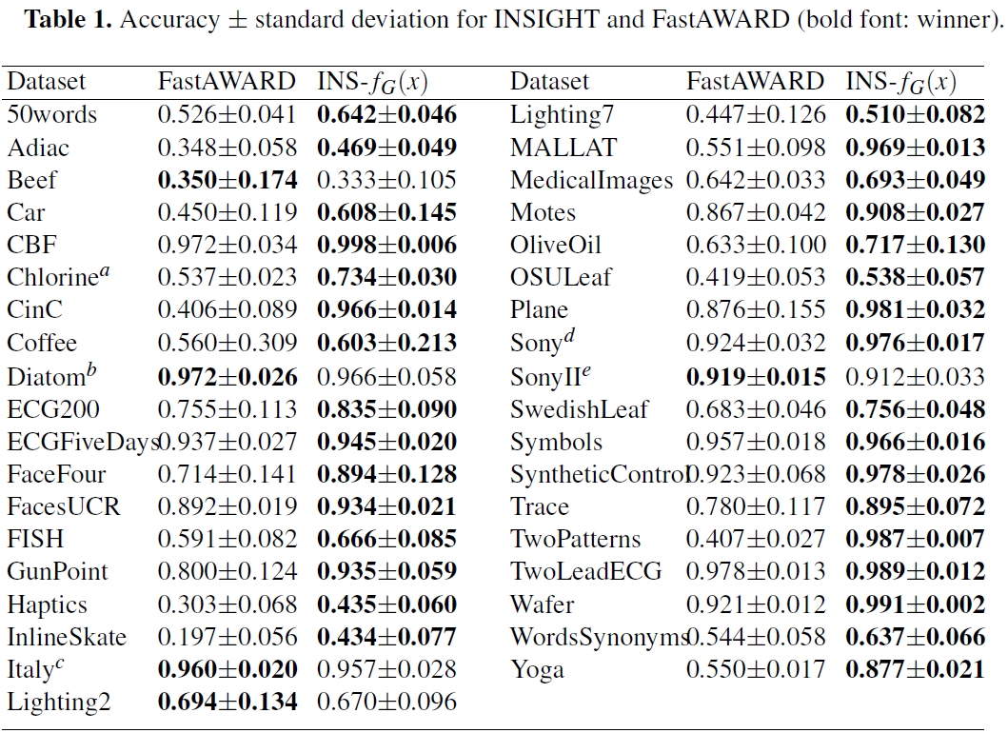
Experiments
s

Slide 12
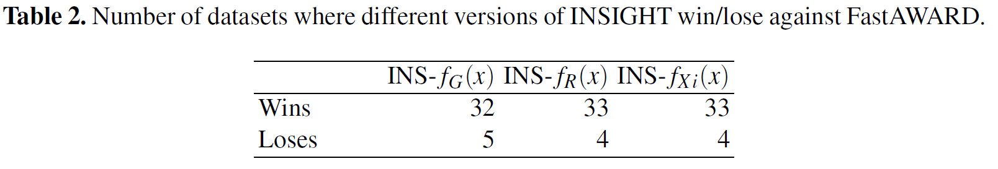
Experiments
Compare the performance of different score function.

Slide 13
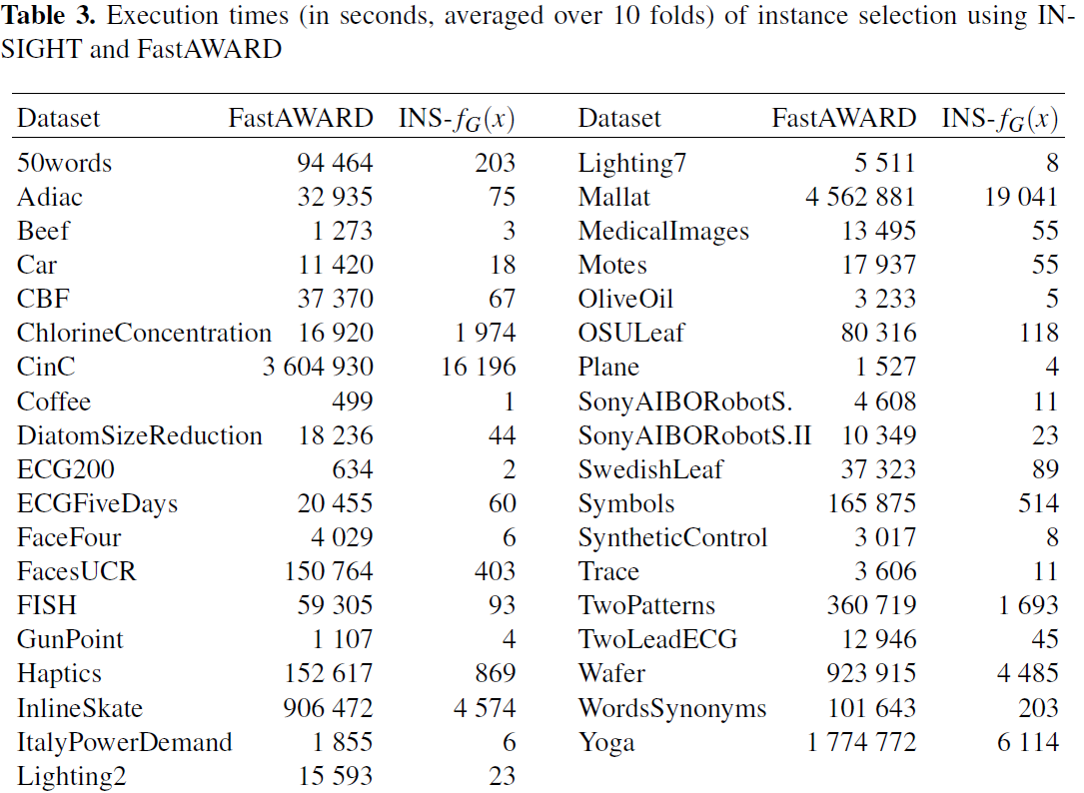
Experiments

