Slide 1
A Fast and Accurate Online Sequential Learning Algorithm for Feedforward Networks
Nan-Ying Liang, Guang-Bin Huang, P. Saratchandran, N. Sundararajan
Nanyang Technological University, Singapore
IEEE TRANSACTIONS ON NEURAL NETWORKS, VOL. 17, NO. 6, NOVEMBER 2006
PP.1411 – 1423
2015/4/21
Presenter : Yao-Chou Tsai

Slide 2
Abstract(1/3)
In this paper, we develop an online sequential learning algorithm for single hidden layer feedforward networks (SLFNs) with additive or radial basis function (RBF) hidden nodes in a unified framework. The algorithm is referred to as online sequential extreme learning machine (OS-ELM) and can learn data one-by-one or chunk-by-chunk (a block of data) with fixed or varying chunk size. The activation functions for additive nodes in OS-ELM can be any bounded nonconstant piecewise continuous functions and the activation functions for RBF nodes can be any integrable piecewise continuous functions.

Slide 3
Abstract(2/3)
In OS-ELM, the parameters of hidden nodes (the input weights and biases of additive nodes or the centers and impact factors of RBF nodes) are randomly selected and the output weights are analytically determined based on the sequentially arriving data. The algorithm uses the ideas of ELM of Huang et al. Developed for batch learning which has been shown to be extremely fast with generalization performance better than other batch training methods. Apart from selecting the number of hidden nodes, no other control parameters have to be manually chosen. Detailed performance comparison of OS-ELM is done with other popular sequential learning algorithms on benchmark problems drawn from the regression, classification and time series prediction areas.

Slide 4
Abstract(3/3)
The results show that the OS-ELM is faster than the other sequential algorithms and produces better generalization performance.

Slide 5
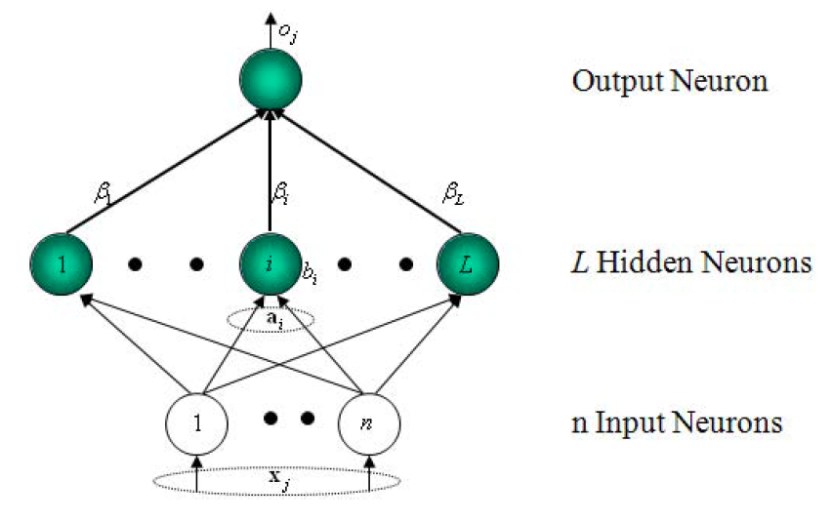
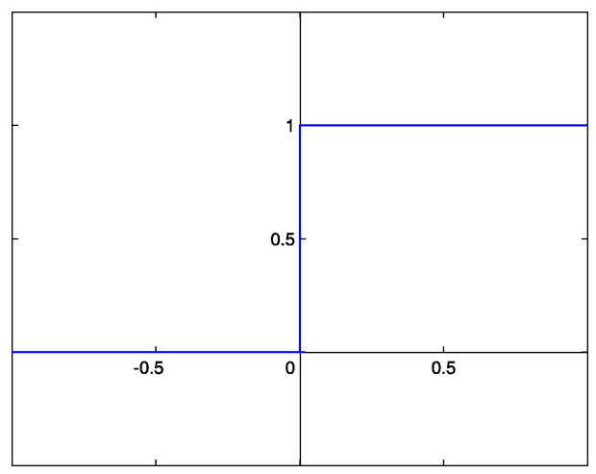
Feedforward Neural Networks(1/2)
Activation Functions example with threshold 0.5
Single-hidden Layer Feedforwards Networks (SLFNs)

Slide 6
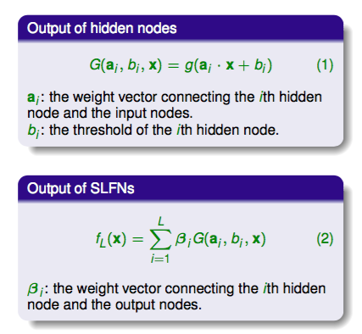
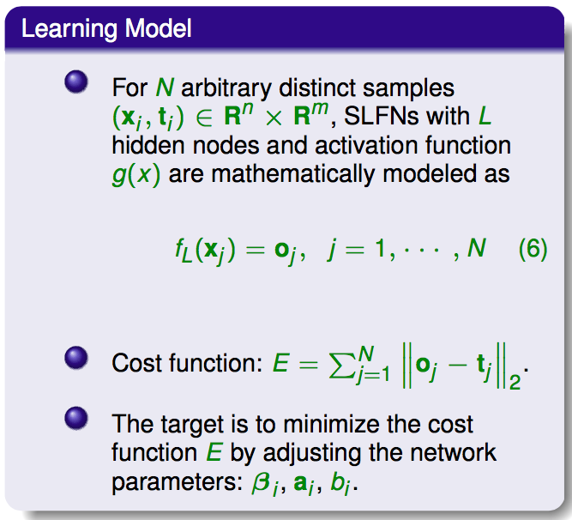
Feedforward Neural Networks(2/2)

Slide 7
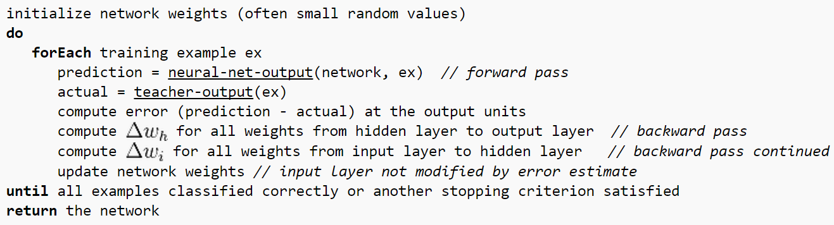
BP learning algorithm and Issues
BP is Back-Propagation
Algorithm:
Issues:
當learning rate太小時收斂較慢，太大又會造成不穩定(發散) 。
有local minima問題。
Over-trained反而造成performance降低。
演算法耗時(time-consuming)。

Slide 8

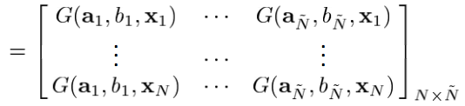

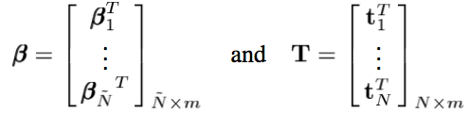
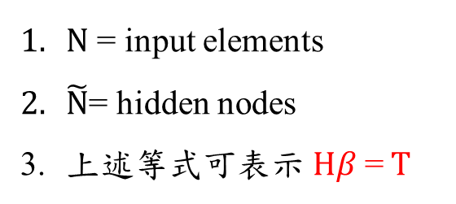
Extreme Learning Machine(1/3)
$N$ = input elements
$\tilde{N}$= hidden nodes
上述等式可表示$Hβ$= $T$

Slide 9


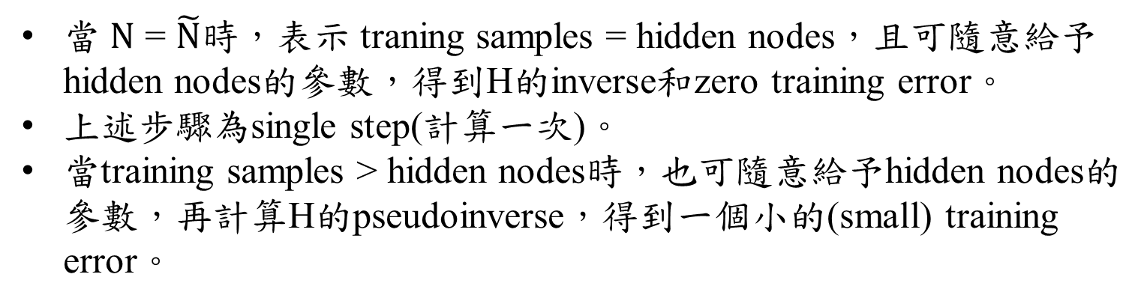
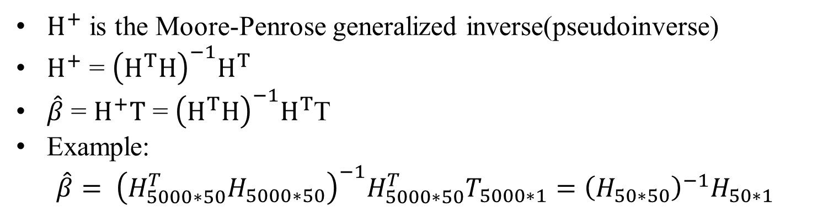
Extreme Learning Machine(2/3)
當 $N$ = $\tilde{N}$時，表示 traning samples = hidden nodes，且可隨意給予hidden nodes的參數，得到H的inverse和zero training error。
上述步驟為single step(計算一次)。
當training samples > hidden nodes時，也可隨意給予hidden nodes的參數，再計算H的pseudoinverse，得到一個小的(small) training error。
$H^{+}$ is the Moore-Penrose generalized inverse(pseudoinverse)
$H^{+}$ = ${\left(H^{T}H\right)}^{−1}H^{T}$
$\hat{β}$ = $H^{+}T$ = ${\left(H^{T}H\right)}^{−1}H^{T}$T
Example:
$$\hat{β}= {\left(H_{5000∗50}^{T}H_{5000∗50}\right)}^{−1}H_{5000∗50}^{T}T_{5000∗1}={\left(H_{50∗50}\right)}^{−1}H_{50∗1}$$

Slide 10
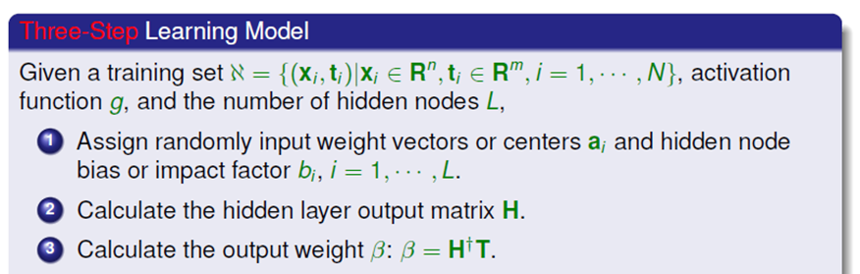
Extreme Learning Machine(3/3)
The learning algorithm for SLFNs

Slide 11

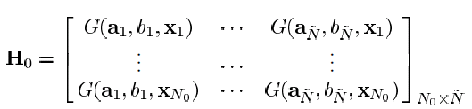
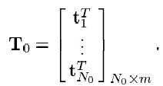

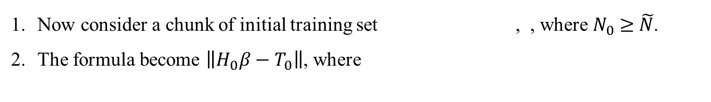

On-Line Sequential Extreme Learning Machine(1/2)
Now consider a chunk of initial training set , , where $N_{0}$ $≥$ $\tilde{N}$.
The formula become $\left\|H_{0}β−T_{0}\right\|$, where
3. Then $β^{\left(0\right)}=K_{0}^{−1}H_{0}^{T}T_{0}$, where $K_{0}=H_{0}^{T}H_{0}$.
When $\left(k+1\right)th$ chunk of data set is received, where $k≥0 and N_{k+1}$
The chunk size is not fixed.

Slide 12

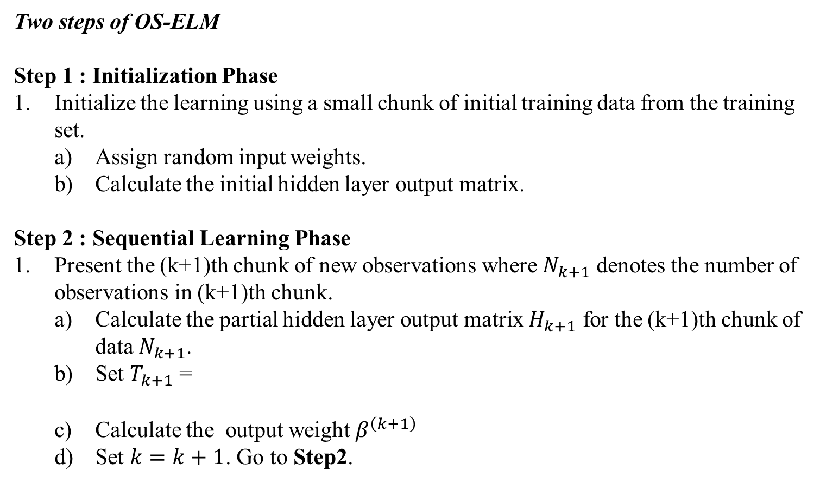
On-Line Sequential Extreme Learning Machine(2/2)
Two steps of OS-ELM
Step 1 : Initialization Phase
Initialize the learning using a small chunk of initial training data from the training set.
Assign random input weights.
Calculate the initial hidden layer output matrix.
Step 2 : Sequential Learning Phase
Present the (k+1)th chunk of new observations where $N_{k+1}$ denotes the number of observations in (k+1)th chunk.
Calculate the partial hidden layer output matrix $H_{k+1}$ for the (k+1)th chunk of data $N_{k+1}$.
Set $T_{k+1}$ =
Calculate the output weight $β^{\left(k+1\right)}$
Set $k=k+1$. Go to Step2.

Slide 13
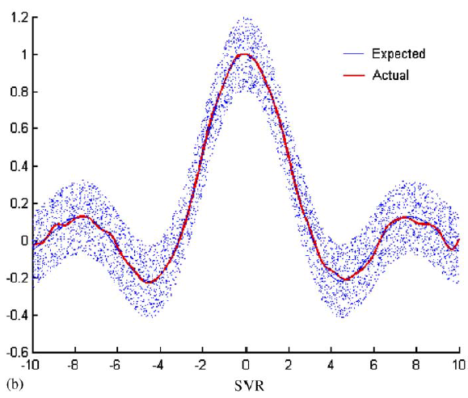
Comparison(ELM)
ELM learning algorithm
SVR

Slide 14
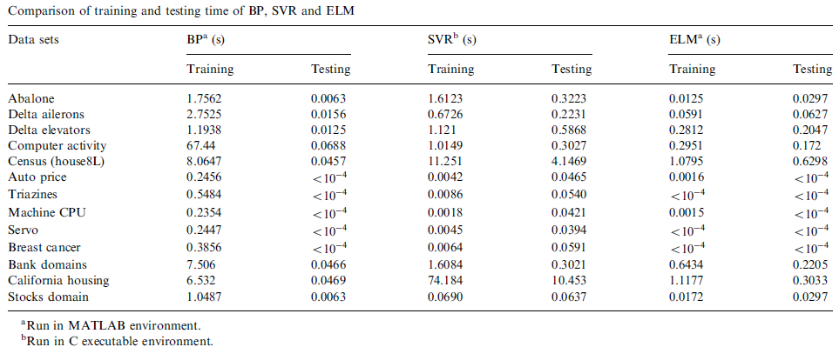
Result of ELM

Slide 15
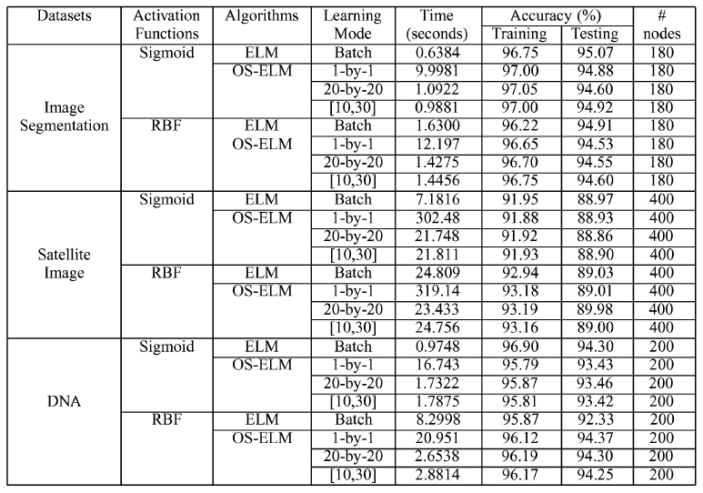
Result of OS-ELM

