Slide 1
The Greedy Algorithm for Edit Distance with Moves
Haim Kaplan, Nira Shafrir Information Processing Letters 97 (2006) 23–27
Presenter: Chan-Yi Chou
Date: 2015/04/28

Slide 2
Introduction
In this paper we give a tighter lower bound on performance of GREEDY, that uses a smaller alphabet size. We show an infinite family of strings for which GREEDY finds a block partition of size Ω(n^{0.46}OPT). The alphabet size of the strings in our family is O(log n).

Slide 3
Edit Distance with Moves
兩字串S與T，透過insert、delete與substitution的操作將S變成T。
Move operation，移動字串中的子字串的編輯操作。
S = bacabacdca → acdcabacab
T = acdcabacab
NP-hard

Slide 4
Block Permutation Problem
|S| = |T|，|Σ_{S}| = |Σ_{T}|
S中字元的出現次數與T相同
分割使S與T被分成一些blocks(substring)，這些blocks在S中出現的次數與在T中出現的次數相同。
S = bacabacdca
T = acdcabacab
OPT = 2 (最佳解)

Slide 5
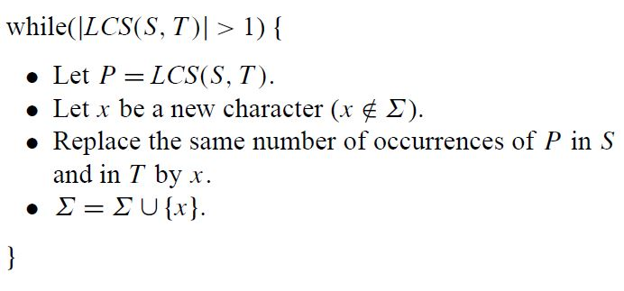
Greedy Method
此處的LCS(S, T)是Longest Common Substring

Slide 6
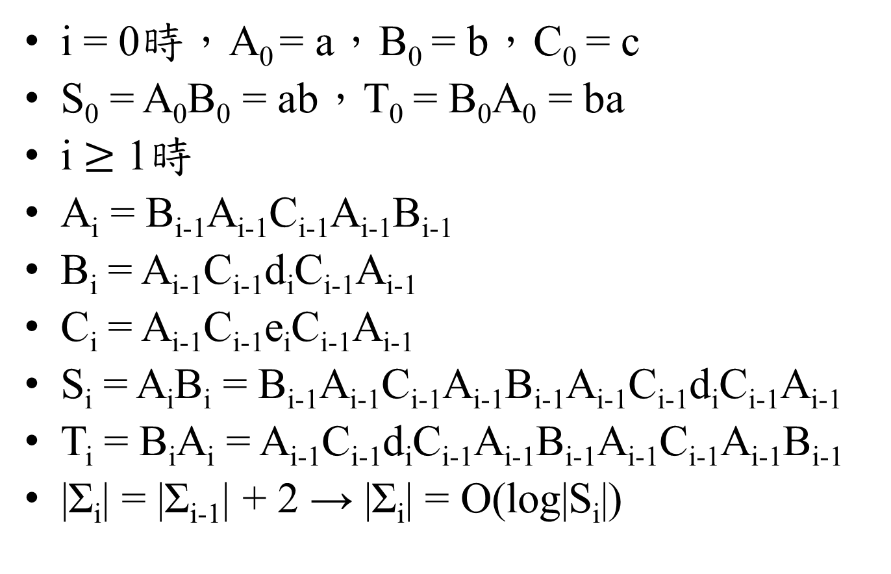
Bad Example for GREEDY
i = 0時，A₀ = a，B₀ = b，C₀ = c
S₀ = A₀B₀ = ab，T₀ = B₀A₀ = ba
i $≥$ 1時
A_{i} = B_{i-1}A_{i-1}C_{i-1}A_{i-1}B_{i-1}
B_{i} = A_{i-1}C_{i-1}d_{i}C_{i-1}A_{i-1}
C_{i} = A_{i-1}C_{i-1}e_{i}C_{i-1}A_{i-1}
S_{i} = A_{i}B_{i} = B_{i-1}A_{i-1}C_{i-1}A_{i-1}B_{i-1}A_{i-1}C_{i-1}d_{i}C_{i-1}A_{i-1}
T_{i} = B_{i}A_{i} = A_{i-1}C_{i-1}d_{i}C_{i-1}A_{i-1}B_{i-1}A_{i-1}C_{i-1}A_{i-1}B_{i-1}
|Σ_{i}| = |Σ_{i-1}| + 2 → |Σ_{i}| = O(log|S_{i}|)

Slide 7
Bad Example for GREEDY
A₁ = bacab，B₁ = acdca，C₁ = aceca
S₁ = bacabacdca
T₁ = acdcabacab
以x做替換後
S’₁ = baxdca
T’₁ = acdxab
GREEDY下一個iteration會觀察ba與ab有沒有LCS，再下一個iteration會觀察dca與acd之間有沒有LCS，沒有，結束。

Slide 8
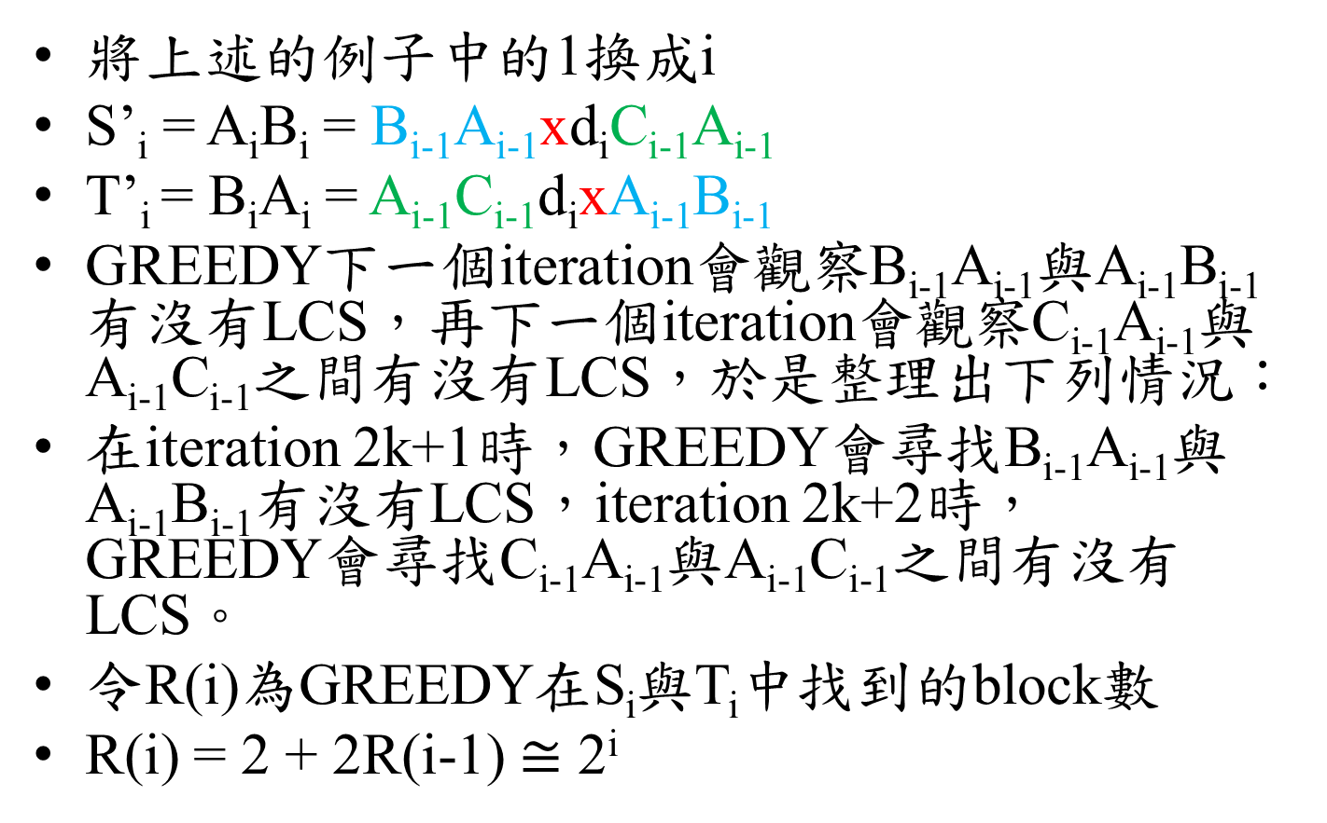
Bad Example for GREEDY
將上述的例子中的1換成i
S’_{i} = A_{i}B_{i} = B_{i-1}A_{i-1}xd_{i}C_{i-1}A_{i-1}
T’_{i} = B_{i}A_{i} = A_{i-1}C_{i-1}d_{i}xA_{i-1}B_{i-1}
GREEDY下一個iteration會觀察B_{i-1}A_{i-1}與A_{i-1}B_{i-1}有沒有LCS，再下一個iteration會觀察C_{i-1}A_{i-1}與A_{i-1}C_{i-1}之間有沒有LCS，於是整理出下列情況：
在iteration 2k+1時，GREEDY會尋找B_{i-1}A_{i-1}與A_{i-1}B_{i-1}有沒有LCS，iteration 2k+2時，GREEDY會尋找C_{i-1}A_{i-1}與A_{i-1}C_{i-1}之間有沒有LCS。
令R(i)為GREEDY在S_{i}與T_{i}中找到的block數
R(i) = 2 + 2R(i-1) $≅$ 2^{i}

Slide 9
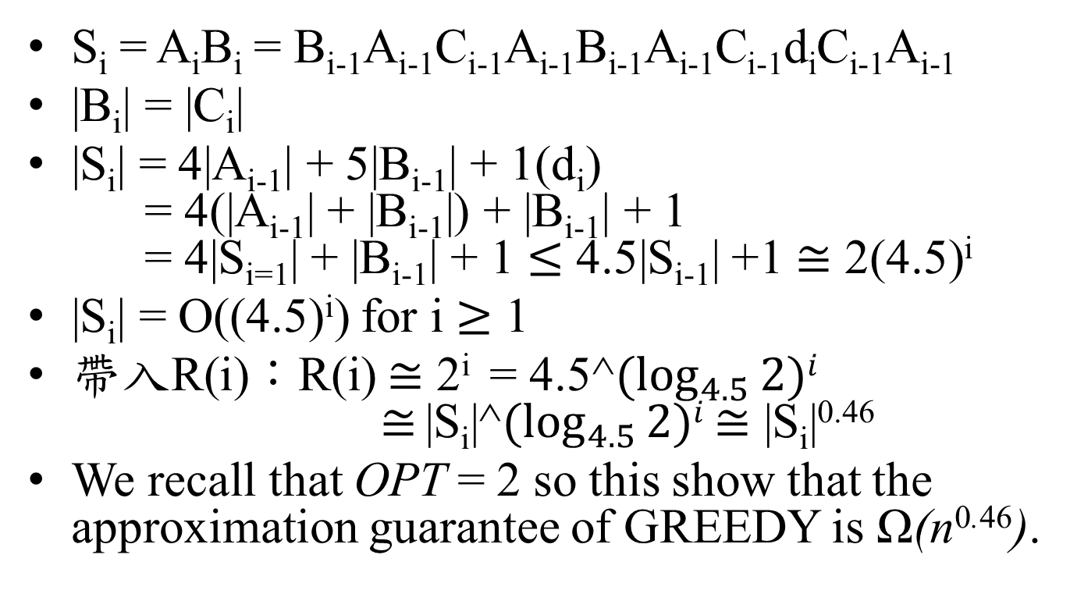
Lower Bound of GREEDY
S_{i} = A_{i}B_{i} = B_{i-1}A_{i-1}C_{i-1}A_{i-1}B_{i-1}A_{i-1}C_{i-1}d_{i}C_{i-1}A_{i-1}
|B_{i}| = |C_{i}|
|S_{i}| = 4|A_{i-1}| + 5|B_{i-1}| + 1(d_{i}) = 4(|A_{i-1}| + |B_{i-1}|) + |B_{i-1}| + 1 = 4|S_{i=1}| + |B_{i-1}| + 1 $≤$ 4.5|S_{i-1}| +1 $≅$ 2(4.5)^{i}
|S_{i}| = O((4.5)^{i}) for i $≥$ 1
帶入R(i)：R(i) $≅$ 2^{i} = 4.5^$(\log_{4.5}{2})i$ $≅$ |S_{i}|^$(\log_{4.5}{2})i$ $≅$ |S_{i}|^{0.46}
We recall that OPT = 2 so this show that the approximation guarantee of GREEDY is Ω(n^{0.46}).

