Slide 1
Parameters Tuning in Support Vector Regression for Reliability Forecasting
Wei Zhao, Tao Tao, Enrico Zio
CHEMICAL ENGINEERING TRANSACTIONS VOL. 33, 2013
Presenter: Ding- Yao Huang
Date:2015/04/28

Slide 2
Abstract
The recent and promising machine learning technique called support vector machine (SVM) has become a hot research subject in time series forecasting, since proposed from Statistic Learning Theory by Vapnik.
As an important application of time series forecasting, reliability prediction by analyzing the historical time series data of system condition to predict the future system behavior and/or diagnose the possible system fault, has been solved successfully by SVM with high forecasting accuracy. For this, the critical problem is the selection of SVM parameters.

Slide 3
Abstract
Many methods have been proposed, such as genetic algorithm, particle swarm optimization and analytic selection; but there is no generally structured way, yet.
In this paper, the capability of SVM to perform function fitting and reliability forecasting based on different methods is investigated by experimenting on both artificial and real-world data.
A comparison of the methods is offered on criteria of prediction accuracy and robustness. Finally, an attempt is made to obtain a comparative optimal parameter selection method

Slide 4
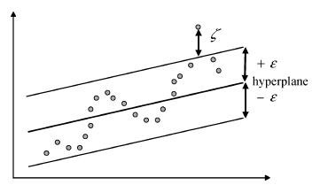

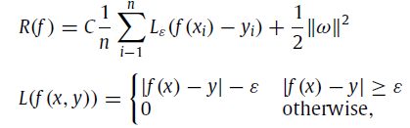

Introduction (Support Vector Regression)
Support Vector Regression 是結構誤差風險最小化原則，兼具經驗誤差風險和信賴區間雙方影響，而不是單方面求經驗誤差最小化
x_{i} 是輸入向量，y_{i} 是實際目標值
是經驗誤差風險(empirical error risk)

Slide 5
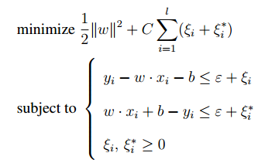
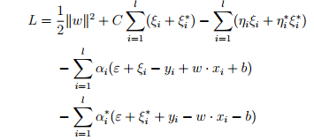

Introduction (Support Vector Regression)
利用 Lagrange multiplier

Slide 6
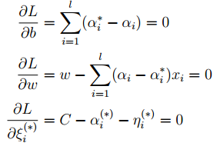
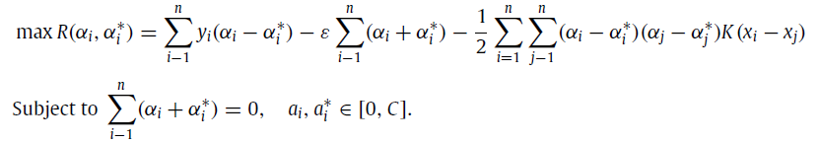
Introduction (Support Vector Regression)
對偶最大化

Slide 7


Introduction (kernel function)
根據Karush-Kuhn-Tucker(KKT) conditions 解b
可發現計算 f(x) 的複雜度和 x 的維度 無關，Support Vector (α_{i} − α_{i}∗ 不為零的 instances) 的個數有關
將線性系統 轉成 非線性系統
kernel function
linear: u'*v
polynomial: (gamma*u'*v + coef0)^degree
radial basis function: exp(-gamma*|u-v|^2)
sigmoid: tanh(gamma*u'*v + coef0)

Slide 8
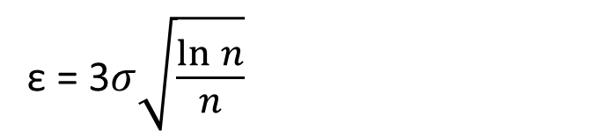


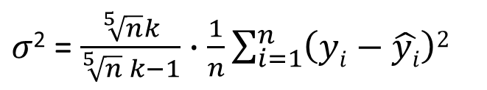
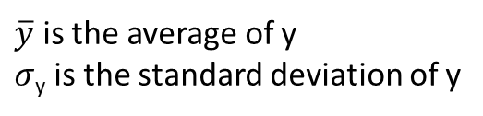
Analytic selection (AS)
Analytical selection C directly from the training data
C = max(| $\overline{y}$+ 3$σy$|,| $\overline{y}$ - 3$σ$_{y} |)
$\overline{y}$ is the average of y
$σ$_{y} is the standard deviation of y
ε = 3$σ\sqrt{\frac{\ln{n}}{n}}$
n is the number of training data
k is recommended to be 3
$σ$² = $\frac{\sqrt[5]{n}k}{\sqrt[5]{n} k−1}∙\frac{1}{n}\sum_{i=1}^{n}{\left(yi−\hat{yi}\right)2}$
KNN for regression
$$γ\sim \left(0.1−0.5\right)∗range(s)$$
range(s)=|max(s)-min(s)|
V. Cherkassky, Y.Ma, Practical selection of SVM parameters and noise estimation for SVM regression, Neural Netw. 17 (2004) 113–126

Slide 9
Introduction (Genetic algorithms)
Choose a randomly generated population
Calculate the fitness of each chromosome in the population
selection
Judge the stopping criteria
crossover
mutation
Get the answer

Slide 10
Genetic Algorithms
Step1: Choose a randomly generated population
1. Binary encoding
2. Real value encoding
3. symbol encoding
Step2: Calculate the fitness of each chromosome in the population
1. f(x) = x+1 適合度越好、競爭力越強
Step3:
1. selection
2. crossover
3. mutation
0 | 1 | 1 | 0 | 1 | 1 | 1 | 0 | 1 | 0 | 0 | 1 | 1 | 1 | 0 | 0 | 1 | 0
85.3 | 115 | 10.8 | 121 | 1.9 | 68.5
A | B | C | D | E | F

Slide 11
Genetic Algorithms (selection)
Step3-1: selection
1.roulette wheel selection
依照適應函數分割輪盤位置，
適合度函數值越大的話，
則在輪盤上佔有的面積比例就越大
2.tournament selection
每一代的演化過程中首先隨機地選取兩個或更多的染色體個體(字串）
具有最大適合度函數值的物種即被選中送至交配池中
適合度函數值越高的個體就越容易被選中

Slide 12
Genetic Algorithms (Crossover)
Step3-2. Crossover
依據交配方式的不同，又可分為單點、兩點以及均勻
兩點間

Slide 13
Genetic Algorithms (mutation)
Step3-3. mutation
利用隨機改變基因，以創造出父母代所未具備的新特徵。過程是將交配後產生的子代
0 | 1 | 1 | 0 | 1 | 1 | 1 | 0 | 1 | 0 | 0 | 1 | 1 | 1 | 0 | 0 | 1 | 0
0 | 1 | 1 | 0 | 1 | 1 | 0 | 0 | 1 | 0 | 0 | 1 | 1 | 1 | 0 | 0 | 1 | 0
1 | 1 | 1 | 0 | 1 | 0 | 1 | 0 | 1 | 0 | 0 | 1 | 1 | 0 | 0 | 0 | 1 | 1
1 | 1 | 1 | 0 | 1 | 0 | 1 | 0 | 1 | 0 | 0 | 1 | 1 | 1 | 0 | 0 | 1 | 1

Slide 14

Genetic Algorithms
Choose a randomly generated population
X=[C, ε,$γ$]
Calculate the fitness of each chromosome in the population
F(X)=MSE_{cv}
selection
Judge the stopping criteria
crossover
0.8
mutation
0.05
Get the answer

Slide 15
Particle swarm optimization (PSO)
Basic algorithm of PSO
Initialize the swarm form the solution space
Evaluate the fitness of each particle
Update individual and global bests
Update velocity and position of each particle
Go to step2, and repeat until termination condition

Slide 16
Particle swarm optimization (PSO)
Calculate fitness values for each particle
Is current fitness value better than pBest?
yes
no
Assign current fitness as new pBest
Keep previous pBest
Assign best pBest value to gBest
Calculate velocity for each particle
Use each particle’s velocity value to update its data values
Target or maximum epochs reached?
no
yes

Slide 17
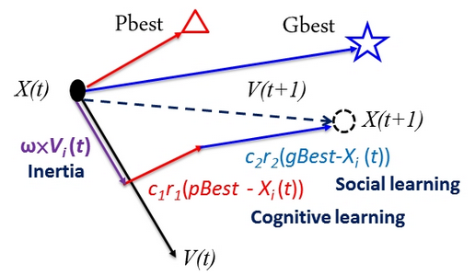

Particle swarm optimization (PSO)
c1,c2 =2
r1,r2 random(0,1)

Slide 18

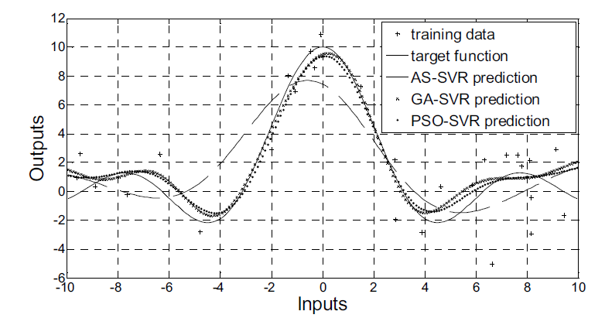
Experiments results

Slide 19
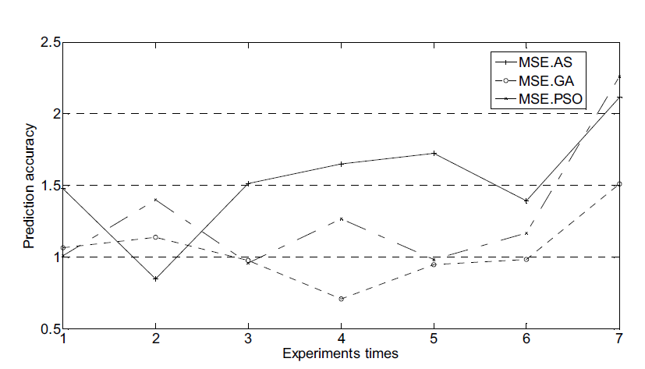
Experiments results

Slide 20
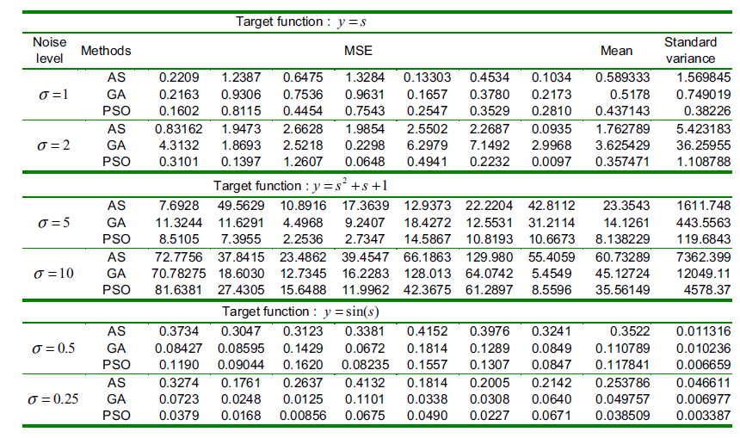
Experiments results

Slide 21
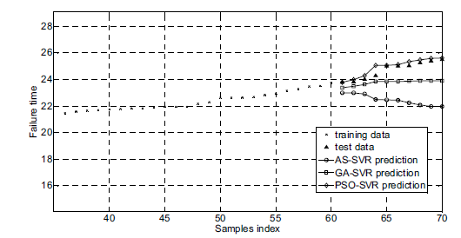
Experiments results

Slide 22
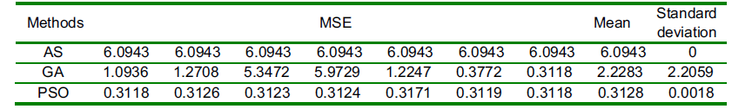
Experiments results

Slide 23
Conclusion
In this work, we have investigated the AS, GA and PSO parameter methods for selecting the parameters of SVM in regression and prediction tasks. Our experiments results suggest that PSO gives superior performances, whereas AS gives comparatively low accuracy and GA is somewhat unstable.
Although the performance of AS is not comparatively satisfactory, its extremely low computational burden makes it attractive for initializing the parameter values for the GA and PSO methods and optimizing their search evolution process to accelerate it and stabilize it: how to embed this into a dynamic online method is a future research issue.

