Slide 1
Detecting and Identifying System Changes in the Cloud via Discovery by Example
Hao Chen, Sastry S. Duriy, Vasanth Balay, Nilton T. Bilay, Canturk Isciy and Ayse K. Coskun
Boston University
2014 IEEE International Conference on Big Data, Washington, DC, 27-30 Oct.
pp.90 - 99
Presenter : Yao-Chou Tsai
Date:2015/04/28

Slide 2
Abstract(1/2)
Discovering and identifying system changes caused by events such as software installation and updates, configuration changes, and security patches are important functionalities for change management, security, compliance and problem diagnosis in emerging cloud platforms. Currently, most discovery tools use manually written rules, which require specific knowledge of software and systems. Approaches based on manually written rules are often fragile and require constant maintenance in this era of continuous integration. In this paper, we propose a novel “discovery by example” approach to autonomously search for and identify system changes.

Slide 3
Abstract(2/2)
Our approach learns characteristic features of system changes automatically, without requiring any explicit rule definitions or specific knowledge of the underlying software or systems. In this approach, given a system change, our method searches a repository that contains previous stored system changes and returns those that are similar to it. We further explore the use of various forms of “fingerprints” to represent system changes efficiently and faithfully in a compact manner. We propose and evaluate two types of fingerprints: the “basename fingerprint” and the “1-D histogram fingerprint”. We show that both fingerprints exhibit different efficiency and accuracy trade-offs, and they can be effectively employed in different use cases. We evaluate the performance of our approach with both techniques and further present an application of it in system real-time streaming monitoring.

Slide 4
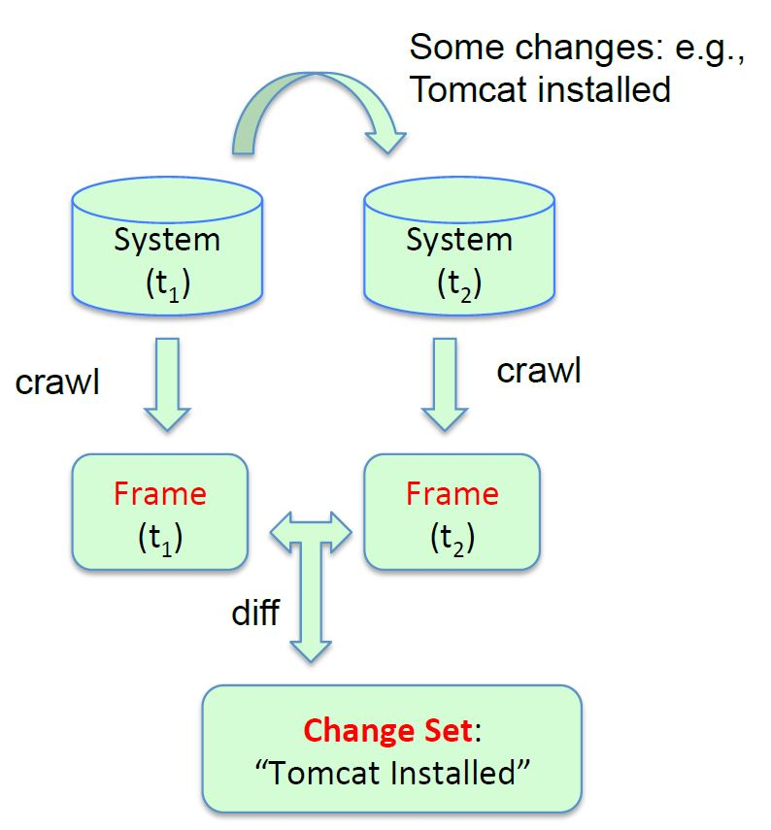
Change set(1/3)
The state of the system is collected into a frame
(1) If a feature is in frame2 but not in frame1, then it is added to additions.
(2) If a feature is in both frames, but their attributes differ, then it is added to modification.
(3) If a feature is in both frames, and attributes match, then it is added to common.
(4) If a feature is not in frame2 but is in frame1, then it is added to deletions.

Slide 5
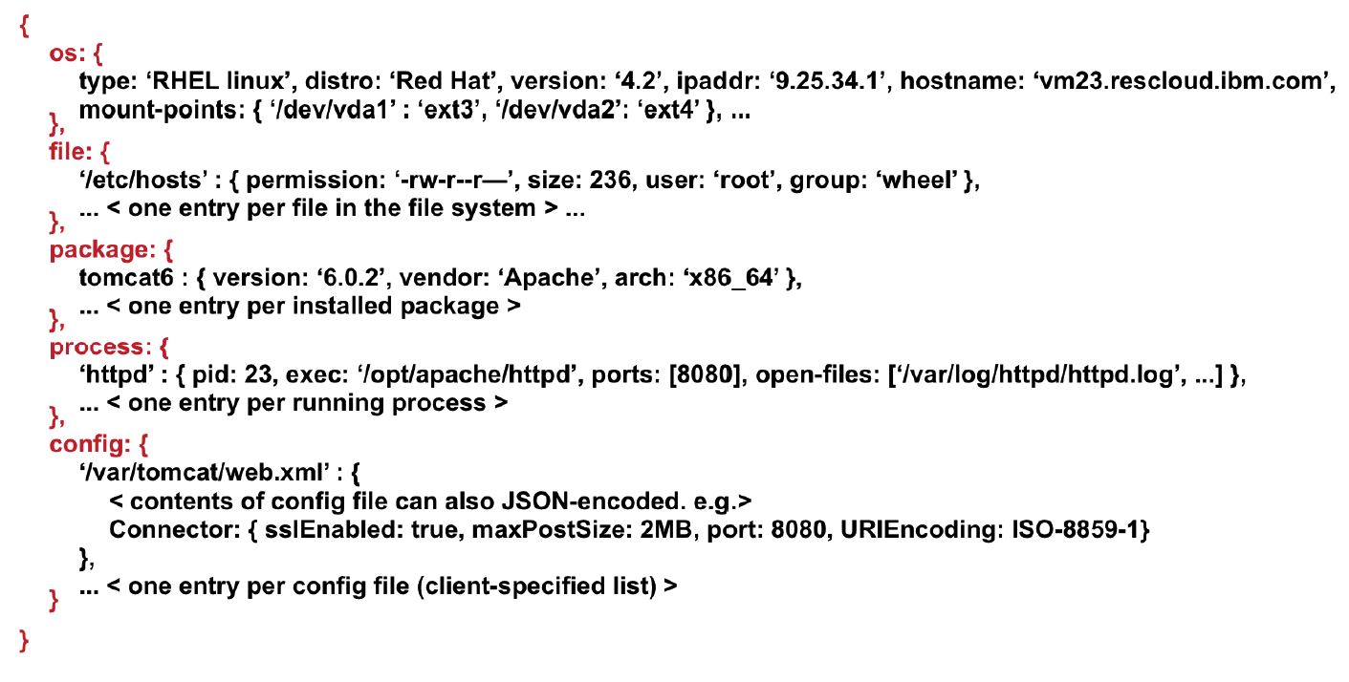
Change set(2/3)
An example of the system state recorded in a frame.

Slide 6
Change set(3/3)
The file feature is the most significant one for identifying system changes, and especially for software installations.

Slide 7
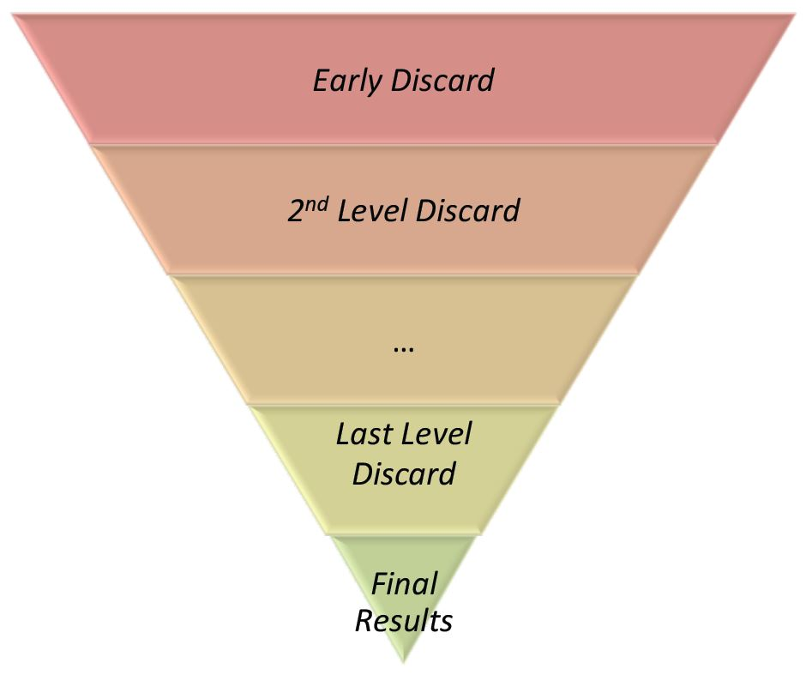
Framework
Take an uncategorized change set C.
Find change sets in the cloud similar to C.
Extract two types of instance fingerprints from the change set.(type1 and type2)
First filter examines the type1 fingerprints for all the change sets in the repository.
Send change sets to second filter which similar to type1
Examines type2.
Output the change sets that meet the similarity criterion.

Slide 8
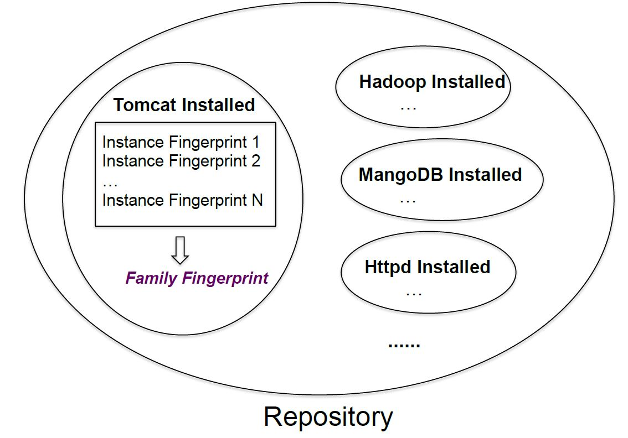
Repository & fingerprint
Group the fingerprint together as a family.
Label the family by the name of event.
The repository is automatically maintained and updated in some fixed periods, e.g., in mid-night.
One can manually update the repository if necessary.
A fingerprint is a subset of a change set

Slide 9
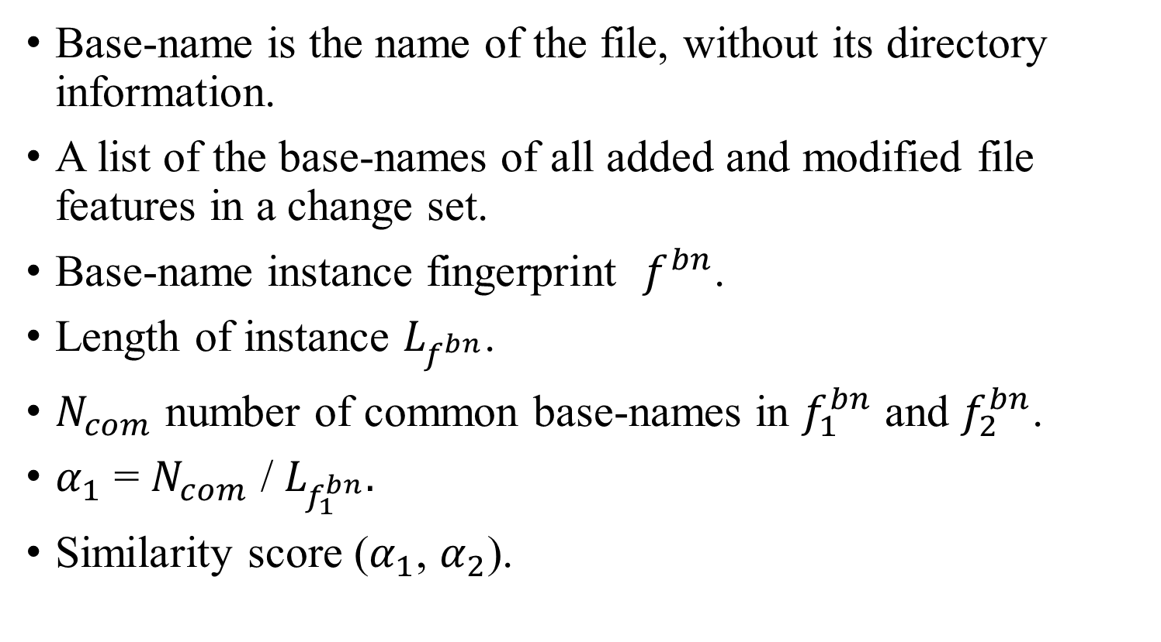
Base-name Instance Fingerprint(1/2)
Base-name is the name of the file, without its directory information.
A list of the base-names of all added and modified file features in a change set.
Base-name instance fingerprint $f^{bn}$.
Length of instance $L_{f^{bn}}$.
$N_{com}$ number of common base-names in $f_{1}^{bn}$ and $f_{2}^{bn}$.
$α_{1}$ = $N_{com}$ / $L_{f_{1}^{bn}}.$
Similarity score ($α_{1}$, $α_{2}$).

Slide 10
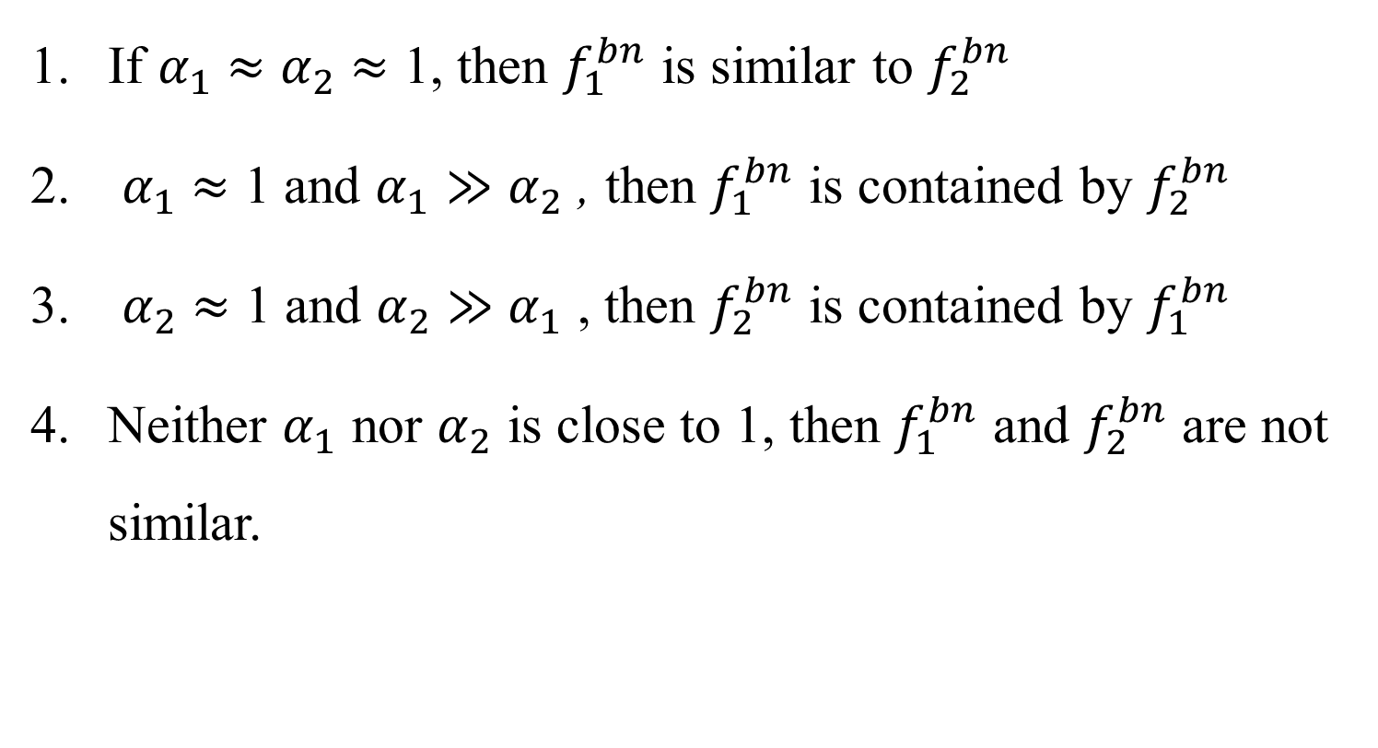
Base-name Instance Fingerprint(2/2)
If $α_{1}$ $≈$ $α_{2}$ $≈$ 1, then $f_{1}^{bn}$ is similar to $f_{2}^{bn}$
$α_{1}$ $≈$ 1 and $α_{1}≫$ $α_{2}$ , then $f_{1}^{bn}$ is contained by $f_{2}^{bn}$
$α_{2}$ $≈$ 1 and $α_{2}$ $≫$ $α_{1}$ , then $f_{2}^{bn}$ is contained by $f_{1}^{bn}$
Neither $α_{1}$ nor $α_{2}$ is close to 1, then $f_{1}^{bn}$ and $f_{2}^{bn}$ are not similar.

Slide 11
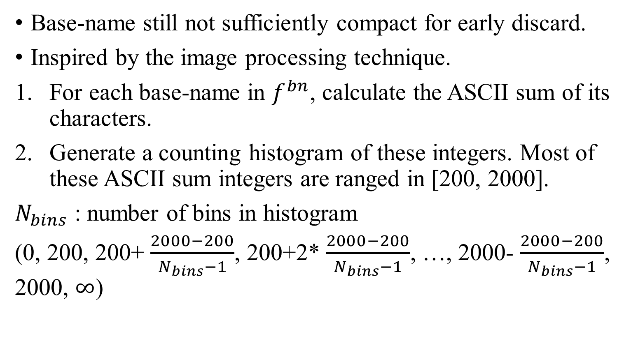
1-D Histogram Instance Fingerprint(1/4)
Base-name still not sufficiently compact for early discard.
Inspired by the image processing technique.
For each base-name in $f^{bn}$, calculate the ASCII sum of its characters.
Generate a counting histogram of these integers. Most of these ASCII sum integers are ranged in [200, 2000].
$N_{bins}$ : number of bins in histogram
(0, 200, 200+ $\frac{2000−200}{N_{bins}−1}$, 200+2* $\frac{2000−200}{N_{bins}−1}$, …, 2000- $\frac{2000−200}{N_{bins}−1}$, 2000, $∞$)

Slide 12
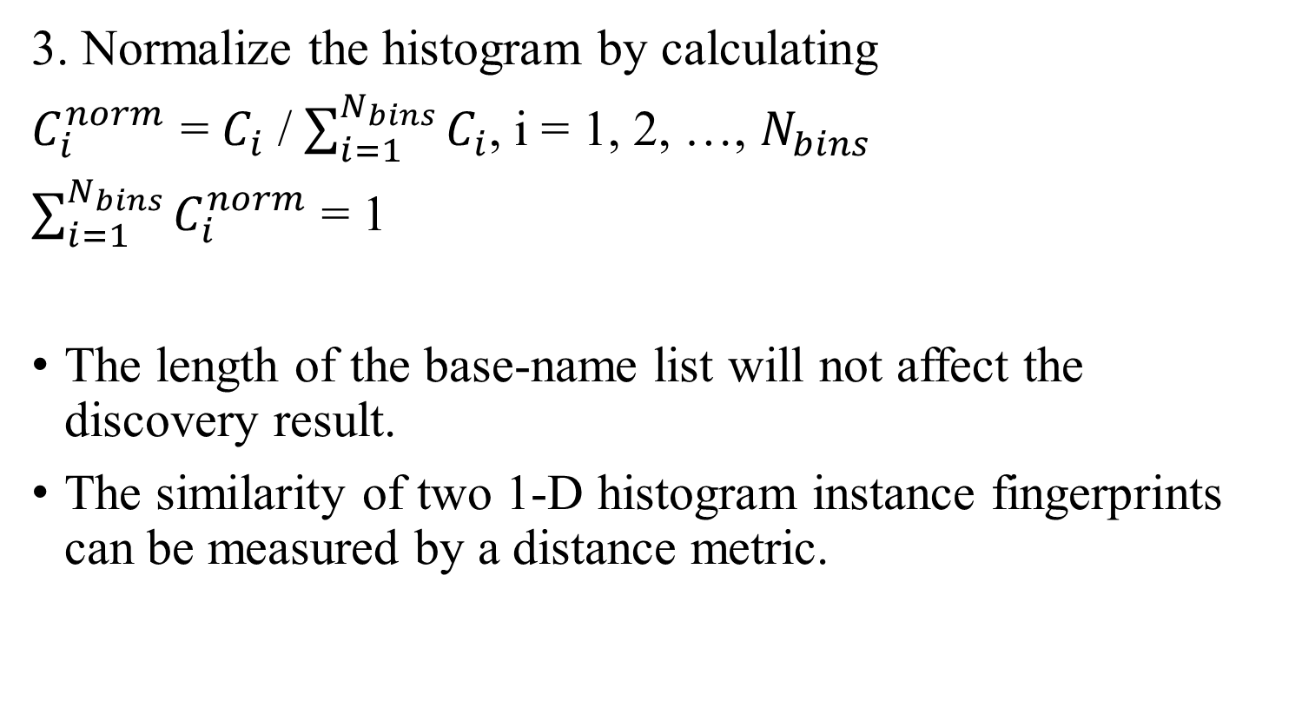
1-D Histogram Instance Fingerprint(2/4)
3. Normalize the histogram by calculating
$C_{i}^{norm}$ = $C_{i}$ / $\sum_{i=1}^{N_{bins}}{C_{i}}$, i = 1, 2, …, $N_{bins}$
$\sum_{i=1}^{N_{bins}}{C_{i}^{norm}}$ = 1
The length of the base-name list will not affect the discovery result.
The similarity of two 1-D histogram instance fingerprints can be measured by a distance metric.

Slide 13

1-D Histogram Instance Fingerprint(3/4)
Two 1-D histogram instance fingerprints $f_{1}^{1D}$ and $f_{2}^{1D}$
The distance $d_{1,2}$ = $\left\|f_{1}^{1D}\right.$ - $\left.f_{2}^{1D}\right\|$
For normalized $d_{1,2}$ = $\frac{\left\|f_{1}^{1D}\right.\text{ − }\left.f_{2}^{1D}\right\| }{\sqrt{2}}$

Slide 14
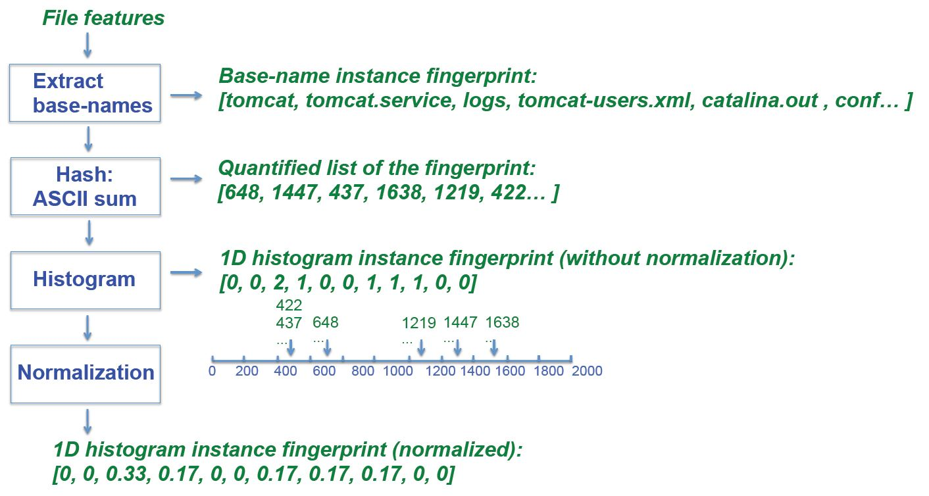
1-D Histogram Instance Fingerprint(4/4)

Slide 15
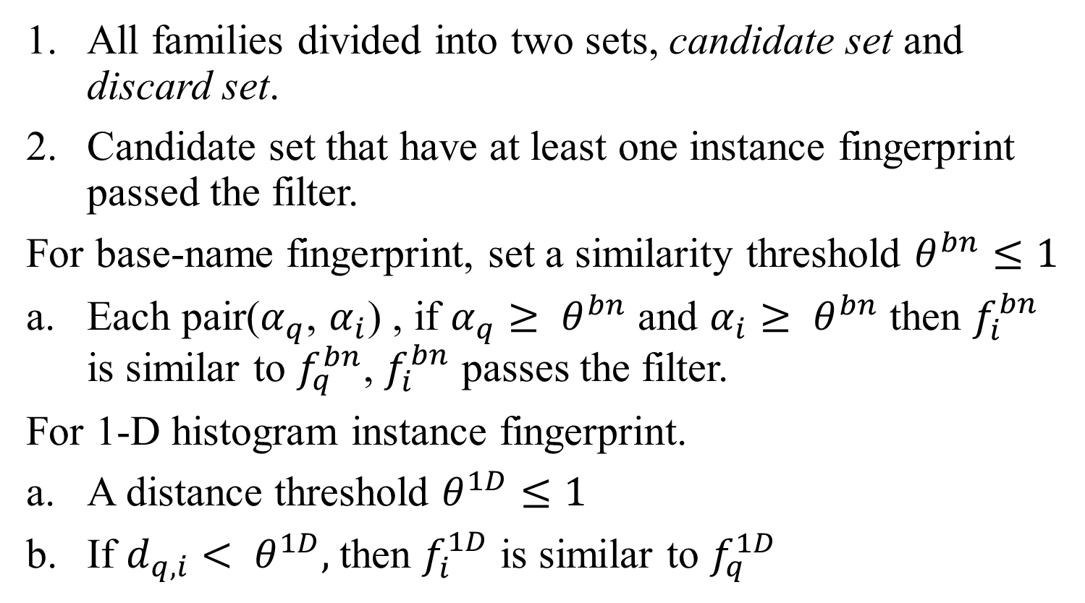
Discovery process with fingerprints(1/3)
All families divided into two sets, candidate set and discard set.
Candidate set that have at least one instance fingerprint passed the filter.
For base-name fingerprint, set a similarity threshold $θ^{bn}≤1$
Each pair($α_{q}$, $α_{i}$) , if $α_{q}≥ θ^{bn}$ and $α_{i}≥ θ^{bn}$ then $f_{i}^{bn}$ is similar to $f_{q}^{bn}$, $f_{i}^{bn}$ passes the filter.
For 1-D histogram instance fingerprint.
A distance threshold $θ^{1D}≤1$
If $d_{q,i}< θ^{1D},$then $f_{i}^{1D}$ is similar to $f_{q}^{1D}$

Slide 16
Discovery process with fingerprints(2/3)
Families in the candidate set are considered similar to the query sample.
For example, if the “Tomcat installation” family is an candidate set, then the query sample may be change caused by Tomcat installation.

Slide 17
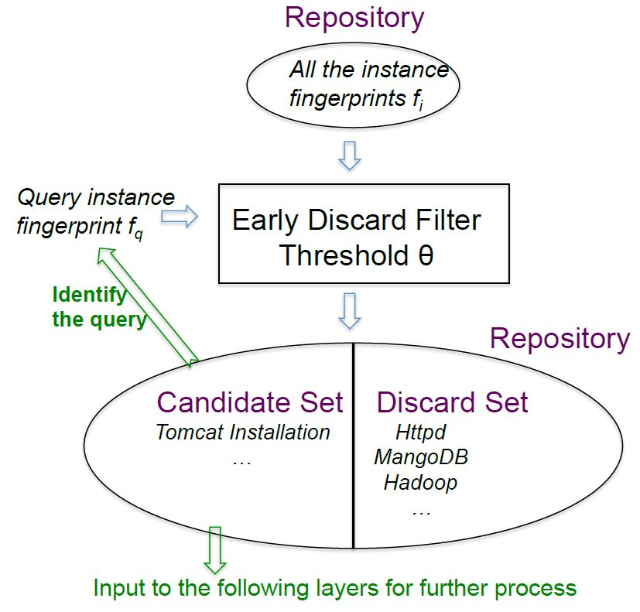
Discovery process with fingerprints(3/3)

Slide 18
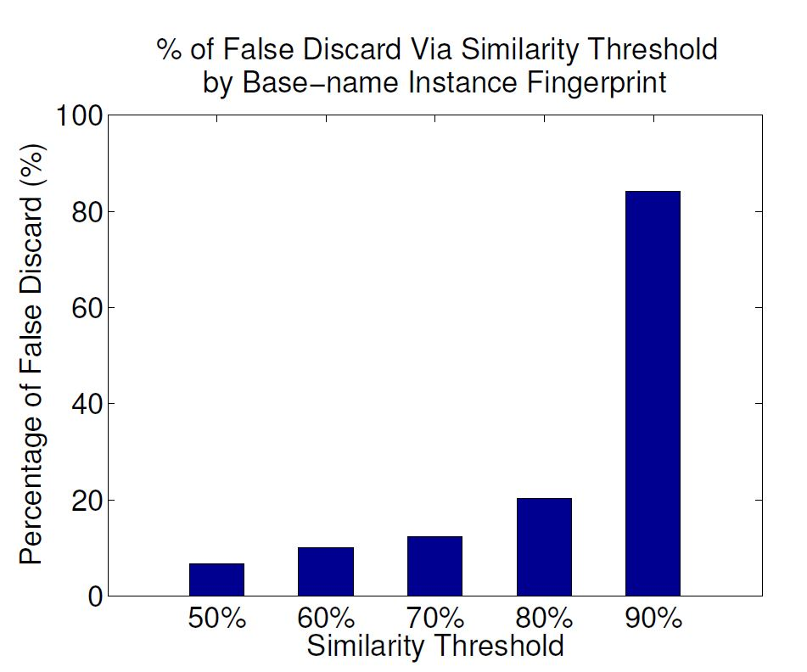
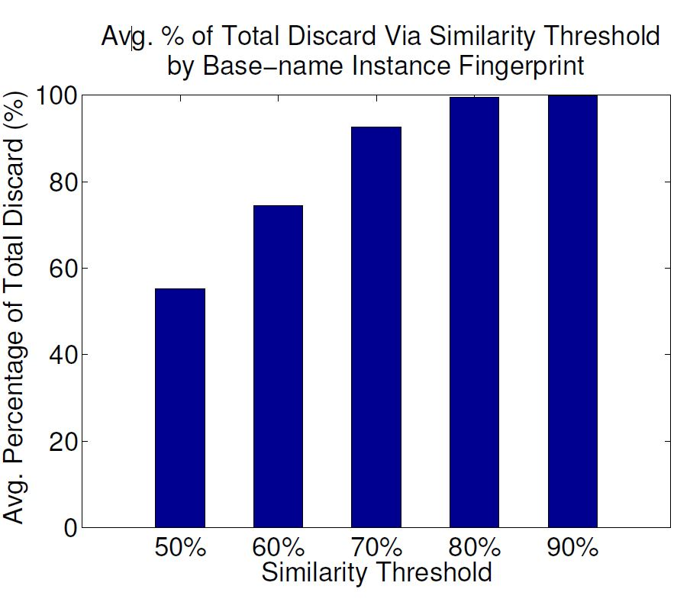
Experimental results

Slide 19
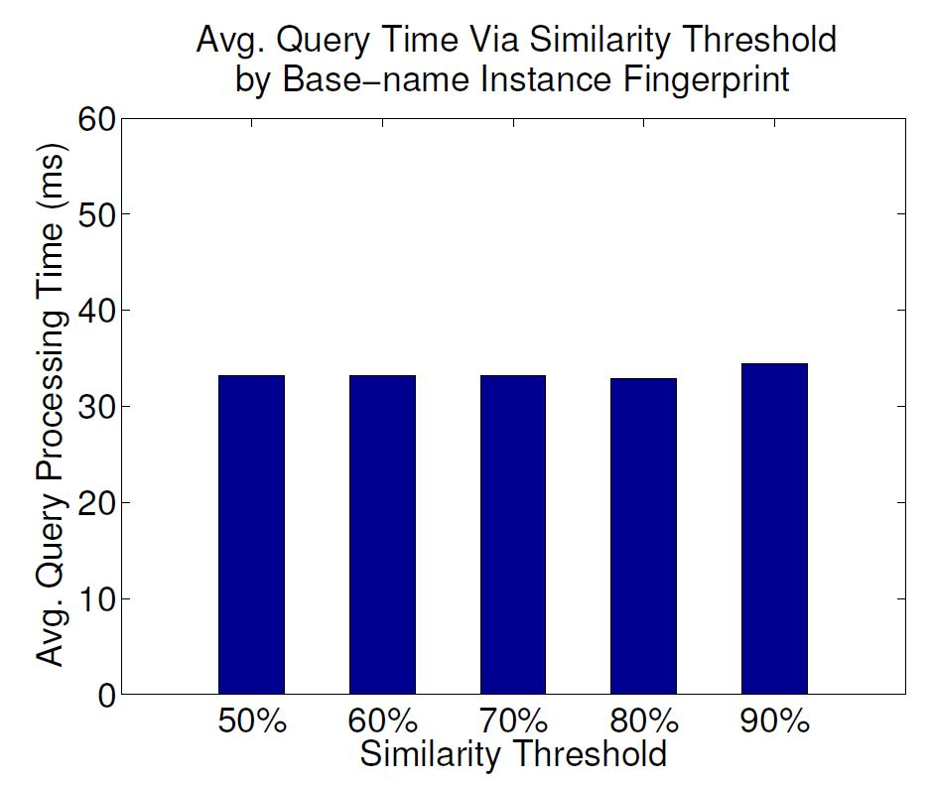
Experimental results

Slide 20
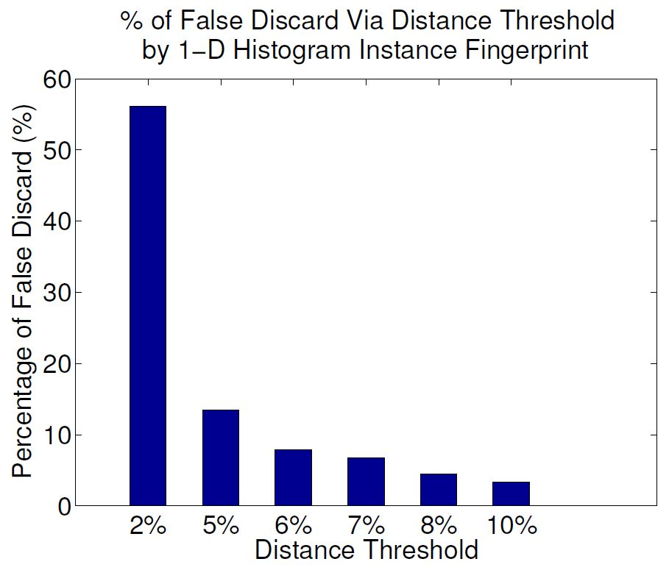
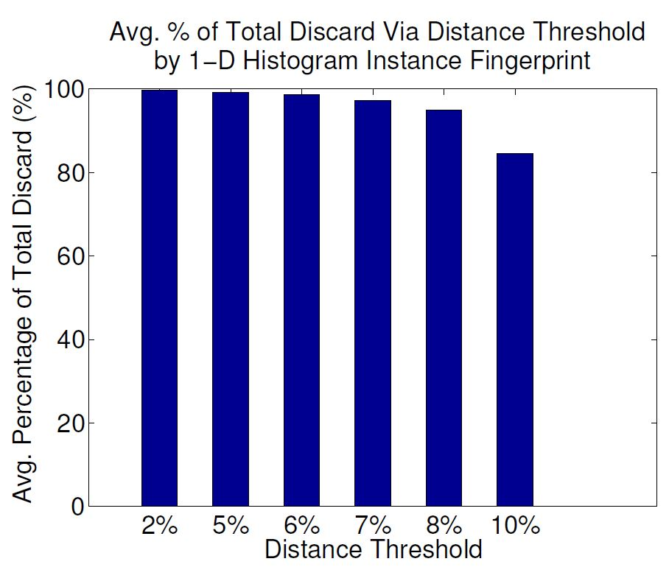
Experimental results

Slide 21
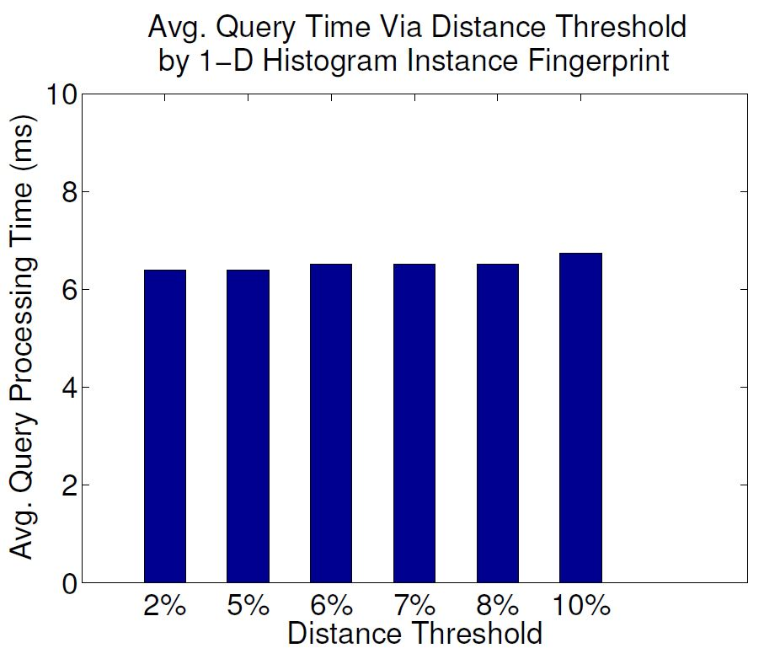
Experimental results

