Slide 1
Correlation and Convolution
Class Notes for CMSC 426, Fall 2005, David Jacobs
Reporter: Wen-Chuan Ho
Date:2015/06/23

Slide 2
Introduction(1/2)
Correlation and Convolution are basic operations that we will perform to extract information from images
Two features
Shift-invariant: we perform the same operation at every point in the image.
Linear: we replace every pixel with a linear combination of its neighbors

Slide 3
Introduction(2/2)
i | 1 | 2 | 3 | 4 | 5 | 6 | 7 | 8 | 9 | 10
value | 5 | 4 | 2 | 3 | 7 | 4 | 6 | 5 | 3 | 6
I：
J：
i | 1 | 2 | 3 | 4 | 5 | 6 | 7 | 8 | 9 | 10
value |  | 11/3 | 3 | 4 | 14/3 | 17/3 | 5 | 14/3 | 14/3

Slide 4
Boundaries
1. pad with zeros
2. pad with the first and last values
3. repeat cyclically
4. reduce the size of J
. | 0 | 0 | 5 | 4 | 2 | 3 | 7 | 4 | 6 | 5 | 3 | 6 | 0 | 0 | .
. | 5 | 5 | 5 | 4 | 2 | 3 | 7 | 4 | 6 | 5 | 3 | 6 | 6 | 6 | .
. | 3 | 6 | 5 | 4 | 2 | 3 | 7 | 4 | 6 | 5 | 3 | 6 | 5 | 4 | .
- | - | - | 5 | 4 | 2 | 3 | 7 | 4 | 6 | 5 | 3 | 6 | - | - | -

Slide 5

Correlation in 1D
I：
. | 5 | 5 | 4 | 2 | 3 | 7 | 4 | 6 | 5 | 3 | 6 | 6 | .
* | * | *
* | * | *
F：
1/3 | 1/3 | 1/3
1/3 | 1/3 | 1/3
 | ∥
 | ∥
5/3 | 4/3 | 2/3
6/3 | 5/3 | 3/3
 | Σ
 | Σ
J：
14/3 | 11/3 | 3 | 4 | 14/3 | 17/3 | 5 | 14/3 | 14/3 | 5

Slide 6

Correlation in 2D
1/9 | 1/9 | 1/9
1/9 | 1/9 | 1/9
1/9 | 1/9 | 1/9
F：
8 | 8 | 3 | 4 | 5 | 5
8 | 8 | 3 | 4 | 5 | 5
7 | 7 | 6 | 4 | 5 | 5
4 | 4 | 5 | 7 | 8 | 8
6 | 6 | 5 | 5 | 6 | 6
6 | 6 | 5 | 5 | 6 | 6
6.44 | 5.22 | 4.33 | 4.67
5.78 | 5.33 | 5.22 | 5.67
5.56 | 5.44 | 5.67 | 6
5.22 | 5.33 | 5.78 | 6.33
I：
J = F。I

Slide 7
Separable filters
(N+1)²M² 2(N+1)M²
1/9 | 1/9 | 1/9
1/9 | 1/9 | 1/9
1/9 | 1/9 | 1/9
0 | 1/3 | 0
0 | 1/3 | 0
0 | 1/3 | 0
0 | 0 | 0
1/3 | 1/3 | 1/3
0 | 0 | 0
F：
＝
。
8 | 3 | 4
7 | 6 | 4
4 | 5 | 7
0 | 1/3 | 0
0 | 1/3 | 0
0 | 1/3 | 0
0 | 0 | 0
1/3 | 1/3 | 1/3
0 | 0 | 0
。
。
0 | 15/3 | 0
0 | 17/3 | 0
0 | 16/3 | 0
0 | 0 | 0
1/3 | 1/3 | 1/3
0 | 0 | 0
＝
。
＝ 5.33

Slide 8


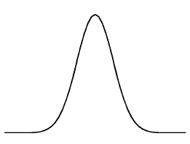
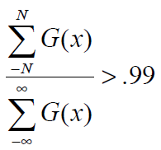
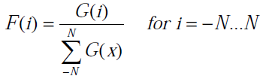


Constructing an Filter from a Continuous Function
1D：
2D：

Slide 9
Matching with Correlation(1/3)
F：
3 | 7 | 5
I：
3 | 2 | 4 | 1 | 3 | 8 | 4 | 0 | 3 | 7 | 7 | 7 | 1 | 2
J：
40 | 43 | 39 | 34 | 64 | 85 | 52 | 27 | 56 | 93 | 105 | 54 | 38 | 27
3X3+8X7+4X5=85
7X3+7X7+7X5=105

Slide 10
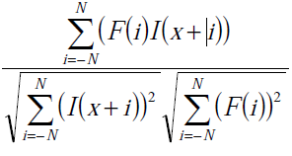
Matching with Correlation(2/3)
Normalized correlation：
F：
3 | 7 | 5
I：
3 | 2 | 4 | 1 | 3 | 8 | 4 | 0 | 3 | 7 | 7 | 7 | 1 | 2
J：
.946 | .877 | .934 | .73 | .81 | .989 | .64 | .59 | .807 | .987 | .931 | .83 | .57 | .988

Slide 11
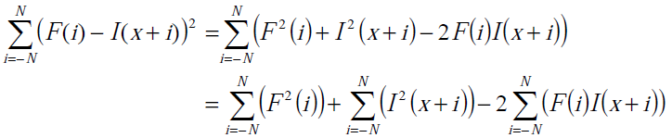
Matching with Correlation(3/3)
F：
3 | 7 | 5
F² = 3²+7²+5² = 83
I：
3 | 2 | 4 | 1 | 3 | 8 | 4 | 0 | 3 | 7 | 7 | 7 | 1 | 2
J：
40 | 43 | 39 | 34 | 64 | 85 | 52 | 27 | 56 | 93 | 105 | 54 | 38 | 27
D：
25 | 26 | 26 | 41 | 29 | 2 | 59 | 54 | 29 | 4 | 20 | 32 | 61 | 38

Slide 12


Convolution
Convolution is just like correlation, except that we flip over the filter before correlating
The key difference between the correlation and convolution is that convolution is associative.
Correlation and convolution are identical when the filter is symmetric.
F*(G*I) = (F*G)*I
1D：
2D：

Slide 13


Orthonormal Basis for Vectors
Two important Reason
Projection
Pythagorean theorem
Example:
(7,3) = 7(1,0)+3(0,1) (7,3)
(7,3) = 4(1,0)+3(1,1) (4,3)

Slide 14



The Fourier Series(1/2)
f has unit magnitude : <f,f> = 1
f and g are orthogonal : <f,g> = 0

Slide 15
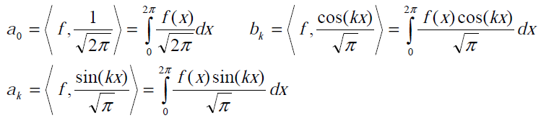

The Fourier Series(2/2)
Any function can be broken down into the sum of sine waves of different amplitudes and phases.
We can solve the values (a₀,b₁,a₁,b₂,….)by taking inner products.

Slide 16

Convolution Theorem
Convolution in the spatial domain is equivalent to component-wise multiplication in the transform domain.
Example(1):
Filter F = sin(x)
An image I
Example(2):
Fourier series representation of a Gaussian.
Smoothing with a Gaussian reduces high frequency components of a signal.

