Slide 1
Efficient Algorithms for the Flexible Longest Common Subsequence Problem
Yi-Pu Guo , Yung-Hsing Peng and Chang-Biau Yang
The 31st Workshop on Combinatorial Mathematics and Computation Theory,
pp. 1-8 (2014)
Presenter: Bi-Shiang Lin
Date:2015/6/30

Slide 2
Abstract
Given two sequences, the traditional longest common subsequence (LCS) problem is to obtain the common subsequence with the maximum number of matches, without considering the continuity of the matched characters. However, in many applications, the matching results with higher continuity are more meaningful than the sparse ones,even if the number of matched characters is a little lower. Accordingly, we define a new variant of the LCS problem, called the flexible longest common subsequence (FLCS) problem.

Slide 3
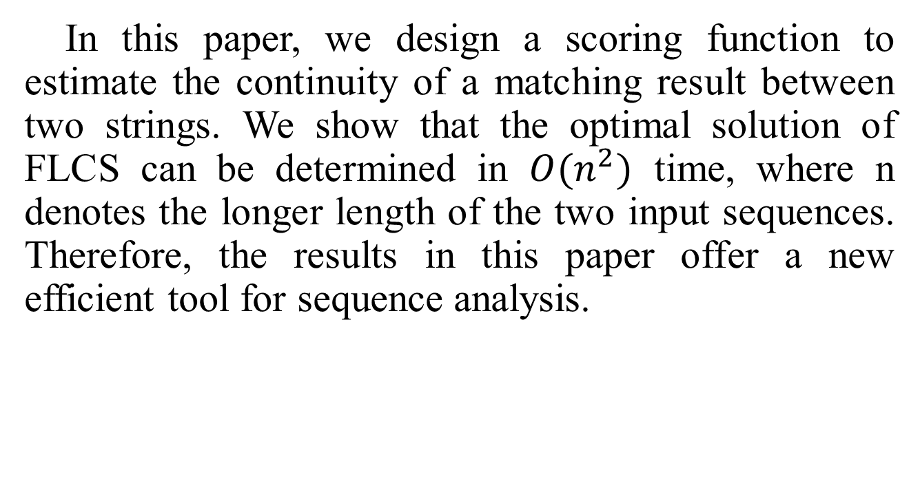
Abstract
In this paper, we design a scoring function to estimate the continuity of a matching result between two strings. We show that the optimal solution of FLCS can be determined in $O(n^{2})$ time, where n denotes the longer length of the two input sequences. Therefore, the results in this paper offer a new efficient tool for sequence analysis.

Slide 4

The LCS Problem
Sequence $X$: abcab
Sequence $Y$: caacb
Common Subsequence : ab ac cab …
Longest Common Subsequence : cab acb

Slide 5
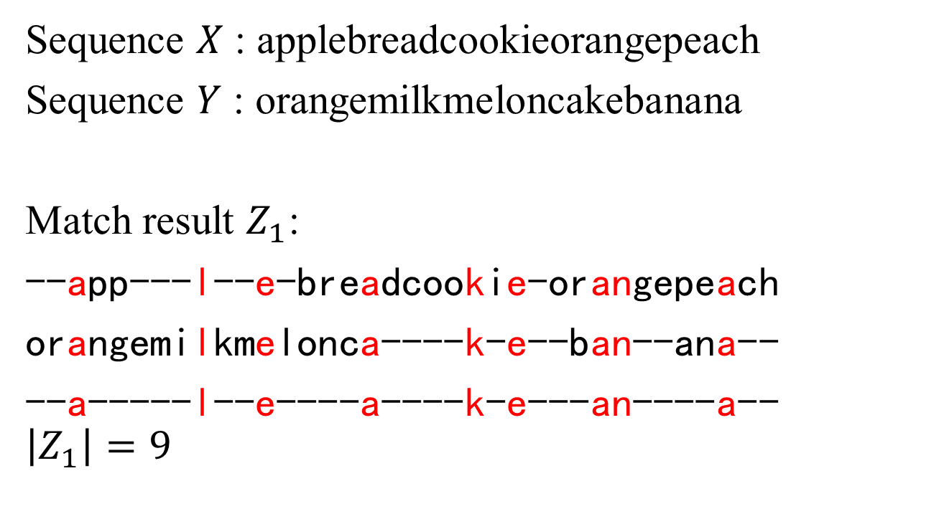
The FLCS Problem
Sequence $X$ : applebreadcookieorangepeach
Sequence $Y$ : orangemilkmeloncakebanana
Match result $Z_{1}$:
--app---l--e-breadcookie-orangepeach
orangemilkmelonca----k-e--ban--ana--
--a-----l--e----a----k-e---an----a--
$$\left|Z_{1}\right|=9$$

Slide 6
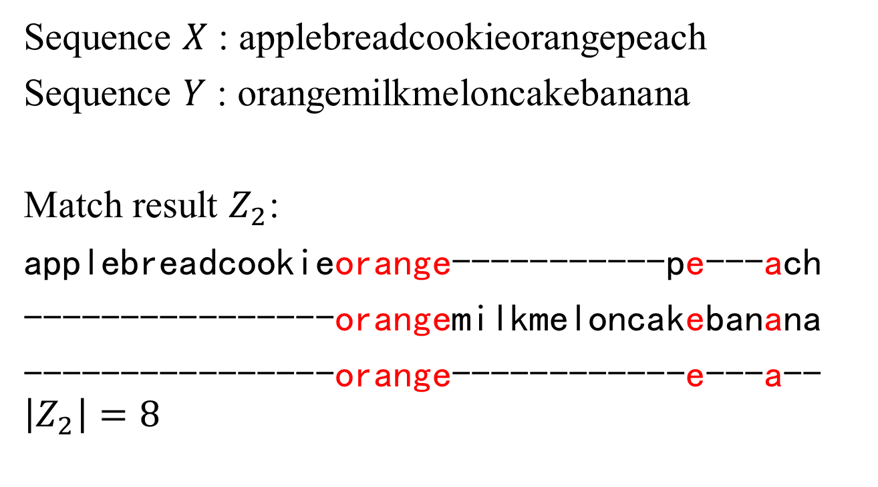
The FLCS Problem
Sequence $X$ : applebreadcookieorangepeach
Sequence $Y$ : orangemilkmeloncakebanana
Match result $Z_{2}$:
applebreadcookieorange-----------pe---ach
----------------orangemilkmeloncakebanana
----------------orange------------e---a--
$$\left|Z_{2}\right|=8$$

Slide 7
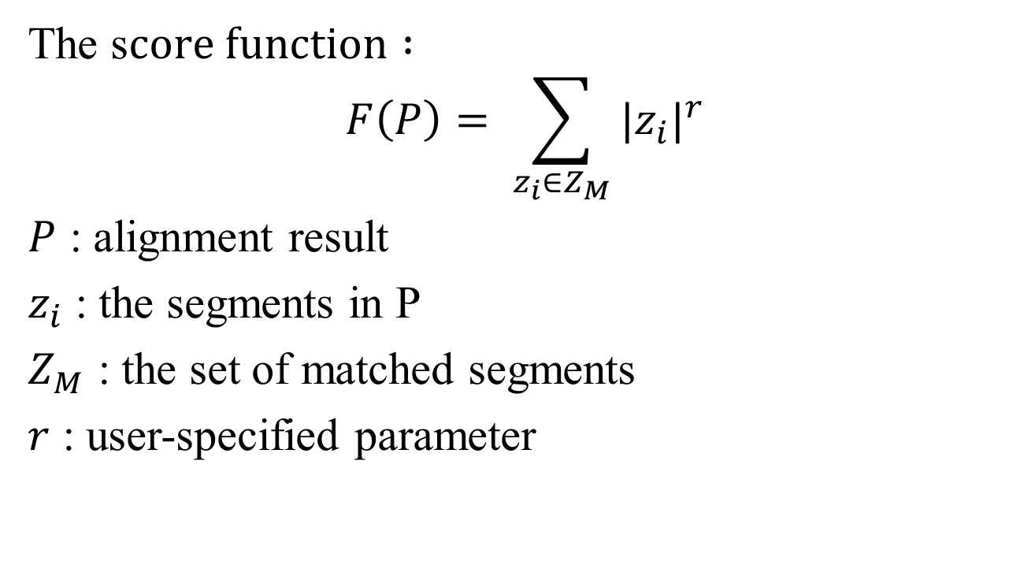
The FLCS Problem
The s$core function :$
$$F\left(P\right)= \sum_{z_{i}∈Z_{M}}{{|z_{i}|}^{r}}$$
$P$ : alignment result
$z_{i}$ : the segments in P
$Z_{M}$ : the set of matched segments
$r$ : user-specified parameter

Slide 8
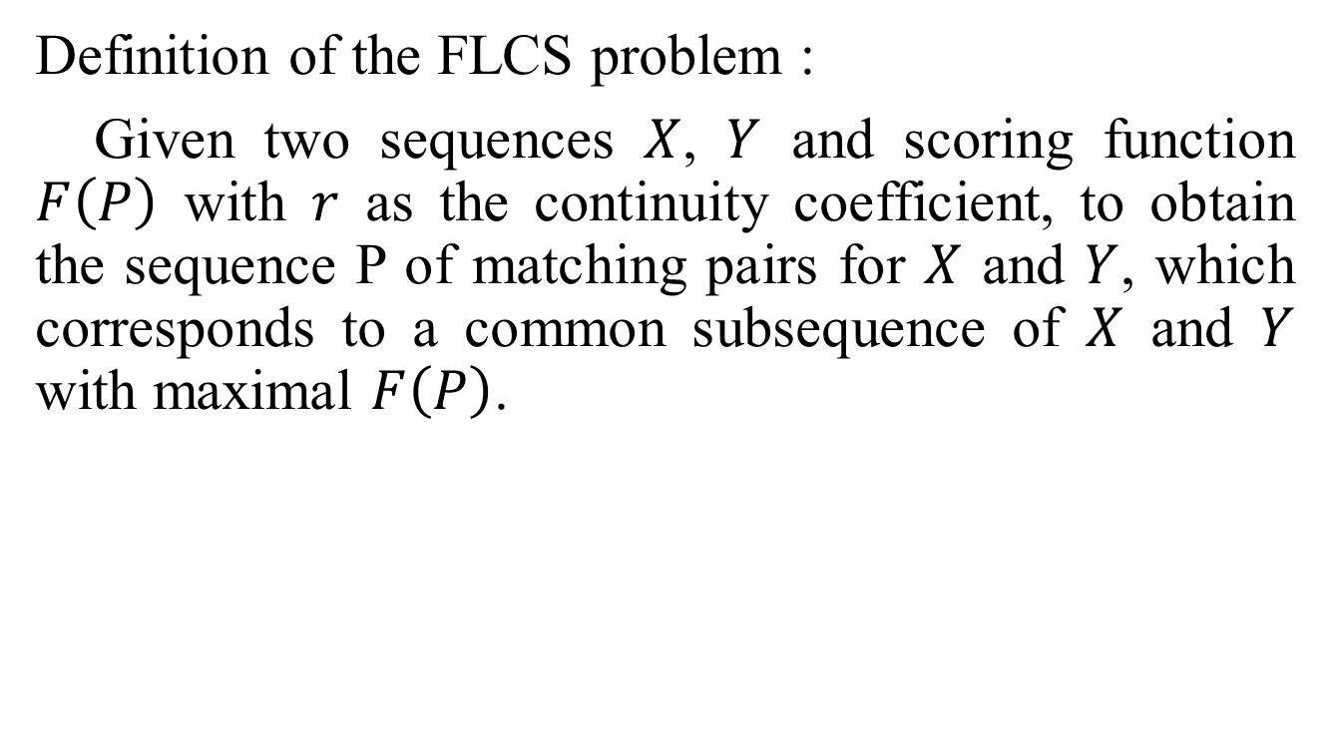
The FLCS Problem
Definition of the FLCS problem :
Given two sequences $X$, $Y$ and scoring function $F\left(P\right)$ with $r$ as the continuity coefficient, to obtain the sequence P of matching pairs for $X$ and $Y$, which corresponds to a common subsequence of $X$ and $Y$ with maximal $F\left(P\right)$.

Slide 9
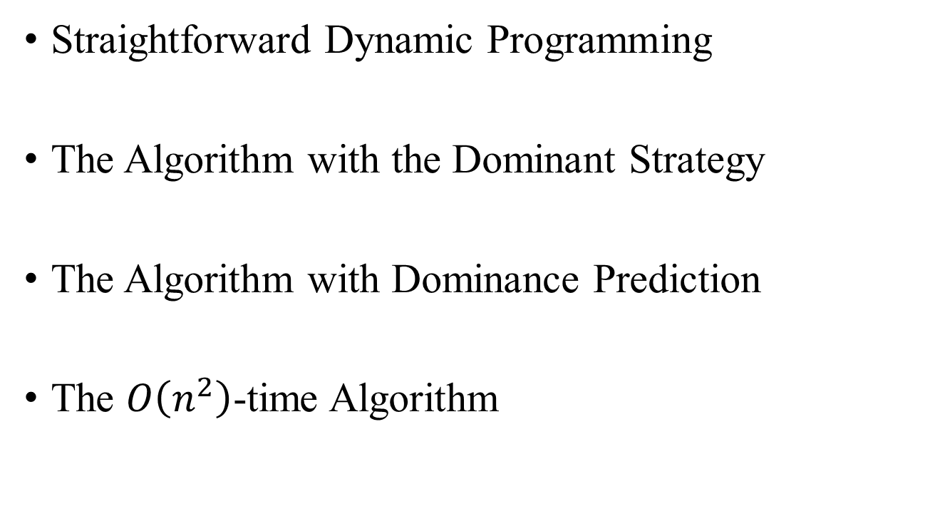
Method
Straightforward Dynamic Programming
The Algorithm with the Dominant Strategy
The Algorithm with Dominance Prediction
The $O\left(n^{2}\right)$-time Algorithm

Slide 10

Straightforward Dynamic Programming
$$L\left(X_{i}, Y_{j}\right)=$$
$$max\left\{\begin{aligned}L(X_{i−1},Y_{j}) \\ L(X_{i},Y_{j−1}) \\ \left\{L\left(X_{i−c},Y_{j−c}\right)+r^{c} \right| c∈Ν and X_{\left(i−c+1\right)..i}=Y_{\left(j−c+1\right)..j}\}\end{aligned}\right.$$
Time complexity : $O(n^{3})$

Slide 11
Straightforward Dynamic Programming
 |  | 1 | 2 | 3 | 4 | 5 | 6
 |  | a | b | a | c | b | a
1 | b | 0 | 1 | 1 | 1 | 1 | 1
2 | a | 1 | 1 | 4 | 4 | 4 | 4
3 | c | 1 | 1 | 4 | 9 | 9 | 9
4 | b | 1 | 2 | 4 | 9 | 16 | 16
5 | b | 1 | 2 | 4 | 9 | 16 | 16
6 | a | 1 | 2 | 4 | 9 | 16 | 17

Slide 12
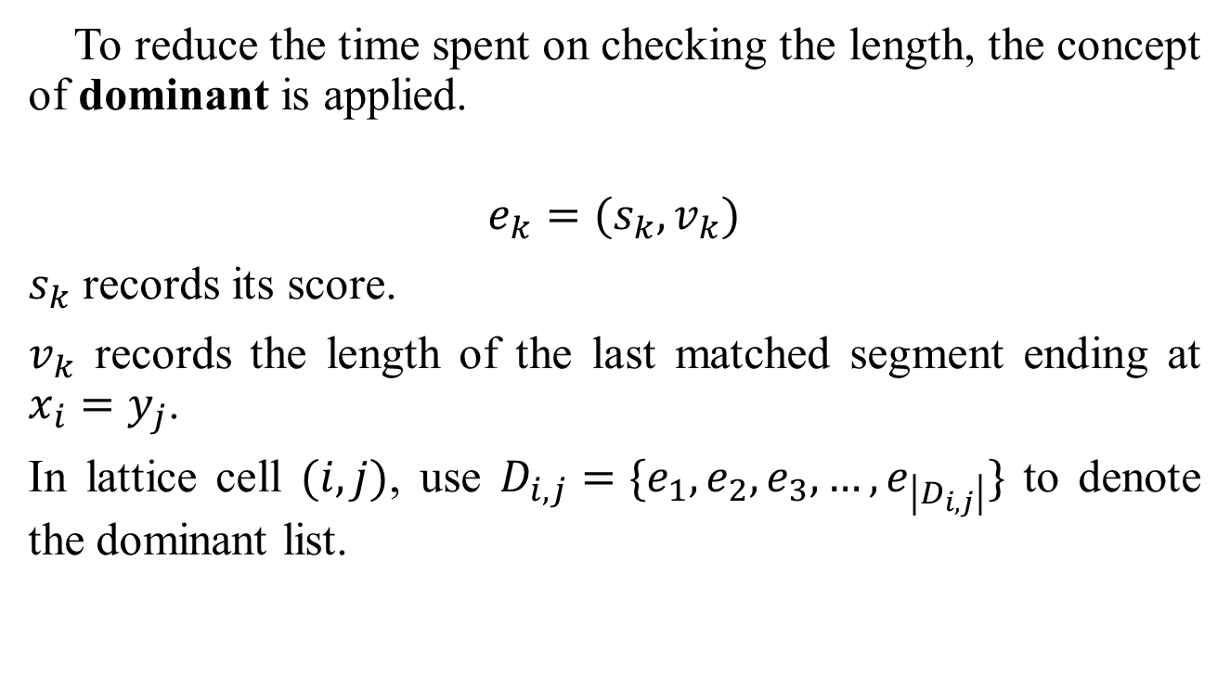
The Algorithm with the Dominant Strategy
To reduce the time spent on checking the length, the concept of dominant is applied.
$$e_{k}=(s_{k},v_{k})$$
$s_{k}$ records its score.
$v_{k}$ records the length of the last matched segment ending at $x_{i}=y_{j}$.
In lattice cell $(i,j)$, use $D_{i,j}=\{e_{1},e_{2},e_{3},…,e_{\left|D_{i,j}\right|}\}$ to denote the dominant list.

Slide 13

The Algorithm with the Dominant Strategy
$e_{k_{1}}=\left(s_{k1},v_{k1}\right)$dominates$e_{k_{2}}=\left(s_{k2},v_{k2}\right)$if $s_{k1}≥ s_{k2}$ and $v_{k1}≥v_{k2}$.
No matter how these two solutions are extended, the extended solution of$e_{k_{1}}$will not be worse than$e_{k_{2}}$.

Slide 14
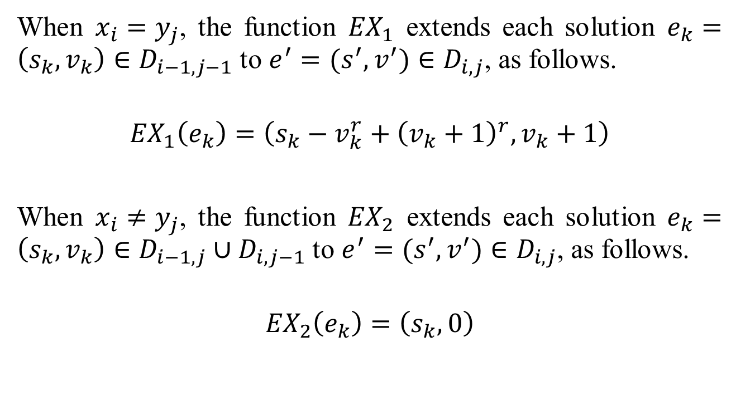
The Algorithm with the Dominant Strategy
When $x_{i}=y_{j}$, the function ${EX}_{1}$ extends each solution $e_{k}=\left(s_{k},v_{k}\right)∈D_{i−1,j−1}$ to $e^{′}=(s^{′}, v^{′})∈D_{i,j}$, as follows.
$${EX}_{1}\left(e_{k}\right)=\left(s_{k}−v_{k}^{r}+{\left(v_{k}+1\right)}^{r}, v_{k}+1\right)$$
When $x_{i}≠y_{j}$, the function ${EX}_{2}$ extends each solution $e_{k}=\left(s_{k},v_{k}\right)∈D_{i−1,j}∪D_{i,j−1}$ to $e^{′}=(s^{′}, v^{′})∈D_{i,j}$, as follows.
$${EX}_{2}\left(e_{k}\right)=\left(s_{k}, 0\right)$$

Slide 15
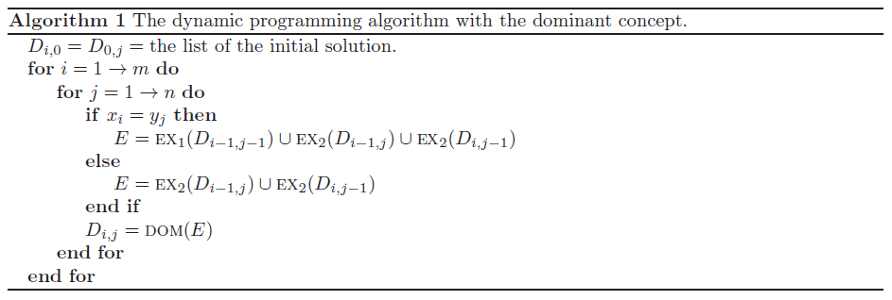
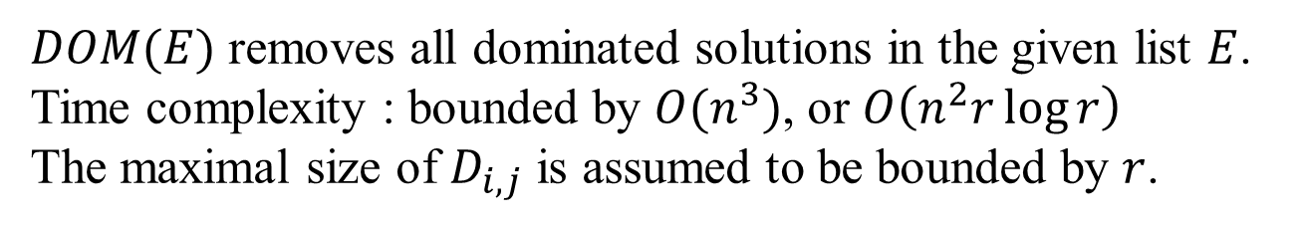
The Algorithm with the Dominant Strategy
$DOM(E)$ removes all dominated solutions in the given list $E$.
Time complexity : bounded by $O(n^{3})$, or $O\left(n^{2}r\log{r}\right)$
The maximal size of $D_{i,j}$ is assumed to be bounded by $r$.

Slide 16
The Algorithm with the Dominant Strategy
 |  | 1 | 2 | 3 | 4 | 5 | 6
 |  | a | b | a | c | b | a
1 | b | (0,0) | (1,1) | (1,0) | (1,0) | (1,1) | (1,0)
2 | a | (1,1) | (1,0) | (4,2) | (4,0) | (4,0) | (4,2)
3 | c | (1,0) | (1,0) | (4,0) | (9,3) | (9,0) | (9,0)
4 | b | (1,0) | (2,1) | (4,0) | (9,0) | (16,4) | (16,0)
5 | b | (1,0) | (2,1) | (4,0) | (9,0) | (16,0) (10,1) | (16,0)
6 | a | (1,1) | (2,0) | (4,2) | (9,0) | (16,0) | (17,1) (13,2)

Slide 17
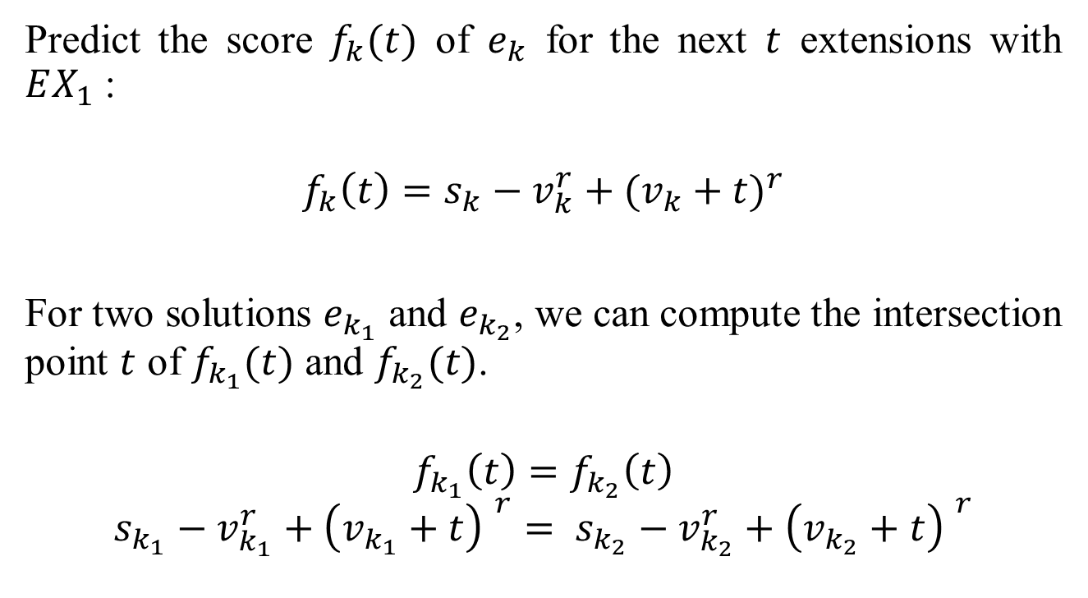
The Algorithm with Dominance Prediction
Predict the score $f_{k}(t)$ of $e_{k}$ for the next $t$ extensions with $EX_{1}$ :
$$f_{k}\left(t\right)=s_{k}−v_{k}^{r}+{(v_{k}+t)}^{r}$$
For two solutions $e_{k_{1}}$ and $e_{k_{2}}$, we can compute the intersection point $t$ of $f_{k_{1}}(t)$ and $f_{k_{2}}(t)$.
$$f_{k_{1}}\left(t\right)=f_{k_{2}}\left(t\right)$$
$$s_{k_{1}}−v_{k_{1}}^{r}+{\left(v_{k_{1}}+t\right) }^{r}= s_{k_{2}}−v_{k_{2}}^{r}+{\left(v_{k_{2}}+t\right) }^{r}$$

Slide 18
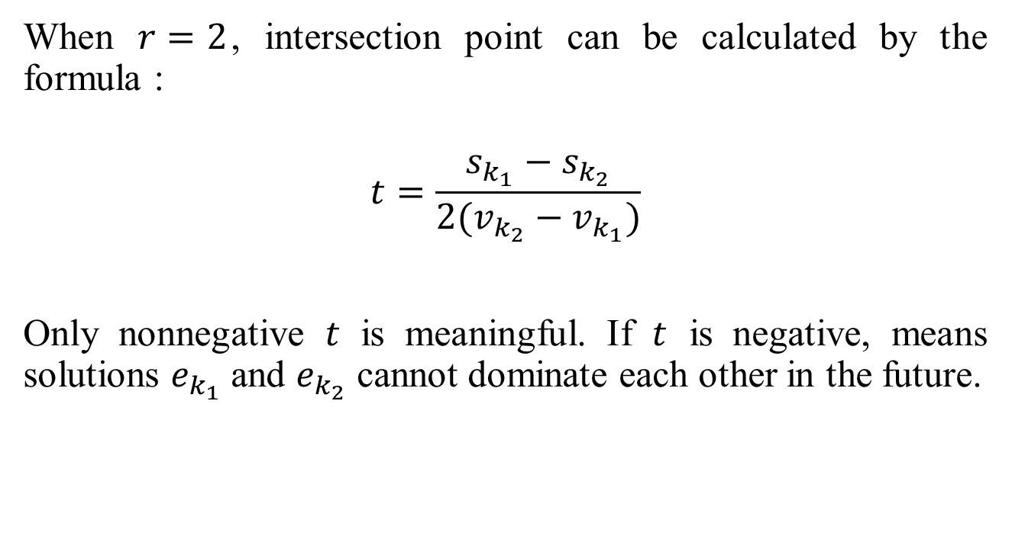
The Algorithm with Dominance Prediction
When $r=2$, intersection point can be calculated by the formula :
$$t=\frac{s_{k_{1}}−s_{k_{2}}}{2(v_{k_{2}}−v_{k_{1}})}$$
Only nonnegative $t$ is meaningful. If $t$ is negative, means solutions $e_{k_{1}}$ and $e_{k_{2}}$ cannot dominate each other in the future.

Slide 19
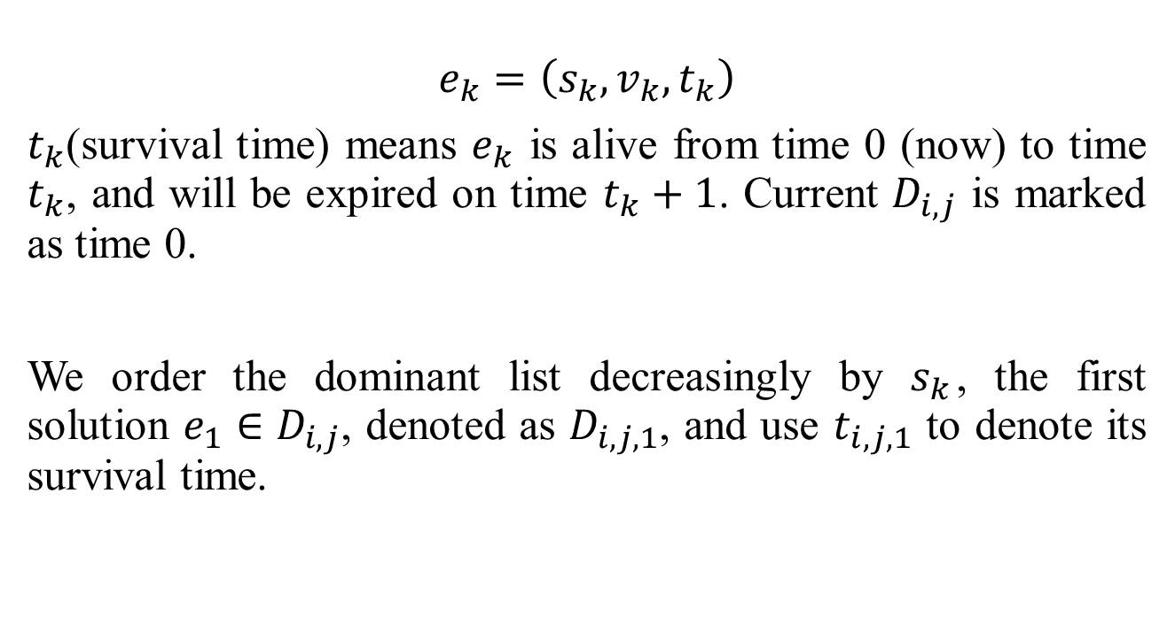
The Algorithm with Dominance Prediction
$$e_{k}=\left(s_{k},v_{k},t_{k}\right)$$
$t_{k}$(survival time) means $e_{k}$ is alive from time 0 (now) to time $t_{k}$, and will be expired on time $t_{k}+1$. Current $D_{i,j}$ is marked as time 0.
We order the dominant list decreasingly by $s_{k}$, the first solution $e_{1}∈D_{i,j}$, denoted as $D_{i,j,1}$, and use $t_{i,j,1}$ to denote its survival time.

Slide 20

The Algorithm with Dominance Prediction
The extending functions with survival time are denoted as $EXT_{1}$ and $EXT_{2}$.
$$EXT_{1}\left(e_{k}\right)=\left(s_{k}−v_{k}^{r}+{\left(v_{k}+1\right)}^{r}, v_{k}+1, t_{k}−1\right)$$
$$EXT_{2}=\left(s_{k},0,∞\right)$$

Slide 21
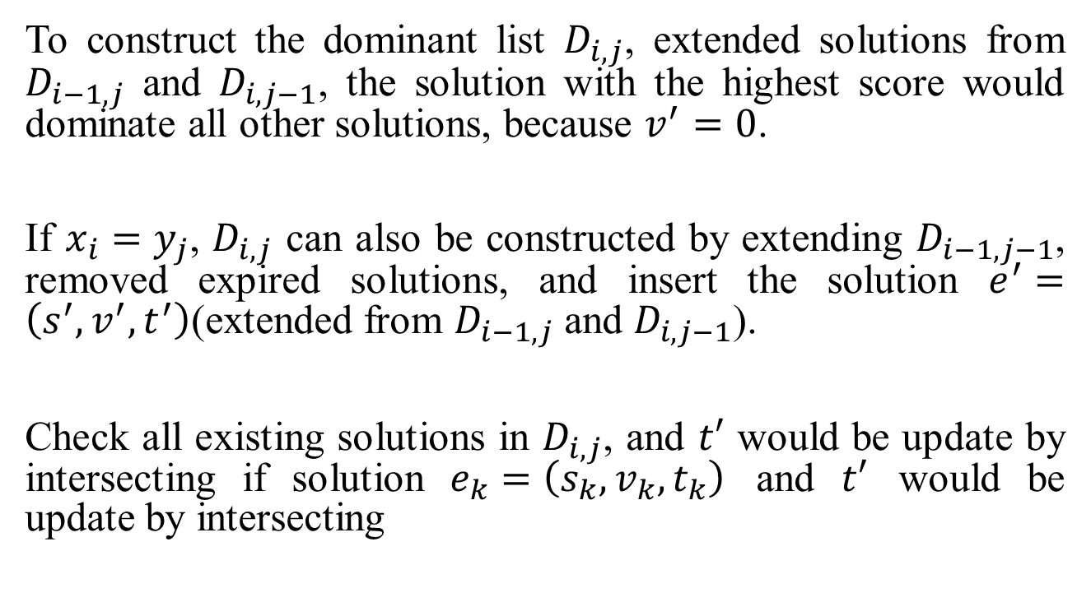
The Algorithm with Dominance Prediction
To construct the dominant list $D_{i,j}$, extended solutions from $D_{i−1,j}$ and $D_{i,j−1}$, the solution with the highest score would dominate all other solutions, because $v^{′}=0$.
If $x_{i}=y_{j}$, $D_{i,j}$ can also be constructed by extending $D_{i−1,j−1}$, removed expired solutions, and insert the solution $e^{′}=\left(s^{′},v^{′},t^{′}\right)$(extended from $D_{i−1,j}$ and $D_{i,j−1}$).
Check all existing solutions in $D_{i,j}$, and $t′$ would be update by intersecting if solution $e_{k}=\left(s_{k},v_{k},t_{k}\right)$ and $t′$ would be update by intersecting

Slide 22
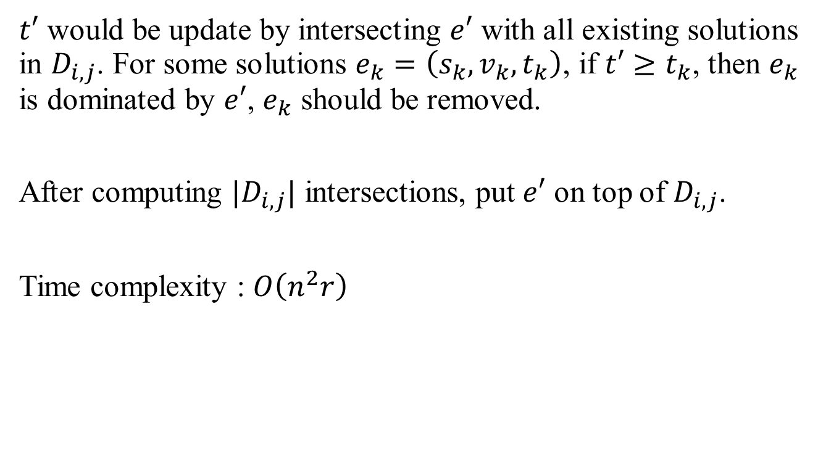
The Algorithm with Dominance Prediction
$t′$ would be update by intersecting $e′$ with all existing solutions in $D_{i,j}$. For some solutions $e_{k}=\left(s_{k},v_{k},t_{k}\right)$, if $t′≥t_{k}$, then $e_{k}$ is dominated by $e′$, $e_{k}$ should be removed.
After computing ${|D}_{i,j}|$ intersections, put $e′$ on top of $D_{i,j}$.
Time complexity : $O\left(n^{2}r\right)$

Slide 23
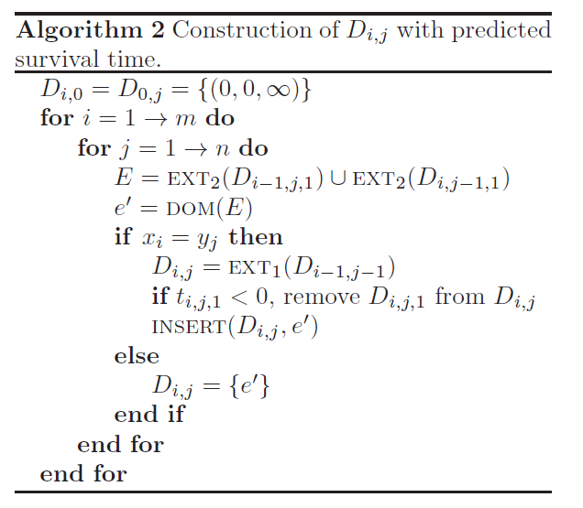
The Algorithm with Dominance Prediction

Slide 24
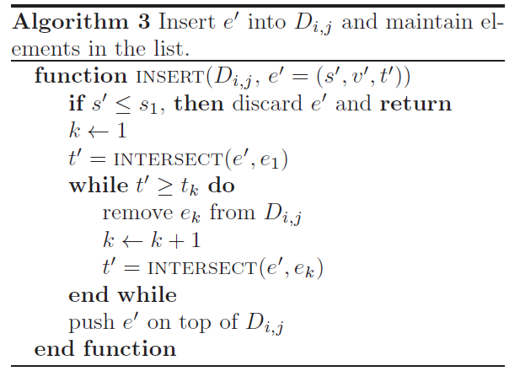
The Algorithm with Dominance Prediction

Slide 25
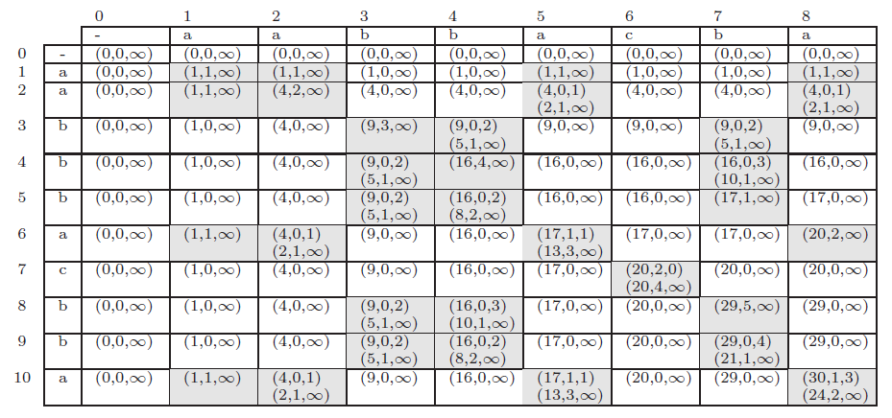
The Algorithm with Dominance Prediction

