Slide 1
From an Artificial Neural Network to a Stock Market Day-Trading System: A Case Study on the BM&F BOVESPA
Leonardo C. Martinez, Diego N. da Hora, Joao R. de M. Palotti
Wagner Meira Jr., Gisele L. Pappa
Federal University of Minas Gerais
2009 Proceedings of International Joint Conference on Neural Networks (IJCNN)
pp.2006 – 2013
Presenter : Tsai Yao-Chou

Slide 2
Abstract(1/2)
Predicting trends in the stock market is a subject of major interest for both scholars and financial analysts. The main difficulties of this problem are related to the dynamic, complex, evolutive and chaotic nature of the markets. In order to tackle these problems, this work proposes a day-trading system that "translates" the outputs of an artificial neural network into business decisions, pointing out to the investors the best times to trade and make profits. The ANN forecasts the lowest and highest stock prices of the current trading day. The system was tested with the two main stocks of the BM&FBOVESPA, an important and understudied market.

Slide 3
Abstract(2/2)
A series of experiments were performed using different data input configurations, and compared with four benchmarks. The results were evaluated using both classical evaluation metrics, such as the ANN generalization error, and more general metrics, such as the annualized return. The ANN showed to be more accurate and give more return to the investor than the four benchmarks. The best results obtained by the ANN had an mean absolute percentage error around 50% smaller than the best benchmark, and doubled the capital of the investor.

Slide 4
Introduction
This paper proposes a stock market day-trading system that uses the outputs of a ANN to guide the user into buying and selling stocks.
The system was tested in the BM&F BOVESPA Stock Exchange(巴西證券交易所).
The reasons used ANN for prediction
They can easily deal with irregularities.
They work with uncertain, incomplete and/or insufficient data, which change fast over short periods of time.
They are powerful tools to find patterns in data, including non-linear relationships.

Slide 5
System architecture
Multi-layer feed-forward neural network.
Trained by the back-propagation algorithm.
Three layers with up to 33 input and two output neurons.
The number of neurons in the hidden layer = the square root of the product between the number of neurons in the input and output layers.
Data pre- and post-processing:
Input(Output) values are divided(multiplied) by the maximum input value times 2.
Learning rate = 0.01

Slide 6
Input data
opening, closing, lowest, highest daily prices
Fundamental analysis (基本分析):
股票價格受政治、經濟、心理等諸多因素影響
例如：一家公司的財務報表、新制度影響分析、人口改變等
Technical analysis (技術分析):
研究過去股價，預測未來股價趨勢
股價的走勢是有規律的，所以可以預測未來走勢
歷史會不斷重演，所以趨勢會不斷循環
Long-term period : Fundamental analysis
Short-term period : Technical analysis

Slide 7
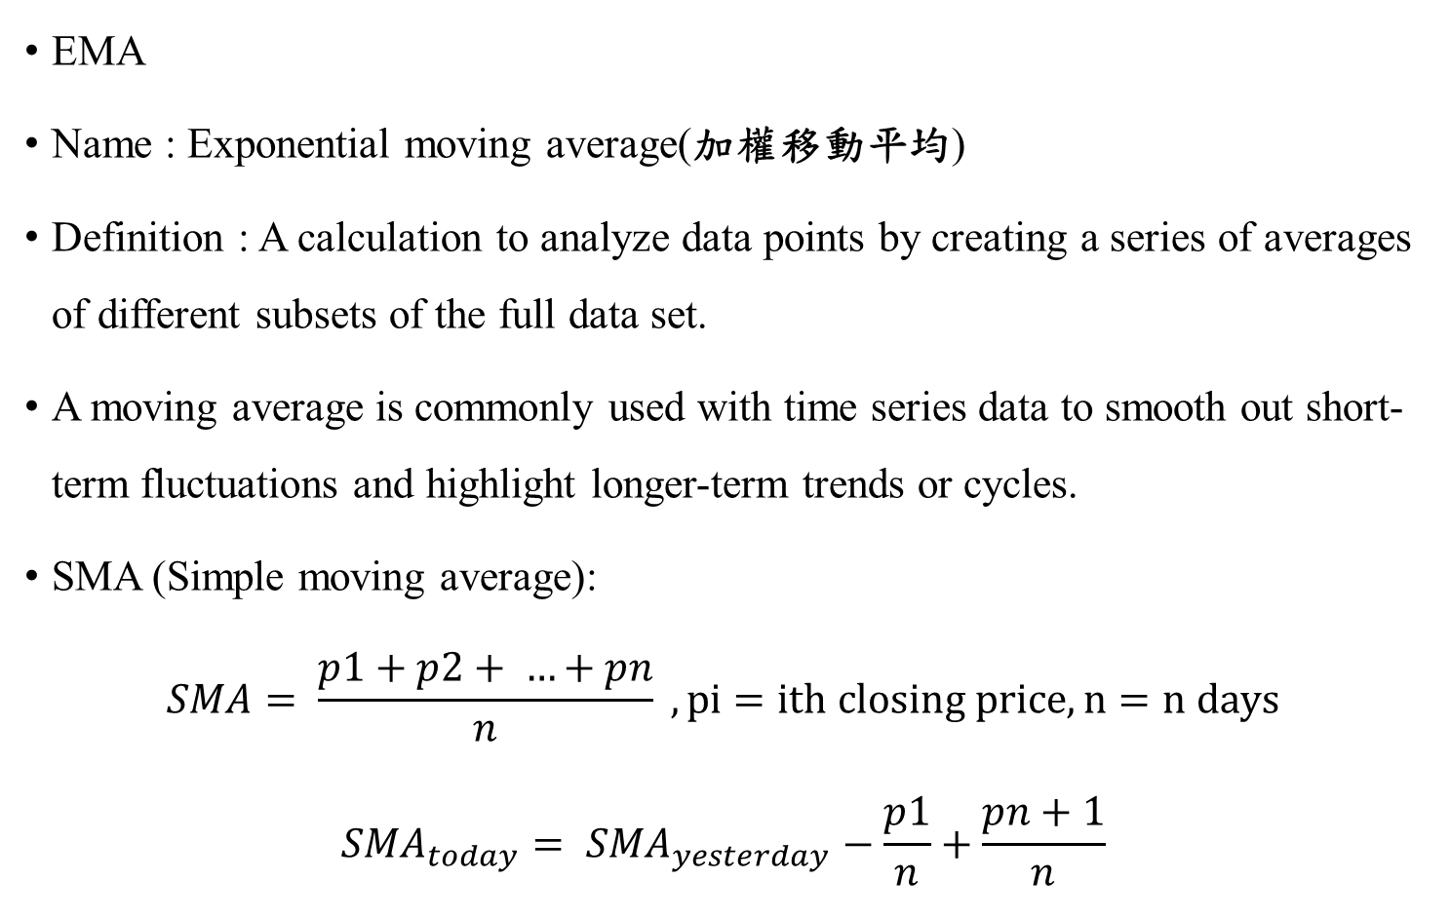
Input data(1/3)
EMA
Name : Exponential moving average(加權移動平均)
Definition : A calculation to analyze data points by creating a series of averages of different subsets of the full data set.
A moving average is commonly used with time series data to smooth out short-term fluctuations and highlight longer-term trends or cycles.
SMA (Simple moving average):
$$SMA= \frac{p1+p2+ …+pn}{n} , pi=ith closing price, n=n days$$
$${SMA}_{today}= {SMA}_{yesterday}−\frac{p1}{n}+\frac{pn+1}{n}$$

Slide 8
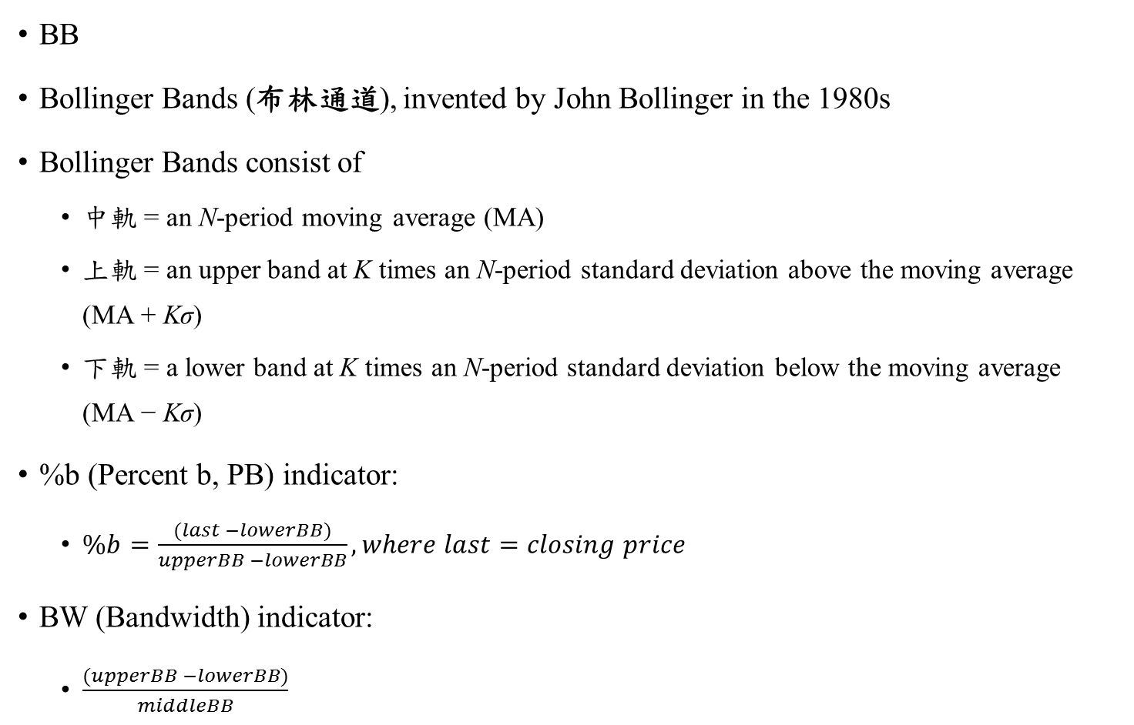
Input data(2/3)
BB
Bollinger Bands (布林通道), invented by John Bollinger in the 1980s
Bollinger Bands consist of
中軌 = an N-period moving average (MA)
上軌 = an upper band at K times an N-period standard deviation above the moving average (MA + Kσ)
下軌 = a lower band at K times an N-period standard deviation below the moving average (MA − Kσ)
%b (Percent b, PB) indicator:
$\%b=\frac{(last −lowerBB)}{upperBB −lowerBB}, where last=closing price$
BW (Bandwidth) indicator:
$\frac{(upperBB −lowerBB)}{middleBB}$

Slide 9
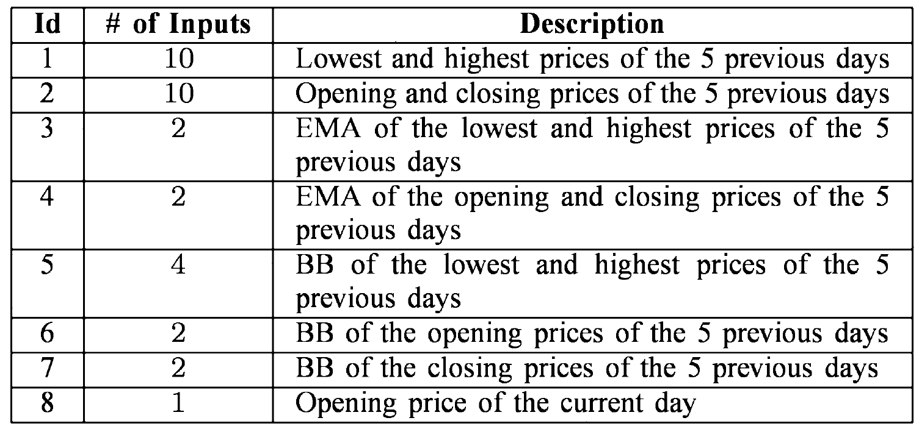
Input data(3/3)
Uses 33 variables
First configuration:
1, 3, 7, 8
Second configuration:
1, 2, 3, 7, 8

Slide 10
Others
Output data:
The minimum and maximum predicted prices for the current day.
Find the optimal time of the day to buy/sell stocks.
Datasets:
Petrobras PN (巴西石油)
Vale R Doce PNA (金屬和採礦業)
1283 days (2003/10/1 – 2008/11/2)
Training:
2007/5/18 – 2007/11/23

Slide 11
Trading system
A set of rules to enter and exit trades.
A risk control mechanism.
A money management scheme.
手續費
Consult the trade rules every 15 minutes.

Slide 12
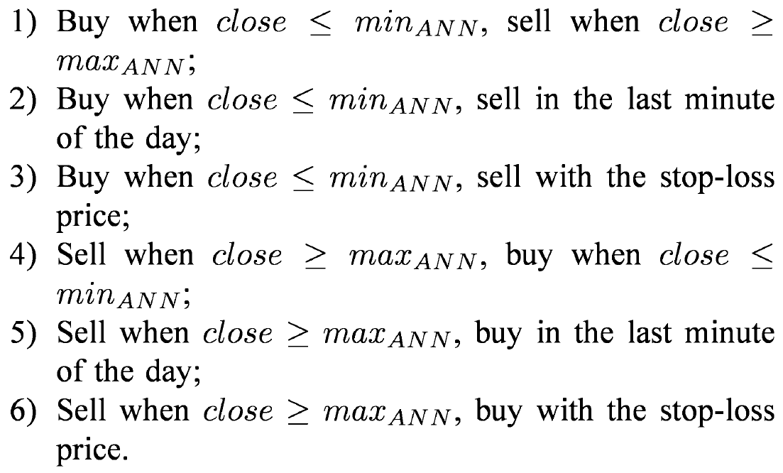
Trading rules
$$\min_{ANN}=minimum predicted value$$
$$\max_{ANN}=maximum predicted value$$
$$close=15_minute interval closing stock price$$

Slide 13
Risk Control
TOPS COLA : “Take Our Profits Slowly, Cut off Losses At once.”
Stop-loss strategy:
Defines a default price, if reached, exit.
The value calculated using the trade entry price.
Low stop-loss avoid profitable trades.
High stop-loss cause a higher loss.
In this paper used 0.5%.

Slide 14

Evaluation metrics
Annualized return
$AR=100 ∗(({\frac{FC}{IC})}^{\frac{365.25}{D}}−1$)
IC = initial capital invested.
FC = final capital obtained
D = number of days of investment
Maximum dropdown
兩次獲利之間損失的最大資本額度.

Slide 15
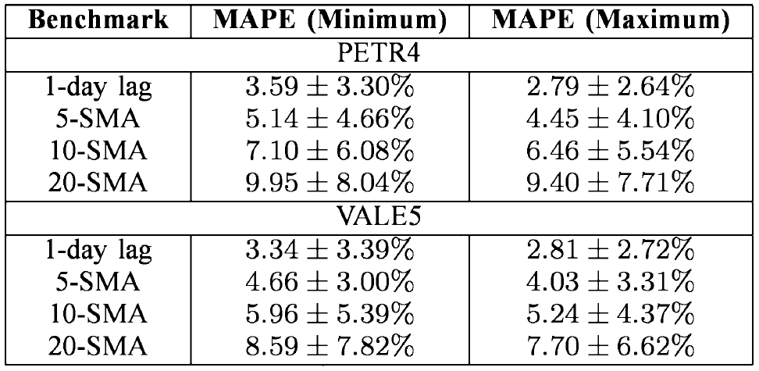
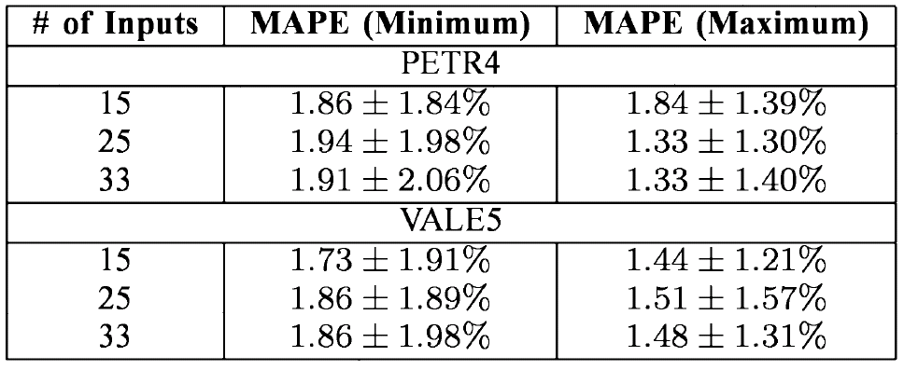
Experiment results(ANN)
N. O'Connor and M. G. Madden, "A neural network approach to predicting stock exchange movements using external factors," Knowl.Based Syst., 19(5), 371-378, 2006

Slide 16
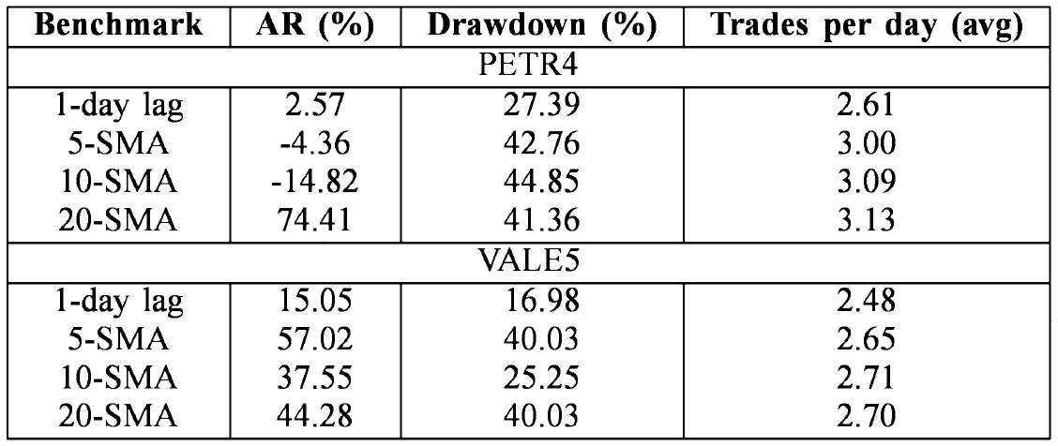
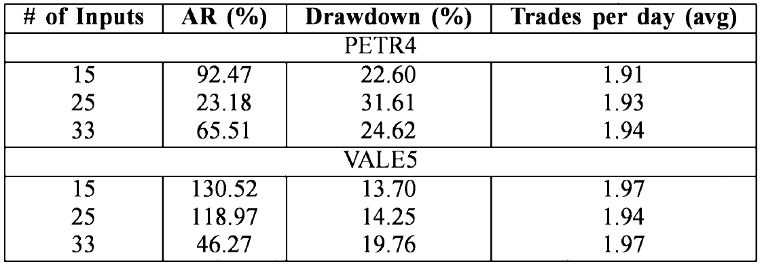
Experiment results(without system)

Slide 17
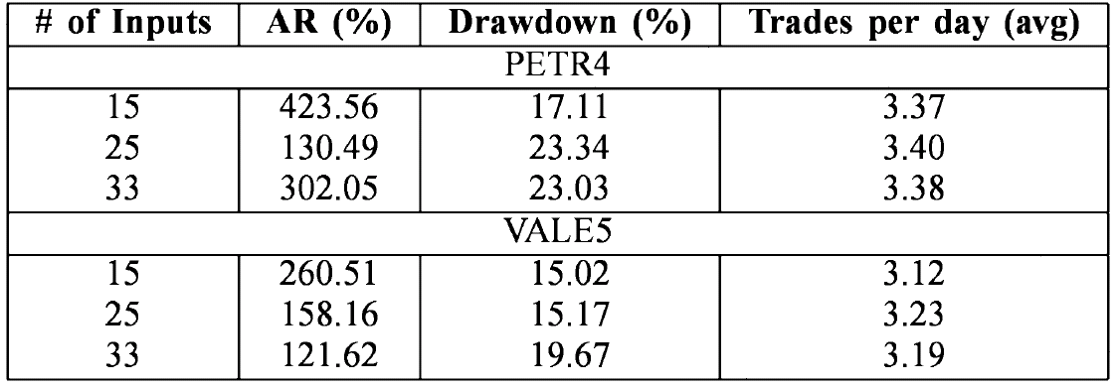
Experiment results(with system)

