Slide 1
Fast string matching for DNA sequences
Cheol Ryu, Thierry Lecroq, Kunsoo Park,
Theoretical Computer Science 812 (2020), pp.137-148
Presenter: Wen-Wen Liao
Date: Jan. 23, 2024
Notes:
特拉維夫市以色列

Slide 2
Abstract
In this paper we propose the Maximal Average Shift (MAS) algorithm that finds a pattern scan order that maximizes the average shift length. We also present two extensions of MAS: one improves the scan speed of MAS by using the scan result of the previous window, and the other improves the running time of MAS by using q-grams. These algorithms show better average performances in scan speed than previous string matching algorithms for DNA sequences.

Slide 3

Preliminaries
$f_{T}(x)$ : x ∈ Σ be the probability that a text character in T is x.
pattern scan order: (scan[1], scan[2],..., scan[m]) is a permutation of (1, 2,...,m).

Slide 4
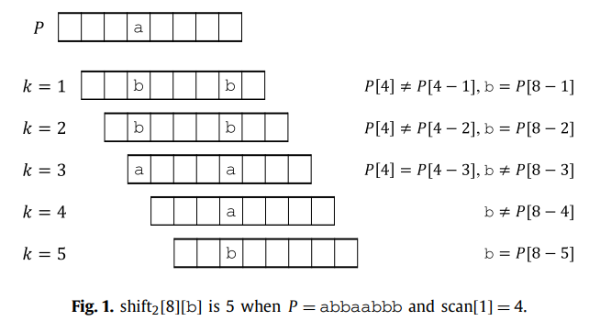
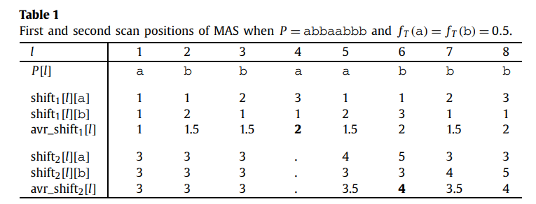
Maximal average shift algorithm

Slide 5
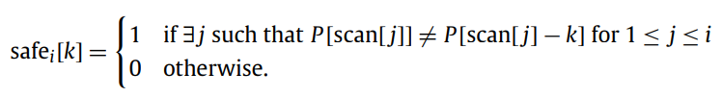
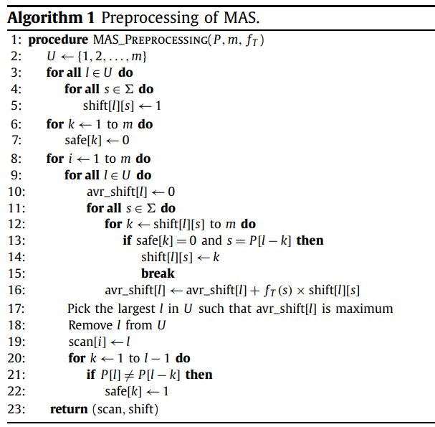
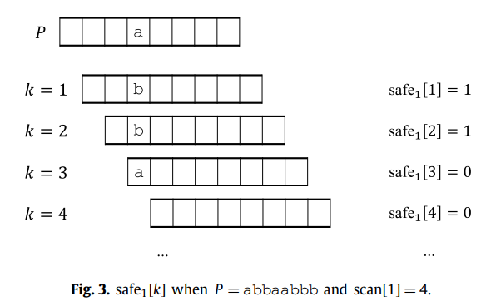
Preprocessing

Slide 6
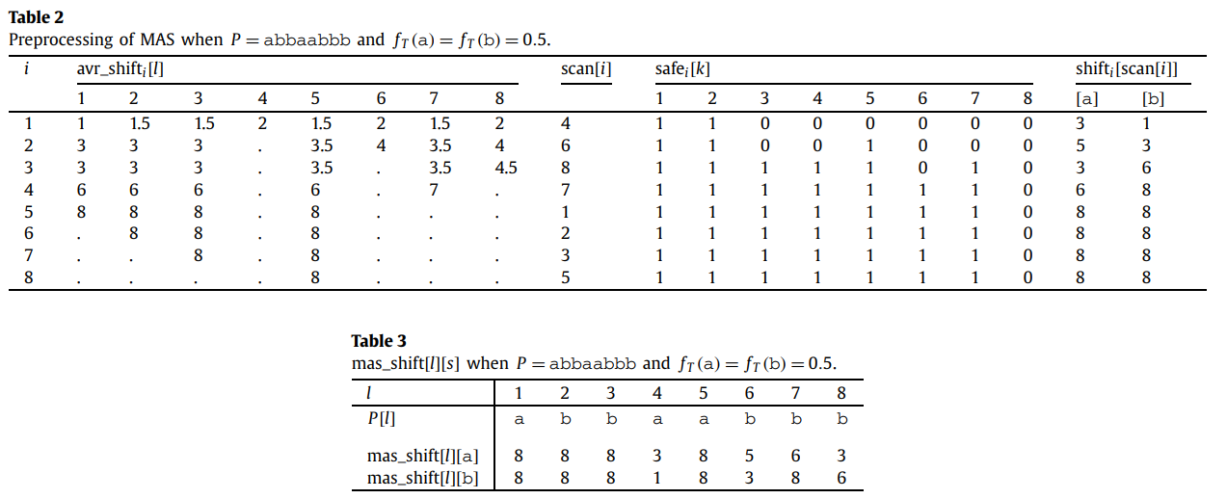

Preprocessing
Time complexity: O($m^{2}|Σ|$)

Slide 7
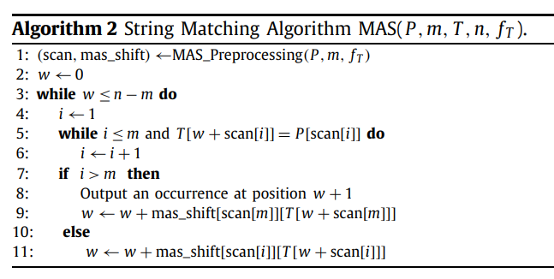
Maximal average shift algorithm

Slide 8
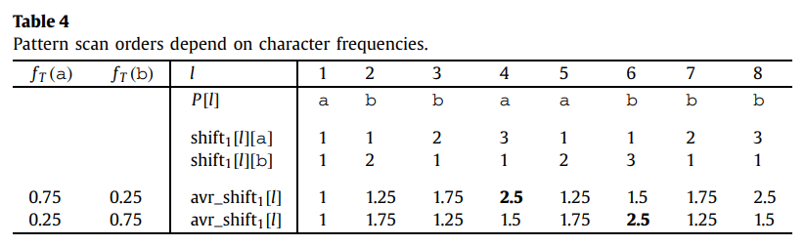
Maximal average shift algorithm
first scan position=4
first scan position=6

Slide 9

Experimental results of MAS
$f_{T}$(A) = 0.293, $f_{T}$(C) = 0.207, $f_{T}$(G) = 0.207, and $f_{T}$(T) = 0.293
Scan speed: the ratio of the text length to the number of text scanned by an algorithm, averaged over 100 patterns.
Running time: the running time of an algorithm / text length × 1,000,000 (i.e., running time per 1,000,000 text characters), averaged over 100 patterns.

Slide 10
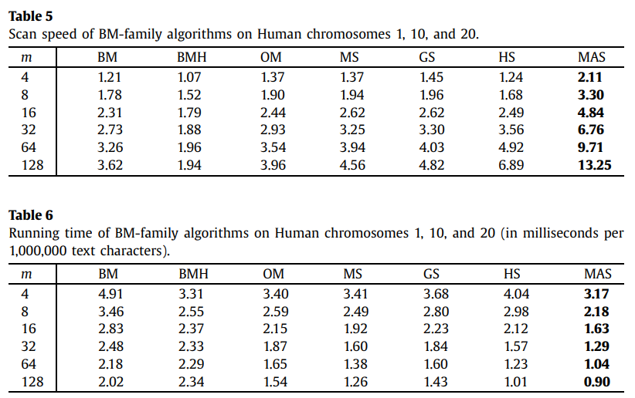
Experimental results of MAS

Slide 11
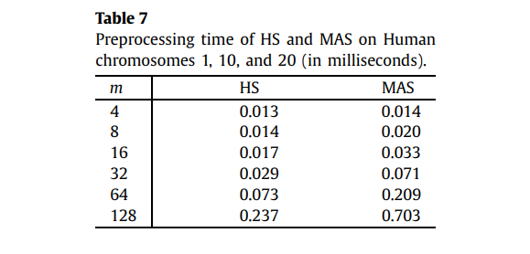
Experimental results of MAS

Slide 12
Extending the MAS algorithm
2 extension
Improve the scan speed of MAS by using the scan result of the previous window.
Improve the running time of MAS by using q-grams.

Slide 13
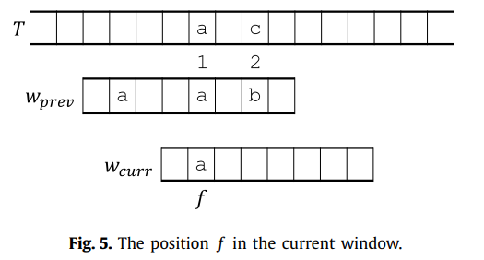
Tuned MAS algorithm
Notes:
TMAS算法根據先前窗口的掃描結果來調整掃描順序和位移長度表，以最大化位移長度，從而提高字串匹配的效率。通過利用先前窗口的信息，TMAS算法能夠更好地適應不同的文本分佈和模式結構，從而提高了字串匹配的性能。 總的來說，TMAS算法通過利用先前窗口的掃描結果來調整掃描順序和位移長度表，從而實現更有效的字串匹配。這種方法可以提高字串匹配的效率，特別是在處理不規則文本分佈和模式結構時。

Slide 14
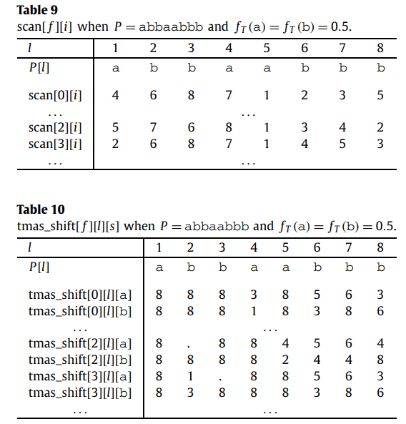
Tuned MAS algorithm

Slide 15
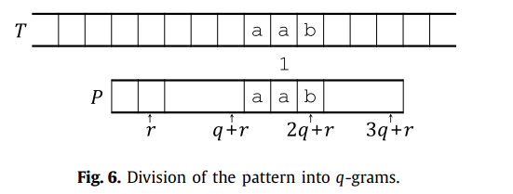
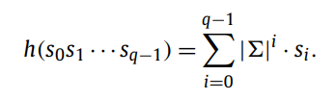

q-gram MAS algorithm
q-gram：Q-MAS算法將模式和文本分割成固定長度的q-gram，這樣可以更有效地處理大型文本和模式。通過利用q-gram，算法能夠減少比較的次數，從而提高字串匹配的效率。
q-gram: $s_{0}$ $s_{1}$ …$s_{q−1}$
fingerprint:

Slide 16
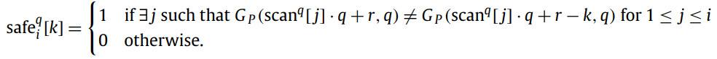
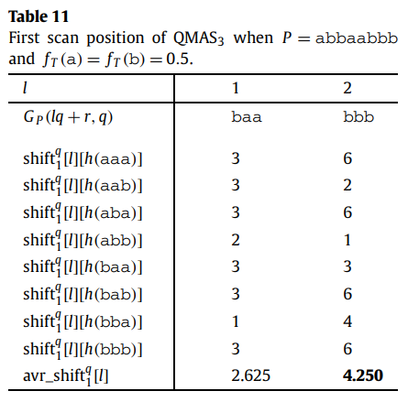
q-gram MAS algorithm

Slide 17
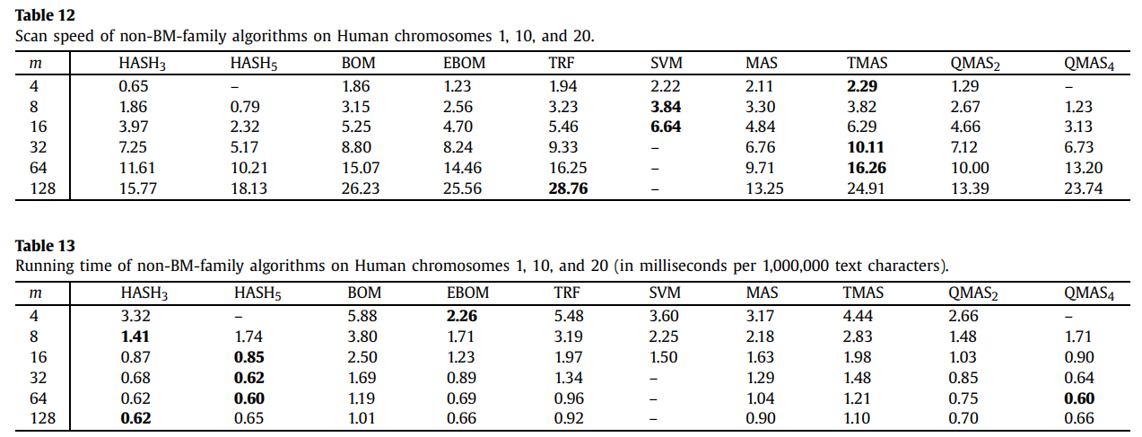
Experimental results

Slide 18
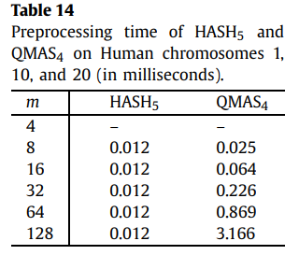
Experimental results

Slide 19
Conclusion
MAS outperforms other BM family algorithms in both scan speed and running time
two extensions
improve the scan speed of MAS by using the scan result of the previous window
improve the running time of MAS by using q-grams

