Slide 1
Normalization of Abbreviation and Acronym on Microtext in Bahasa Indonesia by Using Dictionary-Based and Longest Common Subsequence(LCS)
Dani Gunawan, Zurwatus Saniyah, Ainul Hizriadi
Procedia Computer Science 161 (2019) 553–559
Presenter: Shih-Hong Li
Date: Jan. 26, 2024

Slide 2
Abstract (1/2)
The communication nowadays has reached a need to express the idea in short text. This kind of communication is delivered in various media such as short messages service(SMS), Facebook status, Twitter post, chat messages, comments, and any form of short text. These various kinds of short text are known as microtext. The microtext usually has one sentence or less, written informally, consists of abbreviations, acronyms, emoticons, hashtags, and others. These features of the microtext become aparticular challenge to the text classification. These features cannot be processed directly as in the traditional textprocessing, because it may lead to inaccuracy. Therefore, it requires microtext normalization to transform these features into well-written texts before applying text processing. This research aims to normalize some of these features, which are abbreviations and acronyms.

Slide 3
Abstract (2/2)
The normalization applied dictionary-based and longest common subsequence(LCS) approach to the microtext in Bahasa Indonesia. Dictionary-based has shown an excellenct performance instead of LCS. However, it is limited to pre-defined abbreviations and acronyms. Besides, the LCS offers dynamic microtext normalization. Nevertheless, the combination of both approaches increases normalization performance slightly.

Slide 4
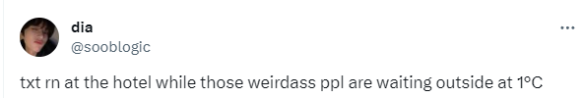

Microtext
E.g. :
USA : United States of America
ASAP : As soon as possible
BTW : By the way
PPL : People
LMAO : Laugh my ass of
IDK : I don’t know

Slide 5
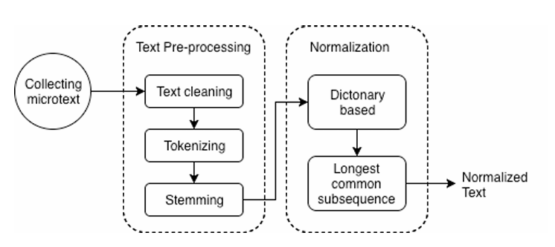
General architecture of normalization process

Slide 6
Data collection
The data source is collected by crawling the twitter posts
蒐集的資料刪除僅由幾個單詞組成的貼文，且透過人工篩選出包含 Microtext 的貼文
The number of collected twitter posts : 400

Slide 7
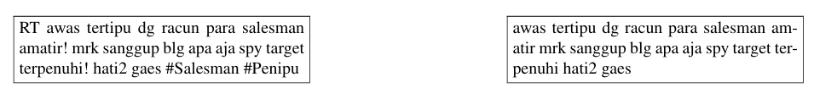
Text pre-processing (Text cleaning)
Original twitter post
Cleaned twitter post

Slide 8

Text pre-processing (Tokenizing)
The post will be tokenizing to “awas”, ”tertipu”, “dg”, “recun”, “para”
”salesman”, ”amatir”, ”mrk”, ”sanggup”, ”blg”, ”apa”, ”aja”, ”spy”, ”target”,”terpenuhi”, ”hati2”, and ”gaes”

Slide 9
Text pre-processing (Stemming)
將token的內容如果包含單詞，則將它們變回他們的原始形式
E.g. : running ran run -> run
如果有做Stemming之token則不用做normalization

Slide 10
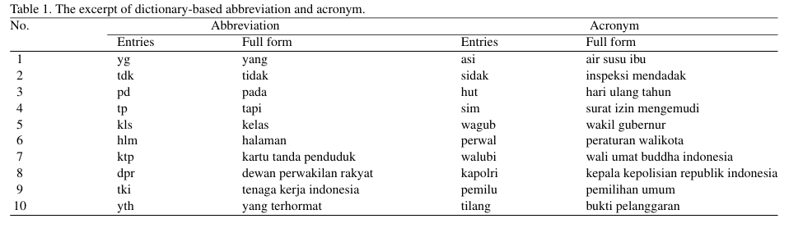
Normalization
A dictionary that provides common abbreviation and acronym provide by Kateglo
Contains more than 7,000 abbreviations and acronyms

Slide 11
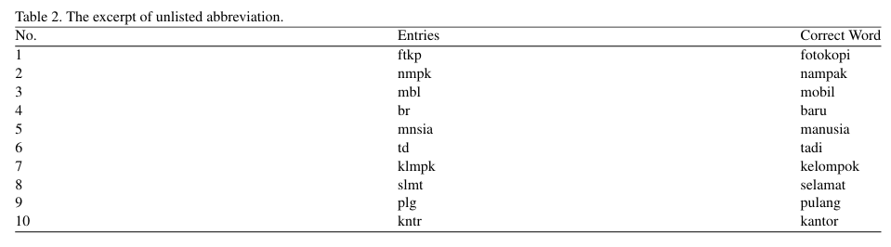
Normalization
Although the dictionary provides many abbreviations and acronyms, the twitter posts might consist of the un predictable and unlisted observation

Slide 12
Normalization
因為 micortext 的種類太多，不太可能都被dictionary紀錄，所以使用LCS方法幫助Normalization
E.g. :”smlt”在stemming被識別為非現有單詞，進入Normalization，方法為將 “smlt” 與現有dictionary內字串開頭為 ”s”的字串做LCS

Slide 13
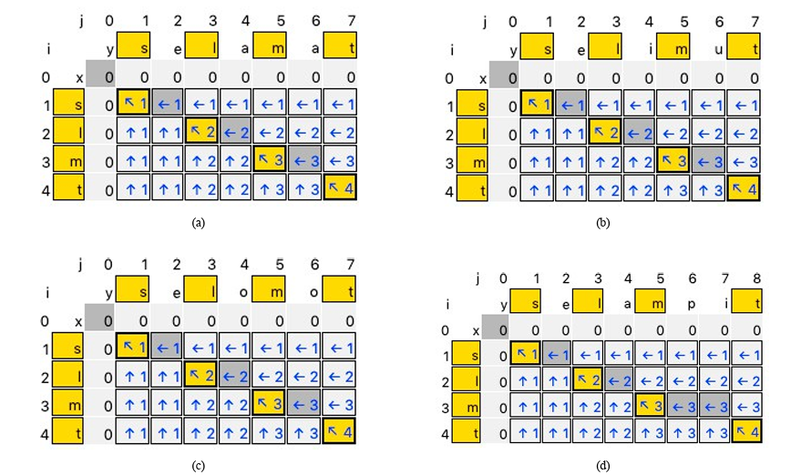
Normalization

Slide 14
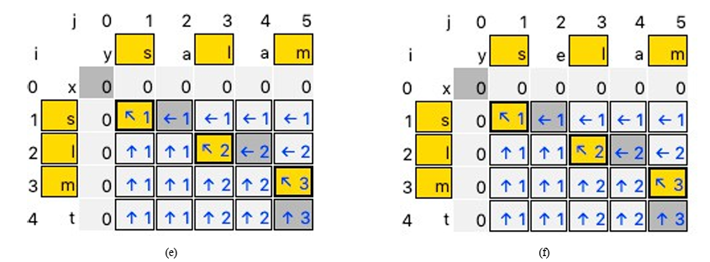
Normalization

Slide 15

Result
TP : 無需做Normalization 的 token
E.g. : running , ran , run
TN : 經過Normalization為正確的字串
如果Normalization 出來有多個可能的答案則視為不正確的字串
FN: 經過Normalization為錯誤的字串
E.g. :NCCU :National Chengchi University(正確), National Chung Cheng University(錯誤)
FP : 在stemming 過程中被錯誤判定成需要做Normalization的token
E.g. : “banyakin” 在印尼語中是一種俚語

Slide 16
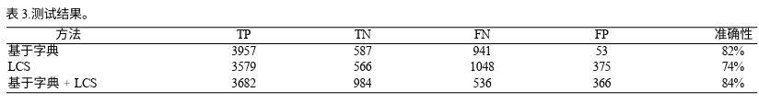
Result

Slide 17
Thanks

