Slide 1
LightGBM: A Highly Efficient Gradient Boosting Decision Tree
KE, Guolin, et al. Advances in neural information processing systems, 2017, 30.
Presenter : Jing-Xiang Yang
Date : Jan. 23, 2024

Slide 2
ABSTRACT(1/2)
Gradient Boosting Decision Tree (GBDT) is a popular machine learning algorithm, and has quite a few effective implementations such as XGBoost and pGBRT. Although many engineering optimizations have been adopted in these implementations, the efficiency and scalability are still unsatisfactory when the feature dimension is high and data size is large. A major reason is that for each feature, they need to scan all the data instances to estimate the information gain of all possible split points, which is very time consuming. To tackle this problem, we propose two novel techniques: Gradient-based One-Side Sampling (GOSS) and Exclusive Feature Bundling (EFB). With GOSS, we exclude a significant proportion of data instances with small gradients, and only use the rest to estimate the information gain. We prove that, since the data instances with larger gradients play a more important role in the computation of information gain, GOSS can obtain quite accurate estimation of the information gain with a much smaller data size.

Slide 3
ABSTRACT(2/2)
With EFB, we bundle mutually exclusive features (i.e., they rarely take nonzero values simultaneously), to reduce the number of features. We prove that finding the optimal bundling of exclusive features is NP-hard, but a greedy algorithm can achieve quite good approximation ratio (and thus can effectively reduce the number of features without hurting the accuracy of split point determination by much). We call our new GBDT implementation with GOSS and EFB LightGBM. Our experiments on multiple public datasets show that, LightGBM speeds up the training process of conventional GBDT by up to over 20 times while achieving almost the same accuracy.

Slide 4
GBDT
A kind of a method in Machine Learning
Training weak classifier sequentially (Decision Tree)
Each model reduces the error of the previous one

Slide 5
Contribution
Gradient-based One-Side Sampling (GOSS)
Exclusive Feature Bundling (EFB)
Improving Computation Speed

Slide 6
GOSS
Instances with larger gradients
contribute more to the information gain
Keep those instances with large gradients
Randomly drop those instances with small gradients
More accurate gain estimation than uniformly random sampling

Slide 7
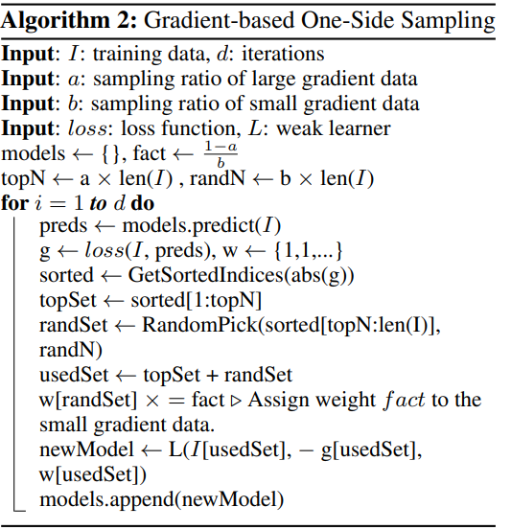
GOSS
Using current model to predict
Calculating gradient
Pick a% large gradient data (topSet)
Pick b% small gradient data (randSet)
randSet *= fact (Assign weight)
Train new learner by (g[topSet], g[randSet])
Update model

Slide 8
EFB
High-dimensional data are usually very sparse
In a sparse feature space, many features are (almost) exclusive
<x,y> : <12,0>, <0,13>, <174,0>, <0,25>
Bundle such exclusive features
<x,y> <z>

Slide 9
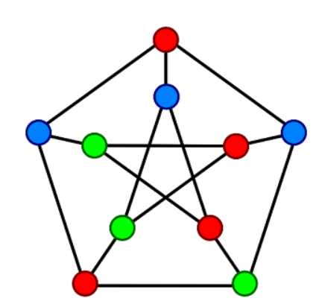
EFB
Partitioning features to smallest number of exclusive bundles is NP-hard
Feature
Conflict
(not exclusion)

Slide 10
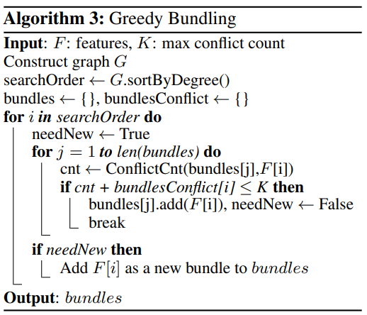
EFB
Ordering by the count of nonzero values
Checking each feature
assign it to an existing bundle
create a new bundle

Slide 11
Merging Feature
x takes value from [0, 10)
y takes value from [0, 20)
add an offset y : [0, 20] -> [10, 30)
Merge and get feature bundle z : [0, 30)

Slide 12
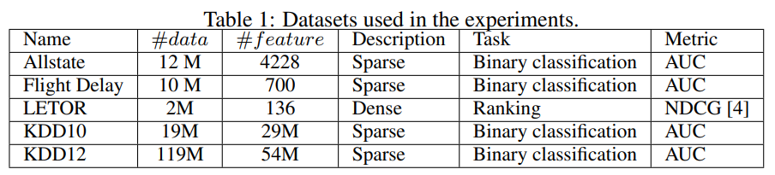
Experiments

Slide 13
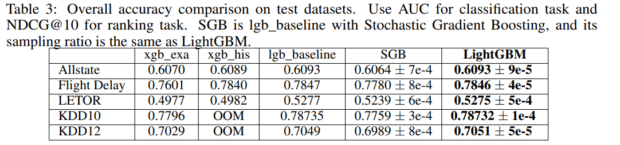
Experiments

Slide 14
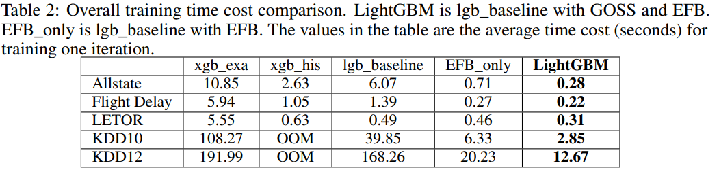
Experiments

Slide 15
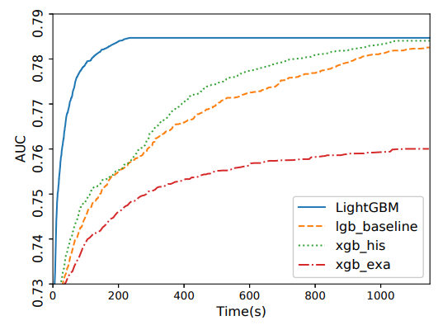
Experiments

Slide 16
Thanks

