Slide 1
An Improved Order-Preserving Pattern Matching Algorithm Using Fingerprints
Youngjoon Kim, Youngho Kim and Jeong Seop Sim
Mathematics, vol. 10, no. 12, 2022
Presenter: Wen-Yu Chang
Date: July 23, 2024

Slide 2
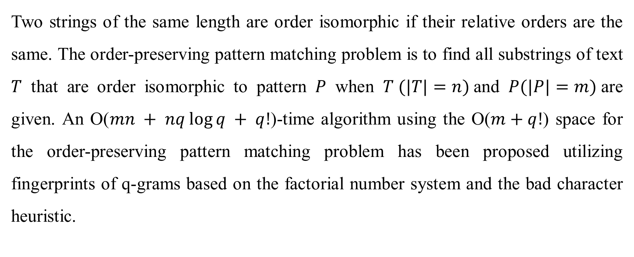
Abstract (1/2)
Two strings of the same length are order isomorphic if their relative orders are the same. The order-preserving pattern matching problem is to find all substrings of text $T$ that are order isomorphic to pattern $P$ when $T (|T|=n)$and $P(|P|=m)$are given. An O($mn + nq log⁡q + q!$)-time algorithm using the O($m+q!$) space for the order-preserving pattern matching problem has been proposed utilizing fingerprints of q-grams based on the factorial number system and the bad character heuristic.
Notes:
!: factorial

Slide 3
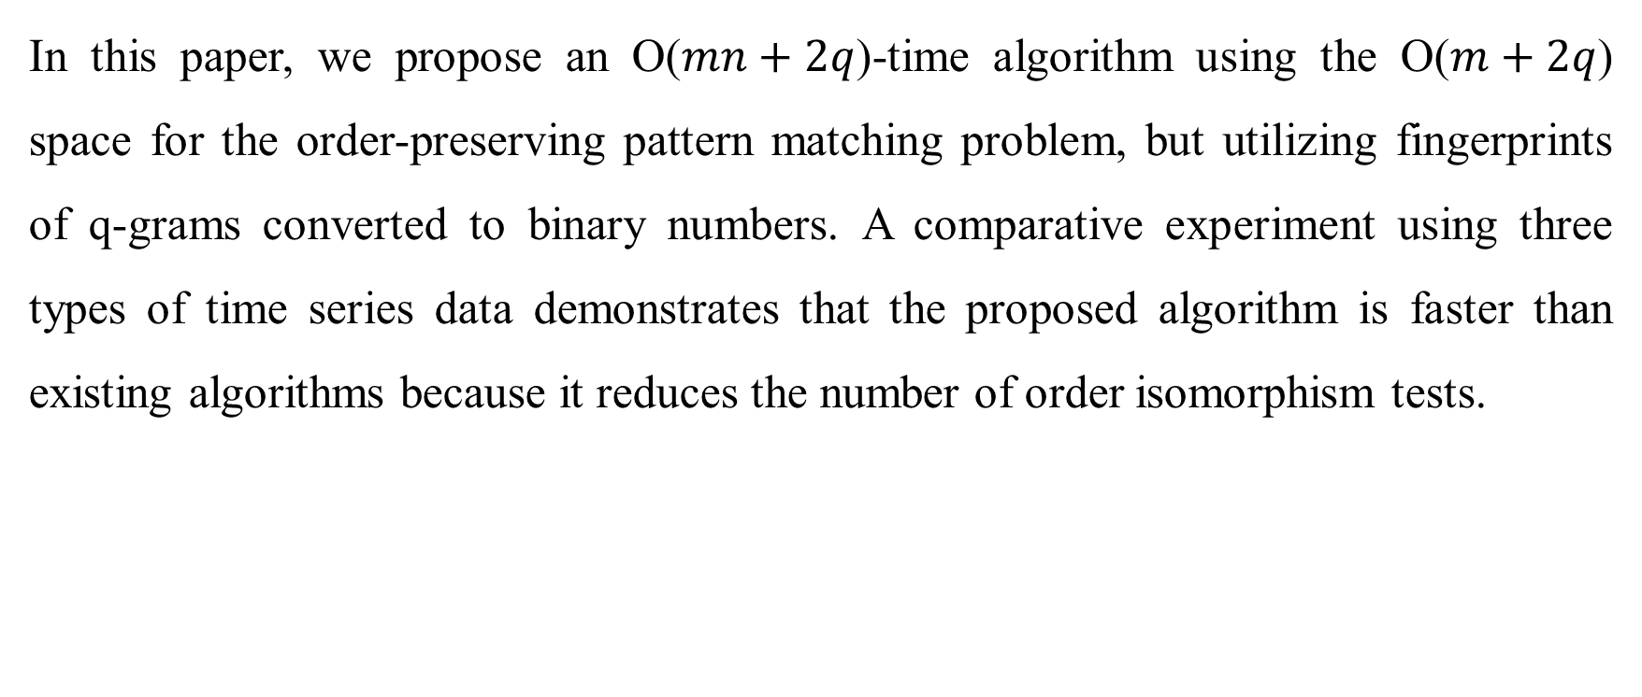
Abstract (2/2)
In this paper, we propose an O($mn+2q$)-time algorithm using the O($m+2q$) space for the order-preserving pattern matching problem, but utilizing fingerprints of q-grams converted to binary numbers. A comparative experiment using three types of time series data demonstrates that the proposed algorithm is faster than existing algorithms because it reduces the number of order isomorphism tests.

Slide 4
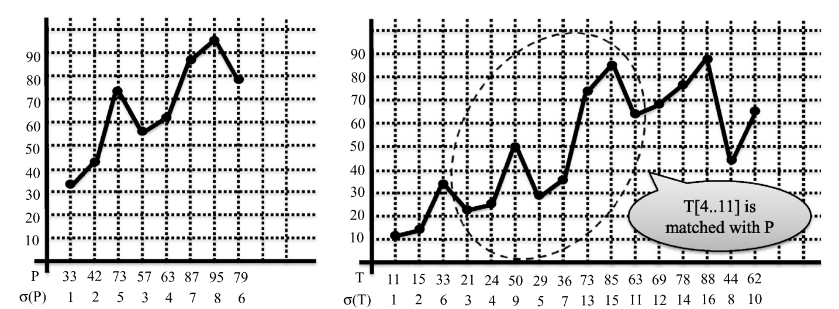

Order-Preserving Pattern Matching
$$σ\left(T\left[4..11\right]\right)=(1, 2, 5, 3, 4, 7, 8, 6)$$

Slide 5
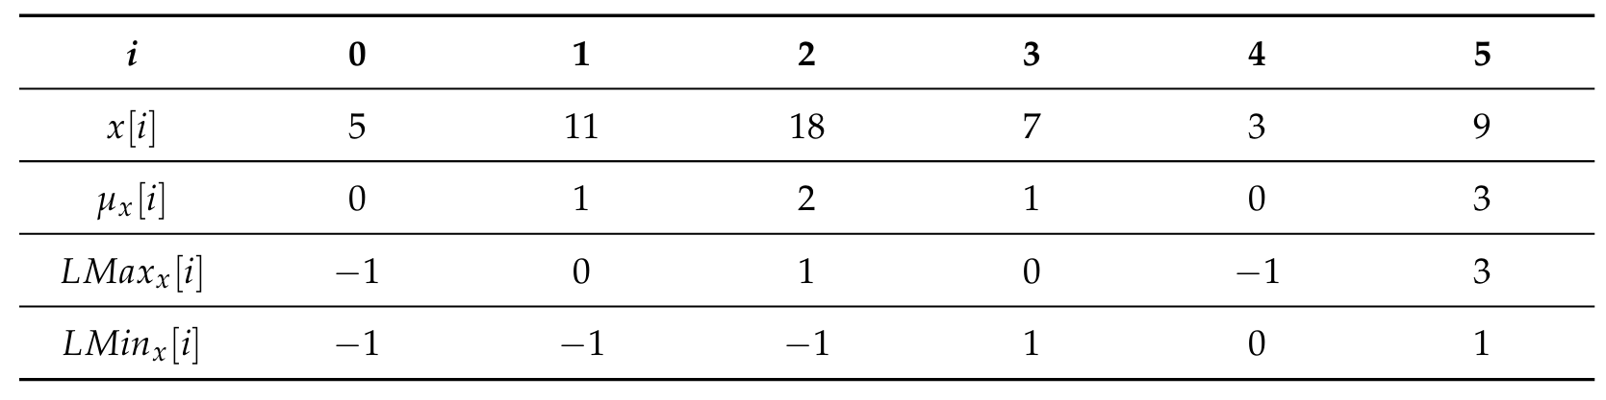
Prefix and Location Tables

Slide 6






Preprocessing (1/2)
Fingerprints of q-gram
q = 3
$$T$$
69 | 52 | 36 | 9 | 15 | 35 | 29 | 20 | 40 | 70 | 55 | 46 | 74 | 90 | 51
$$T′$$
0 | 0 | 0 | 1 | 1 | 0 | 0 | 1 | 1 | 0 | 0 | 1 | 1 | 0
$$P$$
3 | 1 | 4 | 11 | 8 | 6 | 14 | 16 | 7
$$P′$$
0 | 1 | 1 | 0 | 0 | 1 | 1 | 0
$$g\left(w\right)=4$$
$$g\left(w\right)=6$$

Slide 7
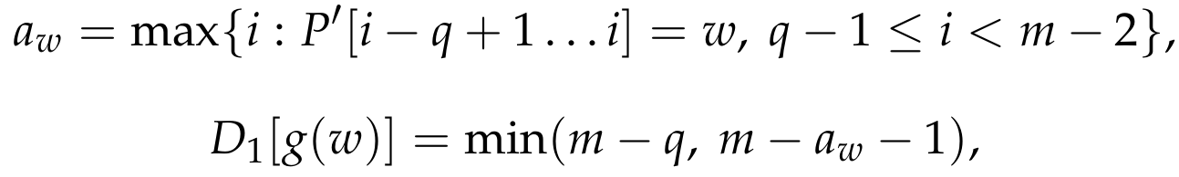
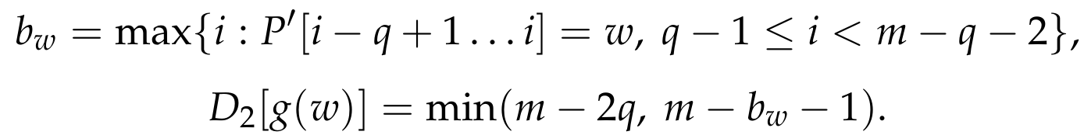
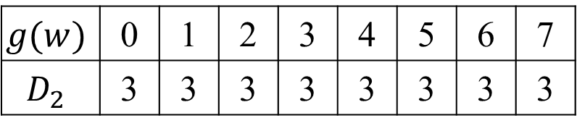

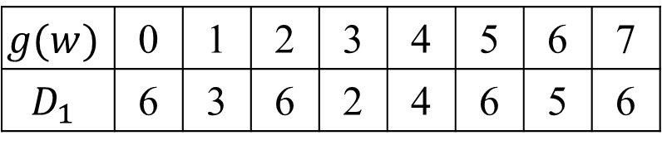





Preprocessing (2/2)
$$i$$
0 | 1 | 2 | 3 | 4 | 5 | 6 | 7 | 8
3 | 1 | 4 | 11 | 8 | 6 | 14 | 16 | 7
0 | 1 | 1 | 0 | 0 | 1 | 1 | 0
$$P$$
$$P′$$
Shift Tables
$D_{1}$
$D_{2}$
$$D_{2}$$
$$D_{1}$$
$$g(w)$$ | 0 | 1 | 2 | 3 | 4 | 5 | 6 | 7
$$D_{1}$$ | 6 | 3 | 6 | 2 | 4 | 6 | 5 | 6
$$g(w)$$ | 0 | 1 | 2 | 3 | 4 | 5 | 6 | 7
$$D_{2}$$ | 3 | 3 | 3 | 3 | 3 | 3 | 3 | 3
Notes:
如果text有一段是001，但對應到的q-gram不是，那就要根據table移動
覺得公式怪怪的（應該要多扣1，因為index是從0開始

Slide 8
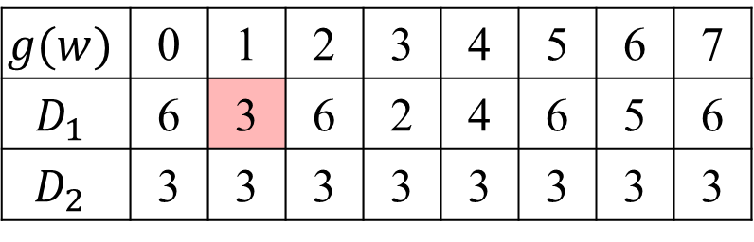




Searching (1/3)
$$g(w)$$ | 0 | 1 | 2 | 3 | 4 | 5 | 6 | 7
$$D_{1}$$ | 6 | 3 | 6 | 2 | 4 | 6 | 5 | 6
$$D_{2}$$ | 3 | 3 | 3 | 3 | 3 | 3 | 3 | 3
0 | 1 | 2 | 3 | 4 | 5 | 6 | 7 | 8 | 9 | 10 | 11 | 12 | 13 | 14
$$T$$
69 | 52 | 36 | 9 | 15 | 35 | 29 | 20 | 40 | 70 | 55 | 46 | 74 | 90 | 51
$$T′$$
0 | 0 | 0 | 1 | 1 | 0 | 0 | 1 | 1 | 0 | 0 | 1 | 1 | 0
$$P$$
3 | 1 | 4 | 11 | 8 | 6 | 14 | 16 | 7
$$P′$$
0 | 1 | 1 | 0 | 0 | 1 | 1 | 0

Slide 9
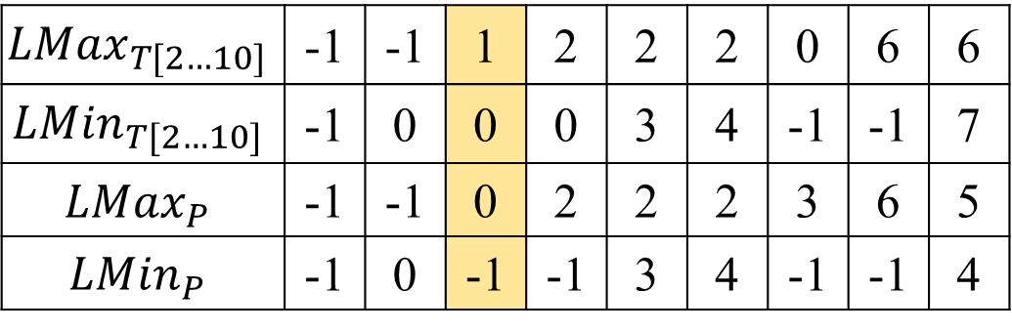
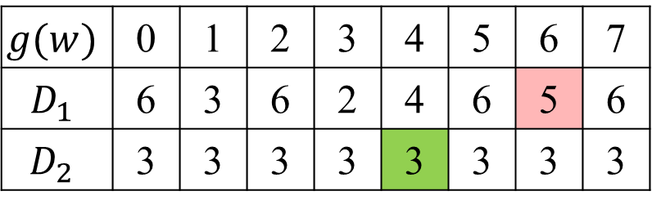
Searching (2/3)
$$g(w)$$ | 0 | 1 | 2 | 3 | 4 | 5 | 6 | 7
$$D_{1}$$ | 6 | 3 | 6 | 2 | 4 | 6 | 5 | 6
$$D_{2}$$ | 3 | 3 | 3 | 3 | 3 | 3 | 3 | 3
0 | 1 | 2 | 3 | 4 | 5 | 6 | 7 | 8 | 9 | 10 | 11 | 12 | 13 | 14
$$T$$
69 | 52 | 36 | 9 | 15 | 35 | 29 | 20 | 40 | 70 | 55 | 46 | 74 | 90 | 51
$$T′$$
0 | 0 | 0 | 1 | 1 | 0 | 0 | 1 | 1 | 0 | 0 | 1 | 1 | 0
$$P$$
3 | 1 | 4 | 11 | 8 | 6 | 14 | 16 | 7
$$P′$$
0 | 1 | 1 | 0 | 0 | 1 | 1 | 0
$${LMax}_{T[2…10]}$$ | -1 | -1 | 1 | 2 | 2 | 2 | 0 | 6 | 6
$${LMin}_{T[2…10]}$$ | -1 | 0 | 0 | 0 | 3 | 4 | -1 | -1 | 7
$${LMax}_{P}$$ | -1 | -1 | 0 | 2 | 2 | 2 | 3 | 6 | 5
$${LMin}_{P}$$ | -1 | 0 | -1 | -1 | 3 | 4 | -1 | -1 | 4

Slide 10
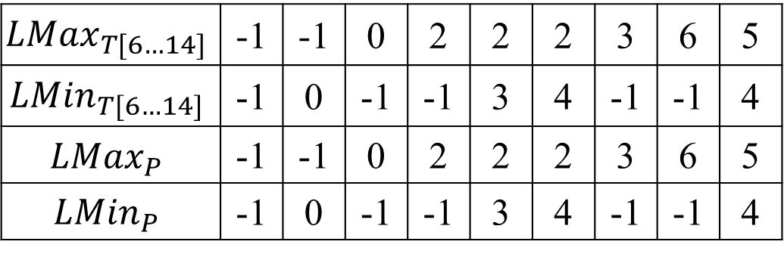
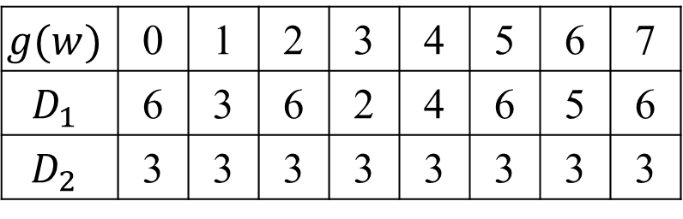
Searching (3/3)
$$g(w)$$ | 0 | 1 | 2 | 3 | 4 | 5 | 6 | 7
$$D_{1}$$ | 6 | 3 | 6 | 2 | 4 | 6 | 5 | 6
$$D_{2}$$ | 3 | 3 | 3 | 3 | 3 | 3 | 3 | 3
0 | 1 | 2 | 3 | 4 | 5 | 6 | 7 | 8 | 9 | 10 | 11 | 12 | 13 | 14
$$T$$
69 | 52 | 36 | 9 | 15 | 35 | 29 | 20 | 40 | 70 | 55 | 46 | 74 | 90 | 51
$$T′$$
0 | 0 | 0 | 1 | 1 | 0 | 0 | 1 | 1 | 0 | 0 | 1 | 1 | 0
$$P$$
3 | 1 | 4 | 11 | 8 | 6 | 14 | 16 | 7
$$P′$$
0 | 1 | 1 | 0 | 0 | 1 | 1 | 0
$${LMax}_{T[6…14]}$$ | -1 | -1 | 0 | 2 | 2 | 2 | 3 | 6 | 5
$${LMin}_{T[6…14]}$$ | -1 | 0 | -1 | -1 | 3 | 4 | -1 | -1 | 4
$${LMax}_{P}$$ | -1 | -1 | 0 | 2 | 2 | 2 | 3 | 6 | 5
$${LMin}_{P}$$ | -1 | 0 | -1 | -1 | 3 | 4 | -1 | -1 | 4

Slide 11
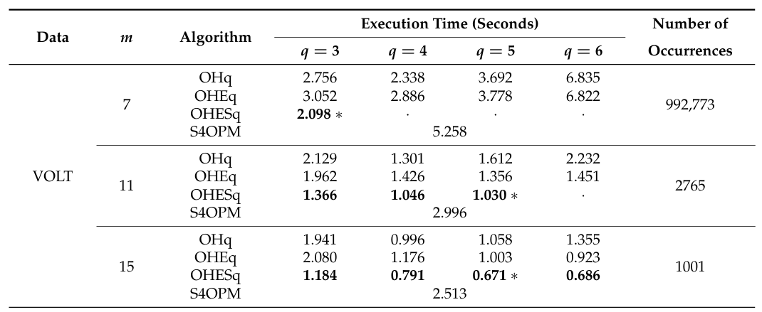
Experimental Results (1/4)
Notes:
功耗指數
第一個演算法：一個q-gram，但是用$μ$去做，看他們的rank
第二個演算法：一個q-gram
第四個演算法：SBNDM4

Slide 12
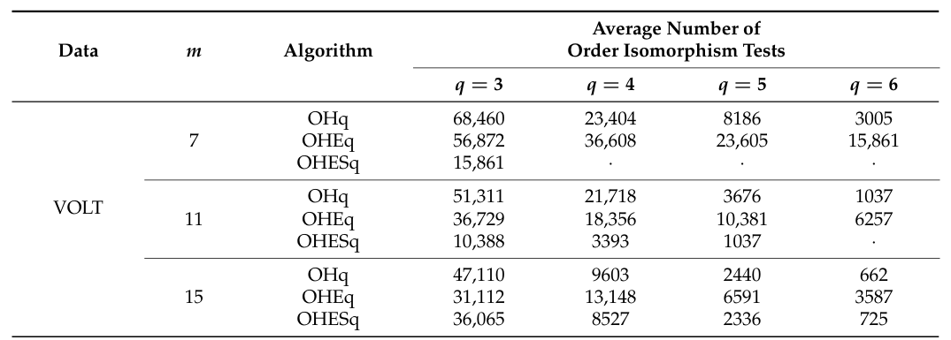
Experimental Results (2/4)

Slide 13
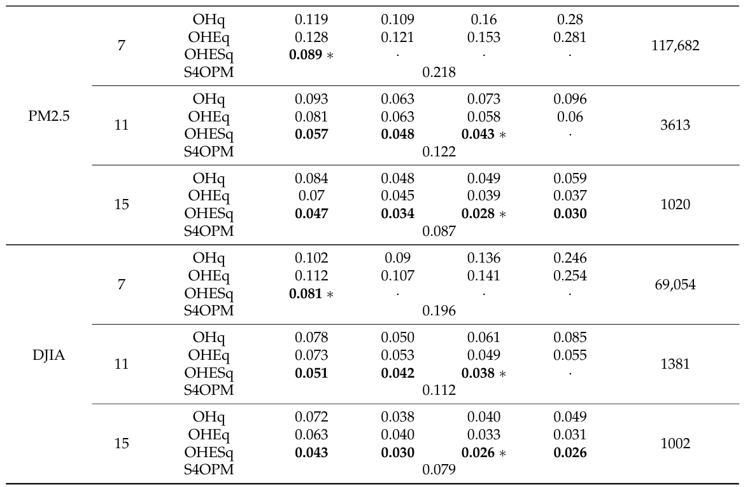
Experimental Results (3/4)

Slide 14
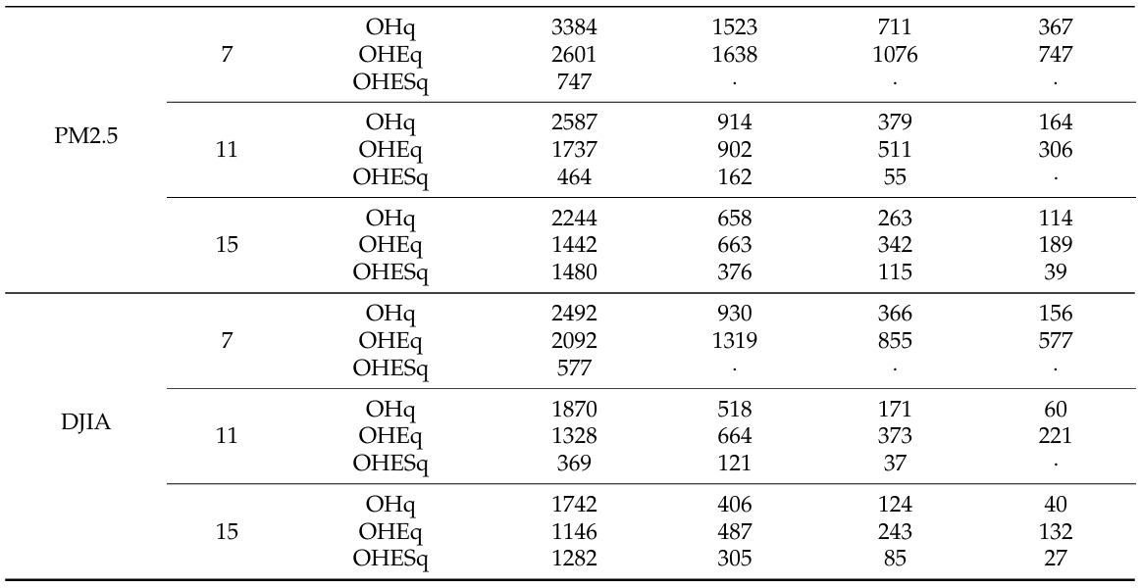
Experimental Results (4/4)

Slide 15
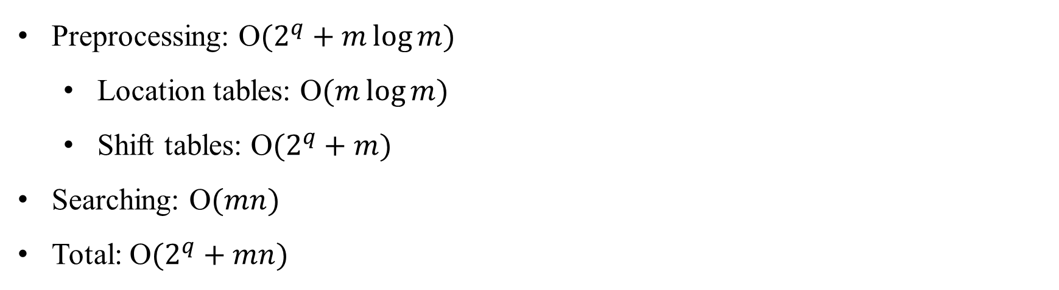
Time Complexity
Preprocessing: O$(2^{q}+m\log{m})$
Location tables: O$(m\log{m})$
Shift tables: O$(2^{q}+m)$
Searching: O$(mn)$
Total: O$(2^{q}+mn)$

