Slide 1
A novel technique to prevent SQL injection and cross-site scripting attacks using Knuth-Morris-Pratt string match algorithm
Abikoye, Oluwakemi Christiana, et al.
EURASIP Journal on Information Security 2020 (2020): 1-14.
Presenter: Shih-Hong Lee
Date: July 23, 2024

Slide 2
Abstract(1/2)
Structured Query Language (SQL) injection and cross-site scripting remain a major threat to data-driven web applications. Instances where hackers obtain unrestricted access to back-end database of web applications so as to steal, edit, and destroy confidential data are increasing. Therefore, measures must be put in place to curtail the growing threats of SQL injection and XSS attacks. This study presents a technique for detecting and preventing these threats using Knuth-Morris-Pratt (KMP) string matching algorithm. The algorithm was used to match user’s input string with the stored pattern of the injection string in order to detect any malicious code. The implementation was carried out using PHP scripting language and Apache XAMPP Server. The security level of the technique was measured using different test cases of SQL injection, cross-site scripting (XSS), and encoded injection attacks.

Slide 3
Abstract(2/2)
Results obtained revealed that the proposed technique was able to successfully detect and prevent the attacks, log the attack entry in the database, block the system using its mac address, and also generate a warning message. Therefore, the proposed technique proved to be more effective in detecting and preventing SQL injection and XSS attacks.

Slide 4
SQL injection
Boolean-based SQL injection or tautology attack
Union-based SQL injection
Error-based SQL injection
Batch query SQL injection/piggy backing attacks
Like-based SQL injection
Hexadecimal/decimal/binary variation attack (encoded injection)

Slide 5
Boolean-based SQL injection or tautology attack
Select * FROM user
WHERE username = ‘user’
AND password = ‘pass’
Select * FROM user
WHERE username = ‘user’
AND password = ‘123’ or ‘1’ = ‘1’
If pass = 123’ or ‘1’ = ‘1

Slide 6
Union-based SQL injection
SELECT username, email
FROM users WHERE id = '1'
UNION SELECT username, password
FROM users
SELECT username, email
FROM users
WHERE id = 'id'
If id = 1' UNION SELECT username, password FROM users --
Notes:
攻擊者需要了解數據庫結構，然後構造一個 UNION 查詢來檢索所需的數據。

Slide 7
Error-based SQL injection
SELECT username, email
FROM users WHERE id=1
SELECT username, email
FROM users WHERE id=1 AND 1=
If id = 1 AND 1=
Notes:
攻擊者注入惡意 SQL 語句，故意引發錯誤，然後分析錯誤消息中包含的數據庫內容

Slide 8
Batch query SQL injection/piggy backing attacks
SELECT username, email
FROM users WHERE id=1
SELECT username, email
FROM users WHERE id=1 ;DROP TABLE users;
If id = 1 ;DROP TABLE users;
Notes:
攻擊者注入多個查詢，其中一個查詢是合法的，其餘的則是惡意的

Slide 9
Like-based SQL injection
SELECT username, email
FROM users
WHERE username LIKE '%name%'
SELECT username, email
FROM users
WHERE username LIKE '%%' OR '1'='1%'
If name = %' OR '1'='1
Notes:
假設有一個簡單的網頁，允許用戶通過輸入部分用戶名來查詢用戶信息，對應的 SQL 查詢如下

Slide 10
Hexadecimal/decimal/binary variation attack (encoded injection)
SELECT * FROM users WHERE
username=CHAR(0x61646d696e)
‘admin’₁₆ = 61646d696e
Notes:
通過將惡意 SQL 片段轉換為不同的編碼形式，攻擊者可以繞過簡單的字符串過濾器。

Slide 11
Cross-site scripting (XSS)
Reflected XSS
Stored XSS
DOM-based XSS

Slide 12
Reflected XSS
http://example.com/search?q=<script>alert('XSS')</script>
<html>
<body>
<h1>Search results for: <script>alert('XSS')</script></h1>
<!-- ... -->
</body>
</html>
Notes:
射型 XSS 攻擊發生在惡意腳本作為 HTTP 請求的一部分被注入到目標網站的響應中。例如，攻擊者在 URL 中嵌入惡意腳本，當受害者點擊該 URL 時，惡意腳本隨著網站的響應被返回並在受害者的瀏覽器中執行。

Slide 13
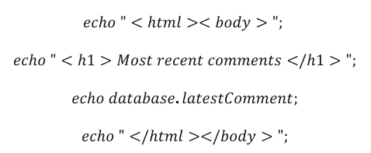
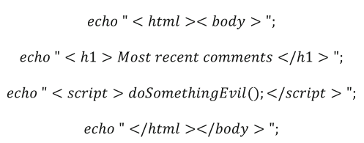
Stored XSS
Notes:
留言板的評論

Slide 14
DOM-based XSS
http://example.com/page?input=<script>alert('XSS')</script>
<!DOCTYPE html>
<html>
<head>
<title>DOM-based XSS Example</title>
</head>
<body>
<div id="output"></div>
<script>
var input = location.search.substring(7);
document.getElementById("output").innerHTML = input;
</script>
</body>
</html>
Notes:
location.search 的值將是 ?input=<script>alert('XSS')</script>，substring(7) 將提取 "<script>alert('XSS')</script>"，並將其直接插入到 div#output 中。這樣，惡意腳本就會在受害者的瀏覽器中執行，彈出一個提示框顯示 XSS。
Document Object Model

Slide 15
string match algorithm
Given a text t = abba
The pattern k = bb
brute force method : O(mn)

Slide 16
Knuth Morris Pratt string match algorithm
i
j
Given a text t = abxabcabcaby
The pattern k = abcaby
a | b | c | a | b | y
0 | 1 | 2 | 3 | 4 | 5
0 | 0 | 0 | 1
i
j
i
j
a | b | c | a | b | y
0 | 1 | 2 | 3 | 4 | 5
0 | 0
a | b | c | a | b | y
0 | 1 | 2 | 3 | 4 | 5
0 | 0 | 0 | 1 | 2
i
j
i
j
a | b | c | a | b | y
0 | 1 | 2 | 3 | 4 | 5
0 | 0 | 0
a | b | c | a | b | y
0 | 1 | 2 | 3 | 4 | 5
0 | 0 | 0 | 1 | 2 | 0

Slide 17
Knuth Morris Pratt string match algorithm
text
a | b | x | a | b | c | a | b | c | a | b | y
a | b | c | a | b | y
0 | 1 | 2 | 3 | 4 | 5
0 | 0 | 0 | 1 | 2 | 0
pattern

Slide 18
Knuth Morris Pratt string match algorithm
text
a | b | x | a | b | c | a | b | c | a | b | y
a | b | c | a | b | y
0 | 1 | 2 | 3 | 4 | 5
0 | 0 | 0 | 1 | 2 | 0
pattern

Slide 19
Knuth Morris Pratt string match algorithm
text
a | b | x | a | b | c | a | b | c | a | b | y
a | b | c | a | b | y
0 | 1 | 2 | 3 | 4 | 5
0 | 0 | 0 | 1 | 2 | 0
pattern

Slide 20
Knuth Morris Pratt string match algorithm
text
a | b | x | a | b | c | a | b | c | a | b | y
a | b | c | a | b | y
0 | 1 | 2 | 3 | 4 | 5
0 | 0 | 0 | 1 | 2 | 0
pattern

Slide 21
Knuth Morris Pratt string match algorithm
text
a | b | x | a | b | c | a | b | c | a | b | y
a | b | c | a | b | y
0 | 1 | 2 | 3 | 4 | 5
0 | 0 | 0 | 1 | 2 | 0
pattern
Time complexity : O(m+n)

Slide 22
The proposed detection and prevention technique
Formation of SQL injection string patterns
Designing parse tree for the various forms of attacks
Detecting SQL injection and XSS attacks
Preventing SQL-injection and XSS attacks using KMP algorithm
Formulating the filter functions

Slide 23
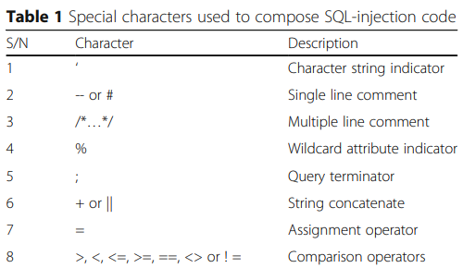
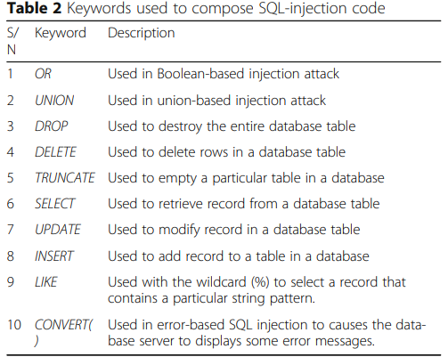
Formation of SQL injection string patterns

Slide 24
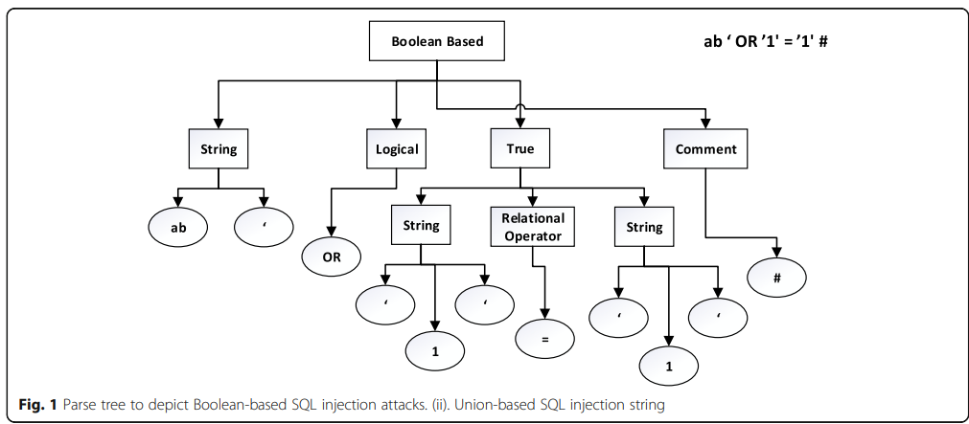
Designing parse tree for the various forms of attacks and Detecting SQL injection and XSS attacks
Notes:
將用戶輸入的字符串解析成語法樹，即解析樹（parse tree）。解析樹是表示輸入字符串的語法結構的樹狀數據結構。

Slide 25
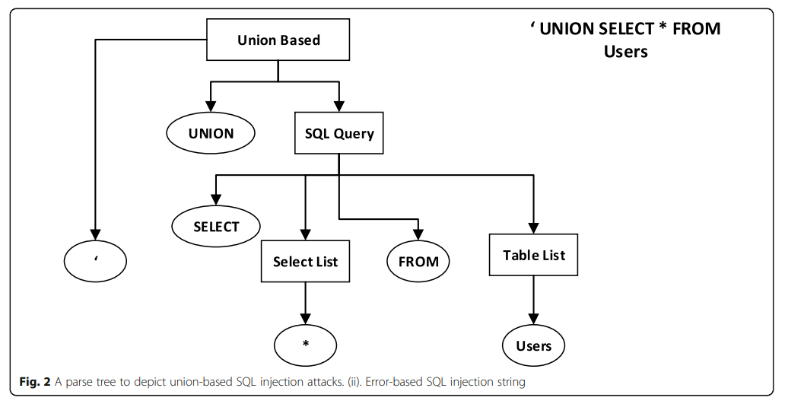
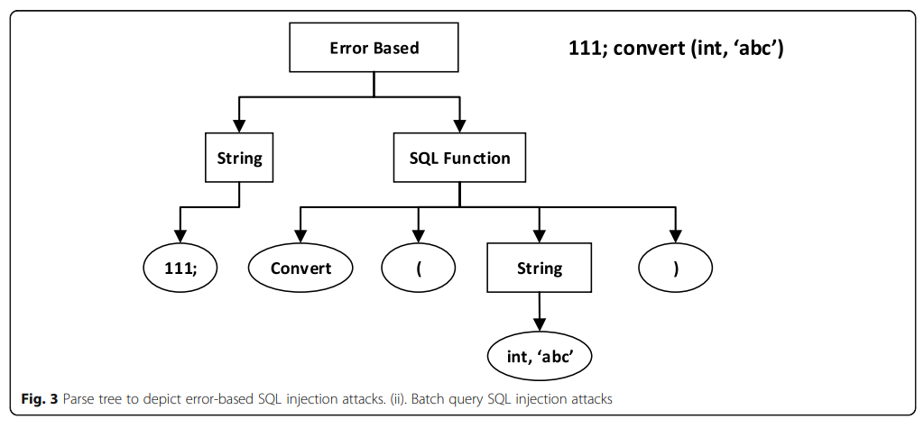
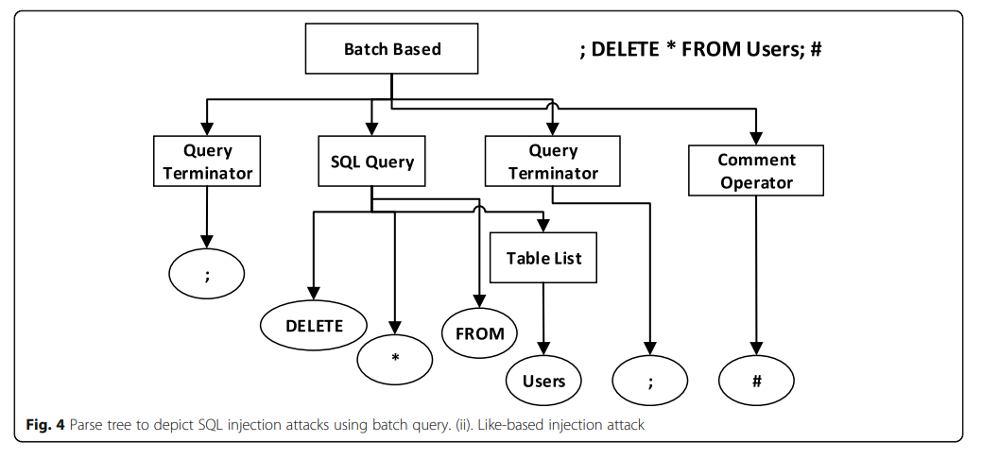
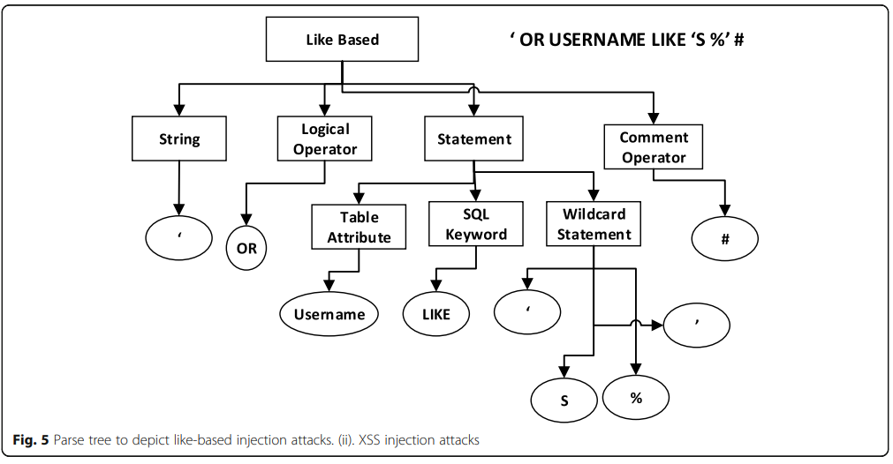
Notes:
將用戶輸入的字符串解析成語法樹，即解析樹（parse tree）。解析樹是表示輸入字符串的語法結構的樹狀數據結構。

Slide 26
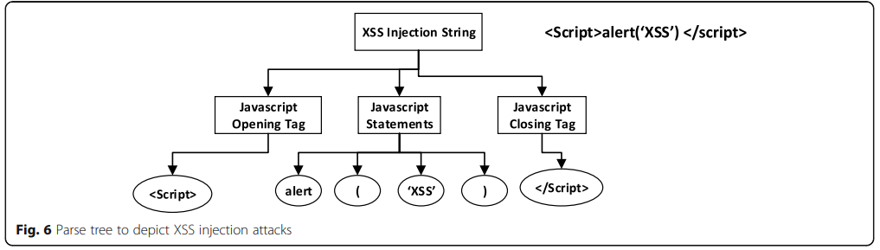

Slide 27
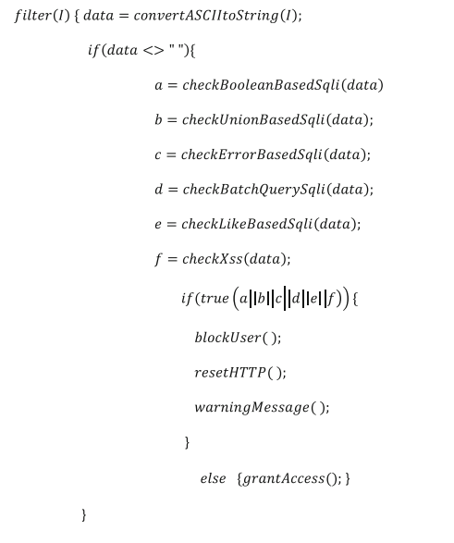
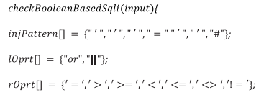
Preventing SQL-injection and XSS attacks using KMP algorithm

Slide 28
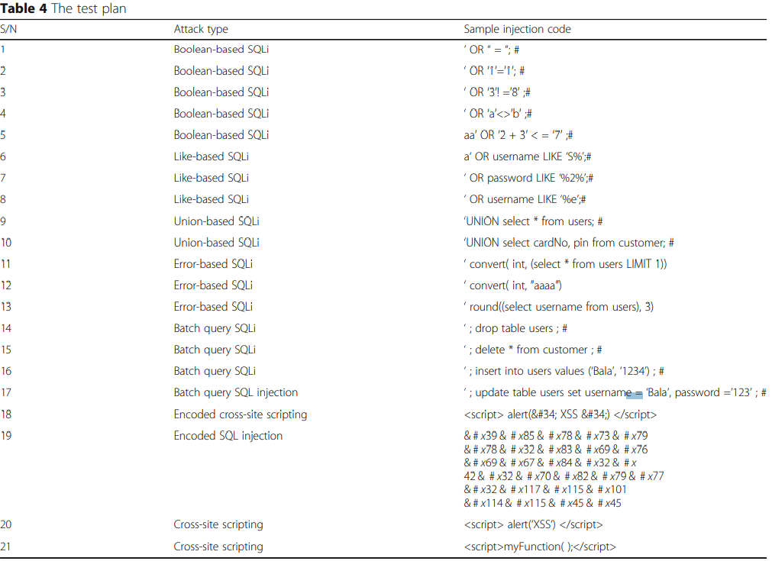
Results
Test environment :
PHP Scripting Language and Apache XAMPP Server

Slide 29
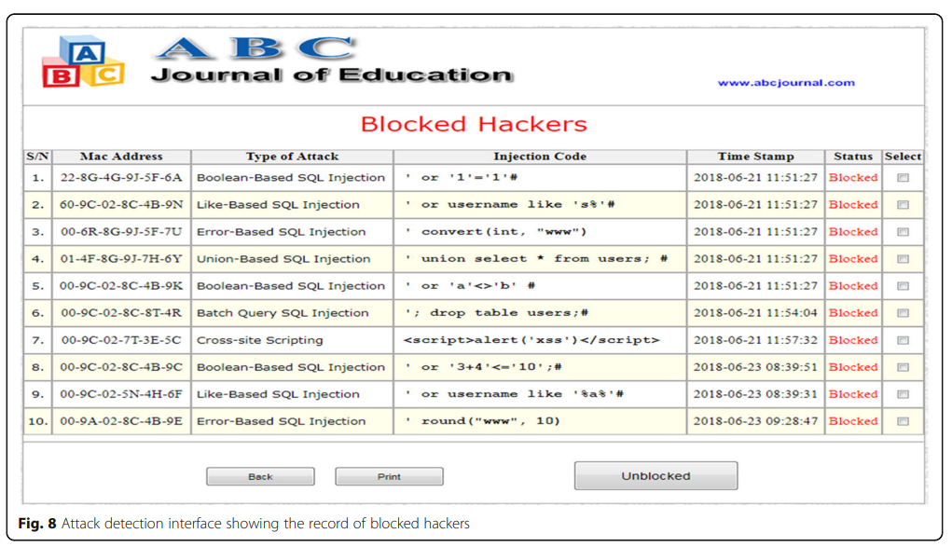
Results

Slide 30
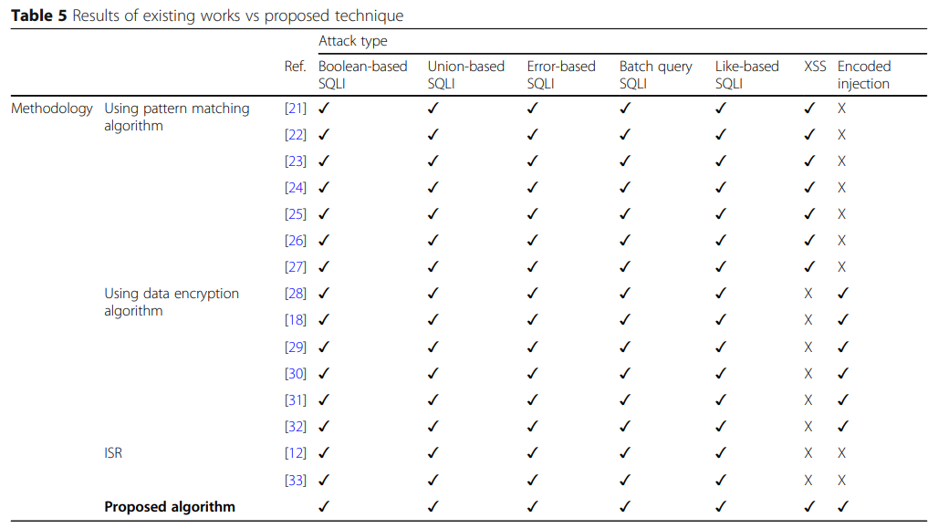

Slide 31
Thanks

