Slide 1
A linear-time algorithm for a special case of disjoint set union
Harold N. Gabow, Robert Endre Targan
Journal of Computer and System Sciences, Vol. 30, no. 2, pp. 209-221, 1985
Presenter: Yen-Yu Chen
Date: July.30, 2024

Slide 2
Abstract(1/3)
This paper presents a linear-time algorithm for the special case of the disjoint set union problem in which the structure of the unions (defined by a "union tree") is known in advance. The algorithm executes an intermixed sequence of m union and find operations on n elements in O(m+n) time and O(n) space. This is a slight but theoretically significant improvement over the fastest known algorithm for the general problem, which runs in O(mα(m+n, n)+n) time and O(n) space, where a is a functional inverse of Ackermann's function.

Slide 3
Abstract(2/3)
Used as a subroutine, the algorithm gives similar improvements in the efficiency of algorithms for solving several other problems, including two-processor scheduling, matching on convex graphs, finding nearest common ancestors off-line, testing a flow graph for reducibility, and finding two disjoint directed spanning trees.

Slide 4
Abstract(3/3)
The algorithm obtains its efficiency by combining the fast algorithm for the general problem with table look-up on small sets, and requires a random access machine for its implementation. The algorithm extends to the case in which single-node additions to the union tree are allowed. The extended algorithm is useful in finding maximum cardinality matchings in nonbipartite graphs.

Slide 5
Operation of Disjoint Set(1/3)
makeset(x)
find(x)
unite(x,y)
x
{x}

Slide 6
Operation of Disjoint Set(2/3)
makeset(x)
find(x)
unite(x,y)
a
{a, k, x, z}

Slide 7
Operation of Disjoint Set(3/3)
a
b
makeset(x)
find(x)
unite(x,y)
{a, k, x, z}
{b, p, y}
a
{a, b, k, p, x, y, z}

Slide 8
Complexity
Time: O(ma(m +n, n) + n) , lower bound
Space: O(n)

Slide 9
Online vs Offline
Category Step | Online |  | Offline
 | Time | Correctness | Time | Correctness
Union | 100 | T | 1 | F
Union | 100 | T | 1 | F
Union | 100 | T | 1 | F
Union | 100 | T | 1 | F
Find | 100 | T | 150 | T
Total | 500 |  | 159

Slide 10
Static tree set union
find(x)
link(x): unite(p(x), x)
p(a)
p(d)
a
p(c)
d
c
Notes:
只會跟 parent 做 union

Slide 11
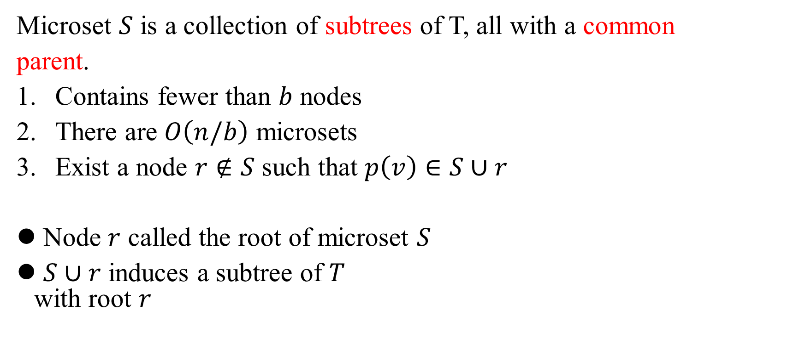
Microset
Microset $S$ is a collection of subtrees of T, all with a common
parent.
Contains fewer than $b$ nodes
There are $O\left(n/b\right)$ microsets
Exist a node $r∉S$ such that $p\left(v\right)∈S∪r$
Node $r$ called the root of microset $S$
$S∪r$ induces a subtree of $T$ with root $r$

Slide 12
Microset (Illustration)
root of microset
microset
a
b
c
d
e
f
g
h
i
j
k

Slide 13
Mark
Mark the nodes that are set names (representation) (all nodes) initially.
A marked node means that it is still a representation.

Slide 14
Mark (Initial) (Illustration)
a
b
c
d
e
f
g
h
i
j
k

Slide 15
Link
link(x): unite(p(x), x)
TODO: dis-mark(x)

Slide 16
Link (1/5)
link(h): dis-mark(h)
a
b
c
d
e
f
g
h
i
j
k

Slide 17
Link (2/5)
link(k): dis-mark(k)
a
b
c
d
e
f
g
h
i
j
k

Slide 18
Link (3/5)
link(d): dis-mark(d)
a
b
c
d
e
f
g
h
i
j
k

Slide 19
Link (4/5)
link(f): dis-mark(f)
a
b
c
d
e
f
g
h
i
j
k

Slide 20
Link (5/5)
link(b): dis-mark(b)
a
b
c
d
e
f
g
h
i
j
k

Slide 21
Meaning of Marked Node
A marked node means that it is the representation of a set
a
b
c
d
e
f
g
h
i
j
k
Notes:
Microset 只是輔助，當我們把microset 去掉，並將實際的 set 顯示，就可以發現每個 set 都只有一個

Slide 22
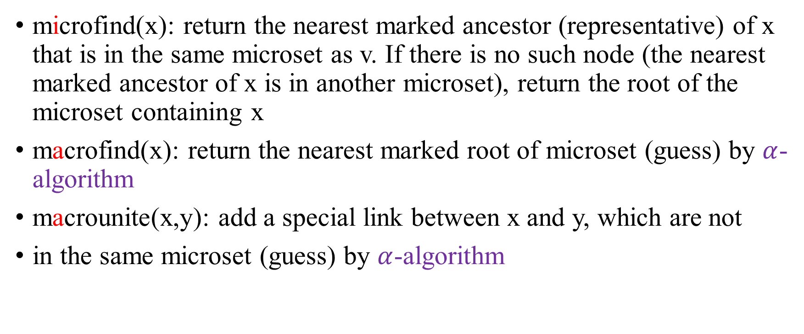
Microfind & Macrofind
microfind(x): return the nearest marked ancestor (representative) of x that is in the same microset as v. If there is no such node (the nearest marked ancestor of x is in another microset), return the root of the microset containing x
macrofind(x): return the nearest marked root of microset (guess) by $α$-algorithm
macrounite(x,y): add a special link between x and y, which are not
in the same microset (guess) by $α$-algorithm

Slide 23

Find
Judgment criteria: micro(x)$≠$micro(microfind(x))
Find the first marked ancestor root by microfind
Find the next ancestor root by macrofind successively

Slide 24
Find(k)
microfind
macrofind
a
macrounite
b
c
d
e
f
g
h
i
j
k

Slide 25
Find(k) Again
microfind
macrofind
a
b
c
d
e
f
g
h
i
j
k

Slide 26
Find(h) Again
microfind
macrofind
a
b
c
d
e
f
g
h
i
j
k

Slide 27
Static Tree Information
root of microset
microset
(1,1)
a
1
(2,1)
b
(2,2)
c
2
(4,1)
d
4
e
(4,2)
f
(2,3)
(3,1)
g
h
(3,2)
(5,1)
i
j
(5,2)
5
(3,3)
k
3

Slide 28
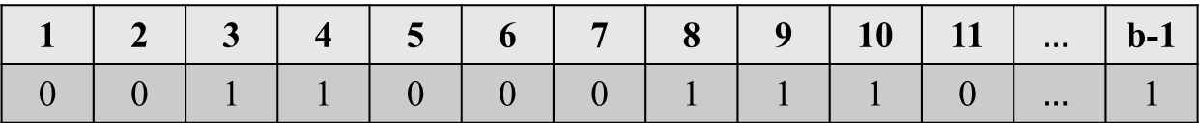
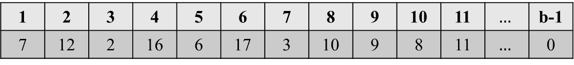
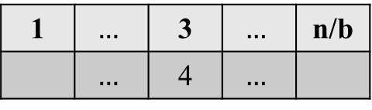
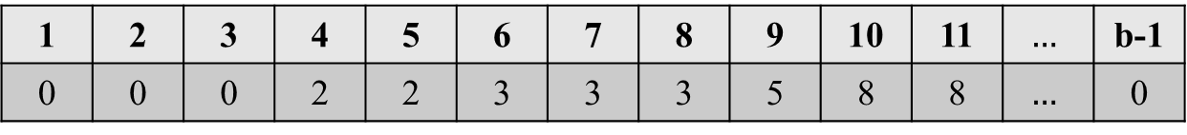
Tables
4
microset 3
7
12
2
node(3,*)
1 | 2 | 3 | 4 | 5 | 6 | 7 | 8 | 9 | 10 | 11 | $$…$$ | b-1
7 | 12 | 2 | 16 | 6 | 17 | 3 | 10 | 9 | 8 | 11 | $$…$$ | 0
16
6
17
3
10
mark(3,*)
word(integer)
9
8
11
1 | 2 | 3 | 4 | 5 | 6 | 7 | 8 | 9 | 10 | 11 | $$…$$ | b-1
0 | 0 | 1 | 1 | 0 | 0 | 0 | 1 | 1 | 1 | 0 | $$…$$ | 1
parent(3,*)
word(integer)
1 | 2 | 3 | 4 | 5 | 6 | 7 | 8 | 9 | 10 | 11 | $$…$$ | b-1
0 | 0 | 0 | 2 | 2 | 3 | 3 | 3 | 5 | 8 | 8 | $$…$$ | 0
root
1 | $$…$$ | 3 | $$…$$ | n/b
 | $$…$$ | 4 | $$…$$

Slide 29
Parent Table
microset 3
parent(3,*)
word(integer)
1 | 2 | 3 | 4 | 5 | 6 | 7 | 8 | 9 | 10 | 11 | $$…$$ | b-1
0 | 0 | 0 | 2 | 2 | 3 | 3 | 3 | 5 | 8 | 8 | $$…$$ | 0

Slide 30
Mark Table
microset 3
mark(3,*)
word(integer)
1 | 2 | 3 | 4 | 5 | 6 | 7 | 8 | 9 | 10 | 11 | $$…$$ | b-1
0 | 0 | 1 | 1 | 0 | 0 | 0 | 1 | 1 | 1 | 0 | $$…$$ | 1

Slide 31
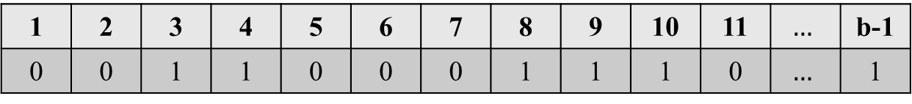

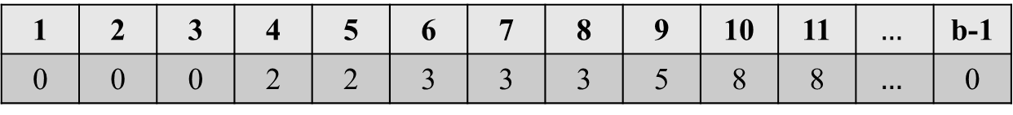
Table Representation
mark: from $1$ to $b−1$, $\{0,1\}$. $2^{b−1}$
parent: from $1$ to $b−1$, content $<b$, encode to $0\sim \left\lceil \log{b}\right\rceil −1$. $2^{\left(b−1\right)\left\lceil \log{b}\right\rceil −1}$
answer: sizeof(parent)*sizeof(mark)*(b-1)
mark
1 | 2 | 3 | 4 | 5 | 6 | 7 | 8 | 9 | 10 | 11 | $$…$$ | b-1
0 | 0 | 1 | 1 | 0 | 0 | 0 | 1 | 1 | 1 | 0 | $$…$$ | 1
parent
1 | 2 | 3 | 4 | 5 | 6 | 7 | 8 | 9 | 10 | 11 | $$…$$ | b-1
0 | 0 | 0 | 2 | 2 | 3 | 3 | 3 | 5 | 8 | 8 | $$…$$ | 0

Slide 32
Microfind(16)
4
microset 3
7
12
2
node(3,*)
1 | 2 | 3 | 4 | 5 | 6 | 7 | 8 | 9 | 10 | 11 | $$…$$ | b-1
7 | 12 | 2 | 16 | 6 | 17 | 3 | 10 | 9 | 8 | 11 | $$…$$ | 0
16
6
17
3
10
mark(3,*)
word(integer)
93
9
8
11
1 | 2 | 3 | 4 | 5 | 6 | 7 | 8 | 9 | 10 | 11 | $$…$$ | b-1
0 | 0 | 1 | 1 | 0 | 0 | 0 | 1 | 1 | 1 | 0 | $$…$$ | 1
node(3,4)
parent(3,*)
word(integer)
256
1 | 2 | 3 | 4 | 5 | 6 | 7 | 8 | 9 | 10 | 11 | $$…$$ | b-1
0 | 0 | 0 | 2 | 2 | 3 | 3 | 3 | 5 | 8 | 8 | $$…$$ | 0
root
1 | $$…$$ | 3 | $$…$$ | n/b
 | $$…$$ | 4 | $$…$$
answer(256,93,4)
2>0

Slide 33
Microfind(10)
4
microset 3
7
12
2
node(3,*)
1 | 2 | 3 | 4 | 5 | 6 | 7 | 8 | 9 | 10 | 11 | $$…$$ | b-1
7 | 12 | 2 | 16 | 6 | 17 | 3 | 10 | 9 | 8 | 11 | $$…$$ | 0
16
6
17
3
10
mark(3,*)
word(integer)
93
9
8
11
1 | 2 | 3 | 4 | 5 | 6 | 7 | 8 | 9 | 10 | 11 | $$…$$ | b-1
0 | 0 | 1 | 1 | 0 | 0 | 0 | 1 | 1 | 1 | 0 | $$…$$ | 1
node(3,8)
parent(3,*)
word(integer)
256
1 | 2 | 3 | 4 | 5 | 6 | 7 | 8 | 9 | 10 | 11 | $$…$$ | b-1
0 | 0 | 0 | 2 | 2 | 3 | 3 | 3 | 5 | 8 | 8 | $$…$$ | 0
root
1 | $$…$$ | 3 | $$…$$ | n/b
 | $$…$$ | 4 | $$…$$
answer(256,93,8)
0

Slide 34

Time Complexity
If set $\left(b−1\right)\left\lceil \log{b}\right\rceil ≤sizeof(word)$, microfind can finish in $O(1)$
macrofind, macrounite finish in $O(α−algorithm)$
$m$ union and a find in $n$ element static tree use $O(m+n)$

