Slide 1
Algorithms for jumbled pattern matching in strings
P´eter Burcsi, Ferdinando Cicalese, Gabriele Fici , and Zsuzsanna Lipt´ak
International Journal of Foundations of Computer Science 23.02 (2012): 357-374.
Presenter: Shih-Hong Lee
Date: July 30, 2024

Slide 2
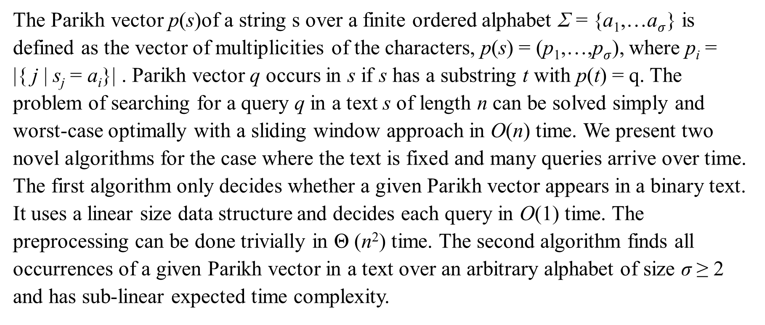
Abstract(1/2)
The Parikh vector p(s)of a string s over a finite ordered alphabet Σ = {a₁,…a$σ$} is defined as the vector of multiplicities of the characters, p(s) = (p₁,…,p$σ$), where p_{i} = |{ j | s_{j} = a_{i}}| . Parikh vector q occurs in s if s has a substring t with p(t) = q. The problem of searching for a query q in a text s of length n can be solved simply and worst-case optimally with a sliding window approach in O(n) time. We present two novel algorithms for the case where the text is fixed and many queries arrive over time. The first algorithm only decides whether a given Parikh vector appears in a binary text. It uses a linear size data structure and decides each query in O(1) time. The preprocessing can be done trivially in Θ (n²) time. The second algorithm finds all occurrences of a given Parikh vector in a text over an arbitrary alphabet of size σ ≥ 2 and has sub-linear expected time complexity.

Slide 3
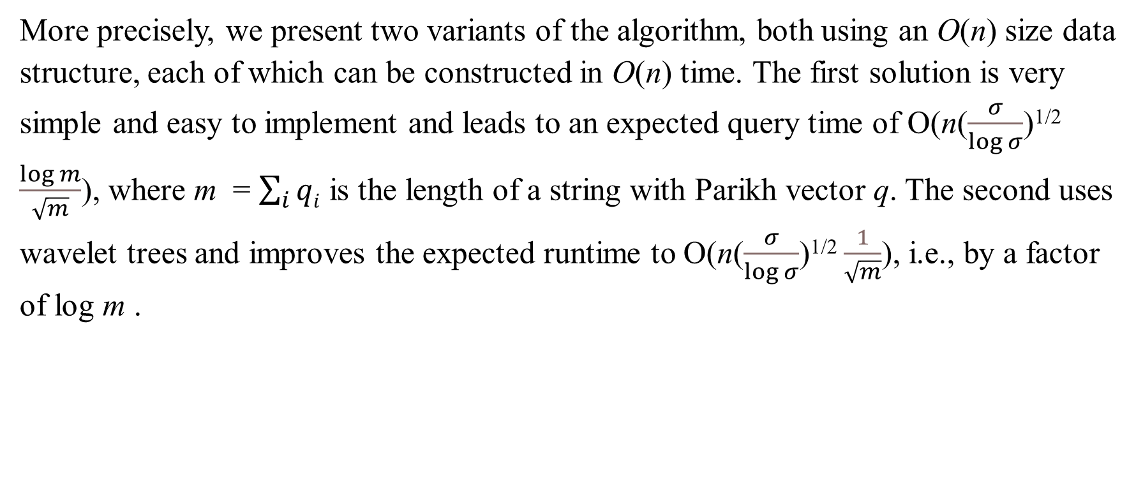
Abstract(2/2)
More precisely, we present two variants of the algorithm, both using an O(n) size data structure, each of which can be constructed in O(n) time. The first solution is very simple and easy to implement and leads to an expected query time of O(n($\frac{σ}{\log{σ}}$)^{1/2} $\frac{\log{m}}{\sqrt{m}}$), where m = $\sum_{i}{qi}$ is the length of a string with Parikh vector q. The second uses wavelet trees and improves the expected runtime to O(n($\frac{σ}{\log{σ}}$)^{1/2} $\frac{1}{\sqrt{m}}$), i.e., by a factor of log m .

Slide 4
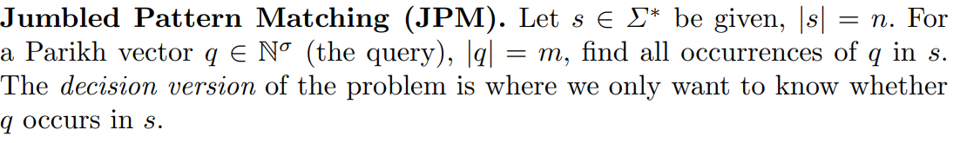
Jumbled pattern matching

Slide 5
The Parikh vector
Given a text t : abbcaaabcb
p(t) = (4,4,2)
A query q = (2,0,0)
t has a substring s with p(s) = q = (2,0,0)
Substring s : aa
Use sliding window based algorithm : O(n)
But with K queries cost O(Kn), and so as exact pattern matching algorithm cost O(K(m+n))
For each queries generated own preprocess data structure

Slide 6
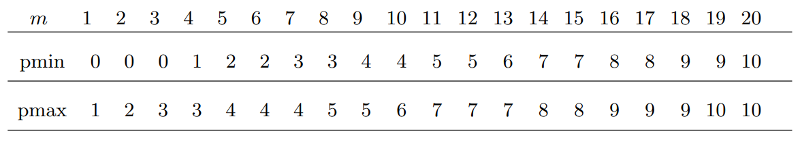

Decision problem in the binary case
Given a string s = ababbaabaabbbaaabbab, |s| = 20
Processing step : $θ\left(n2\right)$
Query time : O(1)

Slide 7
e.g.
Given a string s = ababbaabaabbbaaabbab, |s| = 20
yes if and only if x ∈ [pmin(x + y), pmax(x + y)].
Query q = (3,3)
pmin(3+3) < 3 < pmax(3+3) -> yes

Slide 8
e.g.
Given a string s = ababbaabaabbbaaabbab, |s| = 20
yes if and only if x ∈ [pmin(x + y), pmax(x + y)].
Query q = (4,0)
pmin(4+0) < 4 < pmax(4+0) -> no

Slide 9
The Jumping Algorithm
prv(i) denotes the Parikh vector of the prefix of s of length i
e.g. Given a string s : ababcababc,|s| = 10
i | s[0…i] | prv(i)
0 |  | [0,0,0]
1 | a | [1,0,0]
2 | ab | [1,1,0]
3 | aba | [2,1,0]
4 | abab | [2,2,0]
5 | ababc | [2,2,1]
6 | ababca | [3,2,1]
7 | ababcab | [3,3,1]
8 | ababcaba | [4,3,1]
9 | ababcabab | [4,4,1]
10 | ababcababc | [4,4,2]

Slide 10
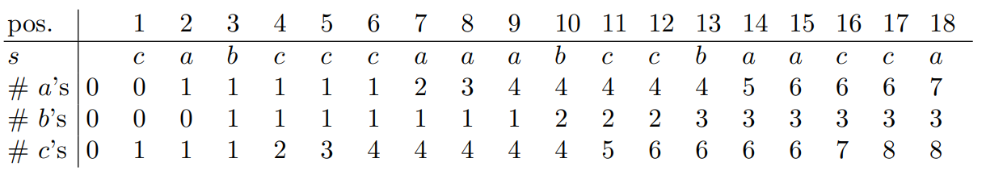
Let Σ = {a, b, c} and s = cabcccaaabccbaacca
Query q = (3,1,2)
L
R
index | 0 | 1 | 2 | 3 | 4 | 5 | 6 | 7 | 8 | 9 | 10 | 11 | 12 | 13 | 14 | 15 | 16 | 17 | 18
text |  | c | a | b | c | c | c | a | a | a | b | c | c | b | a | a | c | c | a

Slide 11
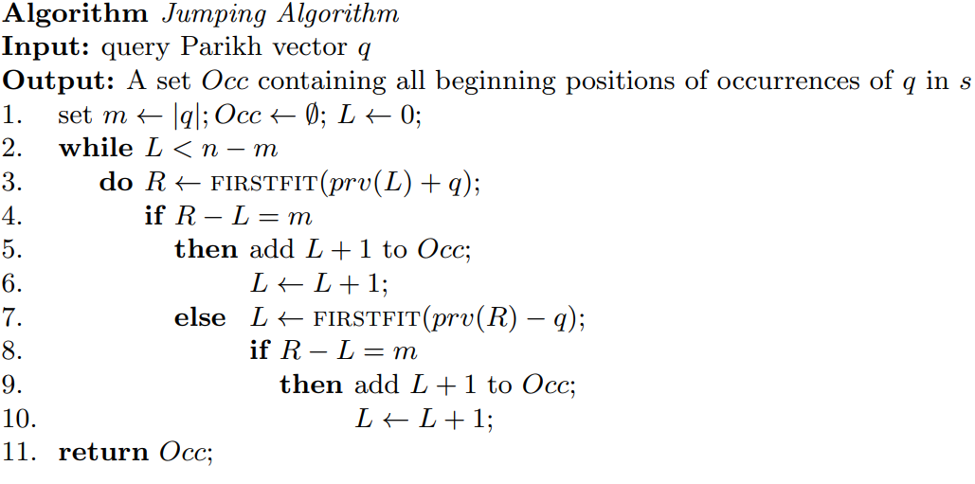


Slide 12

Let Σ = {a, b, c} and s = cabcccaaabccbaacca
Query q = (3,1,2)
R = firstfit((0,0,0)+(3,1,2)) = firstfit(3,1,2) = 8
(3,1,4)-(0,0,0) $≠(3,1,2)$
L = firstfit((3,1,4)-(3,1,2)) = firstfit(0,0,2) = 4
($3,1,4)−(1,1,2)≠(3,1,2)$
L
R
index | 0 | 1 | 2 | 3 | 4 | 5 | 6 | 7 | 8 | 9 | 10 | 11 | 12 | 13 | 14 | 15 | 16 | 17 | 18
text |  | c | a | b | c | c | c | a | a | a | b | c | c | b | a | a | c | c | a
L
R
index | 0 | 1 | 2 | 3 | 4 | 5 | 6 | 7 | 8 | 9 | 10 | 11 | 12 | 13 | 14 | 15 | 16 | 17 | 18
text |  | c | a | b | c | c | c | a | a | a | b | c | c | b | a | a | c | c | a

Slide 13
Let Σ = {a, b, c} and s = cabcccaaabccbaacca
Query q = (3,1,2)
R = firstfit((1,1,2)+(3,1,2)) = firstfit(4,2,4) = 10
(4,2,4) – (1,1,2) = (3,1,2) (occurance)
L =L+1
L
R
index | 0 | 1 | 2 | 3 | 4 | 5 | 6 | 7 | 8 | 9 | 10 | 11 | 12 | 13 | 14 | 15 | 16 | 17 | 18
text |  | c | a | b | c | c | c | a | a | a | b | c | c | b | a | a | c | c | a

Slide 14
Let Σ = {a, b, c} and s = cabcccaaabccbaacca
Query q = (3,1,2)
R = firstfit((1,1,3)+(3,1,2)) = firstfit(4,2,5) = 11
(4,2,5)-(1,1,3) =(3,1,2)(occurance)
L =L+1
L
R
index | 0 | 1 | 2 | 3 | 4 | 5 | 6 | 7 | 8 | 9 | 10 | 11 | 12 | 13 | 14 | 15 | 16 | 17 | 18
text |  | c | a | b | c | c | c | a | a | a | b | c | c | b | a | a | c | c | a

Slide 15
Let Σ = {a, b, c} and s = cabcccaaabccbaacca
Query q = (3,1,2)
R = firstfit((1,1,4)+(3,1,2)) = firstfit(4,2,6) = 12
(4,2,6) – (1,1,4) = (3,1,2) (occurance)
L =L+1
L
R
index | 0 | 1 | 2 | 3 | 4 | 5 | 6 | 7 | 8 | 9 | 10 | 11 | 12 | 13 | 14 | 15 | 16 | 17 | 18
text |  | c | a | b | c | c | c | a | a | a | b | c | c | b | a | a | c | c | a

Slide 16

Let Σ = {a, b, c} and s = cabcccaaabccbaacca
Query q = (3,1,2)
R = firstfit((2,1,4)+(3,1,2)) = firstfit(5,2,6) = 14
(5,3,6) – (2,1,4) $≠(3,1,2)$
L = firstfit((5,3,6)-(3,1,2)) = firstfit(2,2,4) = 10
($5,3,6)−(4,2,4)≠(3,1,2)$
L
R
index | 0 | 1 | 2 | 3 | 4 | 5 | 6 | 7 | 8 | 9 | 10 | 11 | 12 | 13 | 14 | 15 | 16 | 17 | 18
text |  | c | a | b | c | c | c | a | a | a | b | c | c | b | a | a | c | c | a
L
R
index | 0 | 1 | 2 | 3 | 4 | 5 | 6 | 7 | 8 | 9 | 10 | 11 | 12 | 13 | 14 | 15 | 16 | 17 | 18
text |  | c | a | b | c | c | c | a | a | a | b | c | c | b | a | a | c | c | a

Slide 17

Let Σ = {a, b, c} and s = cabcccaaabccbaacca
Query q = (3,1,2)
R = firstfit((4,2,4)+(3,1,2)) = firstfit(7,3,6) = 18
(7,3,8)-(4,2,4) $≠(3,1,2)$
L = firstfit((7,3,8)-(3,1,2)) = firstfit(4,2,6) = 12
(7,3,8)-(4,2,6)=(3,1,2) (occurance)
L
R
index | 0 | 1 | 2 | 3 | 4 | 5 | 6 | 7 | 8 | 9 | 10 | 11 | 12 | 13 | 14 | 15 | 16 | 17 | 18
text |  | c | a | b | c | c | c | a | a | a | b | c | c | b | a | a | c | c | a
L
R
index | 0 | 1 | 2 | 3 | 4 | 5 | 6 | 7 | 8 | 9 | 10 | 11 | 12 | 13 | 14 | 15 | 16 | 17 | 18
text |  | c | a | b | c | c | c | a | a | a | b | c | c | b | a | a | c | c | a

Slide 18
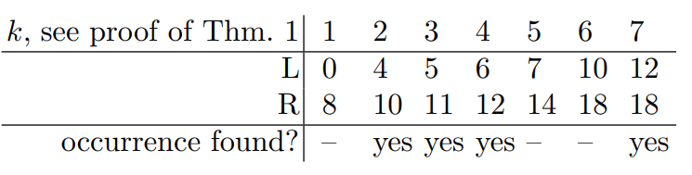

Slide 19
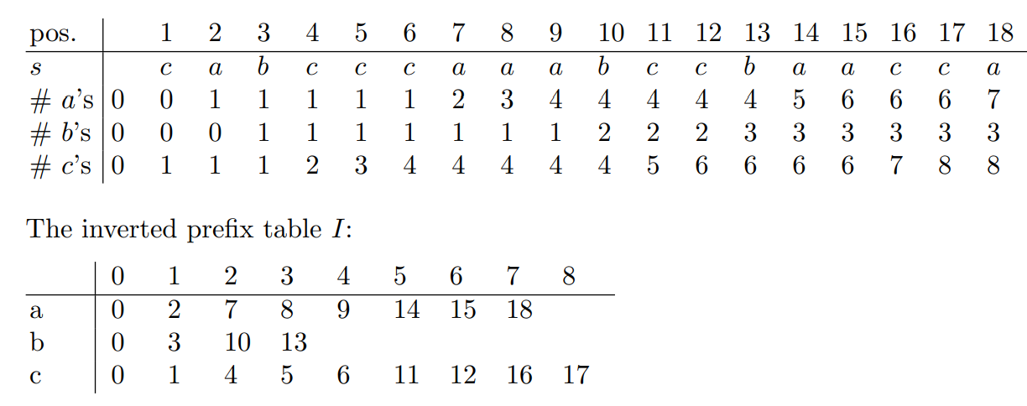
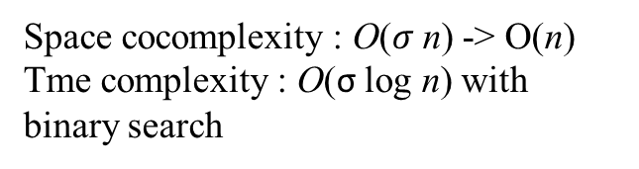
Space cocomplexity : O($σ$n) -> O(n)
Tme complexity : O(σ log n) with binary search

Slide 20
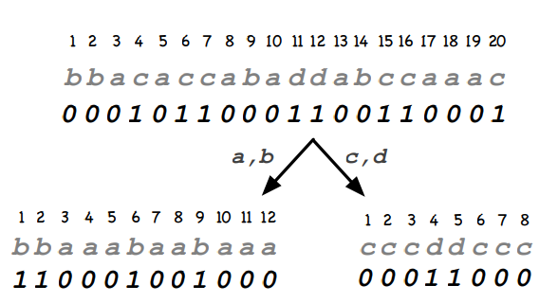
Variant using a wavelet tree
Using a wavelet tree to reduce search firstfit vector to O(σ log σ )
Let s = bbacaccabaddabccaaac . We demonstrate the computation of firstfit(2, 3, 2, 1)

Slide 21
firstfit(2, 3, 2, 1) = max{select_{a}(s, 2), select_{b}(s, 3), select_{c}(s, 2), select_{d}(s, 1)}
select₀(s_{ab}, 2), select₁(s_{ab}, 3) = max{4,6}=6
select₀(s_{cd}, 2), select₁(s_{cd}, 1) = max{2,4}=4
max{select₀(s_{abcd}, 6), select₁(s_{abcd}, 4)}
=max{9,11}=11

Slide 22
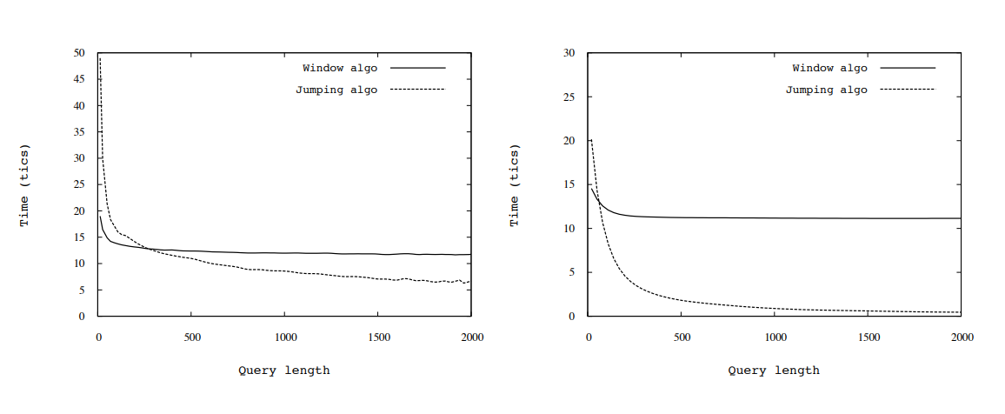
Simulations
Notes:
第一個是最糟糕的情況 第二個是隨機均勻抽樣

Slide 23
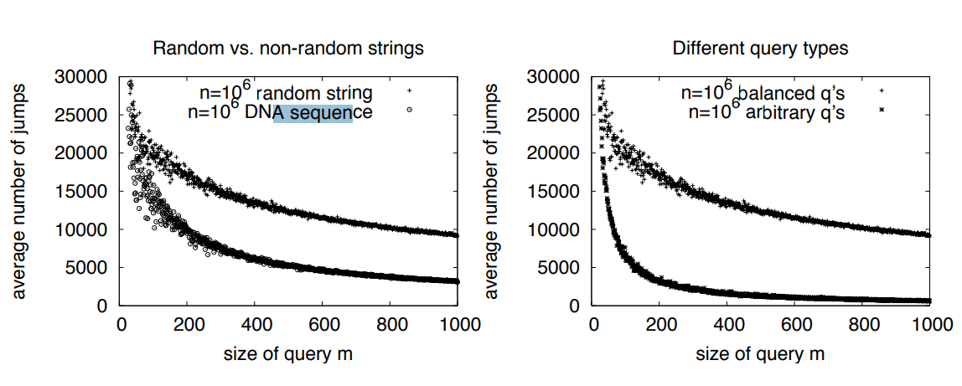
Result

Slide 24
Thanks

