Slide 1
Optimal Play of the Dice Game Pig
Todd W. Neller, Clifton G.M. Presser
The UMAP Journal, (2004), 25(1)
Presenter: Hsin-Chang Yu
Date: July 16, 2024

Slide 2
Abstract
The object of the jeopardy dice game Pig is to be the first player to reach 100 points. Each player's turn consists of repeatedly rolling a die. After each roll, the player is faced with two choices: roll again, or hold (decline to roll again).

Slide 3
Abstract
• If the player rolls a 1, the player scores nothing and it becomes the opponent's turn.
• If the player rolls a number other than 1, the number is added to the player's turn total and the player’s turn continues.
• If the player holds, the turn total, the sum of the rolls during the turn, is added to the player's score, and it becomes the opponent's turn.

Slide 4
Abstract
For such a simple dice game, one might expect a simple optimal strategy, such as in Blackjack (e.g., "stand on 17" under certain circumstances, etc.). As we shall see, this simple dice game yields a much more complex and intriguing optimal policy, described here for the first time. The reader should be familiar with basic concepts and notation of probability and linear algebra.

Slide 5

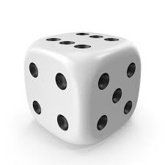
Pig
John Scarne 1945

Slide 6
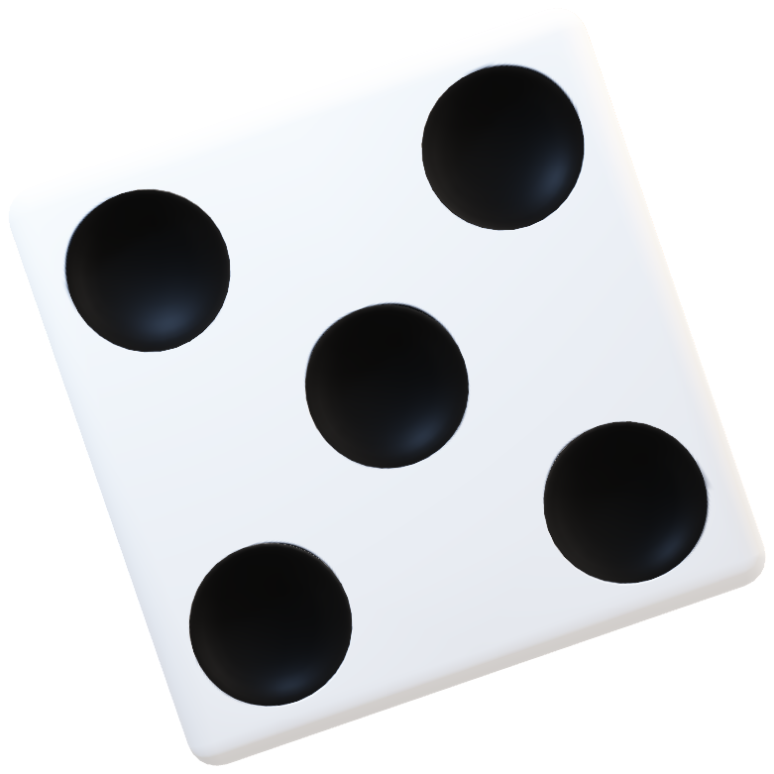

Slide 7

Simple Tactics
10
$\frac{1}{6}×0+\frac{5}{6}×(4+10)=11.\overline{6}$
30
$\frac{1}{6}×0+\frac{5}{6}×(4+30)=28.\overline{3}$

Slide 8
Hold at 20
10
$\frac{1}{6}×0+\frac{5}{6}×(4+10)=11.\overline{6}$
30
$\frac{1}{6}×0+\frac{5}{6}×(4+30)=28.\overline{3}$

Slide 9

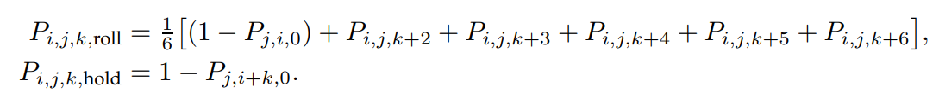

Maximizing the Probability of Winning

Slide 10
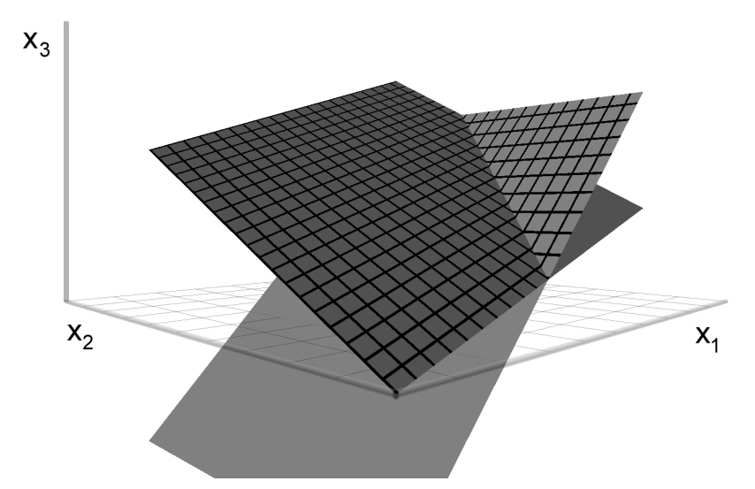
Maximizing the Probability of Winning

Slide 11

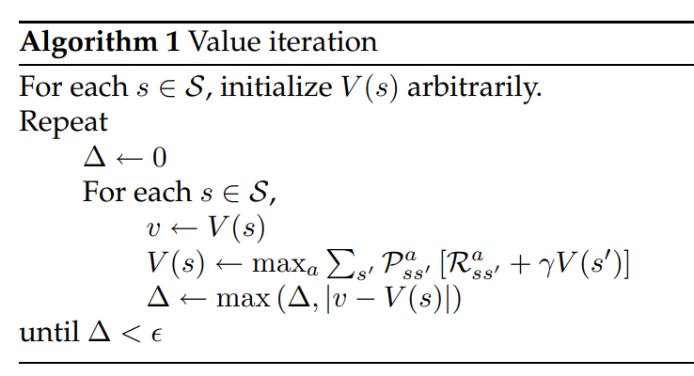
Value Iteration

Slide 12
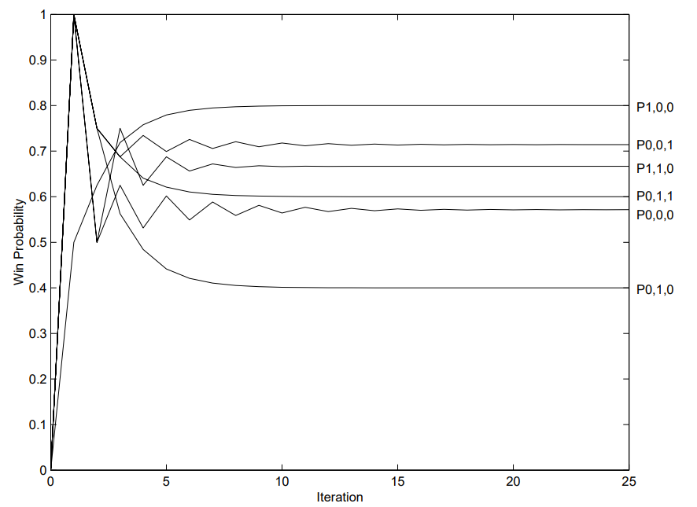
Value Iteration

Slide 13


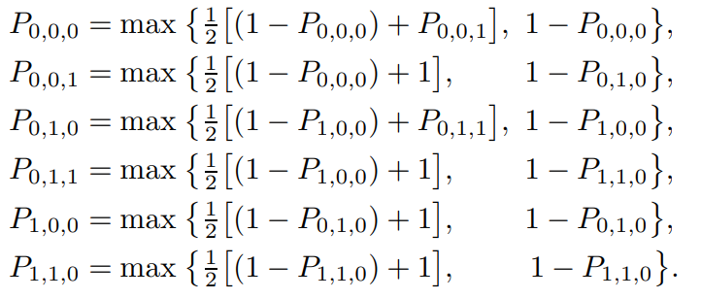
Value Iteration

Slide 14
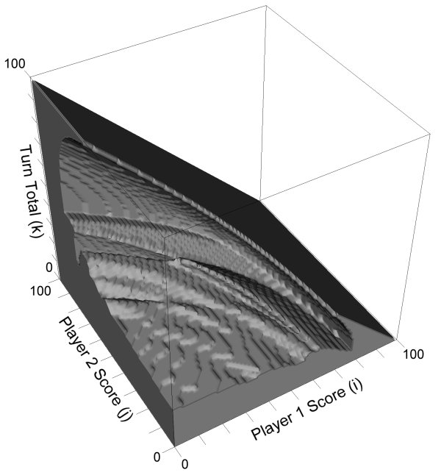
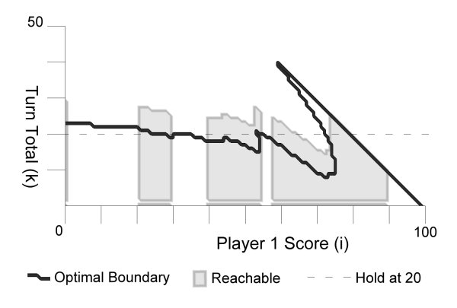
Solution

Slide 15
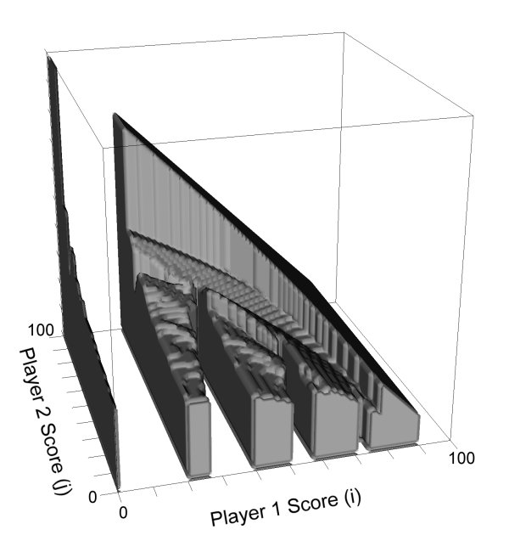
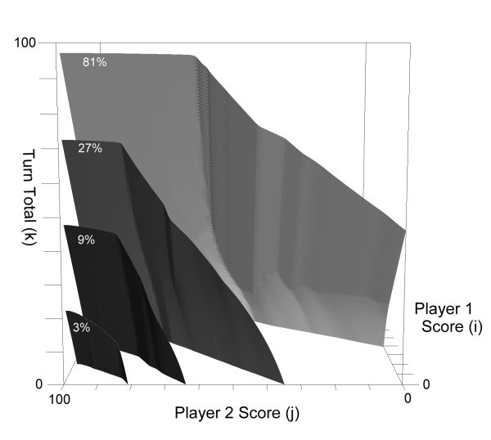
Solution

Slide 16
Solution

Slide 17
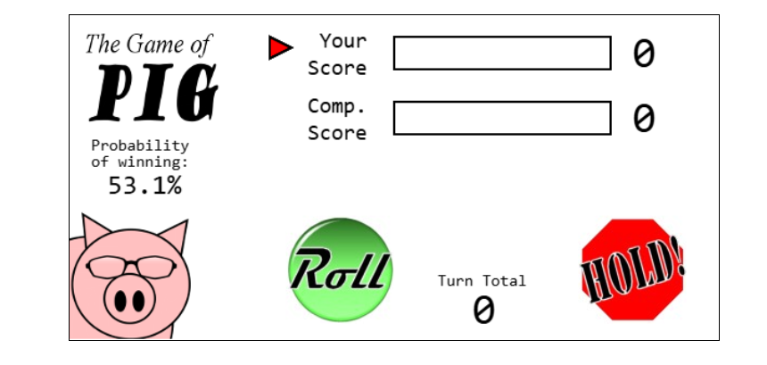
Thanks
Notes:
Given a string S of length n, an integer p ∈ [1..n] is a period of S if S[i] = S[i + p] for all i ∈ [1..n − p].
S[|S| − p + 1] = c

Slide 18
Thanks
Notes:
Given a string S of length n, an integer p ∈ [1..n] is a period of S if S[i] = S[i + p] for all i ∈ [1..n − p].
S[|S| − p + 1] = c

