Slide 1
Space/Time Trade-offs in Hash Coding with Allowable Errors
Burton H Bloom
Communications of the ACM, Vol. 13, Issue. 7, pp. 422-426, 1970
Presenter: Yen-Yu Chen
Date: Aug.27, 2024

Slide 2
Abstract(1/3)
In this paper trade-offs among certain computational factors in hash coding are analyzed. The paradigm problem considered is that of testing a series of messages one-by-one for membership in a given set of messages. Two new hash-coding methods are examined and compared with a particular conventional hash-coding method. The computational factors considered are the size of the hash area (space), the time required to identify a message as a nonmember of the given set (reject time), and an allowable error frequency.

Slide 3
Abstract(2/3)
The new methods are intended to reduce the amount of space required to contain the hash-coded information from that associated with conventional methods. The reduction in space is accomplished by exploiting the possibility that a small fraction of errors of commission may be tolerable in some applications, in particular, applications in which a large amount of data is involved and a core resident hash area is consequently not feasible using conventional methods.

Slide 4
Abstract(3/3)
In such applications, it is envisaged that overall performance could be improved by using a smaller core resident hash area in conjunction with the new methods and, when necessary, by using some secondary and perhaps time-consuming test to “catch” the small fraction of errors associated with the new methods. An example is discussed which illustrates possible areas of application for the new methods.
Analysis of the paradigm problem demonstrates that allowing a small number of test messages to be falsely identified as members of the given set will permit a much smaller hash area to be used without increasing reject time.

Slide 5
Problem
set
8
8
algorithm
7
9
5
3
negative
positive

Slide 6

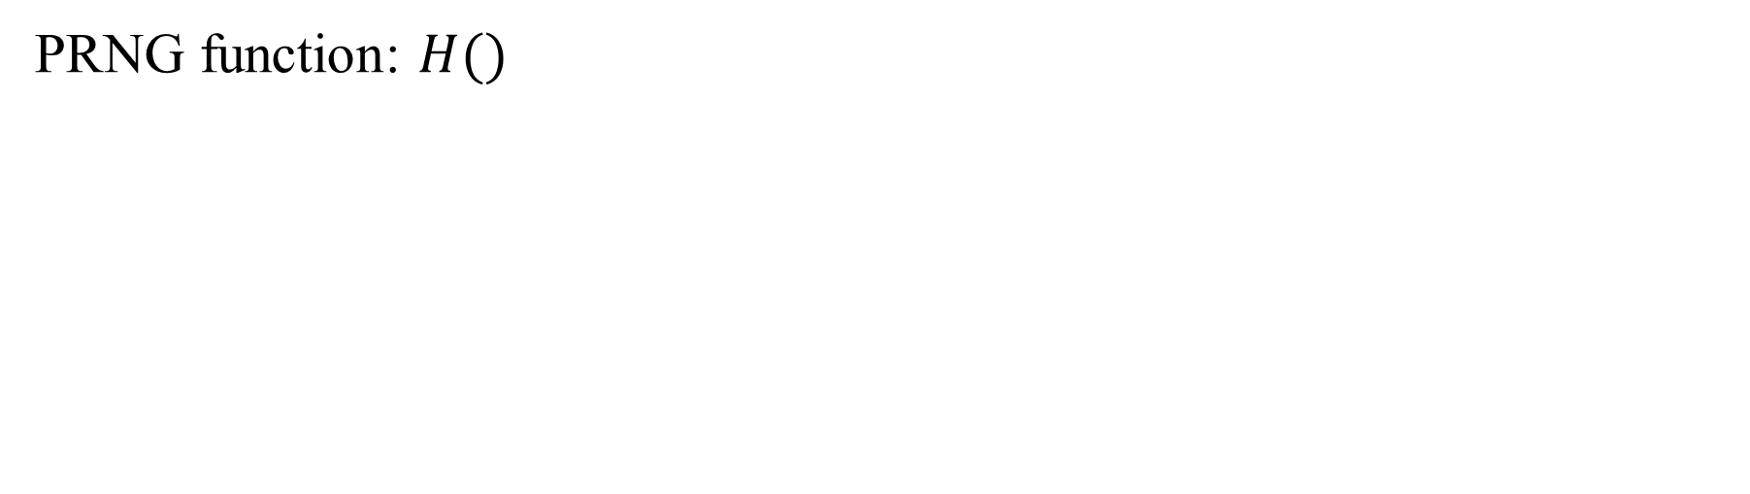
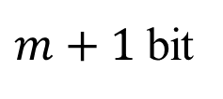
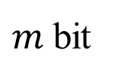
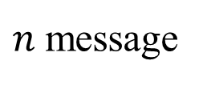
Conventional Hash-Coding Method
set
$n$ message
PRNG function: $H()$
$m$ bit
8
7
9
5
3
$$h>n$$
0 |  | 1 |  | 2 |  | 3 |  | 4 |  | 5 |  | 6 |  | 7 |  | 8 |  | 9
0 |  | 0 |  | 0 |  | 0 |  | 0 |  | 0 |  | 0 |  | 0 |  | 0 |  | 0
$m+1$ bit

Slide 7
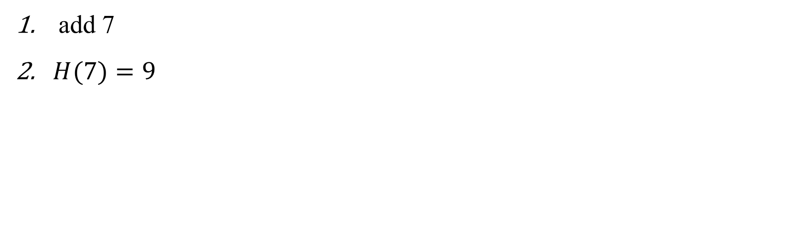
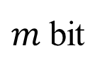
Conventional Hash-Coding Method
set
$n$ message
add 7
$H(7)=9$
$m$ bit
8
7
9
5
3
$$h>n$$
0 |  | 1 |  | 2 |  | 3 |  | 4 |  | 5 |  | 6 |  | 7 |  | 8 |  | 9
0 |  | 0 |  | 0 |  | 0 |  | 0 |  | 0 |  | 0 |  | 0 |  | 0 |  | 1 | 7
$m+1$ bit

Slide 8
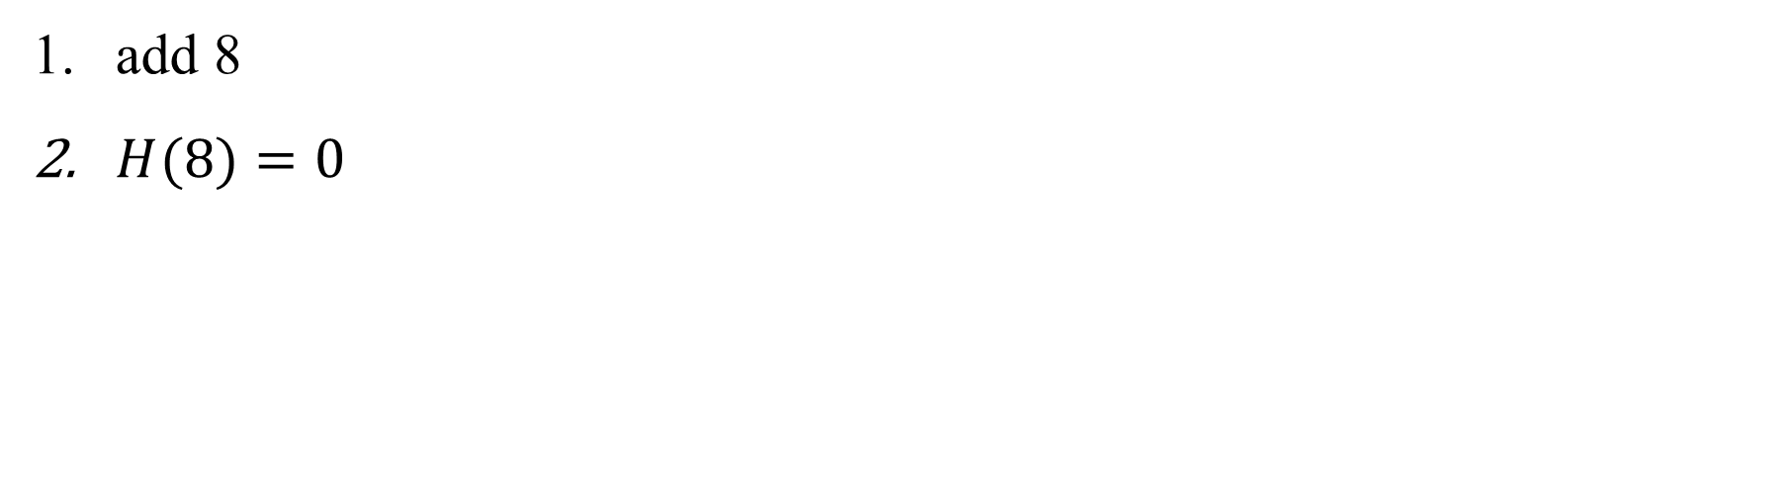
Conventional Hash-Coding Method
set
$n$ message
add 8
$H(8)=0$
$m$ bit
8
7
9
5
3
$$h>n$$
0 |  | 1 |  | 2 |  | 3 |  | 4 |  | 5 |  | 6 |  | 7 |  | 8 |  | 9
1 | 8 | 0 |  | 0 |  | 0 |  | 0 |  | 0 |  | 0 |  | 0 |  | 0 |  | 1 | 7
$m+1$ bit

Slide 9
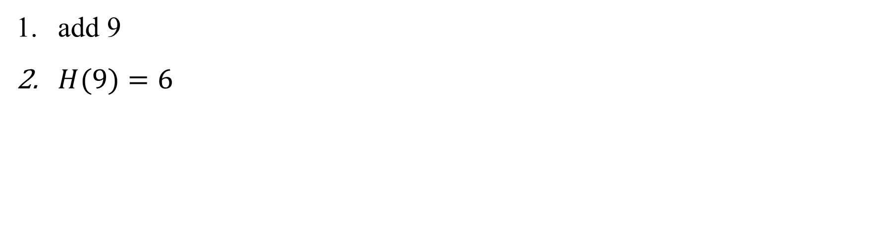
Conventional Hash-Coding Method
set
$n$ message
add 9
$H(9)=6$
$m$ bit
8
7
9
5
3
$$h>n$$
0 |  | 1 |  | 2 |  | 3 |  | 4 |  | 5 |  | 6 |  | 7 |  | 8 |  | 9
1 | 8 | 0 |  | 0 |  | 0 |  | 0 |  | 0 |  | 1 | 9 | 0 |  | 0 |  | 1 | 7
$m+1$ bit

Slide 10
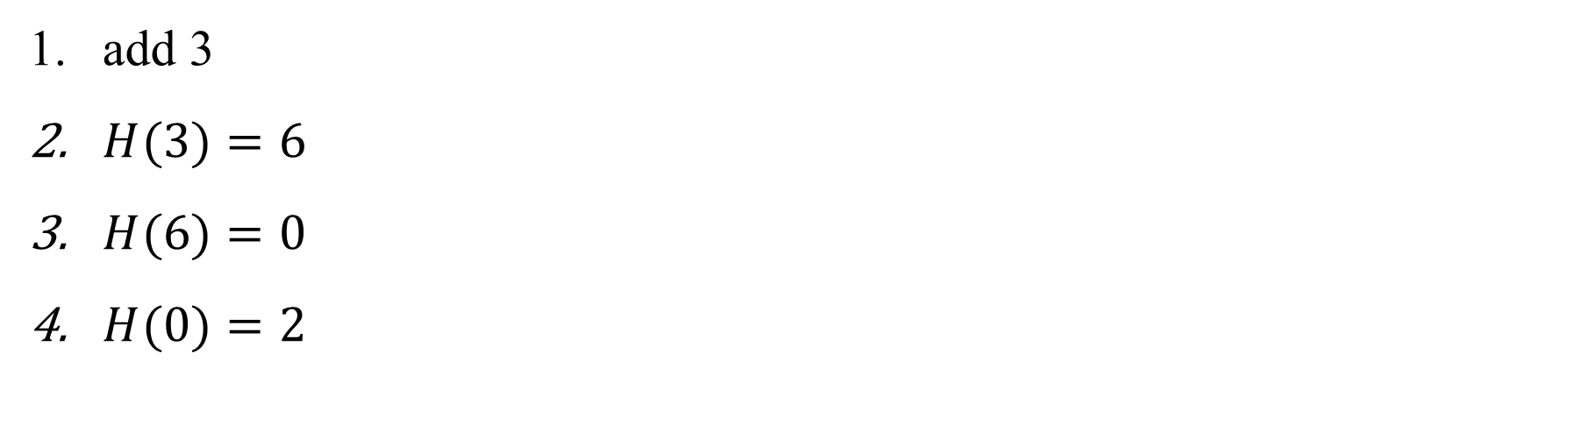
Conventional Hash-Coding Method
set
$n$ message
add 3
$H(3)=6$
$H(6)=0$
$H(0)=2$
$m$ bit
8
7
9
5
3
$$h>n$$
0 |  | 1 |  | 2 |  | 3 |  | 4 |  | 5 |  | 6 |  | 7 |  | 8 |  | 9
1 | 8 | 0 |  | 1 | 3 | 0 |  | 0 |  | 0 |  | 1 | 9 | 0 |  | 0 |  | 1 | 7
$m+1$ bit

Slide 11
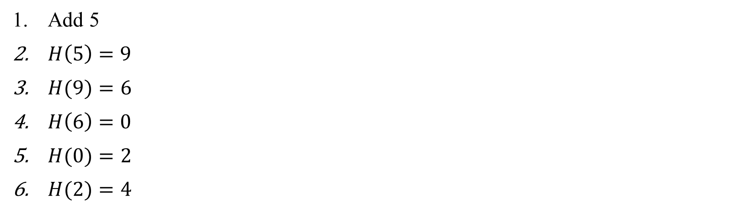
Conventional Hash-Coding Method
set
$n$ message
Add 5
$H\left(5\right)=9$
$H(9)=6$
$H\left(6\right)=0$
$H(0)=2$
$H(2)=4$
$m$ bit
8
7
9
5
3
$$h>n$$
0 |  | 1 |  | 2 |  | 3 |  | 4 |  | 5 |  | 6 |  | 7 |  | 8 |  | 9
1 | 8 | 0 |  | 1 | 3 | 0 |  | 1 | 5 | 0 |  | 1 | 9 | 0 |  | 0 |  | 1 | 7
$m+1$ bit

Slide 12

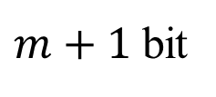
Conventional Hash-Coding Method
set
Search 7
$H\left(7\right)=9$
positive
$n$ message
$m$ bit
8
7
9
5
3
$$h>n$$
0 |  | 1 |  | 2 |  | 3 |  | 4 |  | 5 |  | 6 |  | 7 |  | 8 |  | 9
1 | 8 | 0 |  | 1 | 3 | 0 |  | 1 | 5 | 0 |  | 1 | 9 | 0 |  | 0 |  | 1 | 7
$m+1$ bit

Slide 13

Conventional Hash-Coding Method
set
Search 5
$H\left(5\right)=9$
$H(9)=6$
$H\left(6\right)=0$
$H(0)=2$
$H(2)=4$
positive
$n$ message
$m$ bit
8
7
9
5
3
$$h>n$$
0 |  | 1 |  | 2 |  | 3 |  | 4 |  | 5 |  | 6 |  | 7 |  | 8 |  | 9
1 | 8 | 0 |  | 1 | 3 | 0 |  | 1 | 5 | 0 |  | 1 | 9 | 0 |  | 0 |  | 1 | 7
$m+1$ bit

Slide 14

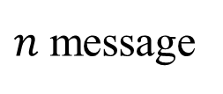
Conventional Hash-Coding Method
set
Search 6
$H\left(6\right)=0$
$H(0)=2$
$H(2)=4$
$H(4)=1$
negative
$n$ message
$m$ bit
8
7
9
5
3
$$h>n$$
0 |  | 1 |  | 2 |  | 3 |  | 4 |  | 5 |  | 6 |  | 7 |  | 8 |  | 9
1 | 8 | 0 |  | 1 | 3 | 0 |  | 1 | 5 | 0 |  | 1 | 9 | 0 |  | 0 |  | 1 | 7
$m+1$ bit

Slide 15

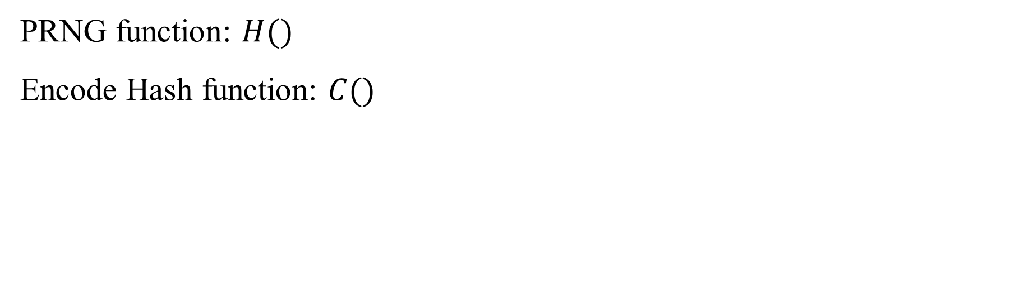
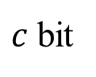
Method 1
set
$n$ message
PRNG function: $H()$
Encode Hash function: $C()$
$m$ bit
8
7
9
5
3
$$h>n$$
0 |  | 1 |  | 2 |  | 3 |  | 4 |  | 5 |  | 6 |  | 7 |  | 8 |  | 9
0 |  | 0 |  | 0 |  | 0 |  | 0 |  | 0 |  | 0 |  | 0 |  | 0 |  | 0
$c$ bit

Slide 16
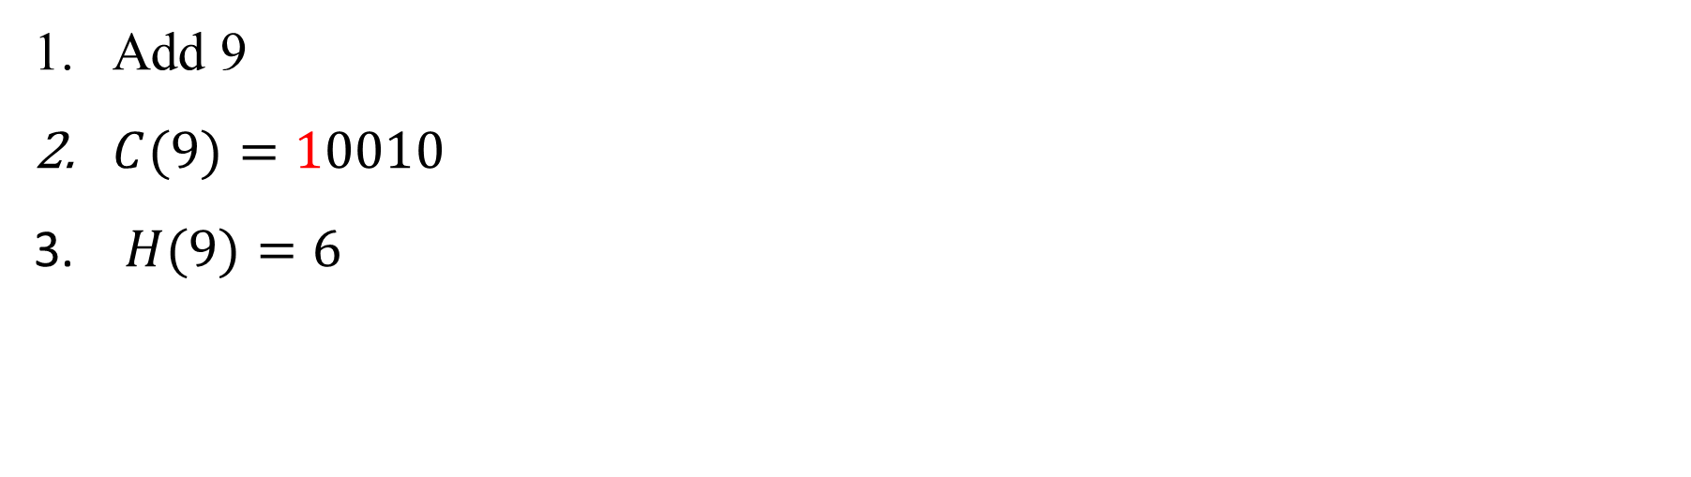
Method 1
set
$n$ message
Add 9
$C(9)=10010$
$H(9)=6$
$m$ bit
8
7
9
5
3
$$h>n$$
0 |  | 1 |  | 2 |  | 3 |  | 4 |  | 5 |  | 6 |  | 7 |  | 8 |  | 9
0 |  | 0 |  | 0 |  | 0 |  | 0 |  | 0 |  | 1 | 0010 | 0 |  | 0 |  | 0
$c$ bit

Slide 17
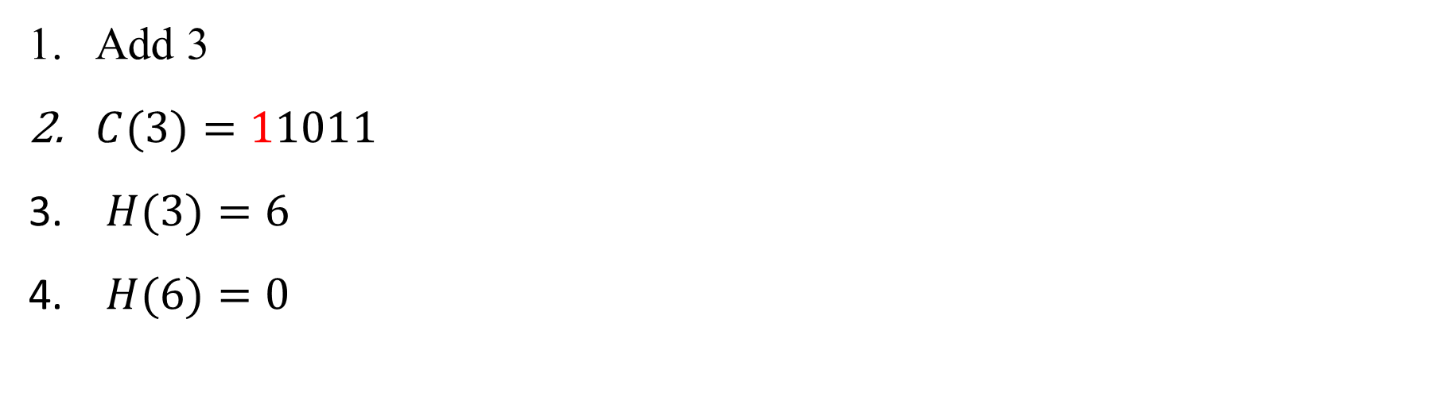
Method 1
set
$n$ message
Add 3
$C(3)=11011$
$H(3)=6$
$H(6)=0$
$m$ bit
8
7
9
5
3
$$h>n$$
0 |  | 1 |  | 2 |  | 3 |  | 4 |  | 5 |  | 6 |  | 7 |  | 8 |  | 9
1 | 1011 | 0 |  | 0 |  | 0 |  | 0 |  | 0 |  | 1 | 0010 | 0 |  | 0 |  | 0
$c$ bit

Slide 18

Method 1
set
$n$ message
Add 5
$C(5)=11000$
$H(5)=9$
$m$ bit
8
7
9
5
3
$$h>n$$
0 |  | 1 |  | 2 |  | 3 |  | 4 |  | 5 |  | 6 |  | 7 |  | 8 |  | 9
1 | 1011 | 0 |  | 0 |  | 0 |  | 0 |  | 0 |  | 1 | 0010 | 0 |  | 0 |  | 1 | 1000
$c$ bit

Slide 19
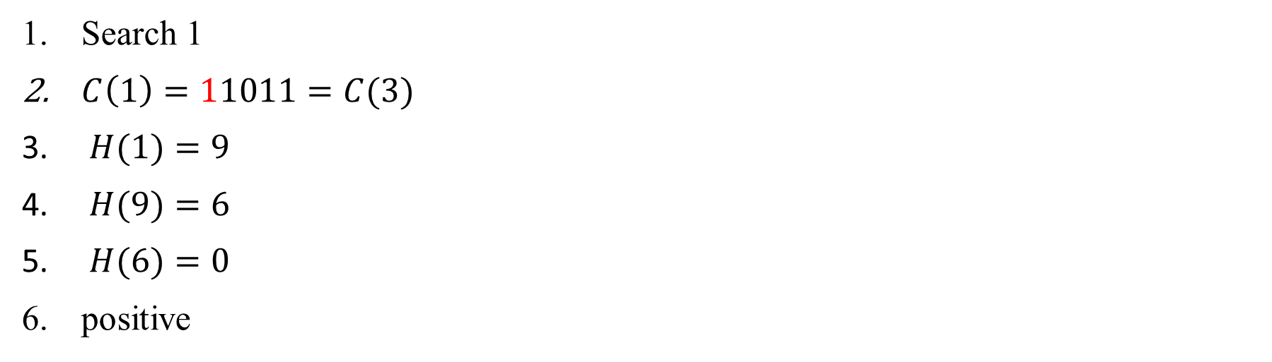
Method 1 false positive
set
$n$ message
Search 1
$C\left(1\right)=11011=C(3)$
$H(1)=9$
$H(9)=6$
$H(6)=0$
positive
$m$ bit
8
7
9
5
3
$$h>n$$
0 |  | 1 |  | 2 |  | 3 |  | 4 |  | 5 |  | 6 |  | 7 |  | 8 |  | 9
1 | 1011 | 0 |  | 0 |  | 0 |  | 0 |  | 0 |  | 1 | 0010 | 0 |  | 0 |  | 1 | 1000
$c$ bit

Slide 20

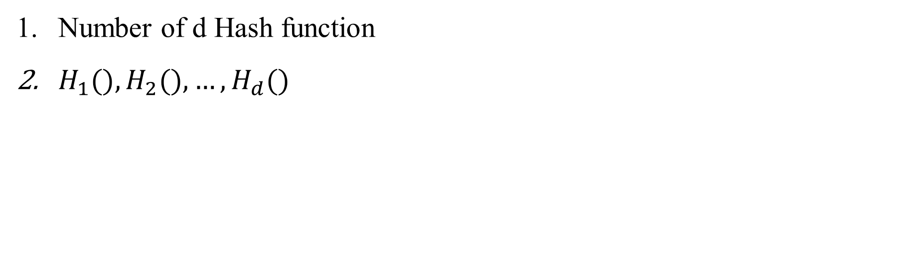
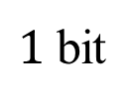
Method 2
set
$n$ message
Number of d Hash function
$H_{1}(),H_{2}(),…, H_{d}()$
$m$ bit
8
7
9
5
3
$$N$$
0 | 1 | 2 | 3 | 4 | 5 | 6 | 7 | 8 | 9 | 10 | 11 | 12 | 13 | 14
0 | 0 | 0 | 0 | 0 | 0 | 0 | 0 | 0 | 0 | 0 | 0 | 0 | 0 | 0
$1$ bit

Slide 21
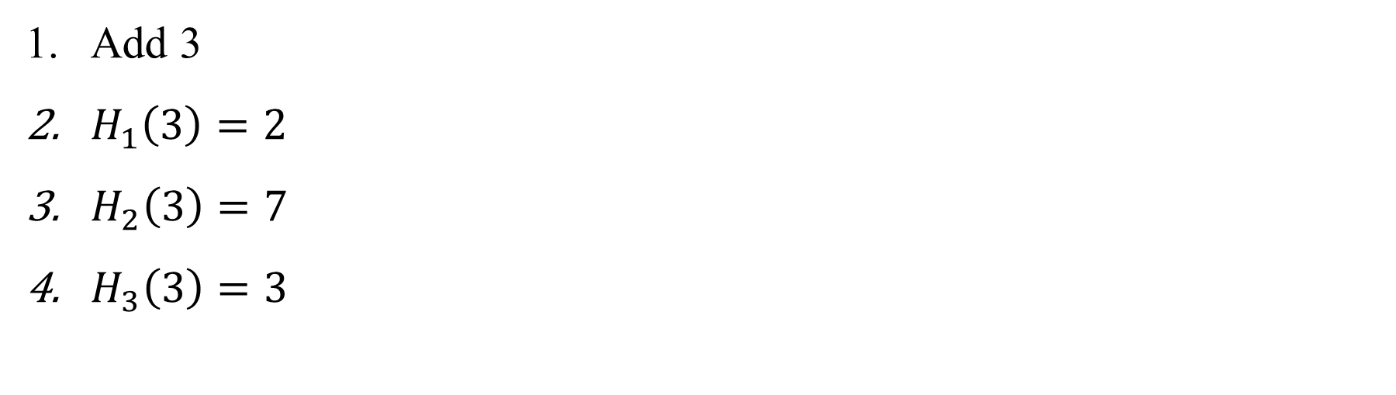
Method 2
set
$n$ message
Add 3
$H_{1}\left(3\right)=2$
$H_{2}\left(3\right)=7$
$H_{3}\left(3\right)=3$
$m$ bit
8
7
9
5
3
$$N$$
0 | 1 | 2 | 3 | 4 | 5 | 6 | 7 | 8 | 9 | 10 | 11 | 12 | 13 | 14
0 | 0 | 1 | 1 | 0 | 0 | 0 | 1 | 0 | 0 | 0 | 0 | 0 | 0 | 0
$1$ bit

Slide 22
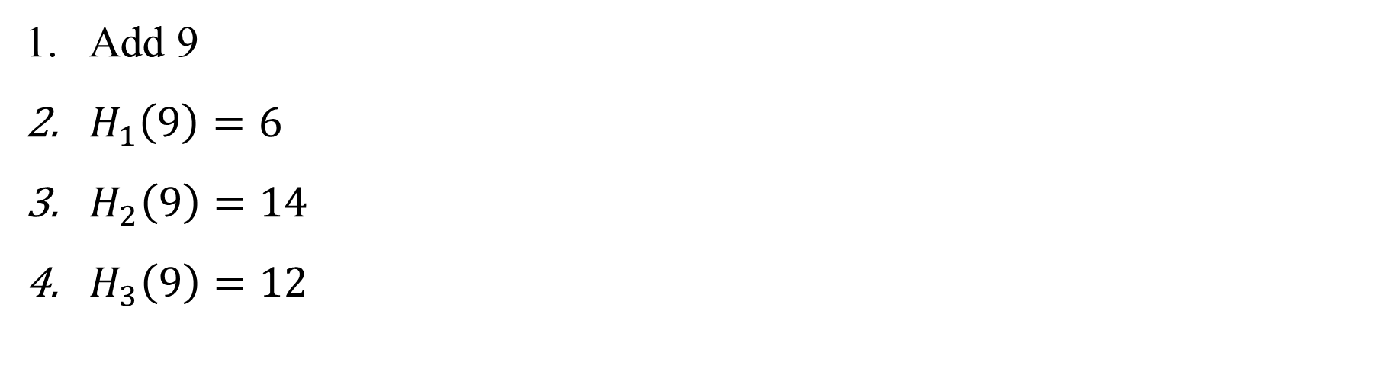
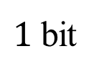
Method 2
set
$n$ message
Add 9
$H_{1}\left(9\right)=6$
$H_{2}\left(9\right)=14$
$H_{3}\left(9\right)=12$
$m$ bit
8
7
9
5
3
$$N$$
0 | 1 | 2 | 3 | 4 | 5 | 6 | 7 | 8 | 9 | 10 | 11 | 12 | 13 | 14
0 | 0 | 1 | 1 | 0 | 0 | 1 | 1 | 0 | 0 | 0 | 0 | 1 | 0 | 1
$1$ bit

Slide 23
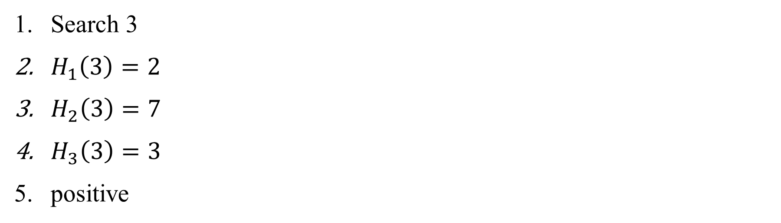
Method 2
set
$n$ message
Search 3
$H_{1}\left(3\right)=2$
$H_{2}\left(3\right)=7$
$H_{3}\left(3\right)=3$
positive
$m$ bit
8
7
9
5
3
$$N$$
0 | 1 | 2 | 3 | 4 | 5 | 6 | 7 | 8 | 9 | 10 | 11 | 12 | 13 | 14
0 | 0 | 1 | 1 | 0 | 0 | 1 | 1 | 0 | 0 | 0 | 0 | 1 | 0 | 1
$1$ bit

Slide 24
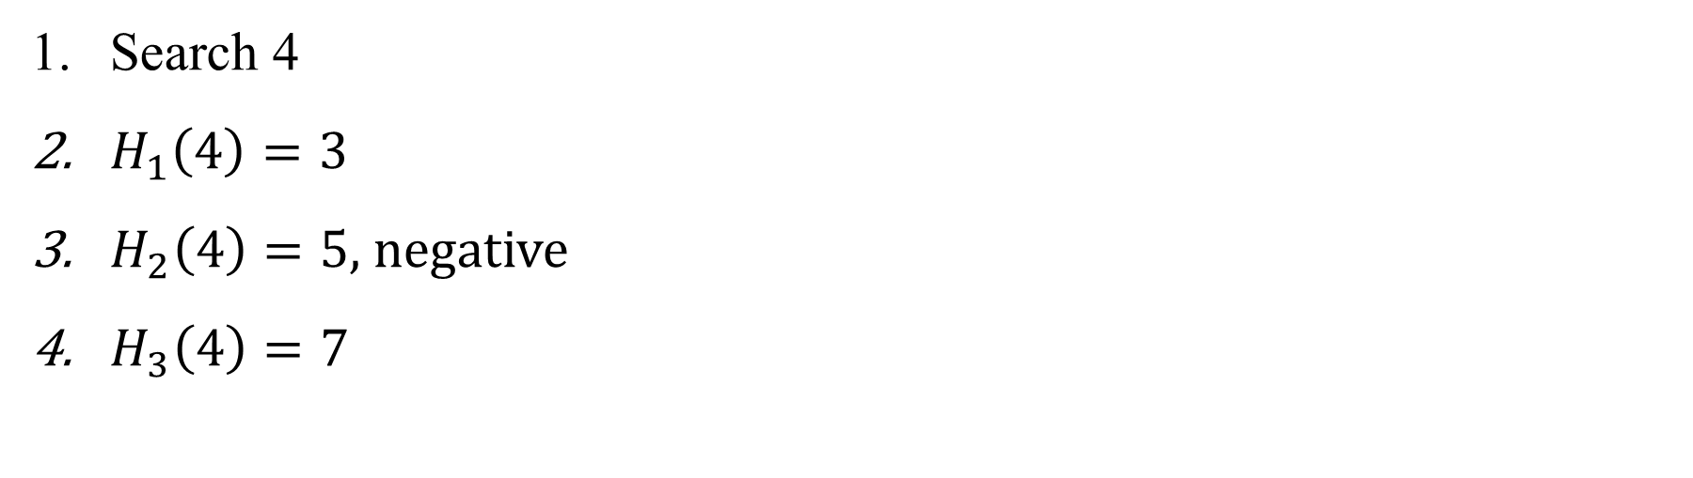
Method 2
set
$n$ message
Search 4
$H_{1}\left(4\right)=3$
$H_{2}\left(4\right)=5$, negative
$H_{3}\left(4\right)=7$
$m$ bit
8
7
9
5
3
$$N$$
0 | 1 | 2 | 3 | 4 | 5 | 6 | 7 | 8 | 9 | 10 | 11 | 12 | 13 | 14
0 | 0 | 1 | 1 | 0 | 0 | 1 | 1 | 0 | 0 | 0 | 0 | 1 | 0 | 1
$1$ bit

Slide 25
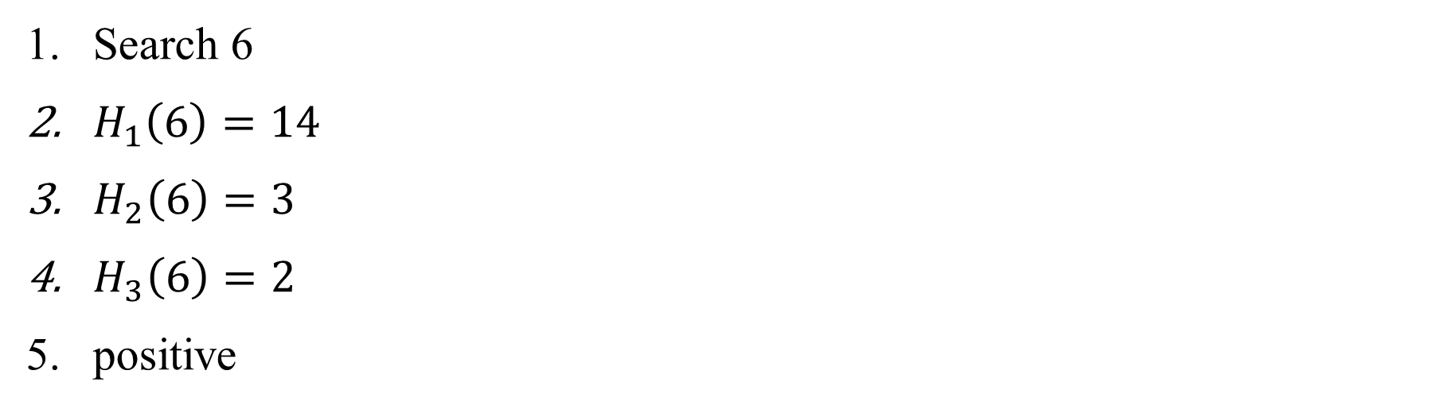
Method 2 false positive
set
$n$ message
Search 6
$H_{1}\left(6\right)=14$
$H_{2}\left(6\right)=3$
$H_{3}\left(6\right)=2$
positive
$m$ bit
8
7
9
5
3
$$N$$
0 | 1 | 2 | 3 | 4 | 5 | 6 | 7 | 8 | 9 | 10 | 11 | 12 | 13 | 14
0 | 0 | 1 | 1 | 0 | 0 | 1 | 1 | 0 | 0 | 0 | 0 | 1 | 0 | 1
$1$ bit

Slide 26





Fraction of Error
Space M: $n_{t}$
$$P=\frac{(n_{a}−n)}{(n_{t}−n)}$$
$=$
$$\overline{a}$$
$a$: $n_{a}$
Set: $n$
Notes:
不是 member 卻被認為是 member 的 條件機率

Slide 27
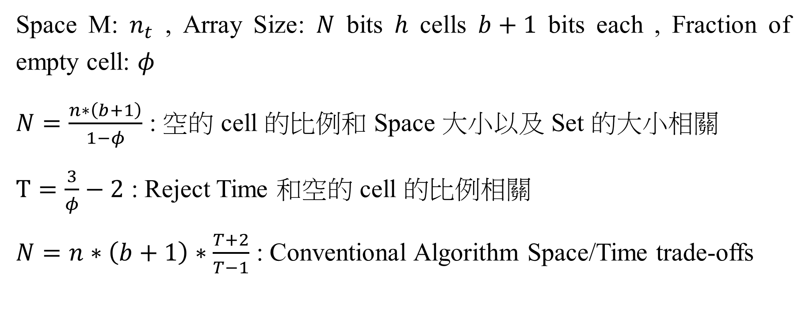
Conventional Algorithm Factor Relationship
Space M: $n_{t}$ , Array Size: $N$ bits $h$ cells $b+1$ bits each , Fraction of empty cell: $φ$
$N=\frac{n∗\left(b+1\right)}{1−φ}$ : 空的 cell 的比例和 Space 大小以及 Set 的大小相關
$T=\frac{3}{φ}−2$ : Reject Time 和空的 cell 的比例相關
$N=n∗\left(b+1\right)∗\frac{T+2}{T−1}$ : Conventional Algorithm Space/Time trade-offs

Slide 28
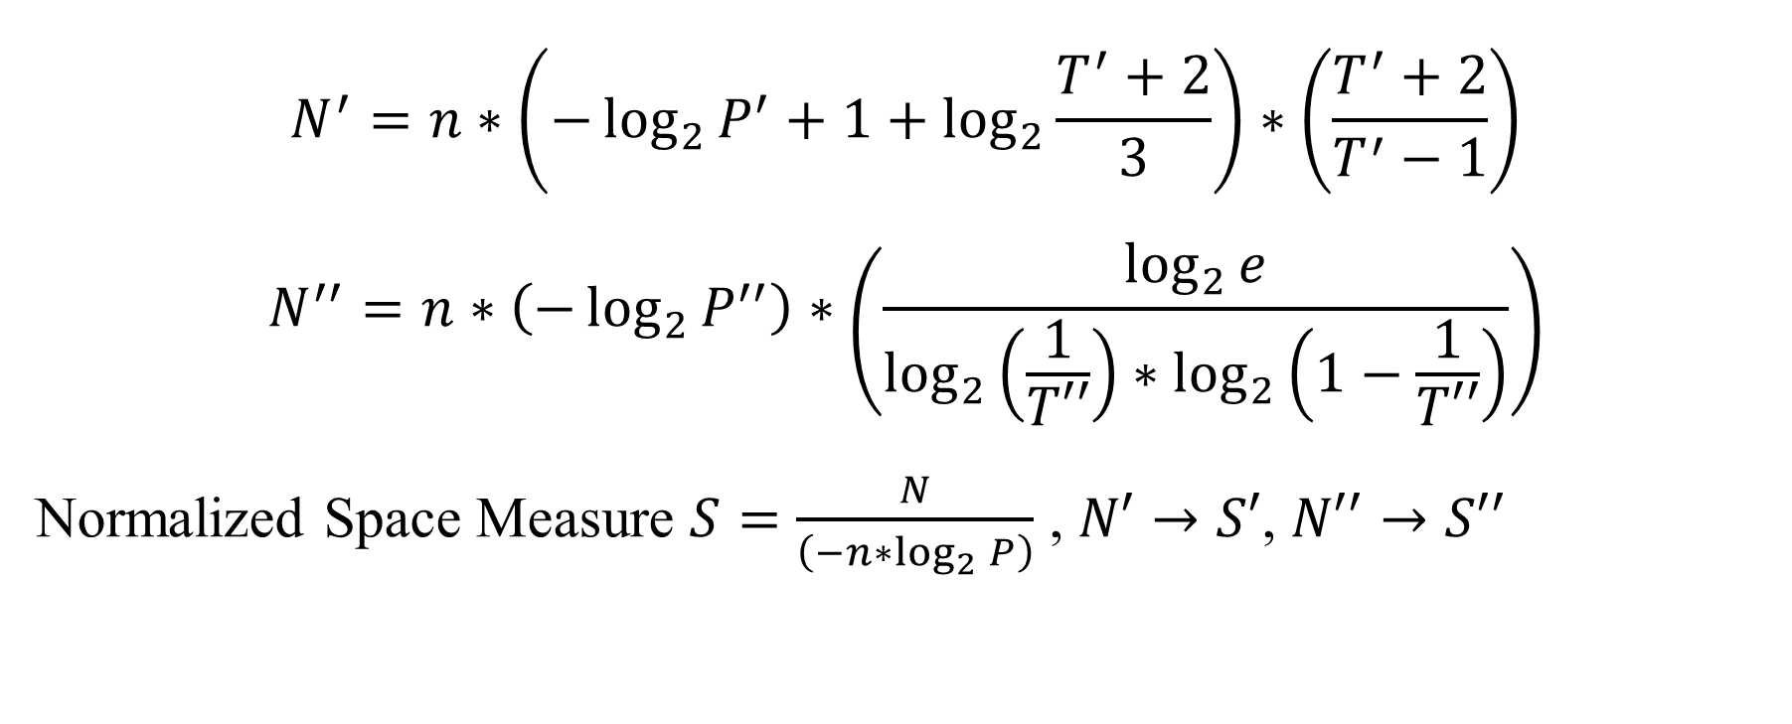
Relationship
$$N^{′}=n∗\left(−\log_{2}{P^{′}}+1+\log_{2}{\frac{T^{′}+2}{3}}\right)∗\left(\frac{T^{′}+2}{T^{′}−1}\right)$$
$$N^{′′}=n∗\left(−\log_{2}{P^{′′}}\right)∗\left(\frac{\log_{2}{e}}{\log_{2}\left(\frac{1}{T′′}\right)∗\log_{2}\left(1−\frac{1}{T′′}\right)}\right)$$
Normalized Space Measure $S=\frac{N}{\left(−n∗\log_{2}{P}\right)}$ , $N′→S′$, $N′′→S′′$

Slide 29
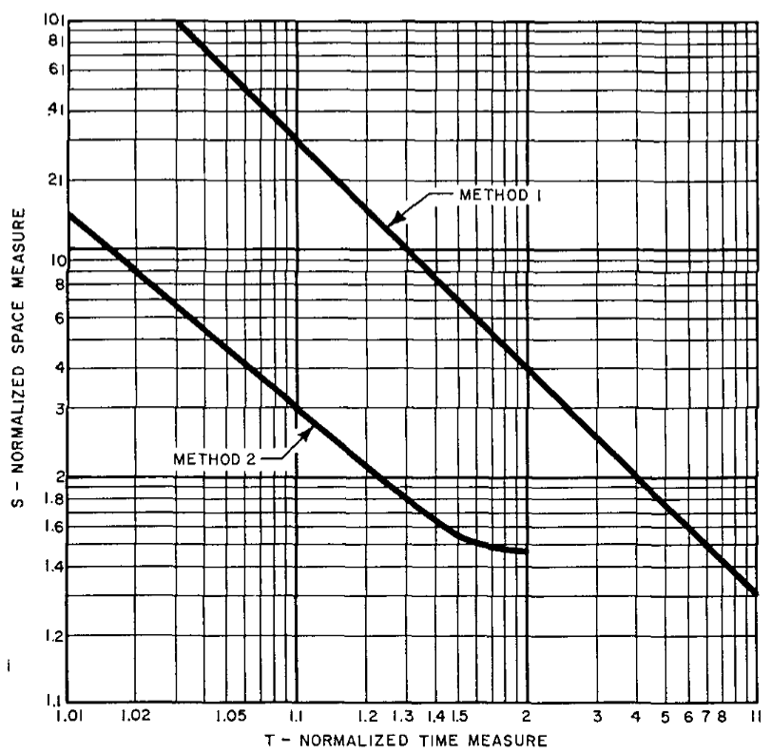
Space/Time trade-offs

Slide 30
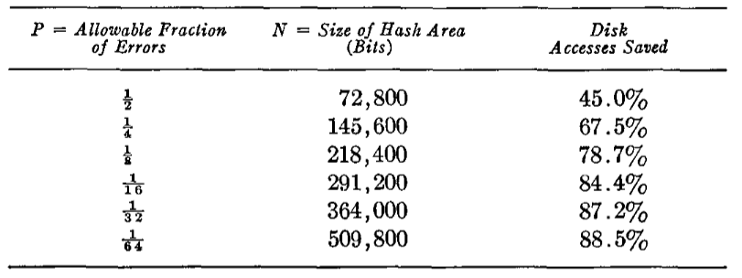
Example
Space: 500,000 words
Set: 50,000 words

Slide 31

Conditional Probability
$$\text{Minimize} P′′={\left(1−{\left(1−\frac{1}{N}\right)}^{dn}\right)}^{d}≈{\left(1−e^{−\frac{dn}{N}}\right)}^{d}$$
$$d=\frac{N}{n}\ln{2}$$

