Slide 1
Skip Lists: A Probabilistic Alternative to Balanced Trees
Pugh, William
Communication of the ACM 33.6 (1990):668-676
Presenter: Pei-Chian Lee
Date: Aug.27, 2024
Notes:
33.6 卷號 and 期號

Slide 2
Absrtract
Skip lists are a data structure that can be used in place of balanced trees. Skip lists use probabilistic balancing rather than strictly enforced balancing and as a result the algorithms for insertion and deletion in skip lists are much simpler and significantly faster than equivalent algorithms for balanced trees.

Slide 3
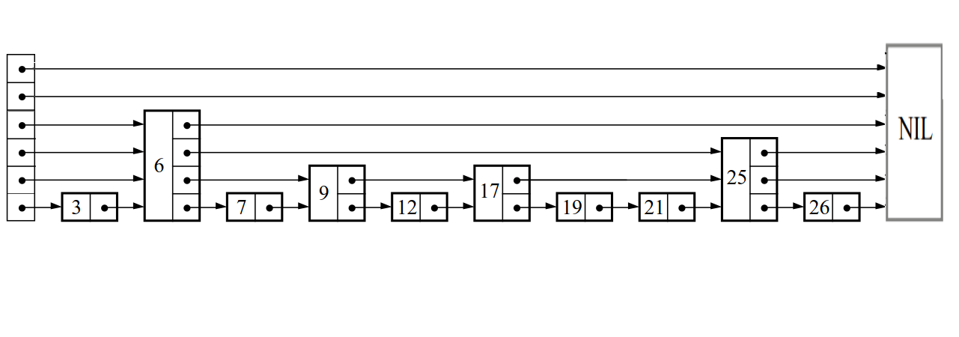
Skip List
MaxLevel = 6
list->level = 4
The list is stored in key order.
The header of a list has forward pointers at levels one through MaxLevel. The forward pointers at levels higher than the current maximum level of the current maximum level of the list point to NIL.
An element NIL is allocated and given a key greater than any legal key.
The level of a node, chosen randomly when the node is inserted, need never change.

Slide 4
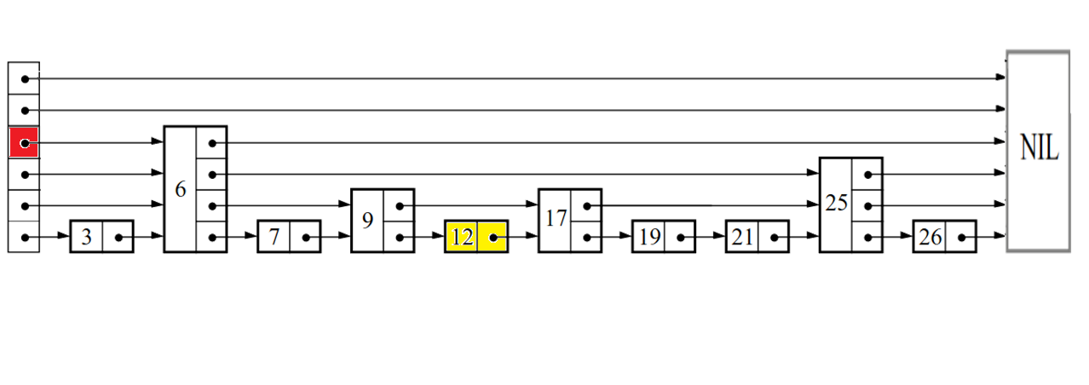
Search: Example with 12
MaxLevel = 6
list->level = 4
i = list->level = 4
x
x->forward[i]< searchKey ?
6 < 12

Slide 5
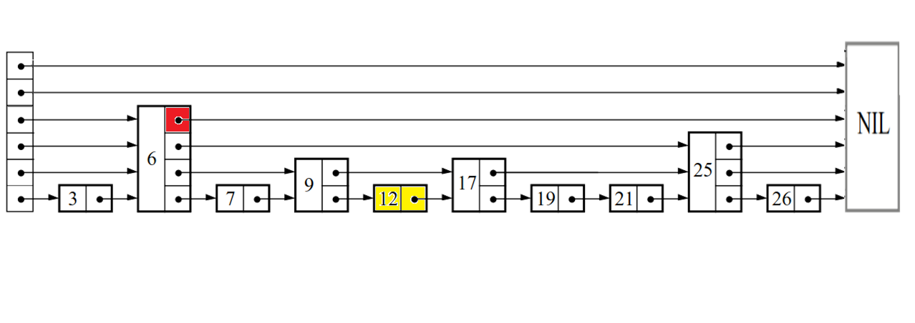
Search: Example with 12
MaxLevel = 6
list->level = 4
i = list->level = 4
x
x->forward[i]< searchKey ?
INT_MAX > 12

Slide 6
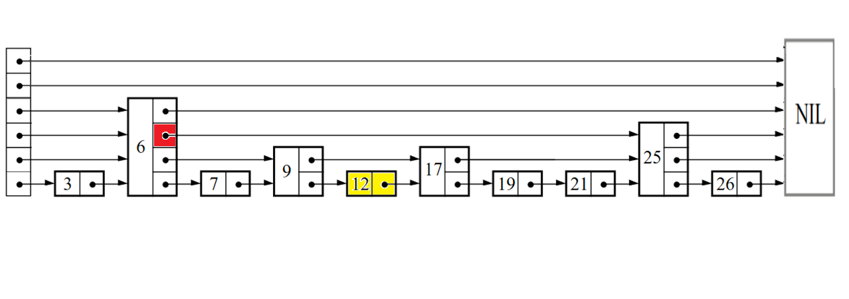
Search: Example with 12
MaxLevel = 6
list->level = 4
i = 3
x
x->forward[i]< searchKey ?
25 > 12

Slide 7
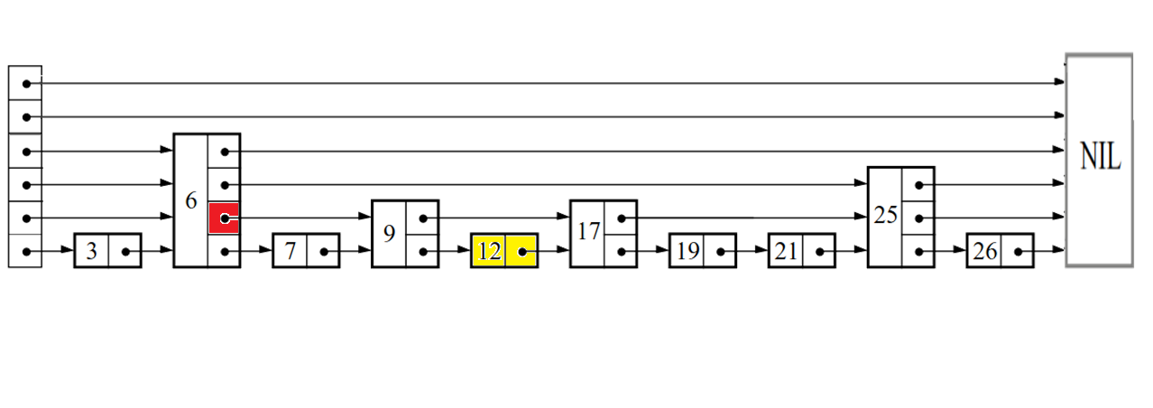
Search: Example with 12
MaxLevel = 6
list->level = 4
i = 2
x
x->forward[i]< searchKey ?
9 < 12

Slide 8
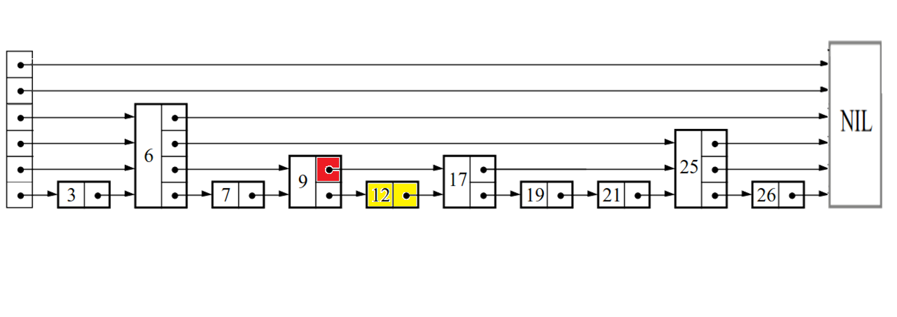
Search: Example with 12
MaxLevel = 6
list->level = 4
i = 2
x
x->forward[i] < searchKey ?
17 > 12

Slide 9
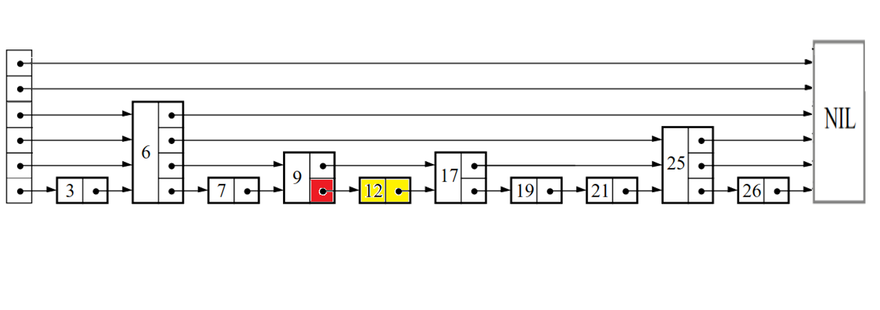
Search: Example with 12
MaxLevel = 6
list->level = 4
i = 1
x
x->forward[i] < searchKey ?
12 = 12

Slide 10
Search: Example with 12
MaxLevel = 6
list->level = 4
i = 1
x
x->forward[1]->key = searchKey ?
12 = 12
Notes:
記得說明insert level，如果是大於現在level情形

Slide 11
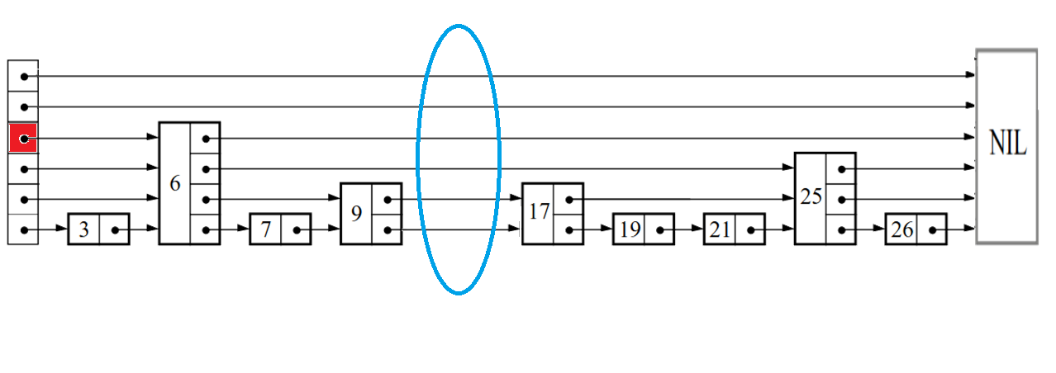
Insert:Example with 12
update[6]=
update[5]=
update[4]=
update[3]=
update[2]=
update[1]=
MaxLevel = 6
list->level = 4
i = list->level = 4
x
x->forward[i]< searchKey ?
6 < 12

Slide 12
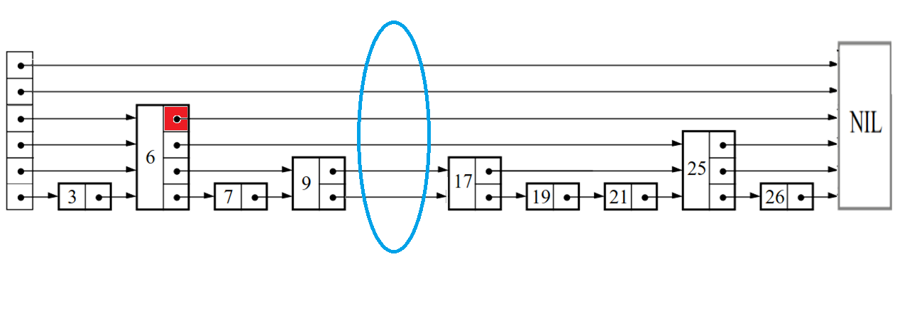
Insert:Example with 12
update[6]=
update[5]=
update[4]=
update[3]=
update[2]=
update[1]=
MaxLevel = 6
list->level = 4
i = list->level = 4
x
x->forward[i]< searchKey ?
INT_MAX > 12

Slide 13
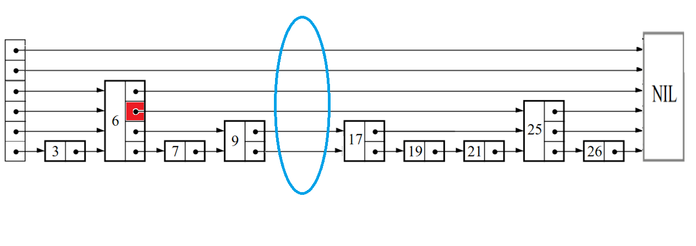
Insert:Example with 12
update[6]=
update[5]=
update[4]= &node6
update[3]=
update[2]=
update[1]=
MaxLevel = 6
list->level = 4
i = 3
x
x->forward[i]< searchKey ?
25 > 12

Slide 14
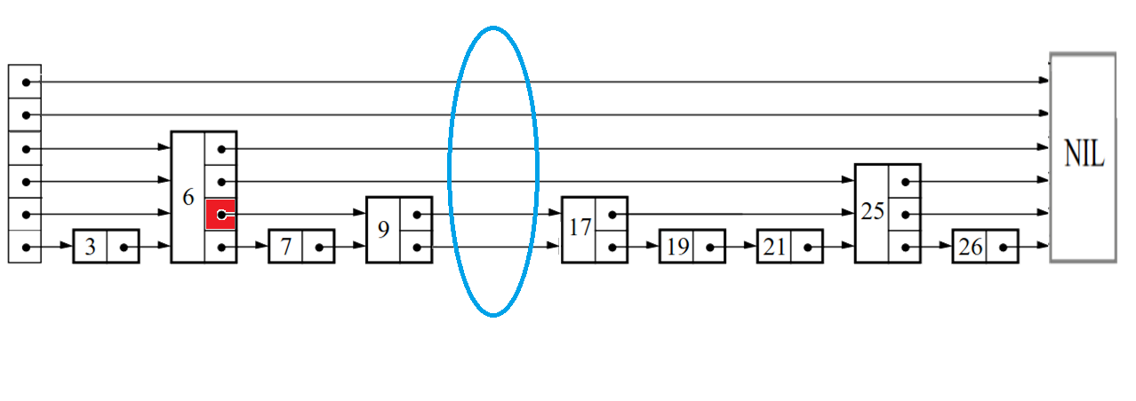
Insert:Example with 12
update[6]=
update[5]=
update[4]= &node6
update[3]=&node6
update[2]=
update[1]=
MaxLevel = 6
list->level = 4
i = 2
x
x->forward[i]< searchKey ?
9 < 12

Slide 15
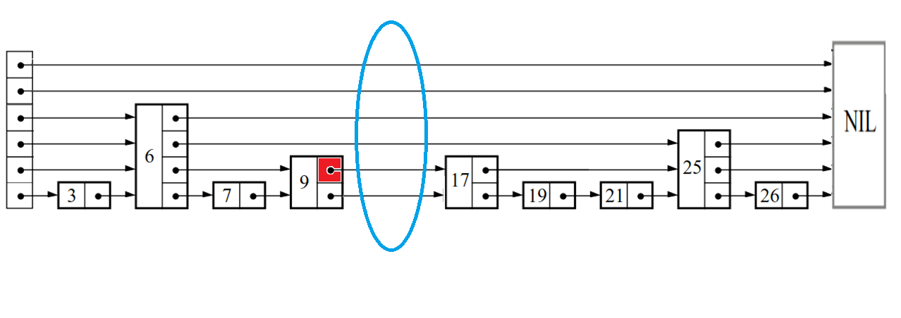
Insert:Example with 12
update[6]=
update[5]=
update[4]= &node6
update[3]=&node6
update[2]=
update[1]=
MaxLevel = 6
list->level = 4
i = 2
x
x->forward[i]< searchKey ?
17 > 12

Slide 16
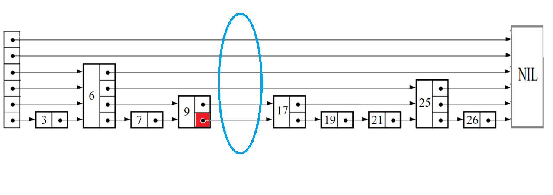
Insert:Example with 12
update[6]=
update[5]=
update[4]= &node6
update[3]=&node6
update[2]=&node9
update[1]=
MaxLevel = 6
list->level = 4
i = 1
x
x->forward[i]< searchKey ?
17 > 12

Slide 17
Insert:Example with 12
update[6]=
update[5]=
update[4]= &node6
update[3]=&node6
update[2]=&node9
update[1]=&node9
MaxLevel = 6
list->level = 4
i = 1
x
x->forward[1]->key = searchKey ?
17 ≠ 12

Slide 18
Delete: Example with 12
update[6]=
update[5]=
update[4]= &node6
update[3]=&node6
update[2]=&node9
update[1]=&node9
MaxLevel = 6
list->level = 4
i = 1
x
x->forward[1]->key = searchKey ?
12 = 12
Notes:
記得說明insert level，如果是大於現在level情形

Slide 19
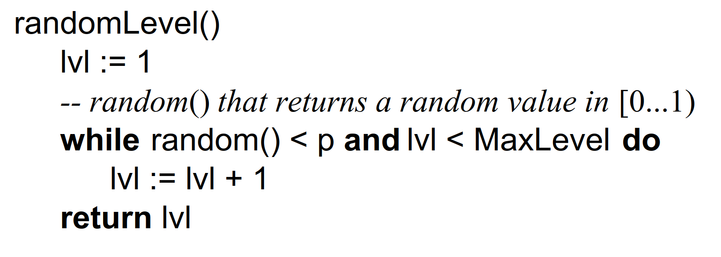
Choosing a Random Level

Slide 20


At what level do start we start a search?
$L=\log_{1/p}{n}$
$p$= $\frac{1}{2}$ , 16 elements
Level 1 : 9 elements
Level 2 : 3 elements
Level 3: 3 elements
Level 14 : 1 elements

Slide 21

MaxLevel
$MaxLevel=L\left(N\right)= \log_{1/p}{N}$
(where N is an upper bound on the number of elements in a skip list)

Slide 22
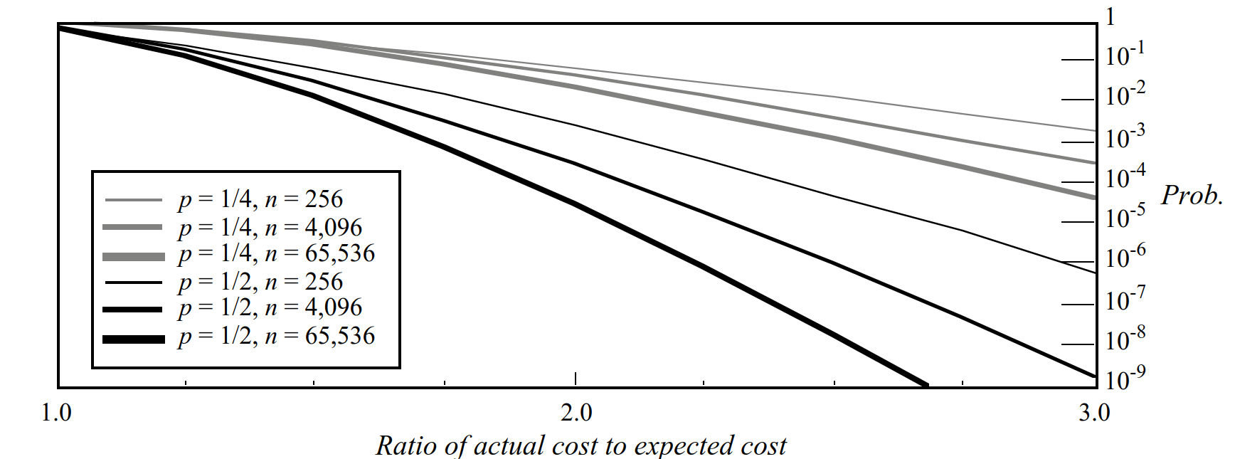
Result

Slide 23
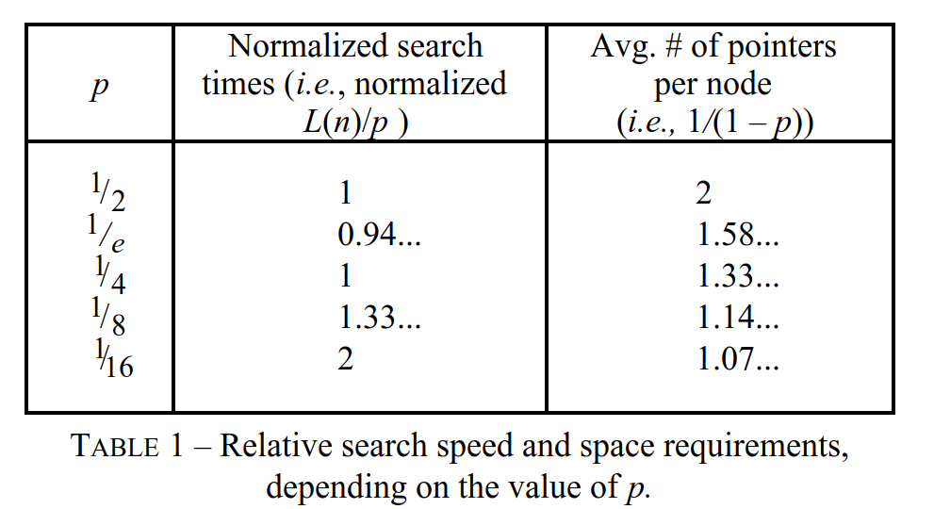
Result

Slide 24
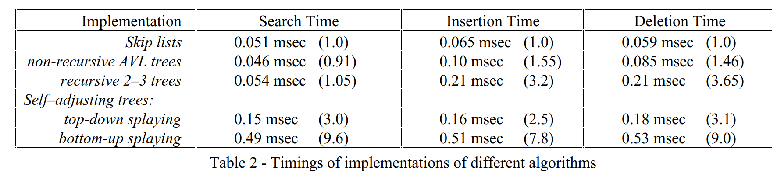
Result

Slide 26
Conclusions
Skip lists have an average search time of O(logn).
Skip lists are significantly easier to implement than balanced trees.
Although skip lists can experience worst-case performance, the likelihood of this happening is very low.

