Slide 1
Faster space-efficient STR-IC-LCS computation
Yuki Yonemoto, Yuto Nakashima, Shunsuke Inenaga, Hideo Bannai
Theoretical Computer Science 1003 (2024): 114607.
Presenter: Shih-Hong Lee
Date: Aug. 27, 2024

Slide 2
Abstract(1/2)
One of the most fundamental method for comparing two given strings 𝐴 and 𝐵 is the longest common subsequence (LCS), where the task is to find (the length) of an LCS of 𝐴 and 𝐵. In this paper, we deal with the STR-IC-LCS problem which is one of the constrained LCS problems proposed by Chen and Chao [J. Comb. Optim, 2011]. A string 𝑍 is said to be an STR-IC-LCS of three given strings 𝐴, 𝐵, and 𝑃 , if 𝑍 is a longest string satisfying that (1) 𝑍 includes 𝑃 as a substring and (2) 𝑍 is a common subsequence of 𝐴 and 𝐵. We present three efficient algorithms for this problem: First, we begin with a space-efficient solution which computes the length of an STR-IC-LCS in 𝑂(𝑛²) time and 𝑂((𝓁 + 1)(𝑛 − 𝓁 + 1)) space, where 𝓁 is the length of an LCS of 𝐴 and 𝐵 of length 𝑛. When 𝓁 = 𝑂(1) or 𝑛 − 𝓁 = 𝑂(1), then this algorithm uses only linear 𝑂(𝑛) space.

Slide 3
Abstract(2/2)
Second, we present a faster algorithm that works in 𝑂(𝑛𝑟∕ log 𝑟 + 𝑛(𝑛 − 𝓁 + 1)) time, where 𝑟 is the length of 𝑃 , while retaining the 𝑂((𝓁 + 1)(𝑛 − 𝓁 + 1)) space efficiency. Third, we give an alternative algorithm that runs in 𝑂(𝑛𝑟∕ log 𝑟 + 𝑛(𝑛 − 𝓁′ + 1)) time with 𝑂((𝓁′ + 1)(𝑛 − 𝓁′ + 1)) space, where 𝓁′ denotes the STR-IC-LCS length for input strings 𝐴, 𝐵, and 𝑃 .

Slide 4
STR-IC-LCS
STR : string
IC : include
LCS : longest common sunsequence
E.g.
Given a string A : abba, B : abab, P : ab
STR-IC-LCS : abb

Slide 5

solution
Given a string A = bcdababcb, B = cbacbaaba, P = abb
minimal intervals of A :<[abab], [abcb]>, B: <[acbab], [abb]>
STR-IC-LCS (A, B, P)
A:[abab], B:[abb]
LCS(bca,cbacb)=2
3
LCS(cb,c) = 1

Slide 6

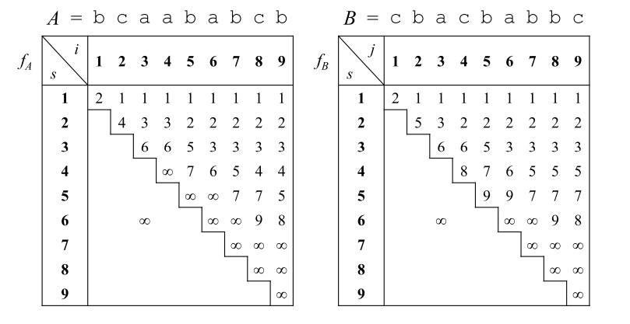
Prefix LCS
F_{a}(2,2) = 4
Means lcs (A[1,2], B[1,4]) = 2 with ending point at B[4]

Slide 7
Prefix LCS
F_{a}(2,2) = min(F_{a}(2,1), j_{2,2}) = min(∞,4) = 4
B[2…9]
1 | 2 | 3 | 4 | 5 | 6 | 7 | 8 | 9
c | b | a | c | b | a | b | b | c

Slide 8
Prefix LCS
F_{a}(5,8) = min(F_{a}(5,7), j_{5,8}) = min(7, 9) = 7
B[5…9]
1 | 2 | 3 | 4 | 5 | 6 | 7 | 8 | 9
c | b | a | c | b | a | b | b | c

Slide 9
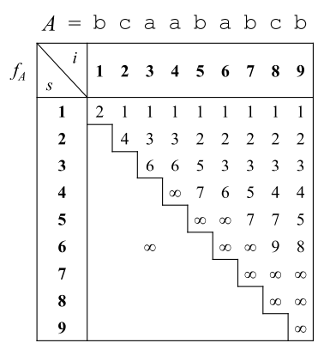
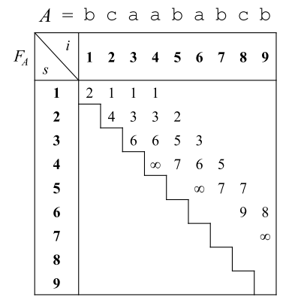
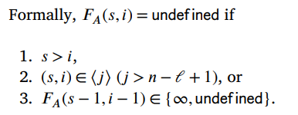
Space-efficient prefix LCS
Lcs(A,B) = 6 = l, store the first n – l +1 diagonals of length l
9-6+1 = 4

Slide 10
Alogorithm
Given a string A = bcdababcb, B = cbacbaaba, P = abb
minimal intervals of A :<[abab], [abcb]>, B: <[acbab], [abb]>
A : [4,7], [6,9]
B : [3,7], [6,8]
Max (
Lcs(A[1,3], B[1,2]) + 3 + lcs(A[8,9], B[8,9])
Lcs(A[1,3], B[1,5]) + 3 + lcs(A[8,9], B[9,9])
Lcs(A[1,5], B[1,2]) + 3 + lcs(↋, B[8,9])
Lcs(A[1,5], B[1,5]) + 3 + lcs(↋, B[9,9])
)

Slide 11
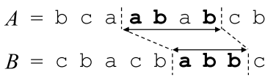
Lcs(A[1,3], B[1,5])
F_{a}(1,3) = 1 ≤ 5 (O), and F_{a}(2,3) = 3 > 5(X)
F_{a}(2,3) = 3 ≤ 5 (O), and F_{a}(3,3) = 6 > 5(O)
And = 2

Slide 12
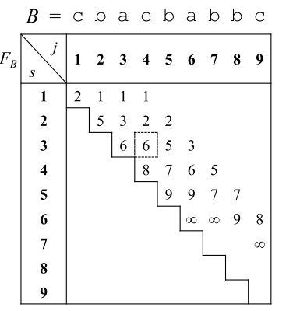
Case 2
Lcs(A[1,7], B[1,4])
F_{a}(1,7) = undefine
F_{a}(2,7) = undefine
F_{a}(3,7) = undefine
F_{a}(4,7) = 5 > 4 and F_{a}(3,7) = undefine
so search F_{b}
F_{b}(1,4) = 1, F_{b}(2,4) = 2, F_{b}(3,4) = 6
F_{b}(4,4) = 8 > 6 , ans = 3

Slide 13
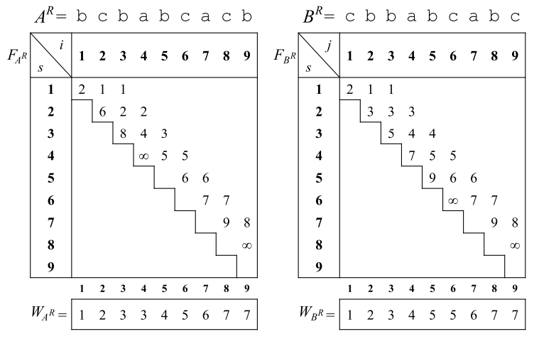
Faster solution

Slide 14
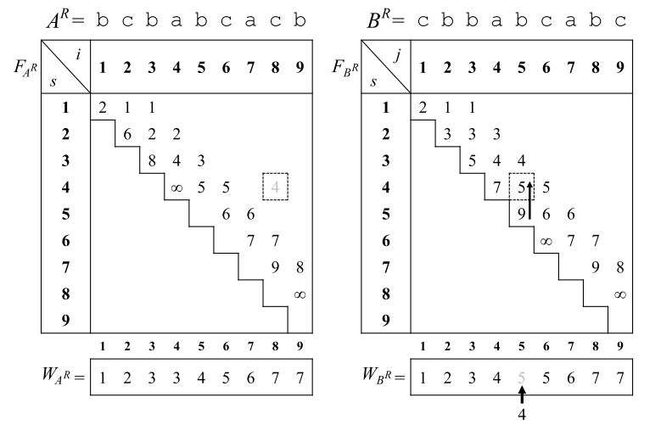
Faster solution
Lcs(A^{R}[1,8], B^{R}[1,5])
F_{ar}(W_{AR}[8] = 7,8) 9 > 5
F_{ar}(6,8) 7 > 5
And F_{ar}(5,8) = undefine
Search F_{br}
F_{br}(W_{BR}[5] = 5,5) 9 > 8
And F_{br}(5-1,5) 5 ≤ 8
Ans = 4 , W_{BR}[5] = 4

Slide 15
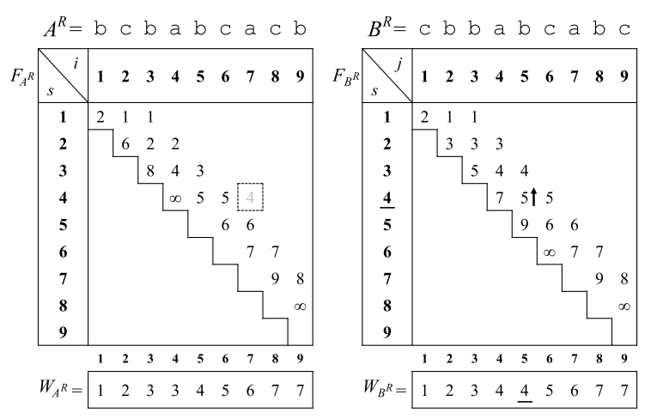
Faster solution
Lcs(A^{R}[1,7], B^{R}[1,5])
F_{ar}(W_{AR}[7] = 6,7) 7 > 5
F_{ar}(6,7) 6 > 5
And F_{ar}(5,7) = undefine
Search F_{br}
F_{br}(W_{BR}[5] = 4,5) 5 ≤ 7
Ans = 4

Slide 16
Thanks

