Slide 1
SABBAC: Online Structural Alphabet-Based Protein
Backbone Reconstruction from Alpha-Carbon Trace
J. Maupetit, R. Gautier and P. Tuffery
Nucleic Acids Research, 2006, Vol. 34, Web Server issue W147–W151
Presenter: Jen-Hui, Wang
Date: Mar. 21, 2007

Slide 2
Abstract
SABBAC is an on-line service devoted to protein backbone reconstruction from alpha-carbon trace. It is based on the assembly of fragments taken from a library of reduced size, selected from the encoding of the protein trace in a hidden Markov model-derived structural alphabet. The assembly of the fragments is achieved by a greedy algorithm, using an energy-based scoring. Alpha-carbon coordinates remain unaffected. SABBAC simply positions the missing backbone atoms, no further refinement is performed. From our tests, SABBAC performs equal or better than other similar on-line approach and is robust to deviations on the alpha-carbon coordinates.

Slide 3
Methods
To select fragments that will be used for the structure generation we encode the alpha-carbon trace in the Hidden Markov Model derived SA-27 structural alphabet
we use the optimal trajectory as produced by the viterbi algorithm. Then at each position, we retain as candidate fragments that represent the letter of the structural alphabet
we have only a number of 155 fragments to describe the 27 letters of the alphabet. Having selected only one letter to describe the conformation of each fragment of four residue length, the average number of fragments used, is only on the order of 5–6 per position. (P. Tuffery et al .)

Slide 4
Improved greedy algorithm for protein structure reconstruction (P. Tuffery et al.)
Definition of the Fragments Associated with Each SBB
  Having encoded 1429 protein structures from PDB, we have extracted and identified for each SBB a set of representative fragments using a standard dynamic clustering procedure based on a minimal dissimilarity threshold (here a maximal RMSD from the centroid of the class)
  Using a threshold of 0.5 Å, it varies from 1 to 23, and results in a collection of 155 fragments for the 27 states, for an average of 4.6 prototypes per letter.

Slide 5
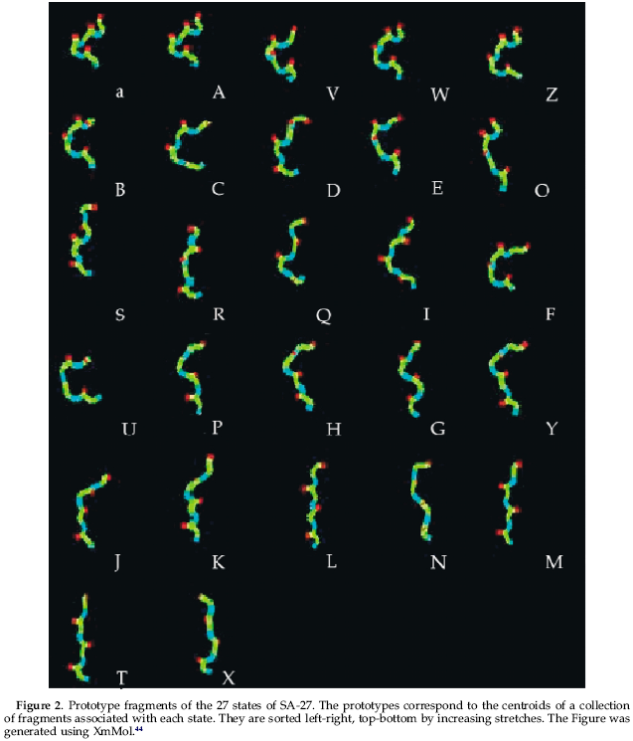

Slide 6
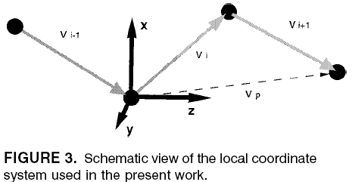

Peptide units coordinates generation
To quickly generate atoms coordinates for the N, HN, C’ and O atoms of the peptide units, we follow a procedure described previously by Milik et al.

Slide 7
Search for an optimal combination of fragments
Given the collection of candidate fragments at each position of the structure, we use a greedy algorithm( P. Tuffery et al.), to search for their optimal combination. At each position, given a collection of reconstruction up to the previous position, we generate all the new possible assemblies of size increased by one residue. Each of them is scored (Energy evaluation), and we retain only a limited subset of assemblies to iterate to the next position (heap size). Here, we use a heap size of only 10, a number learnt from the reconstruction of series of structures.
The rebuild process is only achieved by growing from N-towards C-terminal. The process is not iterated

Slide 8
Greedy algorithm (P. Tuffery et al.)
Greedy algorithms perform the incremental construction of the structure starting from the N-terminus and ending at the C-terminus. Clearly, the number of possible reconstructions for a protein of length L+3 is far too large to be explored exhaustively.
The idea behind basic greedy algorithms , at each of the i positions, and after generating all the possible extensions of the structure, only a maximum of H conformations (heap size) among all the conformations generated are retained for the next step. This process is repeated until the C-terminal extremity is attained.

Slide 9
Energy evaluation
we use an energy criterion combining some of the OPEP force field with some terms assessing the quality of the geometry of the alpha-carbons.
  Esc,sc: side chain-side chain interactions
  E_{HB}: hydrogen bond
  E_{VdW}: The Van der waals backbone-backbone and backbone-side chain interactions
  E_{PhiP}: the phi positive contribution
  E_{BB}: the alpha carbon valence angle distortion
  E_{Trans}: pseudo energy term related to the transitions between consecutive fragments

Slide 10
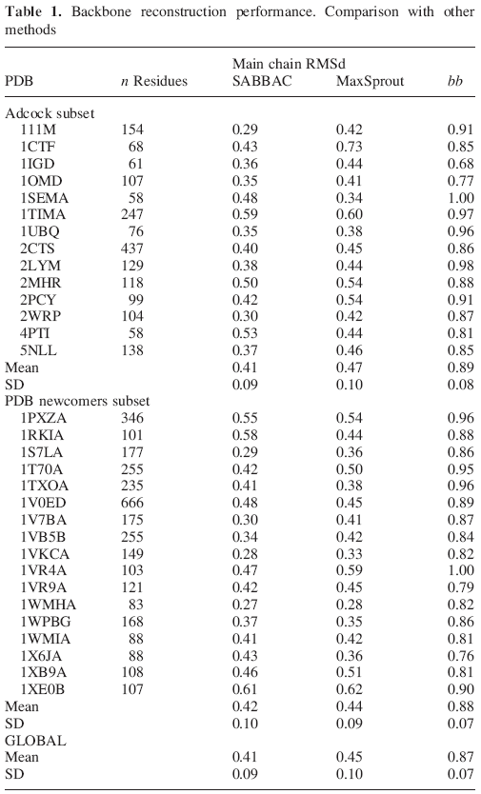
Performances

Slide 11
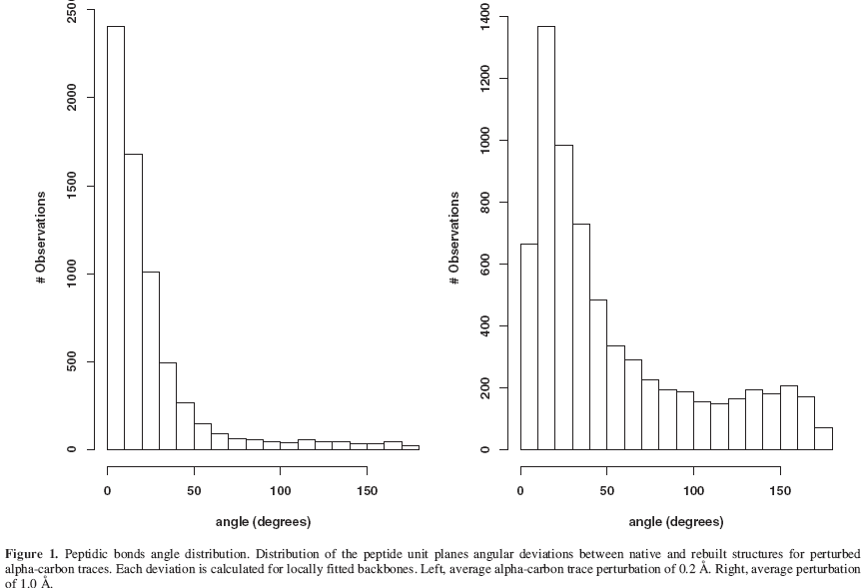
Performances
We have also checked how SABBAC performs for perturbed alpha-carbon trace

