Slide 1
Efficient Algorithms for the Block Edit Problems
Hsing-Yen Ann, Chang-Biau Yang,
Yung-Hsing Peng and Bern-Cherng Liaw
Presenter: Hsing-Yen Ann
Date: November 7, 2026

Slide 2
Introduction to Edit Distance
Edit distance of sequences X and Y:
  The minimal cost to transform X to Y by character deletions and insertions.
  A widely used measurement for the similarity between sequences.
  Consider the character-edit operations independently.
  Insertions, deletions, replacements.

Slide 3
The Classical Edit Distance is Not Sufficient
For following cases:
  To find out the programming code which is plagiarized by the students with relocated functions and renamed variables.
  To find out two identical melodies but with different pitches.
Additional operations are needed:
  Block-Copy, Block-Delete, Block-Shift.

Slide 4
Previous Results and Our Assumptions
Shapira and Storer[14] proved that it is NP-hard when recursive block-move operations are allowed.
Various approximations were proposed.
Our assumptions:
  A series of edit operations are performed from left to right on the source string X.
  Any two block-edit operations would not be performed on overlapping regions on X.

Slide 5
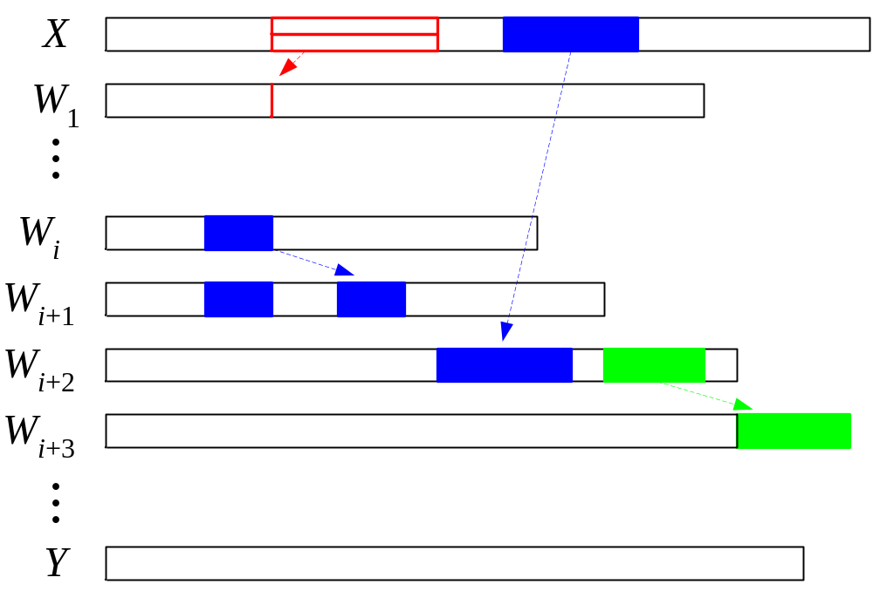
A Series of Block Edit Operations

Slide 6
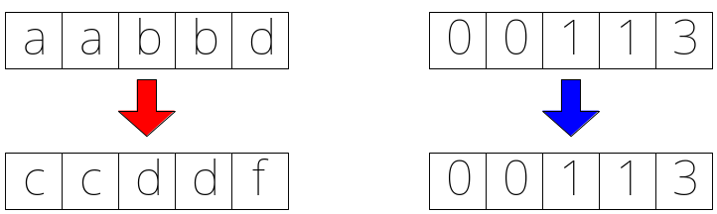
Definitions of the Problems and Their Attributes (1/2)
Let P(o, c) denotes a block edit problem:
  o: a composition of edit operations
  c: the class of cost measures
The Block-Copy operations:
  External copy: copy a substring of X
  Internal copy: copy a valid substring of W_{i-1}
  Shifted copy: copy a shifted substring

Slide 7
Definitions of the Problems and Their Attributes (2/2)
The Cost Measures that can be chosen:
  Constant cost: p_{copy}
  Linear cost: p_{s}+ k × p_{e}
  Nested cost: p_{copy}+ d_{c}(A, B)
Three problems are defined in this paper:
  P(EIS,C)
  P(EI,L)
  P(EI,N)

Slide 8
Problem 1 -- P(EIS,C)
External and internal copies are allowed in constant cost.
Shifted copies are allowed in constant cost.
It can be solved by a straightforward DP algorithm in O(nm² (n + m) |Σ|) time.
We propose an O(nm) time DP algorithm with
  O(n+m²) preprocessing time in the worst cast
  O(n+mlogm) preprocessing time in average

Slide 9
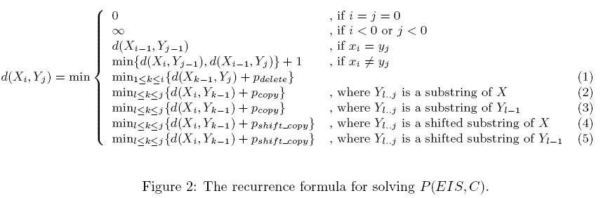
Recurrence Formula for P(EIS,C)

Slide 10
Preprocessing for P(EIS,C)
For external copies:
  Build a suffix tree T(X^{R}#Y^{R}$) to find the common substrings between X and Y.
For internal copies:
  Build a suffix tree T(Y^{R}) to find the valid common substrings to be copied from working string W_{i} to W_{i+1}.
For shifted copies:
  Compute the differential strings X' and Y' of X and Y.
  Find the valid common substrings for external / internal copies.

Slide 11
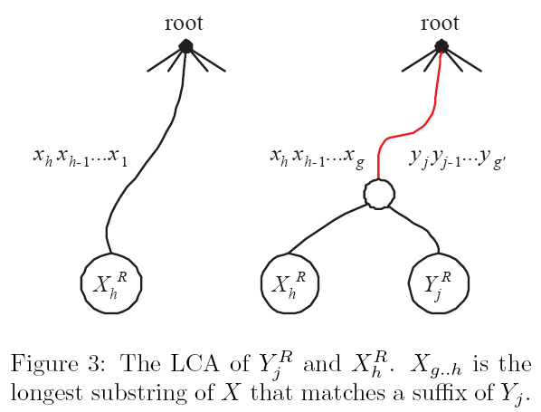
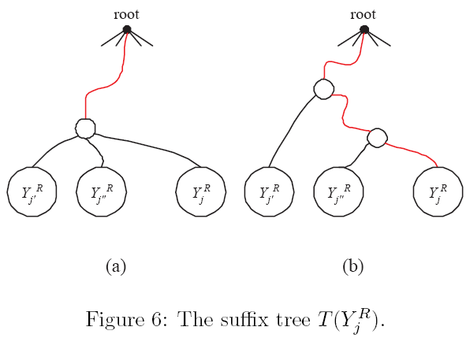
Longest Common Prefixes and Suffix trees

Slide 12
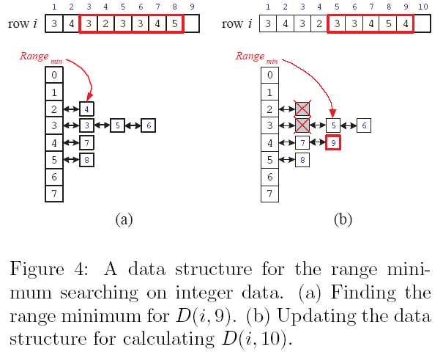
Finding and Maintaining the Range Minimum in Constant Time

Slide 13
Problem 2 -- P(EI,L)
The cost of copies and deletions are with an initial penalty plus a linear extended penalty.
It can be solved by a straightforward DP algorithm in O(nm² (n + m)) time.
We propose an O(n m log m) time DP algorithm.
  The preprocessing time is equal to that of the problem 1.
  Because of the floating-point values in the searching range, we use the balanced binary search trees rather than the data structure shown in Figure 4.

Slide 14
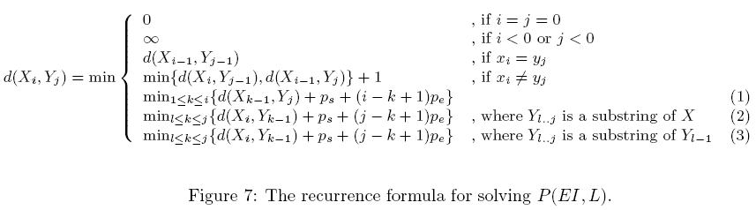
Recurrence Formula for P(EI,L)

Slide 15
Problem 3 -- P(EI,N)
The copied strings can be further edited with character-edit operations.
The cost of a copy operation is equal to a constant copy penalty plus a classical edit distance.
It can be solved by a straightforward DP algorithm in O(n²m³) time.
We propose an O(nm²) time DP algorithm with O((n+m) m²) preprocessing time.

Slide 16
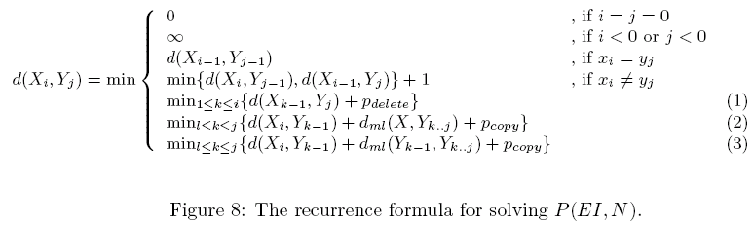
Recurrence Formula for P(EI,N)

Slide 17
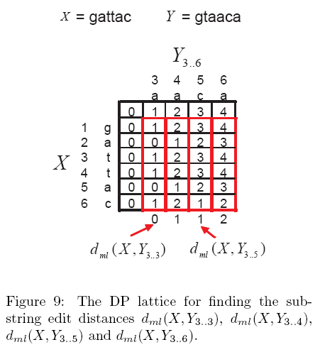
Finding the Substring Edit Distance in Constant Time

Slide 18
Conclusion
We solve the P(EIS,C) problem in O(nm) time, and it is useful when comparing to the classical edit distances.
P(EI,L) and P(EI,N) can be solved in O(nmlogm) and O(nm²) time, respectively.
Does there exist more efficient algorithms to solve the P(EI,N) problem and make it more practical?

Slide 19
Thank You

