Slide 1
Oriented Speckle Reducing
Anisotropic Diffusion
Karl Krissian, Carl-Fredrik Westin, Ron Kikinis, and
Kirby G. Vosburgh
IEEE TRANSACTIONS ON IMAGE PROCESSING,
VOL. 16, NO. 5, MAY 2007
Reporter: Chiou-Yi Hor
Date: June 13, 2007

Slide 2
Introduction
Ultrasound imaging systems (超音波影像系統) provide noninvasive, low-cost, and real-time images that can help clinician in diagnosis, planning, and therapy.
However, although the human eye is able to derive the meaningful information from these images, automatic processing is very difficult due to noise and artifacts present in the image.
A new speckle reducing an-isotropic diffusion (非等向性的擴散) filtering, which adapts the characteristics of the speckle noise, was proposed to improve the image appearance and facilitate its following processing.

Slide 3
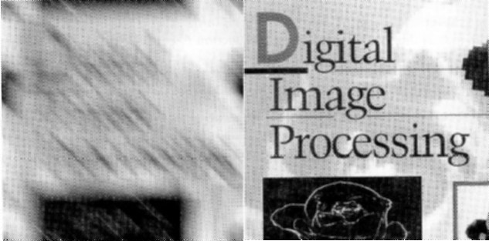
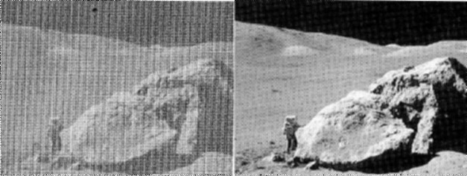
Background
Image Restoration
  The goal of restoration is to improve a degraded image in some predefined sense.
  Example

Slide 4
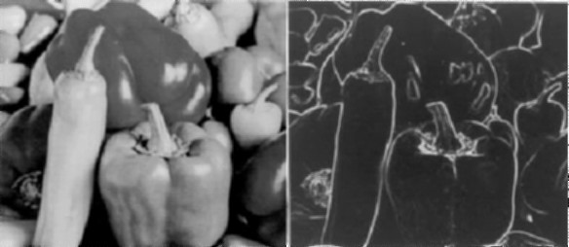
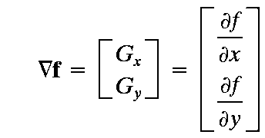
Background
Gradient
  For a 2D image, the gradient is defined as horizontal and vertical spatial derivatives.
  In the image processing, it is used for edge detection as it represents positions of steep intensity change.

Slide 5
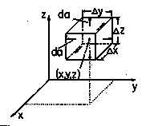
Background
Divergence
  It suggests a combination of derivatives that describes the outflow of A from the neighborhood of the point of evaluation.
  Example in Cartesian coordinates

Slide 6
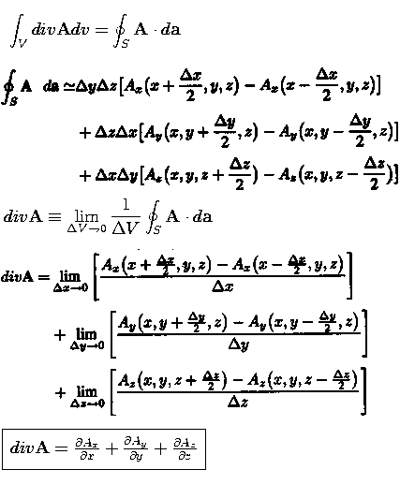
Background
Divergence (Continued)

Slide 7
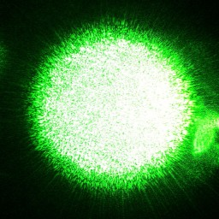
Background
Speckle
  A random intensity pattern produced by the mutual interference of coherent wave-fronts that are subject to phase differences and/or intensity fluctuations
  Examples
    Laser beams, ultrasound, highly magnified image of a star through the atmosphere
  An accurate description of the speckle statistics is still an area of active investigation and it involves complex analytical models.

Slide 8




Background
Study on speckled ultrasonic images
  To use various models to achieve the speckle noise reduction
  General models
    or
    Where f and g denote the original and degraded image; n and m denote multiplicative and additive noises
    n is more significant than m
  For reconstruction, we would like to obtain , which is an estimate of .

Slide 9


Background
Speckled image reconstruction by diffusion
  Original model
  Diffusion model
  An-isotropic diffusion model based on the partial differential equation
  The diffusion coefficient (1-k) is a local statistical property that controls the diffusion (or filtering) process.
  The diffusion process may involve intensive numerical iterations before convergence arrives. (t=0,1Δt,2Δt,…)

Slide 10
Background
Why diffusion coefficient?
  When the observed local standard deviation is characteristic of noises (noise dominant), we prefer k->0 and apply diffusion to smooth the image
  Otherwise, we prefer k->1 to facilitate edge preservation.
  The key point is how to choose k so as to compromise between noise reduction and edge preservation.

Slide 11
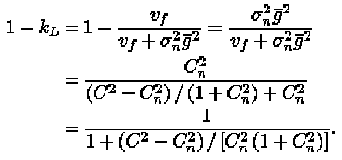


Background
Diffusion coefficient’s how to
  Lee suggests
  Kuan et al. suggest
  Where and . The only item we don’t know is .

Slide 12
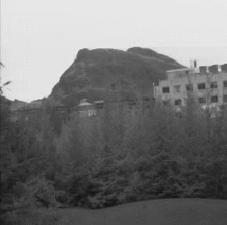

Background
How to estimate noises’ variance
  From a region selected by the user, for example
  From the median of the neighborhood coefficients. The following formula denotes Cu=Cn and Cij=C

Slide 13
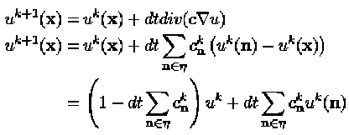

Background
Numerical iterations for diffusion
  Original equation
  We use c to denote (1-k)
  We call it explicit scheme. Although being simple and accurate (less than 1% error), it usually suffers from convergence problem due to improper “dt” selections. This encourages the other adaptation called “semi-explicit scheme” (with error between 1%~1.7%).

Slide 14

Background
Semi-explicit numerical iterations
  Jacobi method
    During each iteration, approximates of other variables are plugged in and the order in which equations are evaluated are irrelevant.
    In spite of requiring intensive computations, Jacobi method is easy to fulfill parallelism.
  Beside Jacobi method, Gauss-Seidel and additive operator splitting (AOS) also belong to this category.

Slide 15
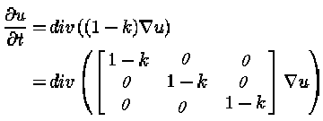

Background
Original speckle reduction an-isotropic diffusion (SRAD) in 3D images:
The following matrix D is denoted diffusion matrix

Slide 16

Methodology
A new diffusion proposed in this paper called oriented SRAD (OSRAD) is based on v0,v1, and v2. The “.” =>0
The decision of k follows Lee or Kuan’s suggestion and v0 is the gradient.
The cmax and cmin represent the amount of smoothing along the direction of maximal and minimal curvature respectively.
For 2D case, only ctangent is adopted.

Slide 17
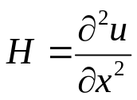

Methodology
Calculation of v1 and v2
  Compute the Hessian matrix of each pixel x
  The principal directions (v1 & v2) of curvature are eigenvectors of the projection of H in the plane orthogonal to the gradient and can be calculated from the eigenvectors of H’
  In this study,(1-k), cmax and cmin are diffusion coefficients along v0, v1 and v2 direction.

Slide 18
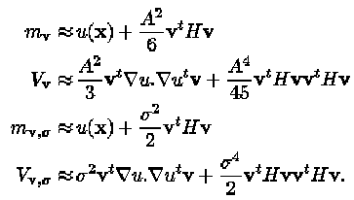


Methodology
Diffusion along v0, v1 and v2 with (1-k), cmax and cmin
  For each pixel (2D) or volex (3D) x:
  Decide how many neighbors (A) are involved for diffusion.
  Calculate local mean & variance along these 3 directions
  Use to calculate local diffusion coefficients with each neighbor n, namely .
  Apply Jacobi diffusion scheme.

Slide 19


Methodology
Measurement of the reconstruction quality
  Mf : a measure of image intensity between the noisy and reconstructed synthetic images
  FOM (Pratt’s figure of merit) : a measurement of edge preservation
  Where f: filter id; r: region index, mr,f,σr,f,: mean intensity and standard deviation of region r for filter f; mr: mean intensity of region r in the noisy image; Dr:average value of dr,f for a region r over all filter f;Nideal,Ń: # of ideal and detected edges;α=0.9; di: Euclidean distance between detected & its nearest ideal edge

Slide 20
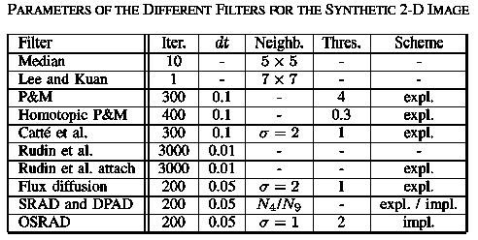
Methodology
Experiment 1 parameters

Slide 21
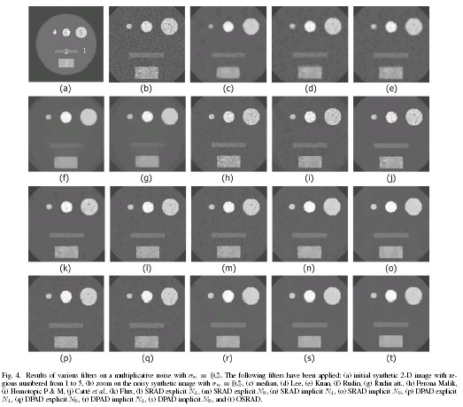
Results
Results of experiment 1

Slide 22
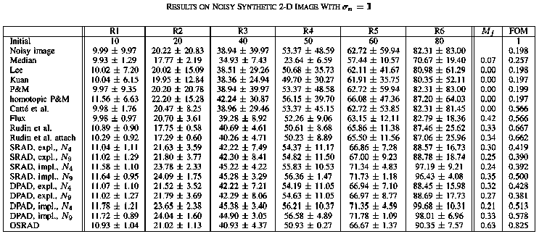
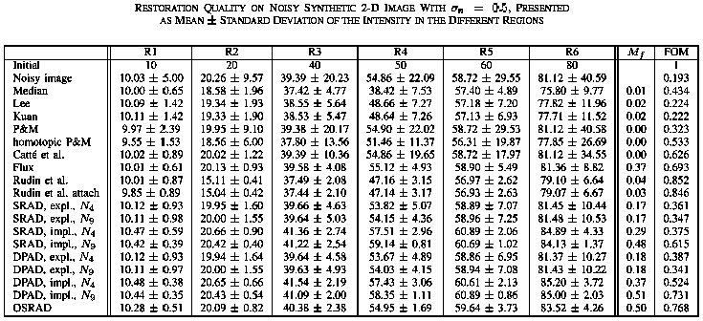
Results
Results of experiment 1

Slide 23
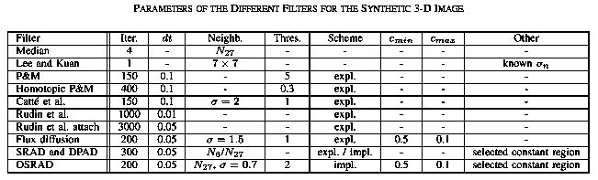
Methodology
Experiment 2 parameters

Slide 24
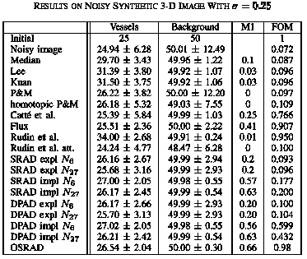
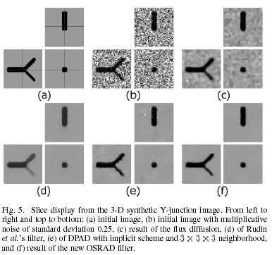
Results
Results of experiment 2

Slide 25
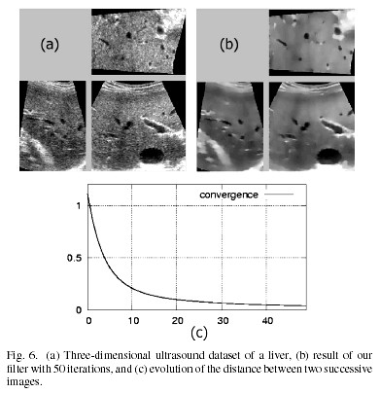
Results
Results of experiment 3
RMS of two images’
Difference

