Slide 1
Efficient String Matching:
An Aid to Bibliographic Search
A. V. Aho and M. J. Corasick
Communications of the ACM, Vol. 18, No. 6,
1975, pp. 333-340
Date: Jun. 13, 2007
Introducer: Hsing-Yen Ann

Slide 2
Abstract
This paper describes a simple, efficient algorithm to locate all occurrences of any of a finite number of keywords in a string of text. The algorithm consists of constructing a finite state pattern matching machine from the keywords and then using the pattern matching machine to process the text string in a single pass. Construction of the pattern matching machine takes time proportional to the sum of the lengths of the keywords. The number of state transitions made by the pattern matching machine in processing the text string is independent of the number of keywords. The algorithm has been used to improve the speed of a library bibliographic search program by a factor of 5 to 10.

Slide 3
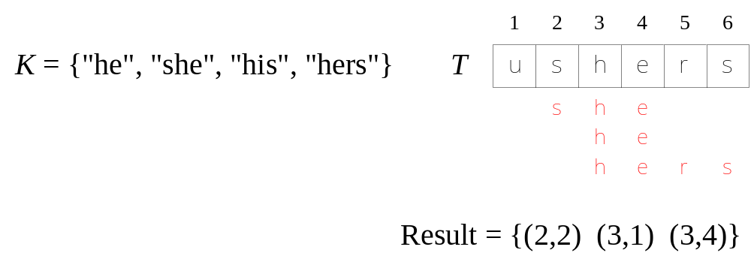
Problem Definition
Input:
  A finite set of keywords K = {P₁, P₂, …, P_{k}}
  A text string T = t₁ t₂ … t_{n}
Output:
  All occurrences of any keyword in T

Slide 4
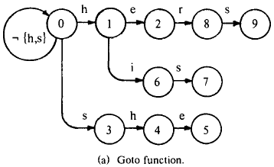
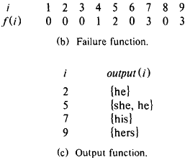
Pattern Matching Machine (1/2)
A pattern matching machine consists of a current state and three functions {Goto, Failure, Output}.
The three functions are computed from keywords.
When a new character of text comes in, the current state changes and check if matched keywords occur.
Failure function maintains the failure paths.

Slide 5
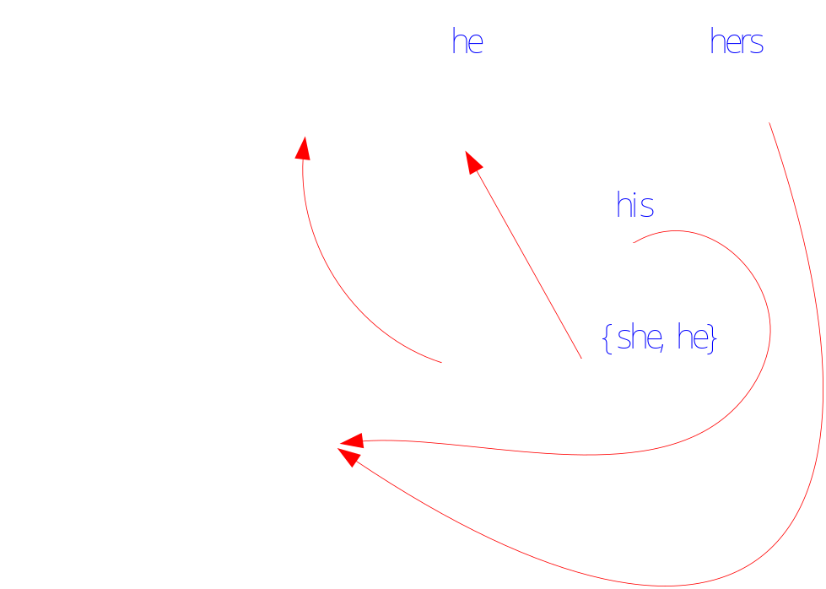
Pattern Matching Machine (2/2)

Slide 6
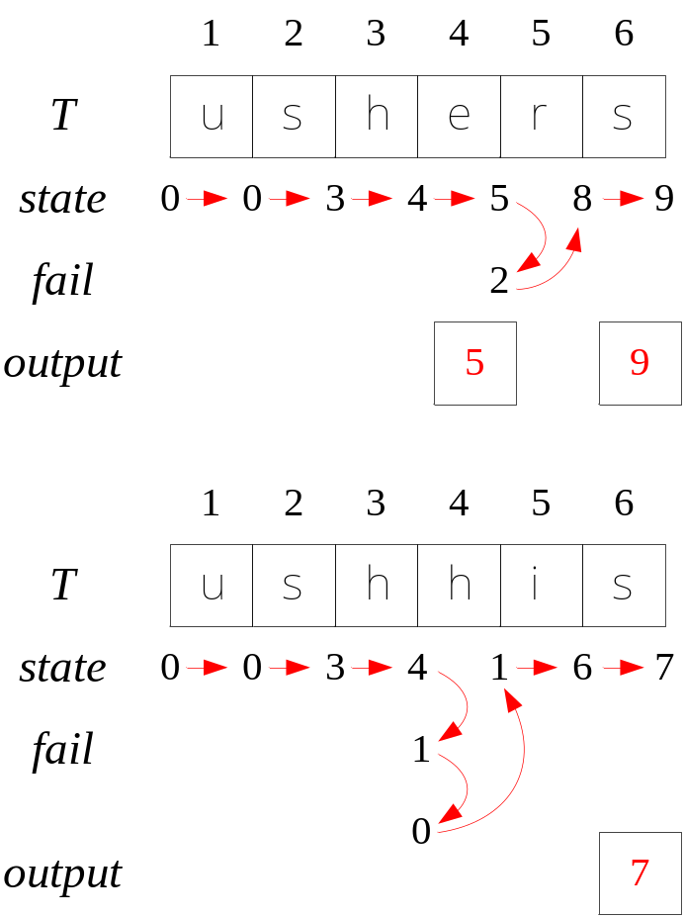
Pattern Matching Process

Slide 7
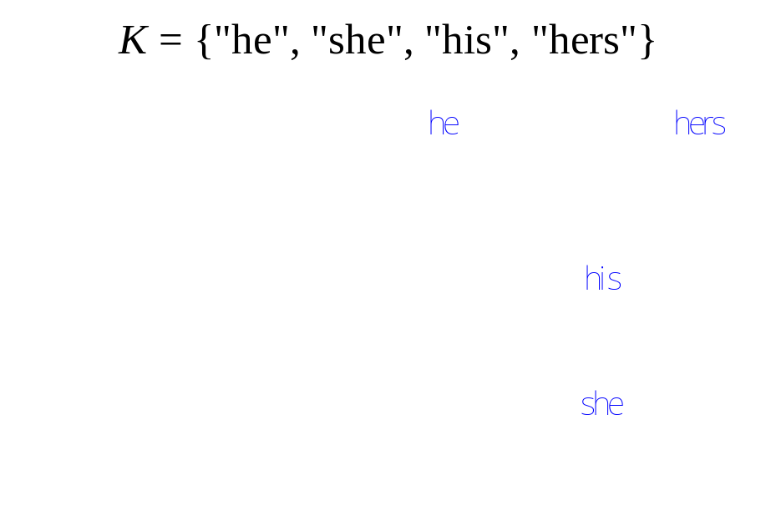
Construct the Goto Function
Goto function is a trie.
When a keyword is completely added, set the output function.

Slide 8
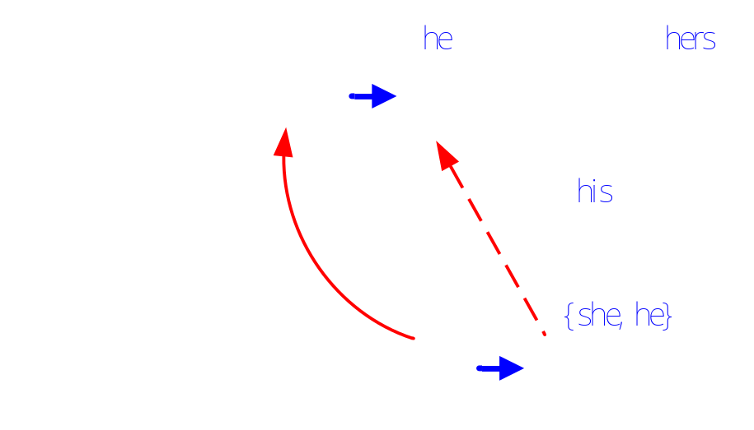
Construct the Failure Function and Update the Output Function
We can compute fail(5) after we knew that:
fail(4)=1 , goto(4, e)=5 and goto(1, e)=2
Then we can set that
fail(5)=goto(fail(4), e)=2, output(5)=output(5)∪output(2)
Compute the low-level nodes first.

Slide 9
Analysis of the Time Complexity
Construction time of the pattern matching machine is O(length(K)).
In the matching process, there are at most n goto steps and n failure steps.
Overall time: O(n + length(K))

Slide 10
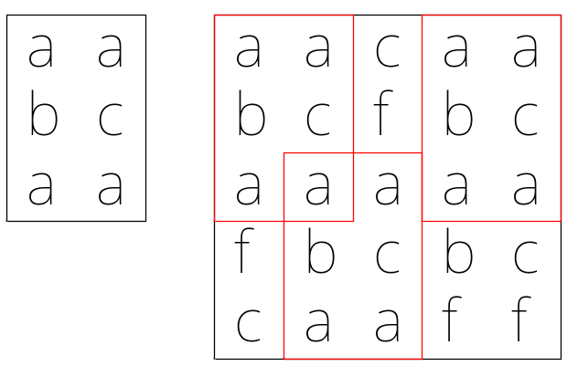
ACM UVa 11019 – Matrix Matcher
Given an N * M text matrix, find the number of occurrences of an X * Y pattern.
15 test cases.
0 < N, M ≦1000 and 0 < X, Y ≦100.
How to solve it in O(NM + XY) time?

Slide 11
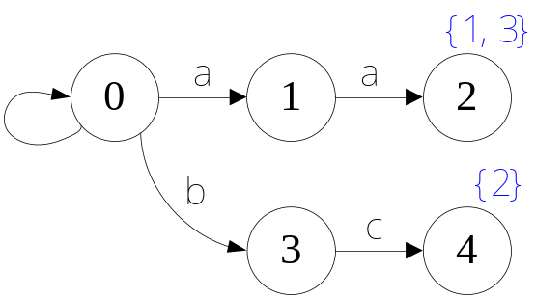
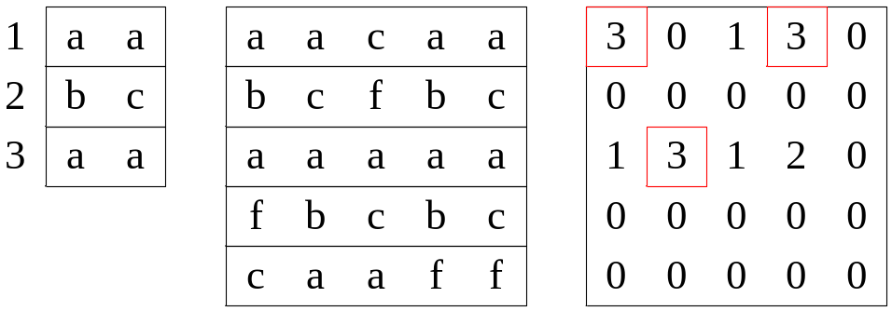
Apply Aho-Corasick algorithm Directly
Use a matrix to count the output keywords at its corresponding start locations.
Identical keyword may be count more than twice.
Needs O(XNM + XY) time in the worst case.

Slide 12
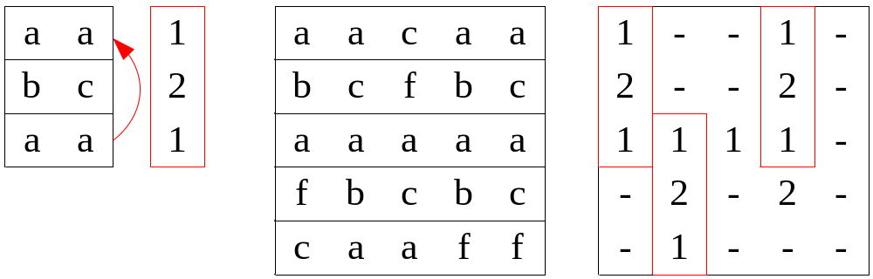
Modify the Output Function and Apply Aho-Corasick Algorithm Twice
The output function returns the first index of the keyword.
We can search the modified pattern in the output matrix.
Use a balanced binary search tree to find the first index of the keywords, total time: O(NM + XY log X)
Use a suffix tree to find the first index of the keywords, total time: O(NM + XY)

