Slide 1
On finding a longest common palindromic subsequence
Sang Won Bae and Inbok Lee
Department of Computer Science, Kyonggi University, Suwon, 443-760, Republic of Korea
Department of Software and Computer Engineering, Korea Aerospace University, Goyang, 412-791, Republic of Korea
Theoretical Computer Science
Volume 710, 1 February 2018, Pages 29-34
Presenter: Ting-Wei Liang
Date:2019/06/18

Slide 2
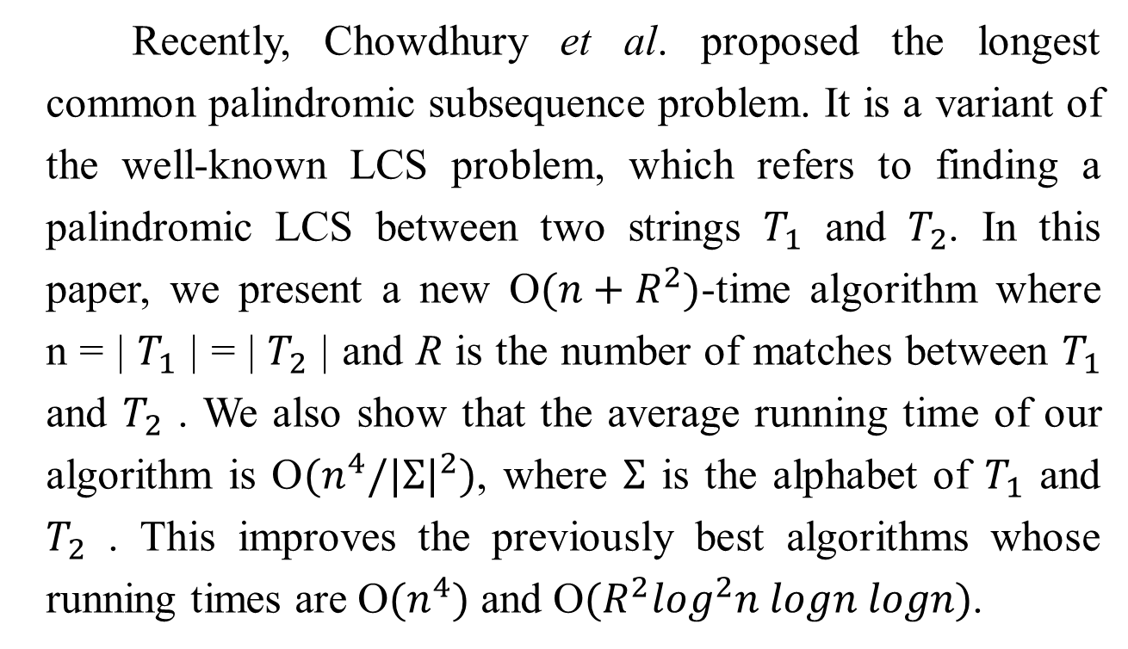
Abstract
Recently, Chowdhury et al. proposed the longest common palindromic subsequence problem. It is a variant of the well-known LCS problem, which refers to finding a palindromic LCS between two strings $T_{1}$ and $T_{2}$. In this paper, we present a new O$(n+R^{2})$-time algorithm where n = | $T_{1}$ | = | $T_{2}$ | and R is the number of matches between $T_{1}$ and $T_{2}$ . We also show that the average running time of our algorithm is O$(n^{4}/{|Σ|}^{2})$, where $Σ$ is the alphabet of $T_{1}$ and $T_{2}$ . This improves the previously best algorithms whose running times are O$(n^{4})$ and O$(R^{2}\log^{2}n logn logn)$.

Slide 3

Longest Common Palindromic Subsequence(LCPS)
$T_{1}$ = acbccdbab
$T_{2}$ = babbcdcba
LCPS(T₁,T₂) = abccba

Slide 4
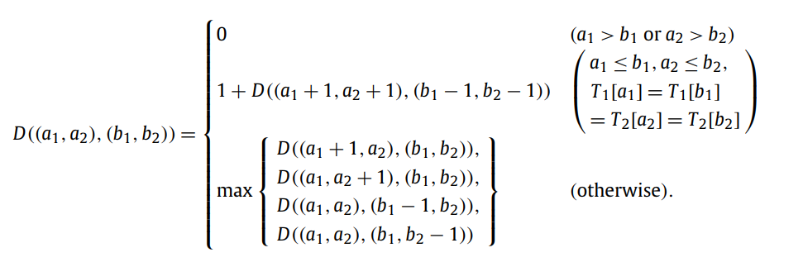

DP method by Chowdhury et al.
Time complexity : $O(n^{4})$

Slide 5

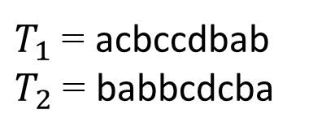
Matches and Partition
B A |  | 1 | 2 | 3 | 4 | 5 | 6 | 7 | 8 | 9
 |  | b | a | b | b | c | d | c | b | a
1 | a |  | ● |  |  |  |  |  |  | ●
2 | c |  |  |  |  | ● |  | ●
3 | b | ● |  | ● | ● |  |  |  | ●
4 | c |  |  |  |  | ● |  | ●
5 | c |  |  |  |  | ● |  | ●
6 | d |  |  |  |  |  | ●
7 | b | ● |  | ● | ● |  |  |  | ●
8 | a |  | ● |  |  |  |  |  |  | ●
9 | b | ● |  | ● | ● |  |  |  | ●
B A |  | 1 | 2 | 3 | 4 | 5 | 6 | 7 | 8 | 9
 |  | b | a | b | b | c | d | c | b | a
1 | a |  | ● |  |  |  |  |  |  | ●
2 | c |  |  |  |  | ● |  | ●
3 | b | ● |  | ● | ● |  |  |  | ●
4 | c |  |  |  |  | ● |  | ●
5 | c |  |  |  |  | ● |  | ●
6 | d |  |  |  |  |  | ●
7 | b | ● |  | ● | ● |  |  |  | ●
8 | a |  | ● |  |  |  |  |  |  | ●
9 | b | ● |  | ● | ● |  |  |  | ●
①
❻
②
③
❺
④
❹
⑤
❸
⑥
❷
❶
$T_{1}$ = acbccdbab
$T_{2}$ = babbcdcba
LCPS($T_{1}$, $T_{2}$) = abccba

Slide 6
Matches and Partition
B A |  | 1 | 2 | 3 | 4 | 5 | 6 | 7 | 8 | 9
 |  | b | a | b | b | c | d | c | b | a
1 | a |  | ● |  |  |  |  |  |  | ●
2 | c |  |  |  |  | ● |  | ●
3 | b | ● |  | ● | ● |  |  |  | ●
4 | c |  |  |  |  | ● |  | ●
5 | c |  |  |  |  | ● |  | ●
6 | d |  |  |  |  |  | ●
7 | b | ● |  | ● | ● |  |  |  | ●
8 | a |  | ● |  |  |  |  |  |  | ●
9 | b | ● |  | ● | ● |  |  |  | ●
B A |  | 1 | 2 | 3 | 4 | 5 | 6 | 7 | 8 | 9
 |  | b | a | b | b | c | d | c | b | a
1 | a |  | ● |  |  |  |  |  |  | ●
2 | c |  |  |  |  | ● |  | ●
3 | b | ● |  | ● | ● |  |  |  | ●
4 | c |  |  |  |  | ● |  | ●
5 | c |  |  |  |  | ● |  | ●
6 | d |  |  |  |  |  | ●
7 | b | ● |  | ● | ● |  |  |  | ●
8 | a |  | ● |  |  |  |  |  |  | ●
9 | b | ● |  | ● | ● |  |  |  | ●
①
❻
②
③
❺
④
❹
⑤
❸
⑥
❷
❶
$T_{1}$ = acbccdbab
$T_{2}$ = babbcdcba
LCPS($T_{1}$, $T_{2}$) = abccba

Slide 7
Matches and Partition
B A |  | 1 | 2 | 3 | 4 | 5 | 6 | 7 | 8 | 9
 |  | b | a | b | b | c | d | c | b | a
1 | a |  | ● |  |  |  |  |  |  | ●
2 | c |  |  |  |  | ● |  | ●
3 | b | ● |  | ● | ● |  |  |  | ●
4 | c |  |  |  |  | ● |  | ●
5 | c |  |  |  |  | ● |  | ●
6 | d |  |  |  |  |  | ●
7 | b | ● |  | ● | ● |  |  |  | ●
8 | a |  | ● |  |  |  |  |  |  | ●
9 | b | ● |  | ● | ● |  |  |  | ●
B A |  | 1 | 2 | 3 | 4 | 5 | 6 | 7 | 8 | 9
 |  | b | a | b | b | c | d | c | b | a
1 | a |  | ● |  |  |  |  |  |  | ●
2 | c |  |  |  |  | ● |  | ●
3 | b | ● |  | ● | ● |  |  |  | ●
4 | c |  |  |  |  | ● |  | ●
5 | c |  |  |  |  | ● |  | ●
6 | d |  |  |  |  |  | ●
7 | b | ● |  | ● | ● |  |  |  | ●
8 | a |  | ● |  |  |  |  |  |  | ●
9 | b | ● |  | ● | ● |  |  |  | ●
①
❻
②
③
❺
④
❹
⑤
❸
⑥
❷
❶
$T_{1}$ = acbccdbab
$T_{2}$ = babbcdcba
LCPS($T_{1}$, $T_{2}$) = abccba

Slide 8
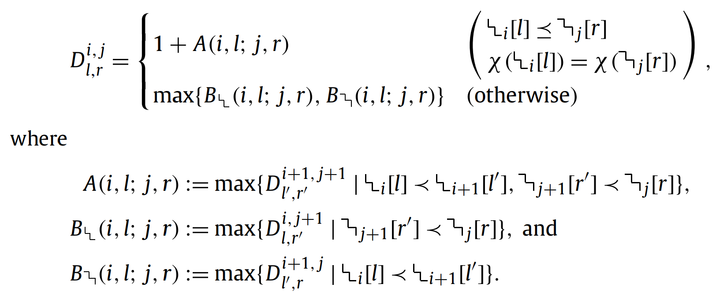



DP method
the problem can be solved via dynamic programming by running four indices:
i from $m_{1}$ down to 1, j from $m_{2}$ down to 1,
l from 1 to , and r from 1 to .
It solves exactly $R^{2}$ subproblems.

Slide 9
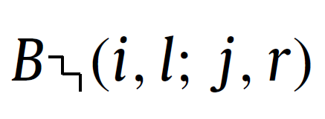
Matches and Partition
B A |  | 1 | 2 | 3 | 4 | 5 | 6 | 7 | 8 | 9
 |  | b | a | b | b | c | d | c | b | a
1 | a |  | ● |  |  |  |  |  |  | ●
2 | c |  |  |  |  | ● |  | ●
3 | b | ● |  | ● | ● |  |  |  | ●
4 | c |  |  |  |  | ● |  | ●
5 | c |  |  |  |  | ● |  | ●
6 | d |  |  |  |  |  | ●
7 | b | ● |  | ● | ● |  |  |  | ●
8 | a |  | ● |  |  |  |  |  |  | ●
9 | b | ● |  | ● | ● |  |  |  | ●
B A |  | 1 | 2 | 3 | 4 | 5 | 6 | 7 | 8 | 9
 |  | b | a | b | b | c | d | c | b | a
1 | a |  | ● |  |  |  |  |  |  | ●
2 | c |  |  |  |  | ● |  | ●
3 | b | ● |  | ● | ● |  |  |  | ●
4 | c |  |  |  |  | ● |  | ●
5 | c |  |  |  |  | ● |  | ●
6 | d |  |  |  |  |  | ●
7 | b | ● |  | ● | ● |  |  |  | ●
8 | a |  | ● |  |  |  |  |  |  | ●
9 | b | ● |  | ● | ● |  |  |  | ●
①
❻
②
③
❺
④
❹
⑤
❸
⑥
❷
❶

Slide 10
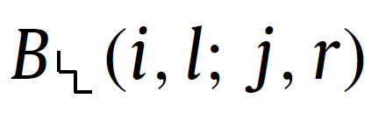
Matches and Partition
B A |  | 1 | 2 | 3 | 4 | 5 | 6 | 7 | 8 | 9
 |  | b | a | b | b | c | d | c | b | a
1 | a |  | ● |  |  |  |  |  |  | ●
2 | c |  |  |  |  | ● |  | ●
3 | b | ● |  | ● | ● |  |  |  | ●
4 | c |  |  |  |  | ● |  | ●
5 | c |  |  |  |  | ● |  | ●
6 | d |  |  |  |  |  | ●
7 | b | ● |  | ● | ● |  |  |  | ●
8 | a |  | ● |  |  |  |  |  |  | ●
9 | b | ● |  | ● | ● |  |  |  | ●
B A |  | 1 | 2 | 3 | 4 | 5 | 6 | 7 | 8 | 9
 |  | b | a | b | b | c | d | c | b | a
1 | a |  | ● |  |  |  |  |  |  | ●
2 | c |  |  |  |  | ● |  | ●
3 | b | ● |  | ● | ● |  |  |  | ●
4 | c |  |  |  |  | ● |  | ●
5 | c |  |  |  |  | ● |  | ●
6 | d |  |  |  |  |  | ●
7 | b | ● |  | ● | ● |  |  |  | ●
8 | a |  | ● |  |  |  |  |  |  | ●
9 | b | ● |  | ● | ● |  |  |  | ●
①
❻
②
③
❺
④
❹
⑤
❸
⑥
❷
❶

Slide 11
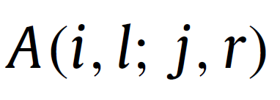
Matches and Partition
B A |  | 1 | 2 | 3 | 4 | 5 | 6 | 7 | 8 | 9
 |  | b | a | b | b | c | d | c | b | a
1 | a |  | ● |  |  |  |  |  |  | ●
2 | c |  |  |  |  | ● |  | ●
3 | b | ● |  | ● | ● |  |  |  | ●
4 | c |  |  |  |  | ● |  | ●
5 | c |  |  |  |  | ● |  | ●
6 | d |  |  |  |  |  | ●
7 | b | ● |  | ● | ● |  |  |  | ●
8 | a |  | ● |  |  |  |  |  |  | ●
9 | b | ● |  | ● | ● |  |  |  | ●
B A |  | 1 | 2 | 3 | 4 | 5 | 6 | 7 | 8 | 9
 |  | b | a | b | b | c | d | c | b | a
1 | a |  | ● |  |  |  |  |  |  | ●
2 | c |  |  |  |  | ● |  | ●
3 | b | ● |  | ● | ● |  |  |  | ●
4 | c |  |  |  |  | ● |  | ●
5 | c |  |  |  |  | ● |  | ●
6 | d |  |  |  |  |  | ●
7 | b | ● |  | ● | ● |  |  |  | ●
8 | a |  | ● |  |  |  |  |  |  | ●
9 | b | ● |  | ● | ● |  |  |  | ●
①
❻
②
③
❺
④
❹
⑤
❸
⑥
❷
❶

Slide 12
Continuous relation
B A |  | 1 | 2 | 3 | 4 | 5 | 6 | 7 | 8 | 9
 |  | b | a | b | b | c | d | c | b | a
1 | a |  | ● |  |  |  |  |  |  | ●
2 | c |  |  |  |  | ● |  | ●
3 | b | ● |  | ● | ● |  |  |  | ●
4 | c |  |  |  |  | ● |  | ●
5 | c |  |  |  |  | ● |  | ●
6 | d |  |  |  |  |  | ●
7 | b | ● |  | ● | ● |  |  |  | ●
8 | a |  | ● |  |  |  |  |  |  | ●
9 | b | ● |  | ● | ● |  |  |  | ●
B A |  | 1 | 2 | 3 | 4 | 5 | 6 | 7 | 8 | 9
 |  | b | a | b | b | c | d | c | b | a
1 | a |  | ● |  |  |  |  |  |  | ●
2 | c |  |  |  |  | ● |  | ●
3 | b | ● |  | ● | ● |  |  |  | ●
4 | c |  |  |  |  | ● |  | ●
5 | c |  |  |  |  | ● |  | ●
6 | d |  |  |  |  |  | ●
7 | b | ● |  | ● | ● |  |  |  | ●
8 | a |  | ● |  |  |  |  |  |  | ●
9 | b | ● |  | ● | ● |  |  |  | ●
①
①
②
②
③
③
④
④
⑤
⑤
⑥
⑥
{1,2,3,4,5}
{5,6}

Slide 13
Continuous relation
B A |  | 1 | 2 | 3 | 4 | 5 | 6 | 7 | 8 | 9
 |  | b | a | b | b | c | d | c | b | a
1 | a |  | ● |  |  |  |  |  |  | ●
2 | c |  |  |  |  | ● |  | ●
3 | b | ● |  | ● | ● |  |  |  | ●
4 | c |  |  |  |  | ● |  | ●
5 | c |  |  |  |  | ● |  | ●
6 | d |  |  |  |  |  | ●
7 | b | ● |  | ● | ● |  |  |  | ●
8 | a |  | ● |  |  |  |  |  |  | ●
9 | b | ● |  | ● | ● |  |  |  | ●
B A |  | 1 | 2 | 3 | 4 | 5 | 6 | 7 | 8 | 9
 |  | b | a | b | b | c | d | c | b | a
1 | a |  | ● |  |  |  |  |  |  | ●
2 | c |  |  |  |  | ● |  | ●
3 | b | ● |  | ● | ● |  |  |  | ●
4 | c |  |  |  |  | ● |  | ●
5 | c |  |  |  |  | ● |  | ●
6 | d |  |  |  |  |  | ●
7 | b | ● |  | ● | ● |  |  |  | ●
8 | a |  | ● |  |  |  |  |  |  | ●
9 | b | ● |  | ● | ● |  |  |  | ●
❻
❻
❺
❺
❹
❹
❸
❸
❷
❷
❶
❶
{1,2,3,4}
{3,4,5}

Slide 14
Maximal
Data : 3, 5, 4, 2, 6, 7, 3, 2
Queue
Deque
2
4
2
5
4
3
5

Slide 15
Maximal
Data : 3, 5, 4, 2, 6, 7, 3, 2
Queue
Deque
2
4
2
5
4
3
5

Slide 16
Time Complexity
Time Complexity : O(R²)
Average R = n²/σ
Complexity in average : O(n⁴/σ²)

