Slide 1
Analysis of distance-based protein structure prediction by deep learning in CASP13
Jinbo Xu, Sheng Wang
bioRxiv.org , 2019
Speaker: Jheng-Yan Lyu
Date: Jun. 18, 2019

Slide 2
Abstract (1/2)
This paper reports the CASP13 results of distance-based contact prediction, threading and folding methods implemented in three RaptorX servers, which are built upon the powerful deep convolutional residual neural network (ResNet) method initiated by us for contact prediction in CASP12. On the 32 CASP13 FM (free-modeling) targets with a median MSA (multiple sequence alignment) depth of 36, RaptorX yielded the best contact prediction among 46 groups and almost the best 3D structure modeling among all server groups without time-consuming conformation sampling. In particular, RaptorX achieved top L/5, L/2 and L long-range contact precision of 70%, 58% and 45%, respectively, and predicted correct folds (TMscore>0.5) for 18 of 32 targets.

Slide 3
Abstract (2/2)
Although on average underperforming AlphaFold in 3D modeling, RaptorX predicted correct folds for all FM targets with >300 residues (T0950-D1, T0969-D1 and T1000-D2) and generated the best 3D models for T0950-D1 and T0969-D1 among all groups. This CASP13 test confirms our previous findings: (1) predicted distance is more useful than contacts for both template-based and free modeling; and (2) structure modeling may be improved by integrating alignment and co-evolutionary information via deep learning. This paper will discuss progress we have made since CASP12, the strength and weakness of our methods, and why deep learning performed much better in CASP13.

Slide 4
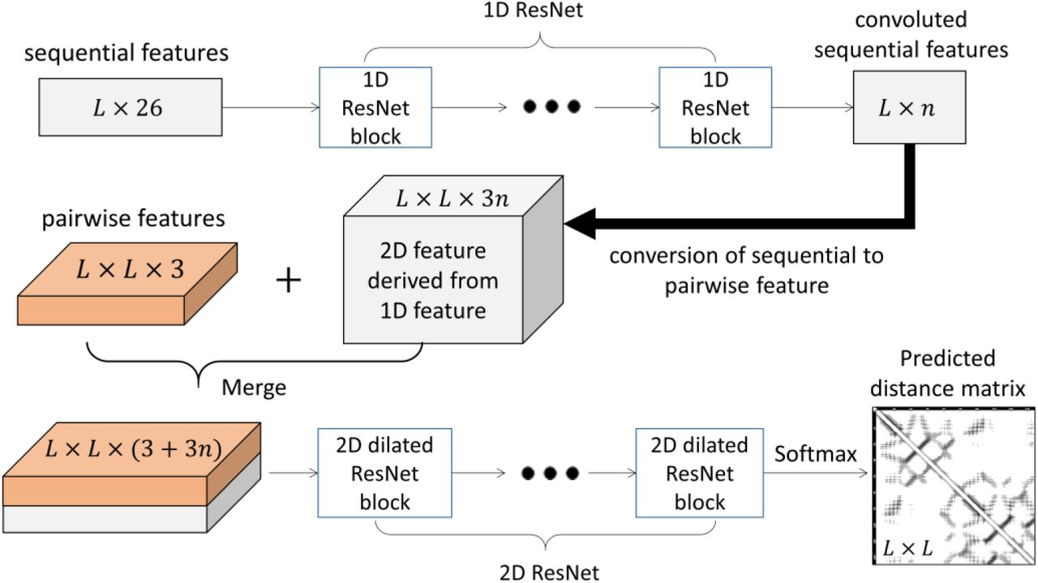
Deep dilated ResNet for protein distance and contact prediction

Slide 5
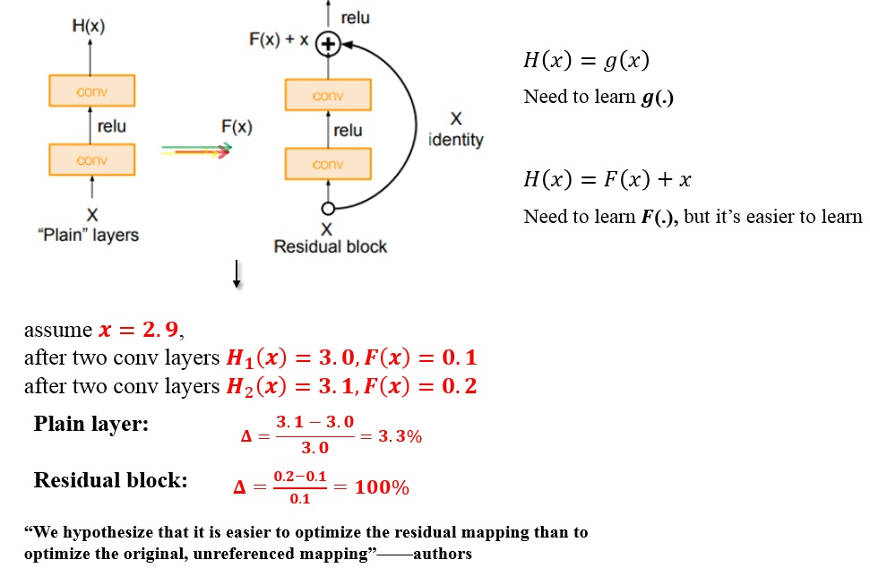
Residual block

Slide 6
Deep dilated ResNet for protein distance and contact prediction
Discretize inter-atom distance into 25 bins: <4.5Å, 4.5-5Å, 5-5.5Å, …, 15-15.5Å, 15.5-16Å, and >16Å and treat each bin as a label for classification.
Contact prediction is fulfilled by summing up the probability of all the Cβ-Cβ distance bins falling into interval [0, 8Å].
Cα-Cα, Cα-Cg, Cg-Cg, and N-O.
Angles ϕ and ψ from position specific scoring matrix (PSSM) generated by HHblits.
σ1, σ2 are the variance and ρ is the correlation.

Slide 7
Multiple sequence alignment (MSA) and input features
Generated four different MSAs by running
HHblits with 3 iterations and E-value set to 0.001 and 1
Jackhmmer with E-value set to 0.001 and 0.00001
Each MSA, we derive protein sequential and pairwise features.
Sequential features include sequence profile, secondary structure and solvent accessibility predicted by RaptorX-Property.
Pairwise features include standard and APC-corrected mutual information, pairwise contact potential and direct co-evolution strength calculated by CCMpred.

Slide 8
RaptorX-Contact
Predicted distance distribution, secondary structure and backbone torsion angles into CNS restraints and builds 3D models by running CNS
CNS is a software program for experimental protein structure determination.
Pick 7L pairs with the highest predicted likelihood (probability) having distance <15Å.
Run CNS to generate 200 possible 3D models and choose 5 with the least violation of distance restraints as the final models.

Slide 9
Results
 | long-range contact precision(%) |  |  | F1-values
 | L/5 | L/2 | L | L/5 | L/2 | L
RaptorX-Contact | 70.054 | 57.787 | 44.731 | 0.233 | 0.362 | 0.411
Other group1 | 65.678 |  |  | 0.213
Other group2 | 64.031 |  |  | 0.208
Other group3 | 60.798 |  |  | 0.192
Other group4 | 60.595 |  |  | 0.191

Slide 10
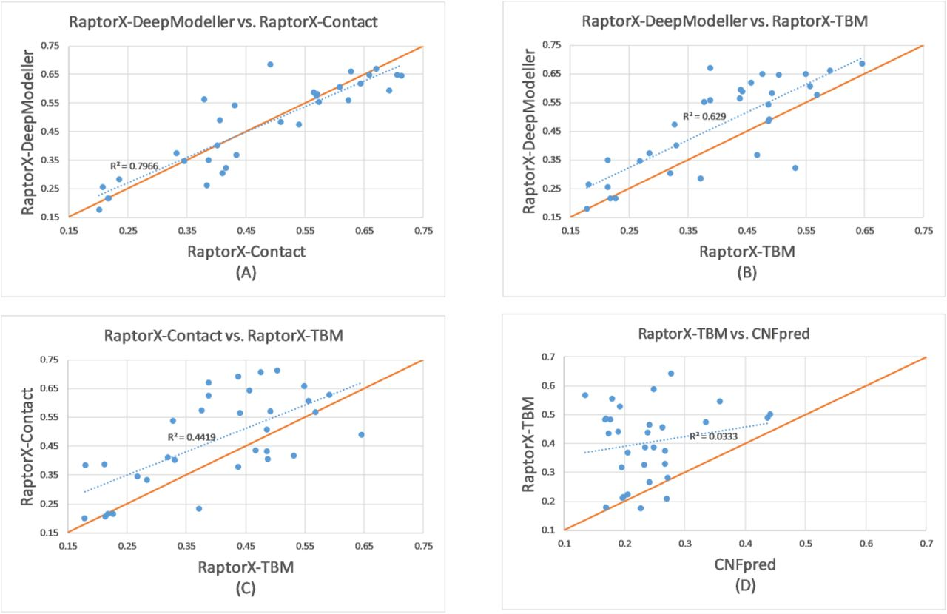
Results

Slide 11
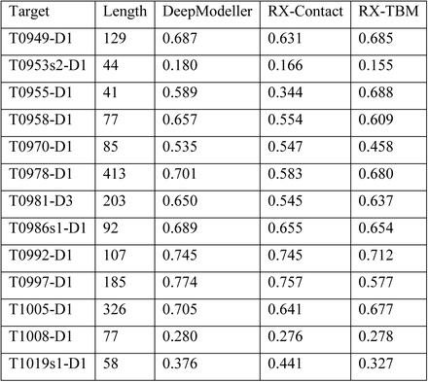
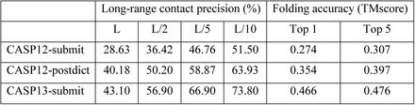
Results

Slide 12
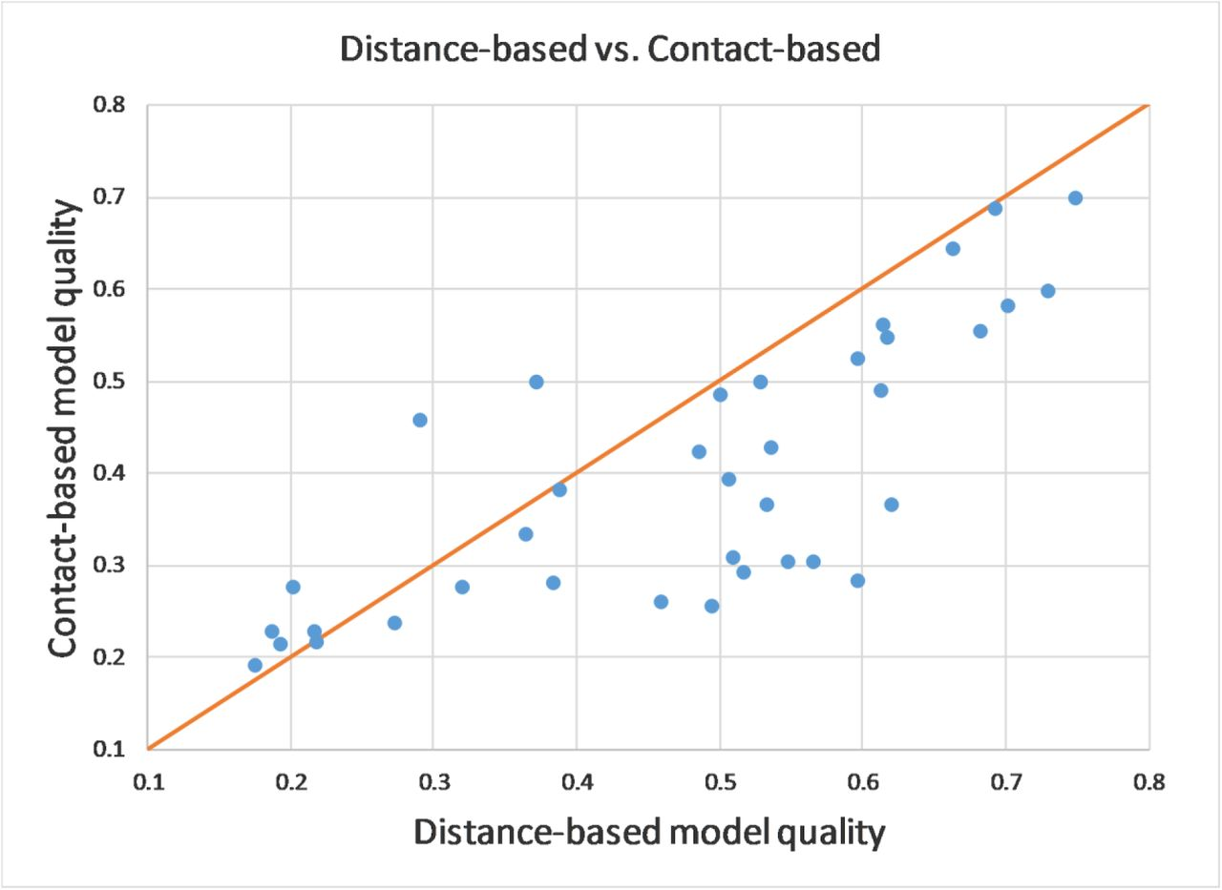
Results

