Slide 1
Detecting Road Intersections from GPS Traces Using Longest Common Subsequence Algorithm
Xingzhe Xie, Wenzhi Liao, Hamid Aghajan, Peter Veelaert and Wilfried Philips
ISPRS International Journal of Geo-Information, Volume 6, Issue 1 (January 2017)
Presenter: Du-Cheng Wu
Date: Jun. 18, 2019

Slide 2
Abstract(1/2)
Intersections are important components of road networks, which are critical to both route planning and path optimization. Most existing methods define the intersections as locations where the road users change their moving directions and identify the intersections from GPS traces through analyzing the road users’ turning behaviors. However, these methods suffer from finding an appropriate threshold for the moving direction change, leading to true intersections being undetected or spurious intersections being falsely detected. In this paper, the intersections are defined as locations that connect three or more road segments in different directions. We propose to detect the intersections under this definition by finding the common sub-tracks of the GPS traces.

Slide 3
Abstract(2/2)
We first detect the Longest Common Subsequences (LCS) between each pair of GPS traces using the dynamic programming approach. Second, we partition the longest nonconsecutive subsequences into consecutive sub-tracks. The starting and ending points of the common sub-tracks are collected as connecting points. At last, intersections are detected from the connecting points through Kernel Density Estimation (KDE). Experimental results show that our proposed method outperforms the turning point-based methods in terms of the F-score.

Slide 4
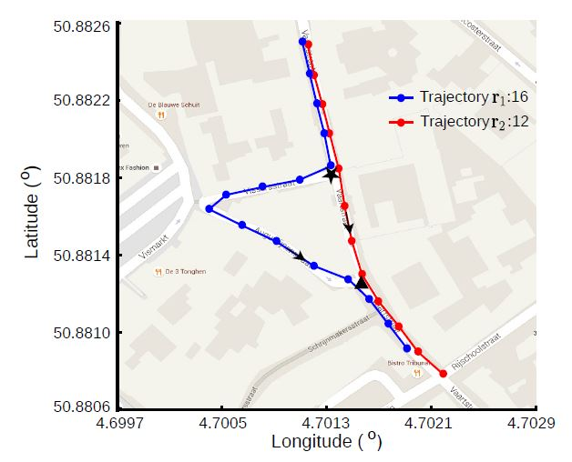
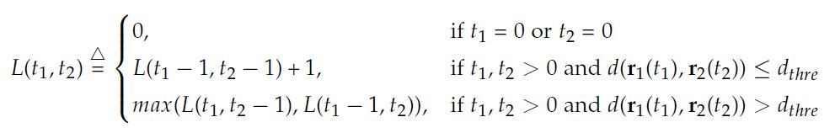
Longest Common Subsequence

Slide 5
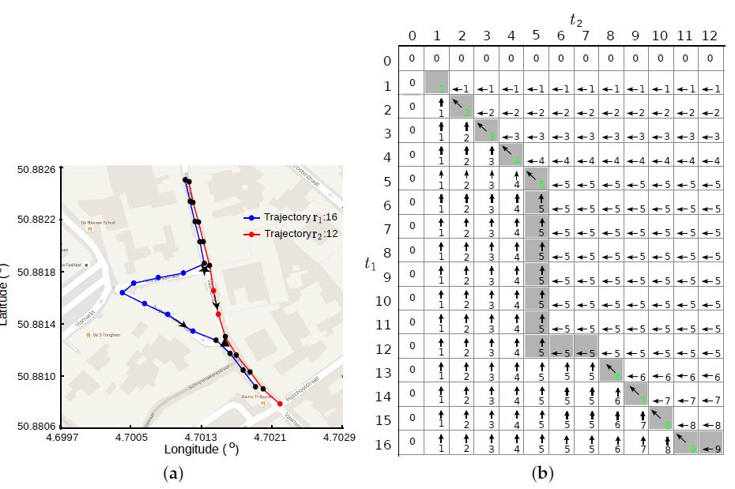
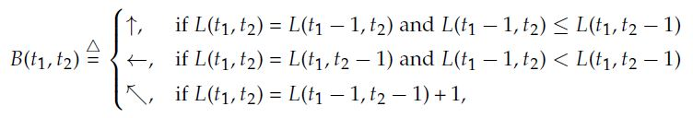
Longest Common Subsequence

Slide 6
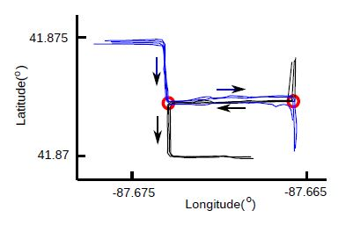
Connecting Point Collection

Slide 7
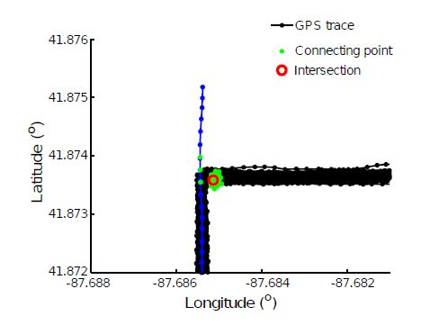
Intersection Extraction from Connecting Points

Slide 8

Intersection Extraction from Connecting Points
Intersection candidate q
M connecting points
N trace
If any $p_{n}$ = M remove
this intersection point

Slide 9

Accuracy Measure
$I_{c}$= matched intersections
$I_{m}$= missing intersections
$I_{s}$ = spurious intersections
recall = $I_{c}/(I_{m}+I_{c})$
precision = $I_{c}/(I_{s}+I_{c})$
F-score = $\frac{2×recall×precision}{recall+precision}$

Slide 10
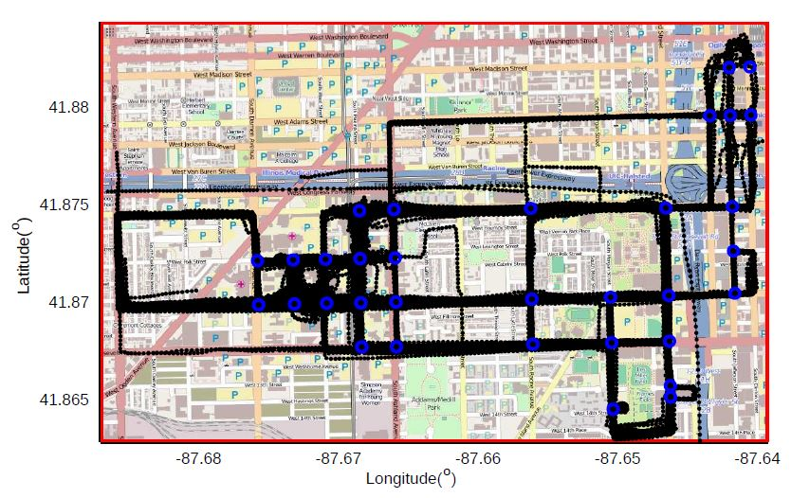
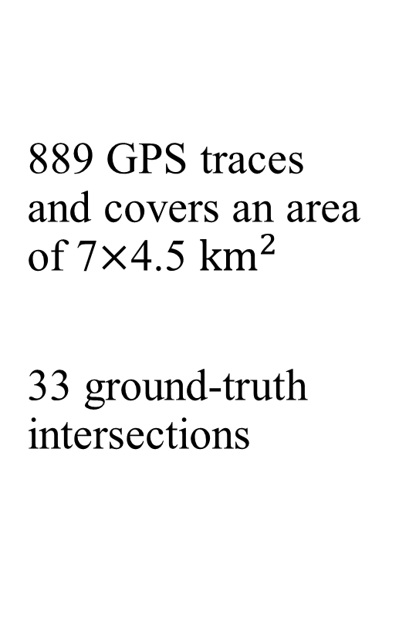
Experimental Results
889 GPS traces and covers an area of 7$×$4.5 ${km}^{2}$
33 ground-truth intersections

Slide 11
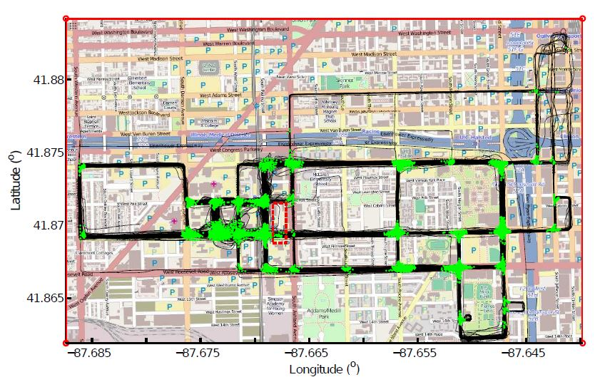
Experimental Results

Slide 12
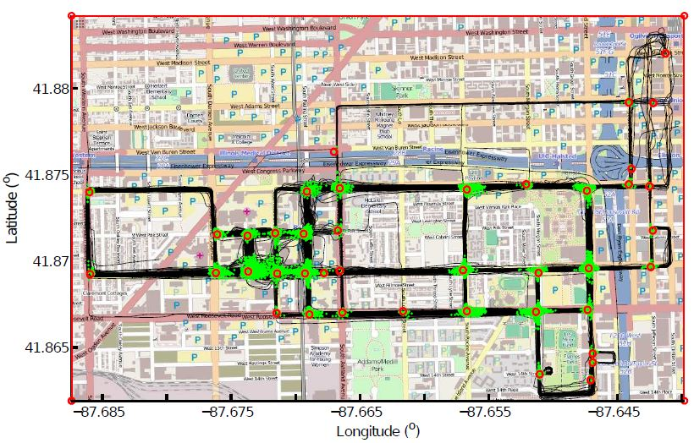
Experimental Results
41 intersection candidates

Slide 13
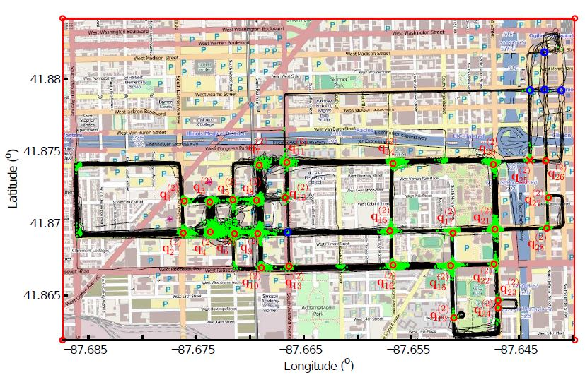
Experimental Results
Remove 13 candidates, 28 intersections are kept, 27 true intersections and 6 missing intersections

Slide 14
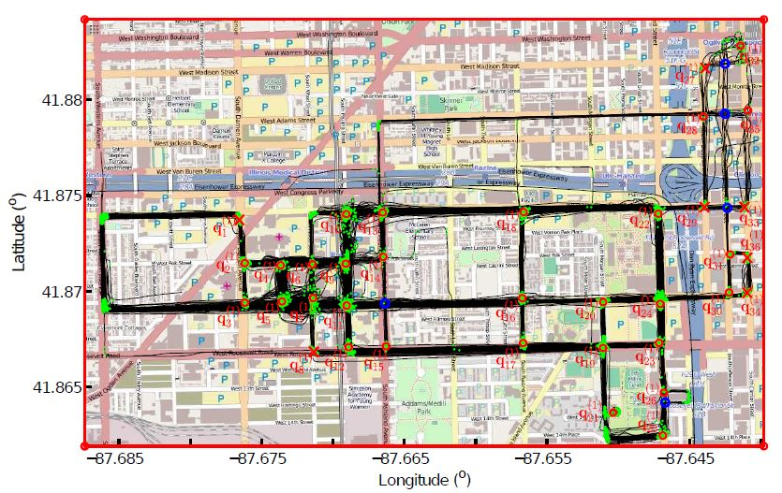
Experimental Results
36 intersections are identified, 29 true intersections and 5 missing intersections

Slide 15
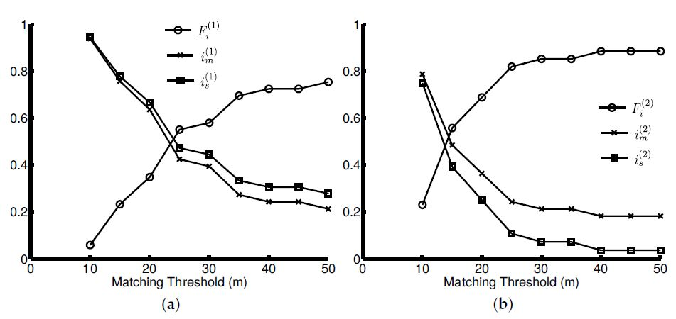
Experimental Results

