Slide 1
FAST: A Novel Protein Structure Alignment Algorithm
Jianhua Zhu, and Zhiping Weng
PROTEINS: Structure, Function, and Bioinformatics 58:618–627 (2005)
Presenter : Feng-Yang Tsai
Date:June. 26, 2019.

Slide 2
Abstract(1/2)
We present a novel algorithm named FAST for aligning protein three-dimensional structures. FAST uses a directionality-based scoring scheme to compare the intra-molecular residue–residue relationships in two structures. It employs an elimination heuristic to promote sparseness in the residue-pair graph and facilitate the detection of the global optimum. In order to test the overall accuracy of FAST, we determined its sensitivity and speciﬁcity with the SCOP classiﬁcation (version 1.61) as the gold standard. FAST achieved higher sensitivities than several existing methods (DaliLite, CE, and K2) at all speciﬁcity levels.

Slide 3
Abstract(2/2)
We also tested FAST against 1033 manually curated alignments in the HOMSTRAD database. The overall agreement was 96%. Close inspection of examples from broad structural classes indicated the high quality of FAST alignments. Moreover, FAST is an order of magnitude faster than other algorithms that attempt to establish residue–residue correspondence.

Slide 4
METHODS :
FAST comprises four steps
We compare the local geometric properties of the two proteins and select a small subset of MN pairs as the vertex set to construct G(V,E).
We assign edges by comparing intra-molecular relationships, using a directionality-based scoring scheme that promotes sparseness of the graph.
We iteratively prune the graph to eliminate “bad vertices,” which are residue pairs that are unlikely to constitute the global optimal alignment, offering the correct alignment a better chance to survive. With the substantially simplified product graph, an initial alignment is easily detected using dynamic programming.
We finetune the initial alignment by finding additional equivalent pairs and eliminating bad pairs.

Slide 5
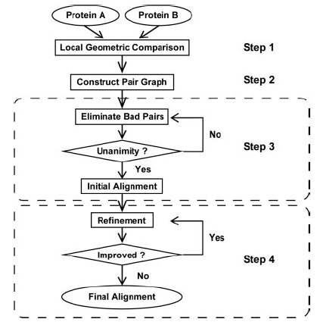

Slide 6
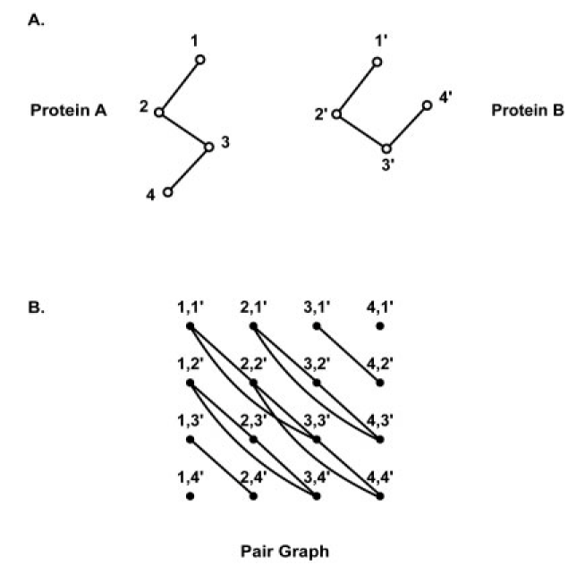

Slide 7

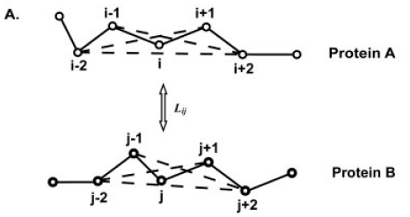
Step 1: Local Geometric Comparison
Lij denotes the similarity between a segment centered around residue i of protein A and a segment centered around residue j in protein B

Slide 8
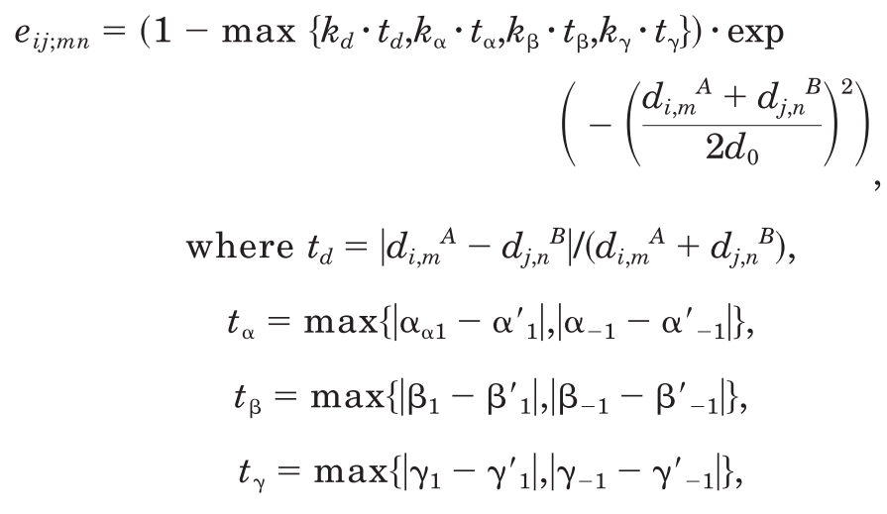
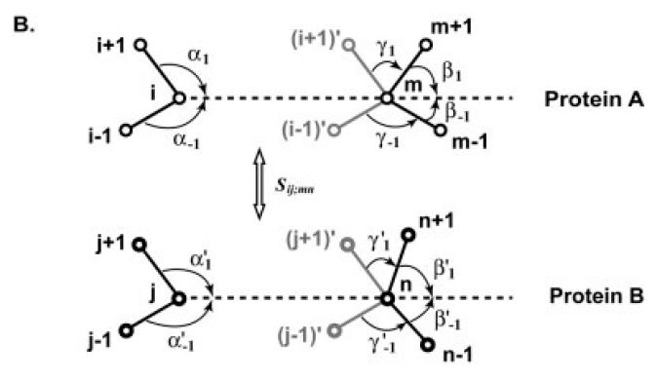



Step 2: Scoring Scheme for Edge Computation
The edge in G(V,E) connecting two vertices (i,j) and (m,n) is assigned the following weight

Slide 9
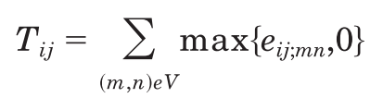
Step 3: Further Pruning and Initial Alignment Step 4: Alignment Refinement
We would expect T to be high if (i,j) is contained in the optimal alignment
Three empirical rules are used to define bad pairs
(a) A vertex receiving a low T score is eliminated.
(b) If the T score of a vertex is due to scattered contributors that do not form stretches, the vertex is eliminated.
(c) If the two residues of a vertex are isolated
In order to measure the extent to which the graph is close to a clique, we define the degree of unanimity of G(V,E) as the number of edges with positive weights divided by the total number of possible edges.
We expect the degree of unanimity to increase as we iteratively eliminate more bad vertices.

Slide 10
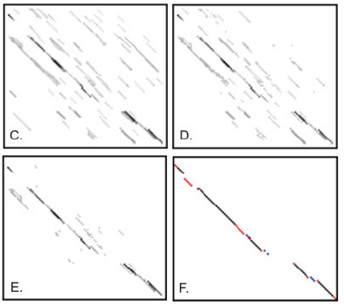
(PDB code 1BHG, A chain, residues 226-328)
(PDB code 1CS6, A chain, residues 209–299)

Slide 11
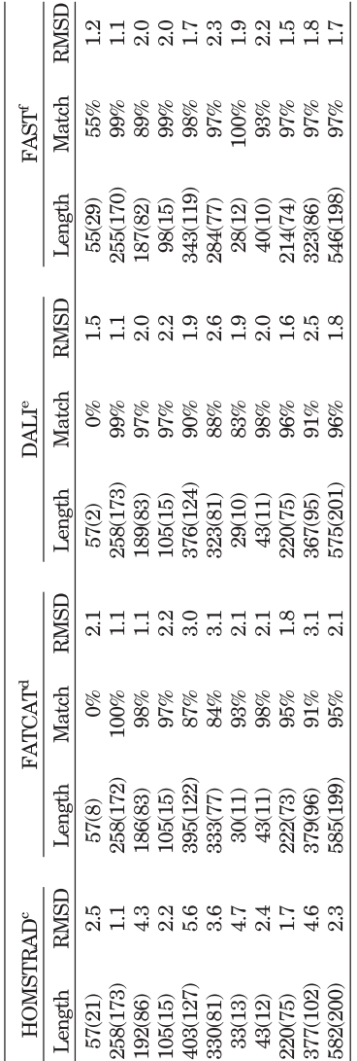
Results:

