Slide 1
EERTREE: An Efficient Data Structure for Processing Palindromes in Strings
Mikhail Rubinchik, Arseny M. Shur Proceedings of 26th International Workshop on Combinatorial Algorithms(IWOCA) Verona, Italy, 5-7 October 2015, pp. 321-333 European Journal of Combinatorics Volume 68, February 2018, pp. 249-265
Speaker: Kuan-Lin Lai
Date: July 2, 2019
Notes:
維羅納

Slide 2
Abstract
We propose a new linear-size data structure which provides a fast access to all palindromic substrings of a string or a set of strings. This structure inherits some ideas from the construction of both the suffix trie and suffix tree. Using this structure, we present simple and efficient solutions for a number of problems involving palindromes.

Slide 3
Definition
A string S = eertree
palindrome = e, r, t, ee, rtr, ertre, eertree
suffix palindrome = ee, eertree
longest suffix palindrome = eertree

Slide 4
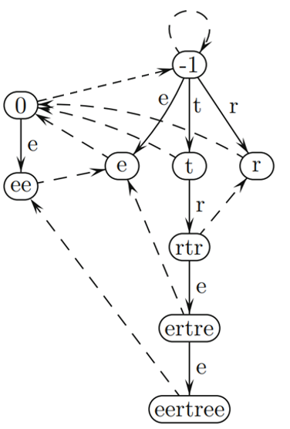
Basic version EERTREE
Edge( )
Suffix link ( )
node -1: imaginary string
node 0 : empty string

Slide 5
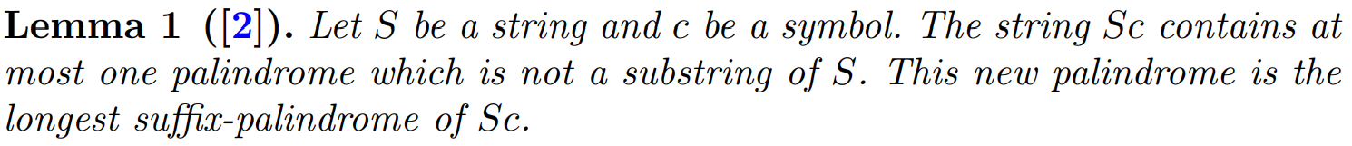
Properties

Slide 6
Improve by quick links
ex: S = aabaabaaba
baab
aba
a
a
edge suffix link quick link
baabaab
abaaba
a
abaabaaba

Slide 7
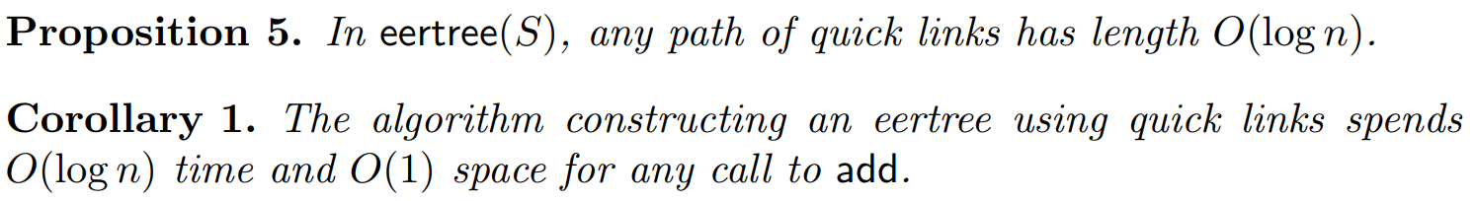
Properties

Slide 8
Improve by direct links
direct links: directLink[v][c] is the longest suffix-palindrome of v preceded in v by c
baab
edge suffix link direct link
aba
a
a
baabaab
abaaba
a
abaabaaba

Slide 9
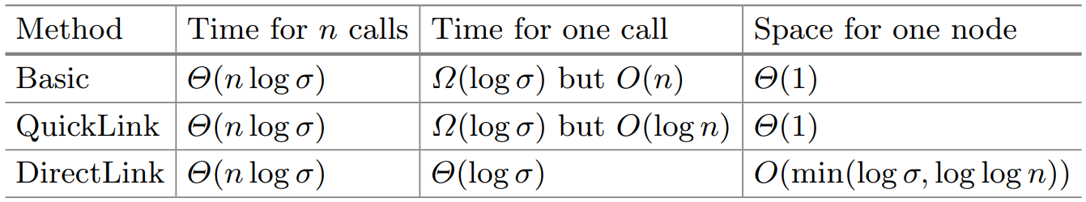
Comparing Different Implementations

Slide 10
Palindromic length
Ex1: S = aabaabaaba ans = 2, [a, abaabaaba] Ex2: S = aabaabab ans = 2, [aabaa, bab]

Slide 11
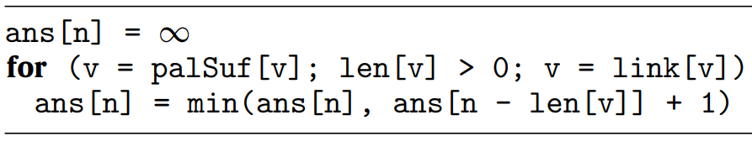

Naive algorithm
S = aabaabaaba link[S] = S1 = abaabaaba link[S1] = S2 = abaaba link[S2] = S3 = aba link[S3] = S4 = a Time complexity: $O(n2)$

Slide 12


Palindromic length
longest suffix palindrome u of v such that diff[u] ≠ diff[v]
ex: v = abaabaaba diff[v] = len[v] – len[link[v]] = 9 – 6 = 3 seriesLink[v] = aba

Slide 13
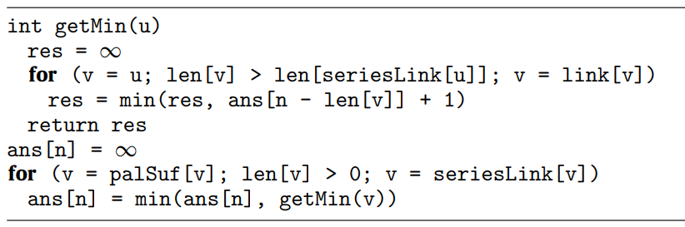
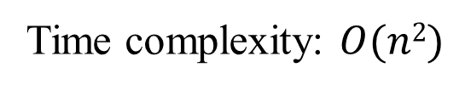
With series links
S = aabaabaaba link[S] = S1 = abaabaaba serieslink[S] = S3 = aba link[S1] = S2 = abaaba link[S2] = S3 = aba link[S3] = S4 = a
Time complexity: $O(n2)$

Slide 14
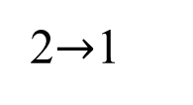
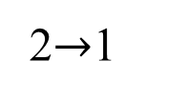
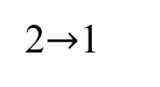
Constant time getMin function
1
2$→$1
a aba aba aba
2$→$1
a aba aba aba aba
2$→$1
a aba aba aba aba aba aba

Slide 15
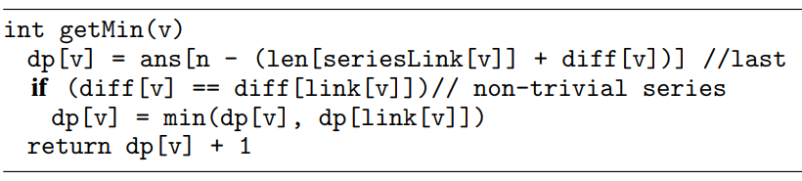
Constant time getMin function

Slide 16
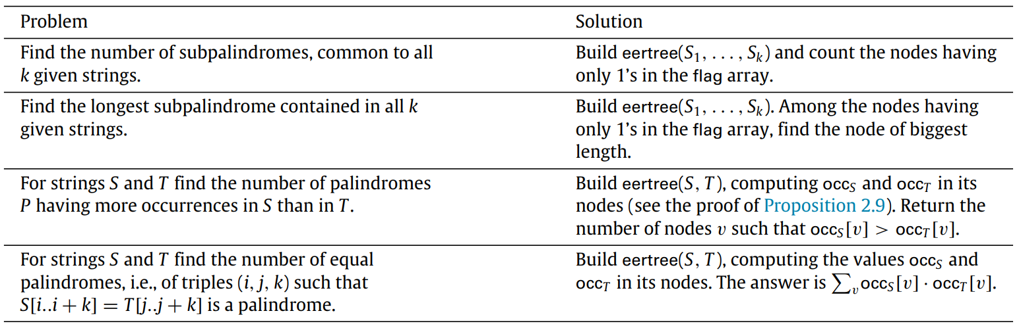
Joint eertree

