Slide 1
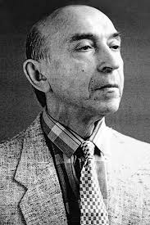
Is there a need for fuzzy logic? A nontraditional view of fuzzy logic
Information sciences 178(13): 2751-2779.2008.
Lotfi A. Zadeh
Presenter: KeXin Zhu
Date: 2019/07/02
Notes:
https://www.letpub.com.cn/index.php?page=journalapp&view=detail&journalid=3567
https://zh.wikipedia.org/zh-tw/%E7%9B%A7%E7%89%B9%E8%8F%B2%C2%B7%E6%BE%A4%E5%BE%B7

Slide 2
Abstract (1/3)
‘‘Is there a need for fuzzy logic?” is an issue which is associated with a long history of spirited discussions and debate. There are many misconceptions about fuzzy logic. Fuzzy logic is not fuzzy. Basically, fuzzy logic is a precise logic of imprecision and approximate reasoning. More specifically, fuzzy logic may be viewed as an attempt at formalization/mechanization of two remarkable human capabilities. First, the capability to converse, reason and make rational decisions in an environment of imprecision, uncertainty, incompleteness of information, conflicting information, partiality of truth and partiality of possibility – in short, in an environment of imperfect information.

Slide 3
Abstract (2/3)
And second, the capability to perform a wide variety of physical and mental tasks without any measurements and any computations [L.A. Zadeh, From computing with numbers to computing with words – from manipulation of measurements to manipulation of perceptions, IEEE Transactions on Circuits and Systems 45 (1999) 105–119; L.A. Zadeh, A new direction in AI – toward a computational
theory of perceptions, AI Magazine 22 (1) (2001) 73–84]. In fact, one of the principal contributions of fuzzy logic – a contribution which is widely unrecognized – is its high power of precisiation.

Slide 4
Abstract (3/3)
Fuzzy logic is much more than a logical system. It has many facets. The principal facets are: logical, fuzzy-set-theoretic, epistemic and relational. Most of the practical applications of fuzzy logic are associated with its relational facet.
In this paper, fuzzy logic is viewed in a nonstandard perspective. In this perspective, the cornerstones of fuzzy logic and its principal distinguishing features – are: graduation, granulation, precisiation and the concept of a generalized constraint.

Slide 5
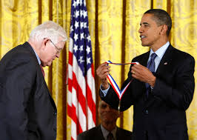
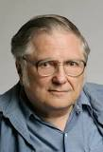
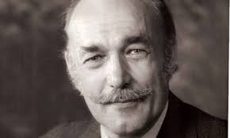

Introduction - Spirited discussion and debate from 1965
“‘‘Fuzzification” is a kind of scientific permissiveness; it tends to result in socially appealing slogans unaccompanied by the discipline of hard scientific work and patient observation.”
“模糊化”是一種科學的放縱; 它往往會產生具有社會吸引力的口號，而不會伴隨著艱苦的科學工作和耐心的觀察.
Kálmán Rudolf Emil.
Development of the Kalman filter.
‘‘Fuzzy theory is wrong, wrong, and pernicious.” ” The danger of fuzzy theory is that it will encourage the sort of imprecise thinking that has brought us so much trouble.”
“模糊理論是錯誤的，錯誤的，有害的。“模糊理論的危險在於它會鼓勵那種給我們帶來太多麻煩的不精確的思維。”
William Kahan.
Turing Award in 1989.
"The Father of Floating Point" .
‘‘probability is the only sensible description of uncertainty and is adequate for all problems involving uncertainty . . . anything that can be done with fuzzy logic can better be done with probability.”
“概率是對不確定性的唯一合理描述，並且適用於涉及不確定性的所有問題。。。 任何可以用模糊邏輯完成的事情都可以用概率來完成。”
Dennis Lindley.
Leading advocate of Bayesian statistics.
《Deviant Logic Fuzzy Logic》:‘‘Since neither of the main arguments that are offered in its favor is acceptable, I conclude that we do not need fuzzy logic.”
《模糊邏輯是離譜邏輯》：“因為它所提供的主要論證都不可接受，所以我得出結論，我們不需要模糊邏輯。”
Susan Haack.
Cooper Senior Scholar
in Arts and Sciences.

Slide 6
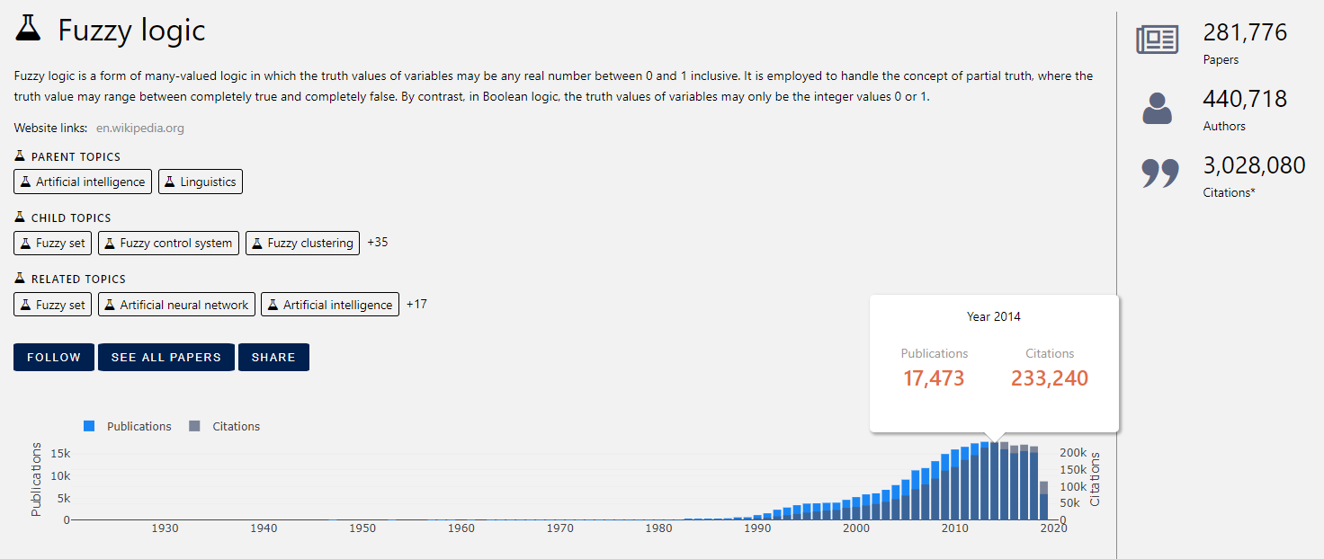
Introduction - Spirited discussion and debate from 1965

Slide 7
Part 1: What is fuzzy logic – a nontraditional view
1.1 Fuzzy logic – principal concepts and ideas
什麼是模糊邏輯？

Slide 8
1. Misconceptions about fuzzy logic
Fuzzy logic is not fuzzy.
Fuzzy logic is a precise logic of imprecision and approximate reasoning.
Fuzzy logic is an attempt at formalization/mechanization of two remarkable human capabilities:
First, the capability to make decisions in an environment of imperfect information.
Second, the capability to perform physical and mental tasks without any measurements and computations.（e.g.: Fuzzy Control）

Slide 9
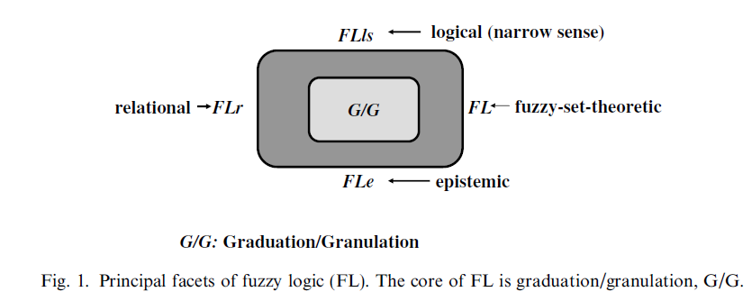
2. The duality of meaning of fuzzy logic
模糊邏輯含義的二元性：
In a narrow sense(狹義上):
Fuzzy logic is a logical system which is a generalization of multivalued logic.
In a wide sense(廣義上):
FL has many facets. The four principal facets are:

Slide 10
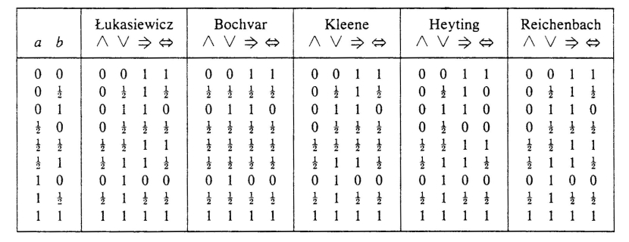
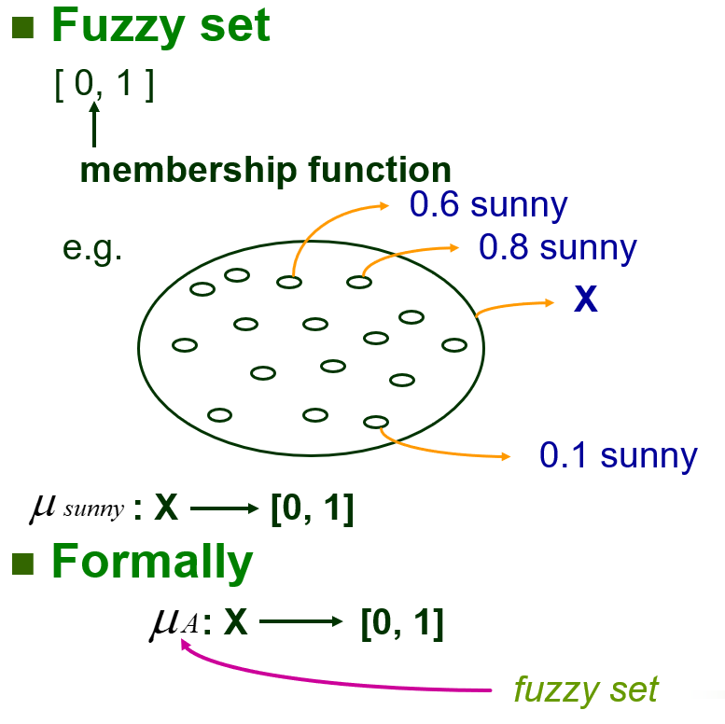
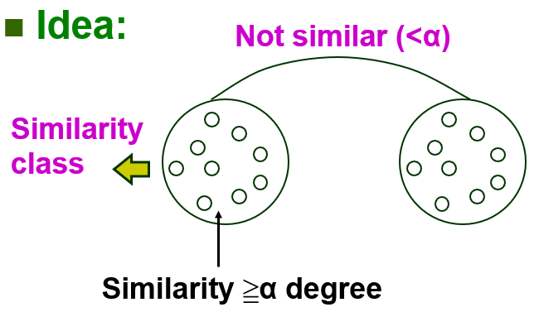
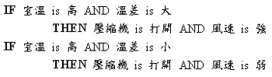
3. The principal facets of fuzzy logic
FL1: The logical facet(narrow sense), may be viewed as a generalization of multivalued logic.
FLs: The fuzzy-set-theoretic facet, focused on classes whose boundaries are unsharp. FLs is central to fuzzy logic.
FLr: The relational facet. The concept of a linguistic variable – and the associated calculi of fuzzy if–then rules.
Fle: The epistemic facet, concerned with knowledge representation, semantics of natural languages and information analysis.

Slide 11
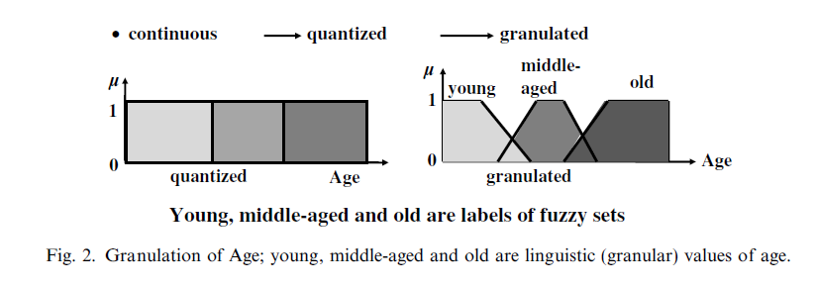
4. Core of FL: Graduated granulation
模糊邏輯的核心：漸進顆粒化
E.g.: Linguistic variable（語義變量）:
連續值(age = 30) -> 量化(age = young) -> 漸進顆粒化(age = 0.3/young + 0.3/middle-aged)

Slide 12
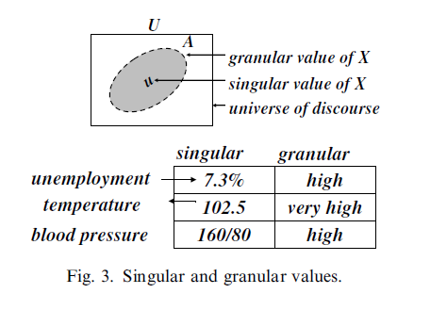
4. Core of FL: Graduated granulation
Granular value（值的顆粒化）:
Singular value(單點值) -> Granular value(顆粒值)
失業率 =
溫度 =
血壓 =

Slide 13
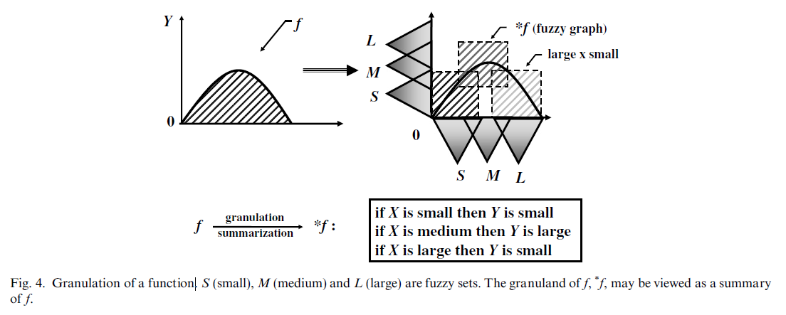
4. Core of FL: Graduated granulation
Granulation of a function(函數的顆粒化):

Slide 14
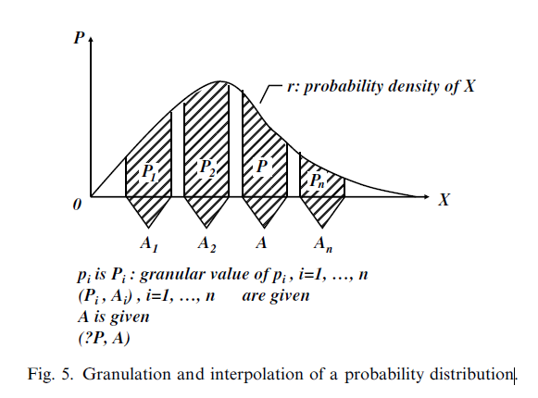
4. Core of FL: Graduated granulation
Granulation of a probability distribution（概率分佈的顆粒化）:

Slide 15
Part 1: What is fuzzy logic – a nontraditional view
1.2 The concepts of precisiation and cointensive precisiation
什麼是強一致性精確化？

Slide 16
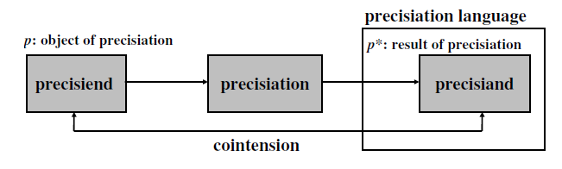
1. The concepts of precisiation
Mathematical modeling <-> Precisiation
Basic concepts:
精確目標p
精確化
精確化結果p*
一致性(close(p, p*))

Slide 17
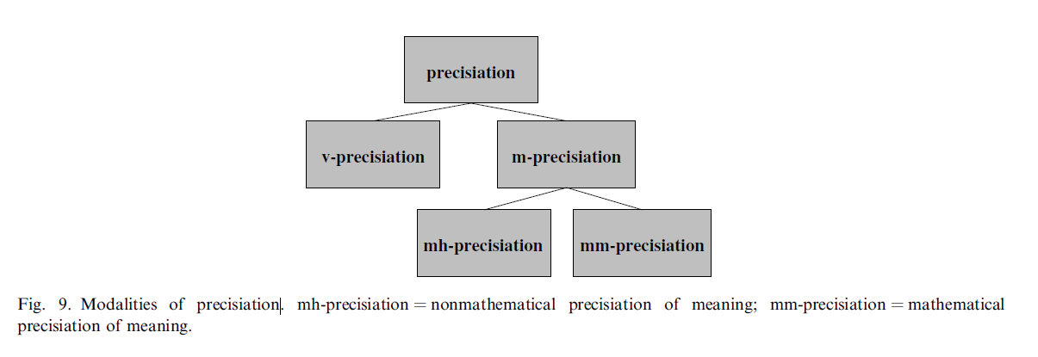
1. The concepts of precisiation
Modalities of precisiation:
值的精確化
含義的精確化
面向人的含義精確化
面向機器的含義精確化

Slide 18
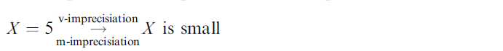
1. The concepts of precisiation
Example:
‘‘Bear market”（熊市）:
mh-precisiand: Declining stock market with expectation of further decline.
mm-precisiand: 30% decline after 50 days, or a 13% decline after 145 days.
mh-precisiand:
知識(薪水 決定 消費 ) 精確化 Y(消費) = A*X(薪水) + B

Slide 19
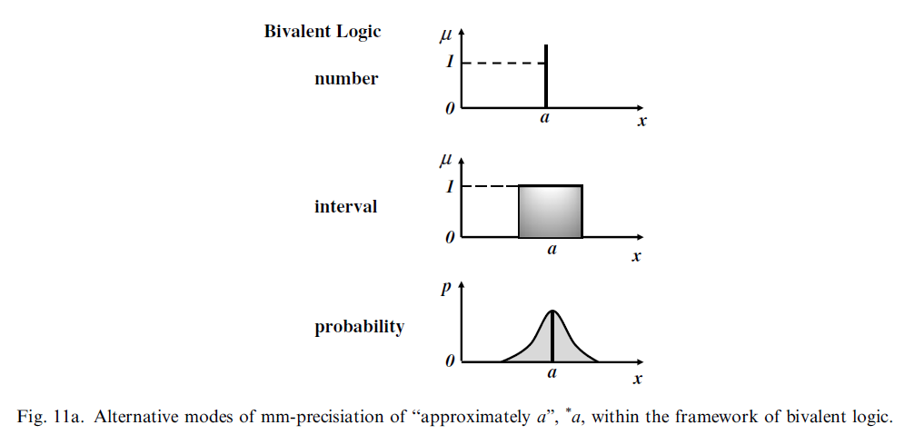
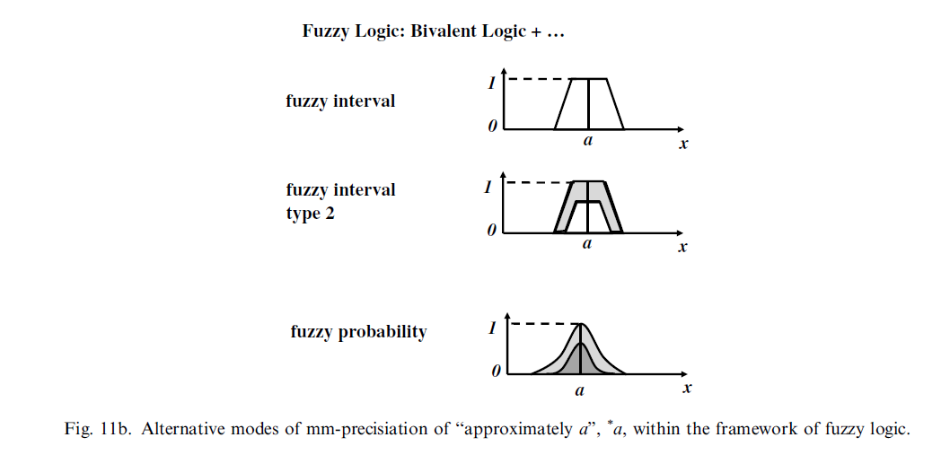
1. The concepts of precisiation
Unbounded number of ways in precisiation:
Pricisiend: x=a
選擇哪一個方法？

Slide 20
2. The concepts of cointension
Two basic metrics associate with p* :
(a) Cointension(一致性) – a qualitative measure of the proximity of the meanings of p and p*;
(b) Computational complexity(計算複雜度) of p*.

Slide 21
2. The concepts of cointension
Analogy between mm-precisiation and mathematical modeling:
知識(薪水 決定 消費 ) 精確化 Y(消費) = A*X(薪水) + B
mm-precisiation | mathematical modeling
precisiend | the object of modeling (X, Y)
precisiand | the model (Y* = f(X))
meaning | the input/output relation (X -> Y)
cointension | proximity of the relations (Y – Y*)

Slide 22
2. The concepts of cointension
Aim of precisiation / modeling:
Cointensive mm-precisiation(強一致性精確化).
A concept/tool which plays a pivotal role in mm-precisiation:
Generalized constraint(廣義約束).

Slide 23
Part 1: What is fuzzy logic – a nontraditional view
1.3 The concept of a generalized constraint
and the fundamental thesis of fuzzy logic
廣義約束和模糊邏輯的理論基礎

Slide 24



1. The concept of a generalized constraint
約束是表達信息的主要工具。
E.g.：Knapsack Problem：max , , ;
SVM：2
T-test：H₀: μ = μ₀ ; H₁: μ != μ₀ ; t < α = 0.05.

Slide 25
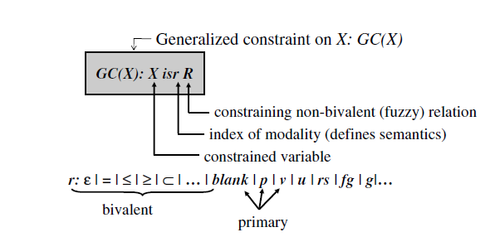
1. The concept of a generalized constraint
The principal features of the concept of generalized constraint（廣義約束）:
GC(X)(廣義約束): X(被約束變量) is(約束形態) R(約束關係)

Slide 26
1. The concept of a generalized constraint
Constrained variable(被約束變量) :
(1) X is an n-array variable, X = (X1 , . . . ,Xn);
(2) X is a proposition, e.g., Leslie is tall;
(3) X is a relation;
(4) X is a function of another variable: X = f(Y);
(5) X is conditioned on another variable, X/Y;
(6) X is conditioned on another generalized constraint, X isr if Y iss S;
(7) X has a structure, e.g., X = Location(Residence(Carol));

Slide 27
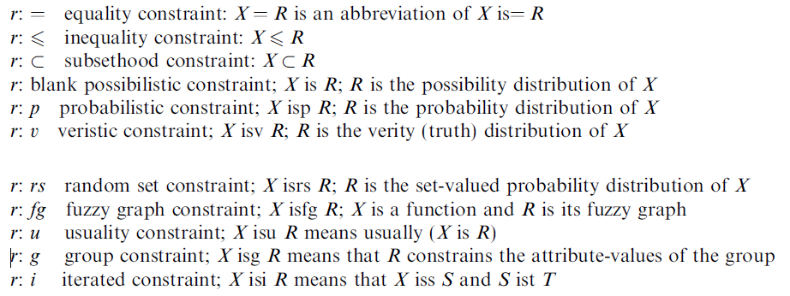
1. The concept of a generalized constraint
Modalities of generalized constraints(常見約束形態):

Slide 28
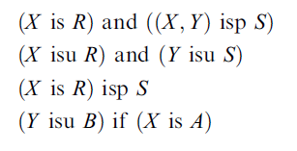
1. The concept of a generalized constraint
Generalized constraint language (GCL) (廣義約束語言): :
GCL is generated by (combination, projection, qualification, propagation and counterpropagation) of generalized constraints.
任何知識都可以用GCL來表示
Simple examples:

Slide 29
2. Example of a generalized constraint
Primary constraints (主要約束) | Standard constraints (標準約束)
(a) possibilistic | (a) bivalent possibilistic
(b) probabilistic | (b) probabilistic
(c) veristic | (c) bivalent veristic

Slide 30
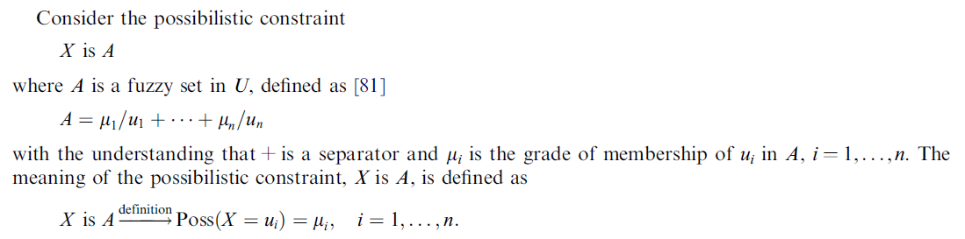
2. Example of a generalized constraint
Possibilistic constraint(可能性約束):

Slide 31
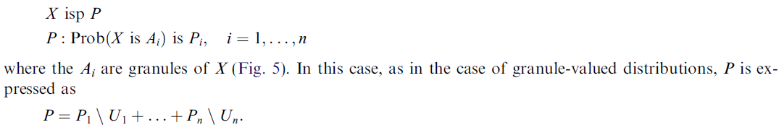
2. Example of a generalized constraint
Probabilistic constraint (概率約束): :

Slide 32
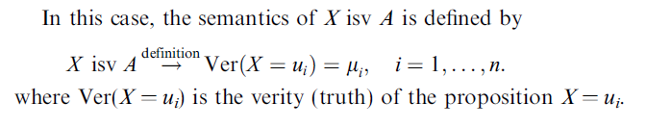
2. Example of a generalized constraint
Veristic constraint (真實度約束): :

Slide 33
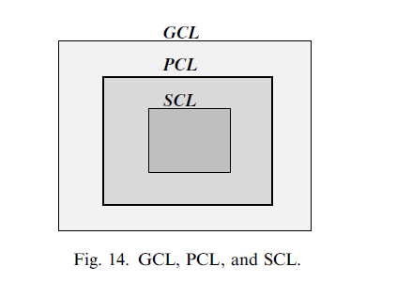
3. Generalized constraint language (GCL)
Subsets of GCL:
In relation to GCL, PCL and SCL are subsets of GCL which are generated by primary and standard constraints.
SCL < PCL < GCL

Slide 34

3. Generalized constraint language (GCL)
Precisiate the concepts of information and meaning:
information = generalized constraint (1)
meaning of p = generalized constraint (2)
mm-precisiand = generalized constraint (3)
mm-precisiation = translation into GCL (4)
Since SCL is a subset of GCL =>
The inequality implies that :
Employment of fuzzy logic would lead to a precisiand whose cointension is significantly higher than use of bivalent logic.
Fuzzy logic >= bivalent logic

Slide 35
Part 2: What does fuzzy logic have to offer?

Slide 36
1. What does fuzzy logic have to offer?
Contributions of fuzzy logic:
(1) Linguistic variables and fuzzy if–then rules(語義變量).
(2) FL-generalization(FL泛化).
(3) The concepts of precisiation and cointension(一致性精確化).
(4) NL-Computation, computing with words (CW) and precisiated natural language (PNL) (自然語言計算).
(5) Computational theory of perceptions (感知的計算理論)..
(6) Possibility theory (可能性理論)..
(7) Computation with imprecise probabilities (不精確概率的計算).
(8) Fuzzy logic as a modeling language (模糊邏輯建模語言).

Slide 37
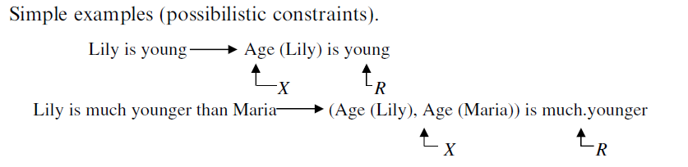
2. Fuzzy logic and natural language
Example:

Slide 38
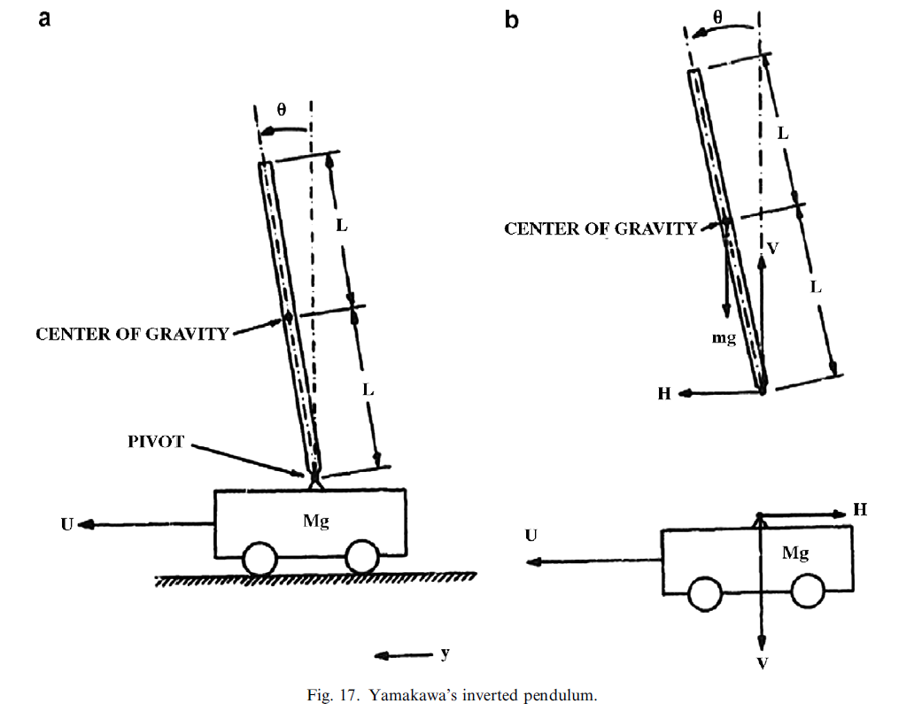
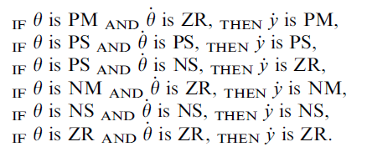
3. Fuzzy logic as a modeling language
Professor Yamakawa’s use of fuzzy logic to stabilize an inverted pendulum(穩定倒立擺):

Slide 39
4. Fuzzy logic as the basis for generalization of scientific theories
Scientific theories been FL-generalized:
control -> fuzzy control.
linear programming -> fuzzy linear programming.
probability theory -> fuzzy probability theory.
measure theory -> fuzzy measure theory.

Slide 40
4. Fuzzy logic as the basis for generalization of scientific theories
Scientific theories been FL-generalized:
topology -> fuzzy topology.
graph theory -> fuzzy graph theory.
.
cluster analysis -> fuzzy cluster analysis.
Prolog -> fuzzy Prolog.
etc.

Slide 41
Conclusion
Fuzzy logic is not fuzzy:
Fuzzy logic is a precise logic of imprecision and approximate reasoning.
Fuzzy logic is needed to deal effectively with fuzzy reality.
Fuzzy logic has many facets.
The logical facet and the fuzzy-set-theoretic facet are the basic facets of fuzzy logic.
Relational facet plays a pivotal role – a facet which is focused on linguistic variables and fuzzy if–then rules.
In this paper, fuzzy logic is viewed in a nontraditional perspective.
This status reflects one of the most important contributions of fuzzy logic: High power of precisiation

