Slide 1
A Systematic Prediction of Drug-Target Interactions Using Molecular Fingerprints and Protein Sequences
Huang Yu-an(黃昱安), You Zhu-hong(尤著宏), Chen Xing(陳星)
Current Protein and Peptide Science, Volume 19, Number 5, 2018, pp. 468-478
Speaker: Jheng-Yan Lyu
Date: July 09, 2019

Slide 2
Abstract (1/2)
Background: Drug-Target Interactions (DTI) play a crucial role in discovering new drug candidates and finding new proteins to target for drug development. Although the number of detected DTI obtained by high-throughput techniques has been increasing, the number of known DTI is still limited. On the other hand, the experimental methods for detecting the interactions among drugs and proteins are costly and inefficient.
Objective: Therefore, computational approaches for predicting DTI are drawing increasing attention in recent years. In this paper, we report a novel computational model for predicting the DTI using extremely randomized trees model and protein amino acids information.
Method: More specifically, the protein sequence is represented as a Pseudo Substitution Matrix Representation (Pseudo-SMR) descriptor in which the influence of biological evolutionary information is retained. For the representation of drug molecules, a novel fingerprint feature vector is utilized to describe its substructure information.

Slide 3
Abstract (2/2)
Then the DTI pair is characterized by concatenating the two vector spaces of protein sequence and drug substructure. Finally, the proposed method is explored for predicting the DTI on four benchmark datasets: Enzyme, Ion Channel, GPCRs and Nuclear Receptor.
Results: The experimental results demonstrate that this method achieves promising prediction accuracies of 89.85%, 87.87%, 82.99% and 81.67%, respectively. For further evaluation, we compared the performance of Extremely Randomized Trees model with that of the state-of-the-art Support Vector Machine classifier. And we also compared the proposed model with existing computational models, and confirmed 15 potential drug-target interactions by looking for existing databases.
Conclusion: The experiment results show that the proposed method is feasible and promising for predicting drug-target interactions for new drug candidate screening based on sizeable features.

Slide 4
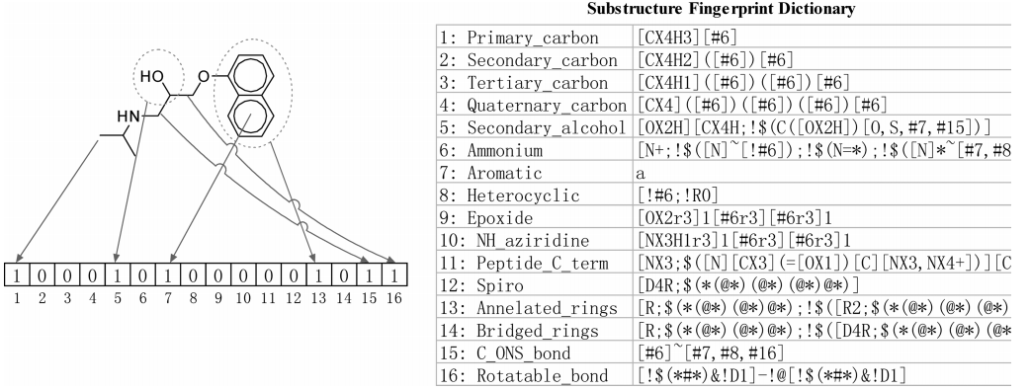
Drug Molecules Representation
Use a variety of molecular substructure fingerprints to represent drug compounds.

Slide 5
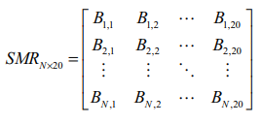
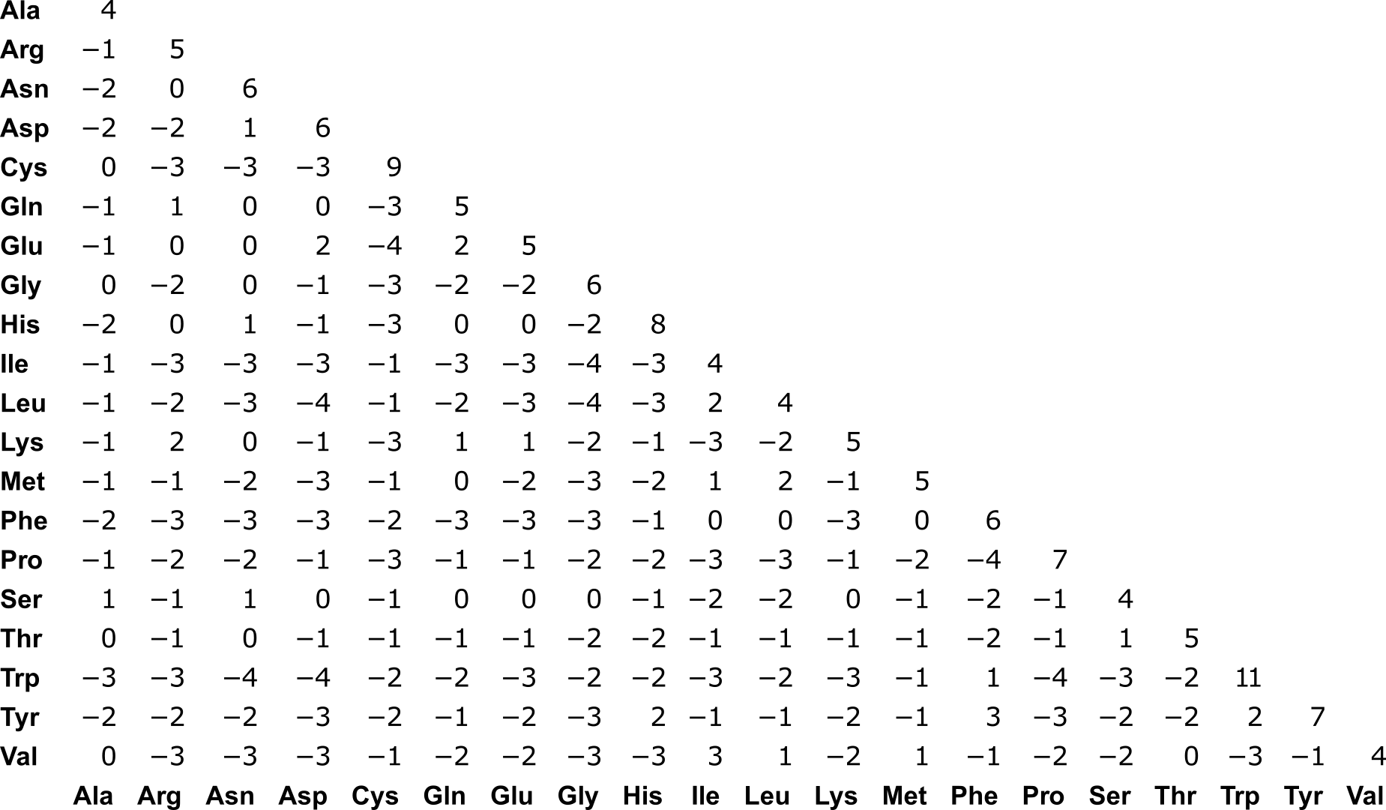
Target Protein Representation
Substitution Matrix Representation (SMR) is used for the representation of protein feature.
Use the BLOSUM62 matrix

Slide 6
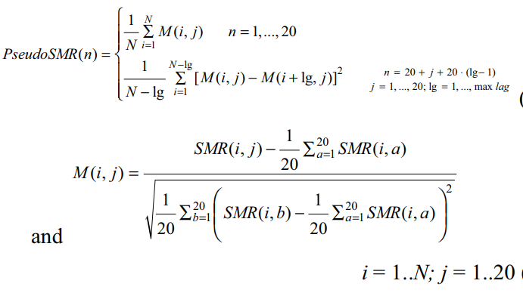
Target Protein Representation
Pseudo-SRM descriptor is obtained from a SMR matrix
lg represents the distance between one residue and its neighbors

Slide 7
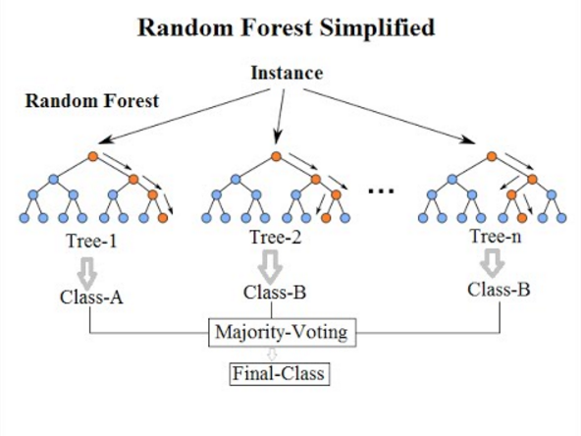
Extremely Randomized Trees
Like Random Forest
Difference:
Training data is not randomly selected
Split方式不同

Slide 8
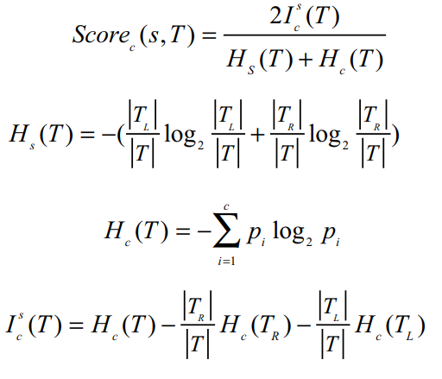

Extremely Randomized Trees
given a training set T with m-dimensional attributes A={a1,a2,…,am}, K attributes, {a1,…, ak} would be randomly selected without replacement.
All split would be evaluated by a scoring formula

Slide 9
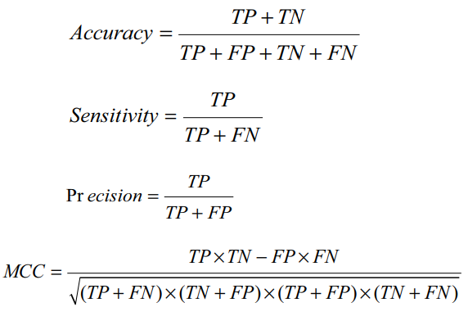
Results
Evaluation Criteria

Slide 10
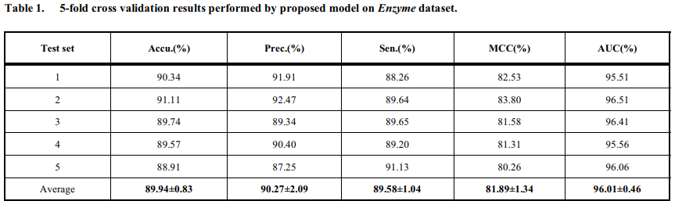
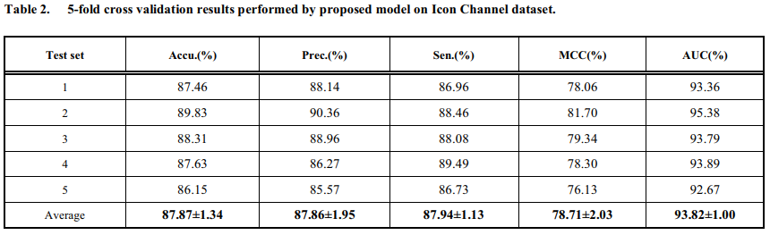
Results
Assessment of Prediction Ability

Slide 11
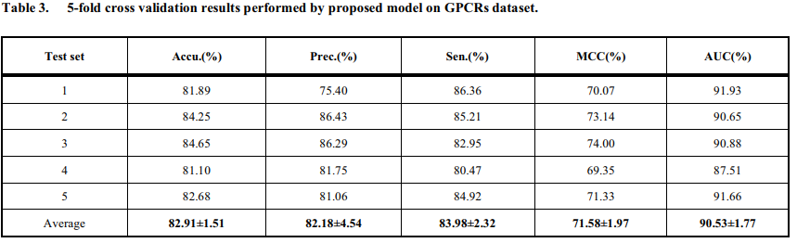
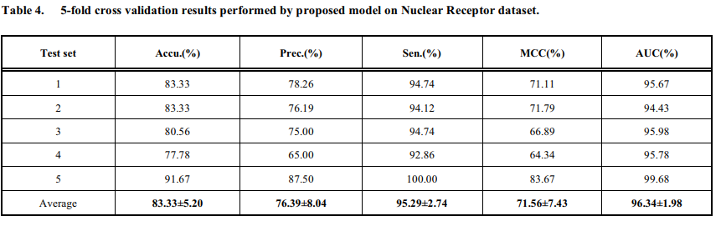
Results
Assessment of Prediction Ability

Slide 12
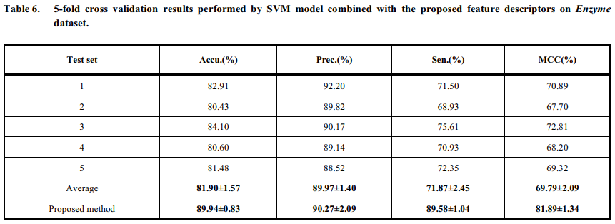
Results

