Slide 1
Bit-Parallel Algorithms for the Merged Longest Common Subsequence Problem
Sebastian Deorowicz and Agnieszka Danek
International Journal of Foundations of Computer Science
Vol. 24, No. 8 (2013) 1281–1298
Presenter: Du-Cheng Wu
Date: Jul. 9, 2019

Slide 2
Abstract
It is often a necessity to compare some sequences to find out how similar they are. There are many similarity measures that can be used, e.g., longest common subsequence, edit distance, sequence alignment. Recently a merged longest common subsequence (MergedLCS) problem was formulated with applications in bioinformatics. We propose the bit-parallel algorithms for the MergedLCS problem and evaluate them in practice showing that they are usually tens times faster than the already published methods.

Slide 3
MergedLCS
T = ABA, A = DDA, B = BAC
LCS(T, E₁(A, B)) = LCS(ABA, DDBAAC) = AA or BA
LCS(T, E₂(A, B)) = LCS(ABA, BACDDA) = AA or BA
LCS(T, E₃(A, B)) = LCS(ABA, DDABAC) = ABA
LCS(T, E(A, B)) = LCS (T, E₃(A, B))
|LCS(T, E(A, B))| = 3

Slide 4
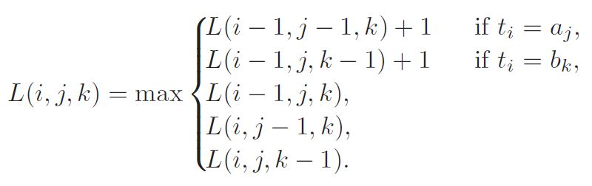
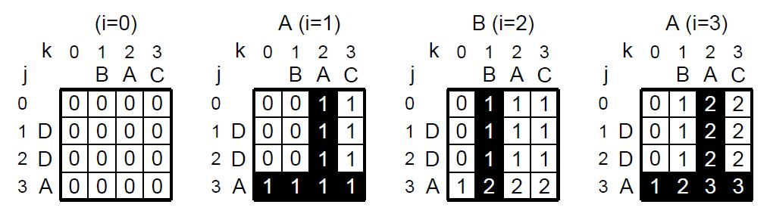
MergedLCS
|T| = r, |A| = n, |B| = m, 0≦i≦r, 0≦j≦n, 0≦k≦m
O(mnr)

Slide 5
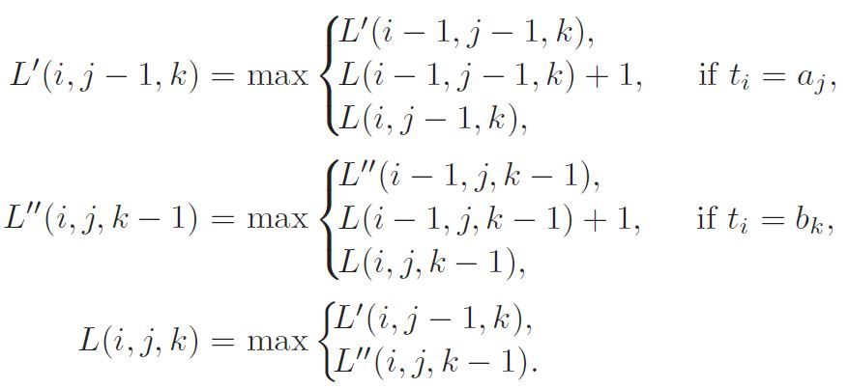
Bit-parallel Algorithm

Slide 6

M(j, k)
M(3, 3) = {1, 2, 3}, M(2, 3) = {1, 3}, M(3, 2) = {1, 2, 3}

Slide 7
M′(j, k) and M′′(j, k)
M′( j, k)
i ∈ M′( j, k) if and only if L′(i, j, k) - L′(i - 1, j, k) = 1 for 1 ≦i ≦ r
M′′( j, k)
i ∈ M′′( j, k)if and only if L′′(i, j, k) - L′′(i - 1, j, k) = 1 for 1 ≦i ≦ r

Slide 8

M′(j-1, k) and M′′(j, k-1)

Slide 9
W(j, k)
M(3, 3) = {1, 2, 3} M(2, 3) = {1, 3}
W(3, 3) = W(2, 3) =
index | value
0 | 1
1 | 0
2 | 0
3 | 0
index | value
0 | 1
1 | 0
2 | 1
3 | 0

Slide 10
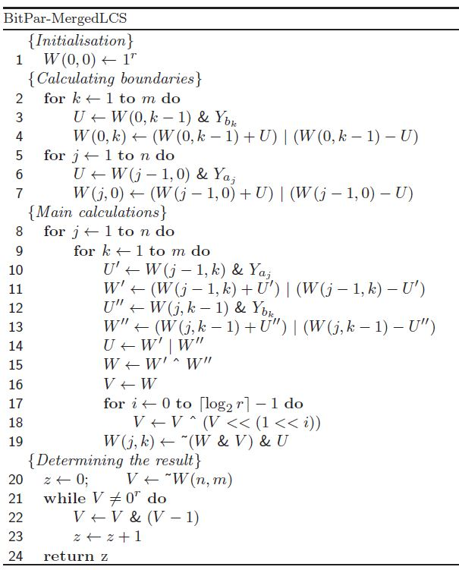
Algorithm

Slide 11
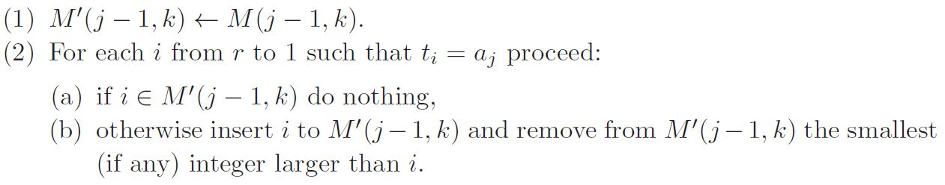
M′(j-1, k) and M′′(j, k-1)
ex: T = ABA, A = DDA, M(2,1) = {2}
M′(2, 1) = M(2, 1) = {2}
t₃ = A = A = a₃, M′(2, 1) = (2, 3)
t₁ = A = A = a₃, M′(2, 1) = (1, 2, 3)

Slide 12
W′(j, k) and W′′(j, k)
ex: M(2, 1) = {2}, W(2, 1) = , Y_{A} = 1010
W′(2, 1) = W(2, 1) & Y_{A} = 1010
W′(2, 1) = (W(2, 1) + W′(2, 1)) | (W(2, 1) - W′(2, 1))
= 0101
3 | 2 | 1 | 0
1 | 0 | 1 | 1

Slide 13
Algorithm

Slide 14
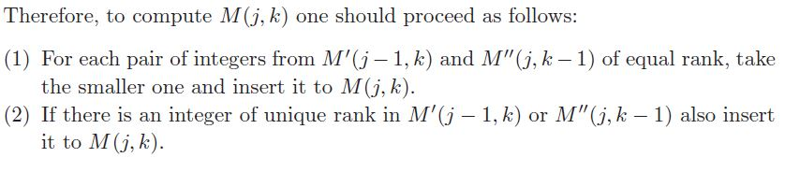
M(j, k)
ex: M(3, 3) M′(2, 3) = {1, 3}
M′′(3, 2) = {1, 2, 3}
M(3, 3) = {1, 2, 3}

Slide 15
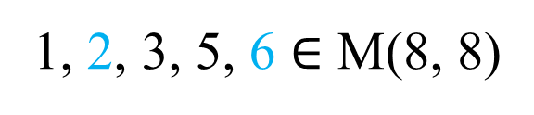
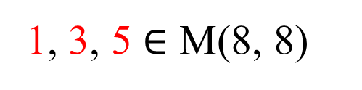
W(j, k)
ex: M(8, 8) M′(7, 8) = {1, 3, 4, 5, 6}
M′′(8, 7) = {1, 2, 3, 5, 8}
M(8, 8) = {1, 2, 3, 5, 6}
M′ (7, 8) = {1, 3, 4, 5, 6}
M′′(8, 7) = {1, 2, 3, 5, 8}
M′ (7, 8) = {4, 6}
M′′(8, 7) = {2, 8}
1, 3, 5 $∈$ M(8, 8)
1, 2, 3, 5, 6 $∈$ M(8, 8)

Slide 16
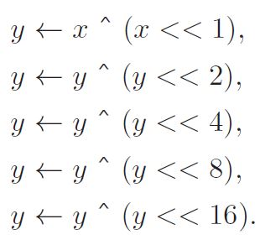
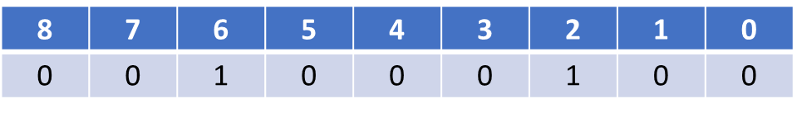
W(j, k) in a 32-bit computer
M′ (7, 8) = {4, 6}
M′′(8, 7) = {2, 8}
x =
y = x ^ (x << 1) = 111111100
y = y ^ (y << 2) = 000001100
y = y ^ (y << 4) = 011001100
y & x =
8 | 7 | 6 | 5 | 4 | 3 | 2 | 1 | 0
1 | 0 | 1 | 0 | 1 | 0 | 1 | 0 | 0

Slide 17
M′(7, 8) = {1, 3, 4, 5, 6}, W′ =
M′′(8, 7) = {1, 2, 3, 5, 8}, W′′ =
M(8, 8) = {1, 2, 3, 5, 6}, W =
U = W′|W′′ = 111010101
W= W′^W′′ = 101010100 (2, 4, 6, 8)
V = W = 101010100
V = V^(V<<1)=111111100
V = V^(V<<2)=000001100
V = V^(V<<4)=011001100
W(8, 8) = ~(W & V) & U = 11001001
8 | 7 | 6 | 5 | 4 | 3 | 2 | 1 | 0
1 | 1 | 0 | 0 | 0 | 0 | 1 | 0 | 1
0 | 1 | 1 | 0 | 1 | 0 | 0 | 0 | 1
1 | 1 | 0 | 0 | 1 | 0 | 0 | 0 | 1

Slide 18
Algorithm
O(⌈r/w⌉mn logw)
|T| = r, |A| = n, |B| = m
w : word size

Slide 19
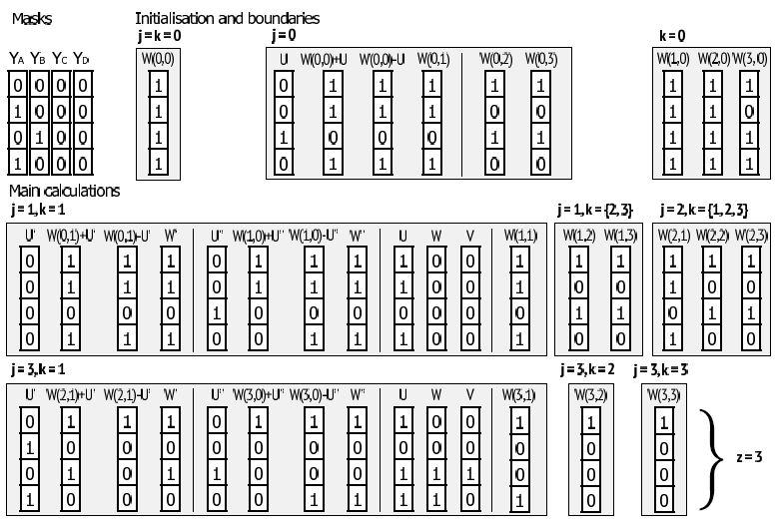
Algorithm

Slide 20
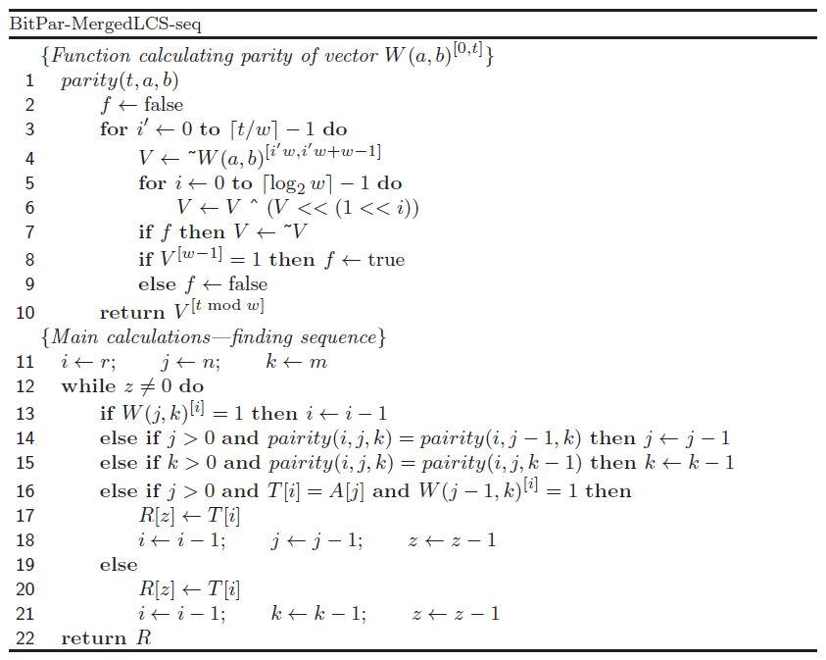
Algorithm

Slide 21
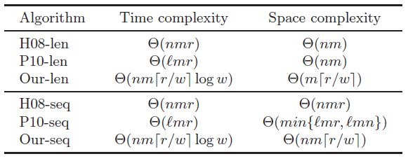
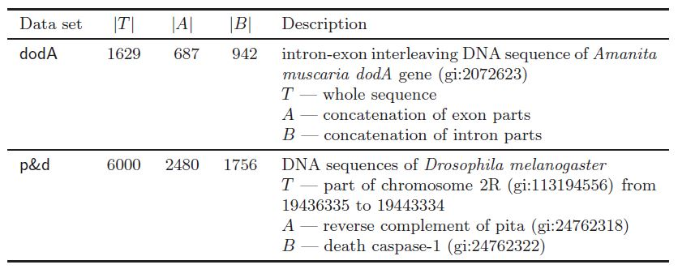
Experimental Result

Slide 22
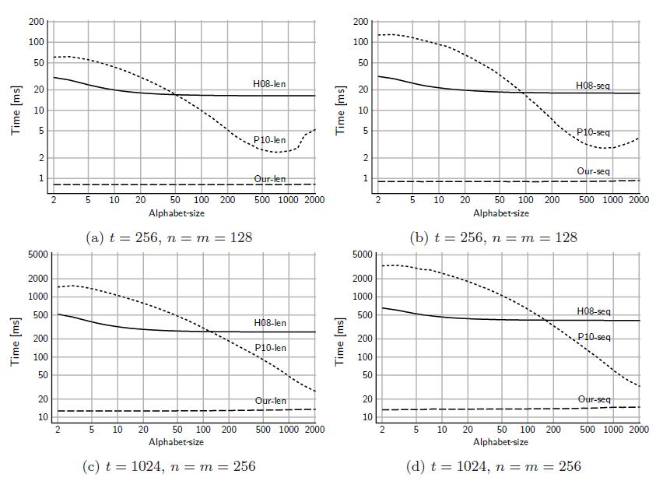
Experimental Result

Slide 23
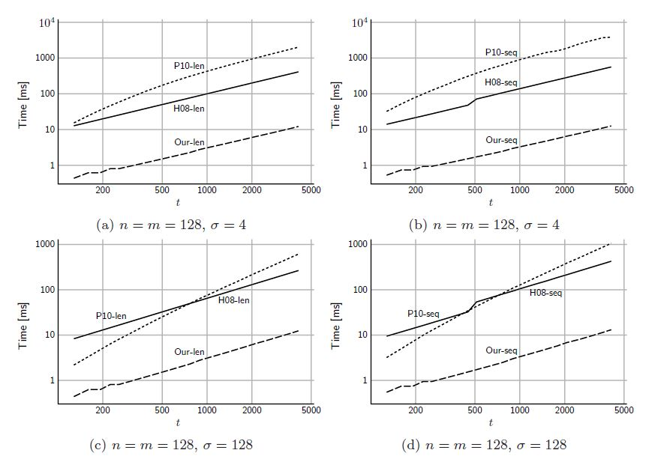
Experimental Result

Slide 24
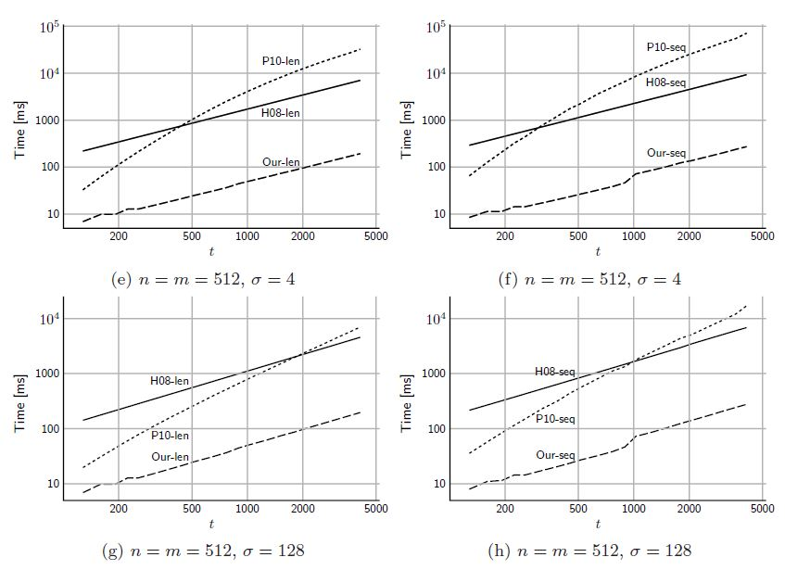
Experimental Result

