Slide 1
Quadratic-time algorithm for a string constrained LCS problem
Sebastian Deorowicz
Information Processing Letters 112 (2012) 423–426
Presenter: Du-Cheng Wu
Date: Aug. 20, 2019

Slide 2
Abstract
The problem of finding a longest common subsequence of two main sequences with some constraint that must be a substring of the result (STR-IC-LCS) was formulated recently. It is a variant of the constrained longest common subsequence problem. As the known algorithms for the STR-IC-LCS problem are cubic-time, the presented quadratic-time algorithm is significantly faster.

Slide 3
constrained longest common subsequence(CLCS)
X = acctagttga
Y = taggccactg
P = tt
LCS = accatg
CLCS = tagtg

Slide 4
constrained longest common subsequence(CLCS)
X = acctagttga
Y = taggccactg
P = tt
LCS = accatg
CLCS = tagtg

Slide 5
STR-IC-LCS
X = acctagttga
Y = taggccactg
P = tt
LCS = accatg
STR-IC-LCS = ttg

Slide 6
STR-IC-LCS
F matrix
P = aga
R matrix
 |  | t | a | g | g | c | c | a | c | t | g
 | 0 | 0 | 0 | 0 | 0 | 0 | 0 | 0 | 0 | 0 | 0
a | 0 | 0 | 1 | 1 | 1 | 1 | 1 | 1 | 1 | 1 | 1
c | 0 | 0 | 1 | 1 | 1 | 2 | 2 | 2 | 2 | 2 | 2
c | 0 | 0 | 1 | 1 | 1 | 2 | 3 | 3 | 3 | 3 | 3
t | 0 | 1 | 1 | 1 | 1 | 2 | 3 | 3 | 3 | 4 | 4
a | 0 | 1 | 2 | 2 | 2 | 2 | 3 | 4 | 4 | 4 | 4
g | 0 | 1 | 2 | 3 | 3 | 3 | 3 | 4 | 4 | 4 | 5
t | 0 | 1 | 2 | 3 | 3 | 3 | 3 | 4 | 4 | 5 | 5
t | 0 | 1 | 2 | 3 | 3 | 3 | 3 | 4 | 4 | 5 | 5
g | 0 | 1 | 2 | 3 | 4 | 4 | 4 | 4 | 4 | 5 | 6
a | 0 | 1 | 2 | 3 | 4 | 4 | 4 | 5 | 5 | 5 | 6
 | t | a | g | g | c | c | a | c | t | g
a | 6 | 6 | 5 | 5 | 5 | 4 | 4 | 3 | 2 | 1 | 0
c | 5 | 5 | 5 | 5 | 5 | 4 | 3 | 3 | 2 | 1 | 0
c | 5 | 4 | 4 | 4 | 4 | 4 | 3 | 3 | 2 | 1 | 0
t | 5 | 4 | 3 | 3 | 3 | 3 | 3 | 2 | 2 | 1 | 0
a | 4 | 4 | 3 | 3 | 3 | 3 | 3 | 2 | 2 | 1 | 0
g | 3 | 3 | 3 | 3 | 2 | 2 | 2 | 2 | 2 | 1 | 0
t | 3 | 2 | 2 | 2 | 2 | 2 | 2 | 2 | 2 | 1 | 0
t | 3 | 2 | 2 | 2 | 2 | 2 | 2 | 2 | 2 | 1 | 0
g | 2 | 2 | 2 | 2 | 1 | 1 | 1 | 1 | 1 | 1 | 0
a | 1 | 1 | 1 | 1 | 1 | 1 | 1 | 0 | 0 | 0 | 0
 | 0 | 0 | 0 | 0 | 0 | 0 | 0 | 0 | 0 | 0 | 0

Slide 7
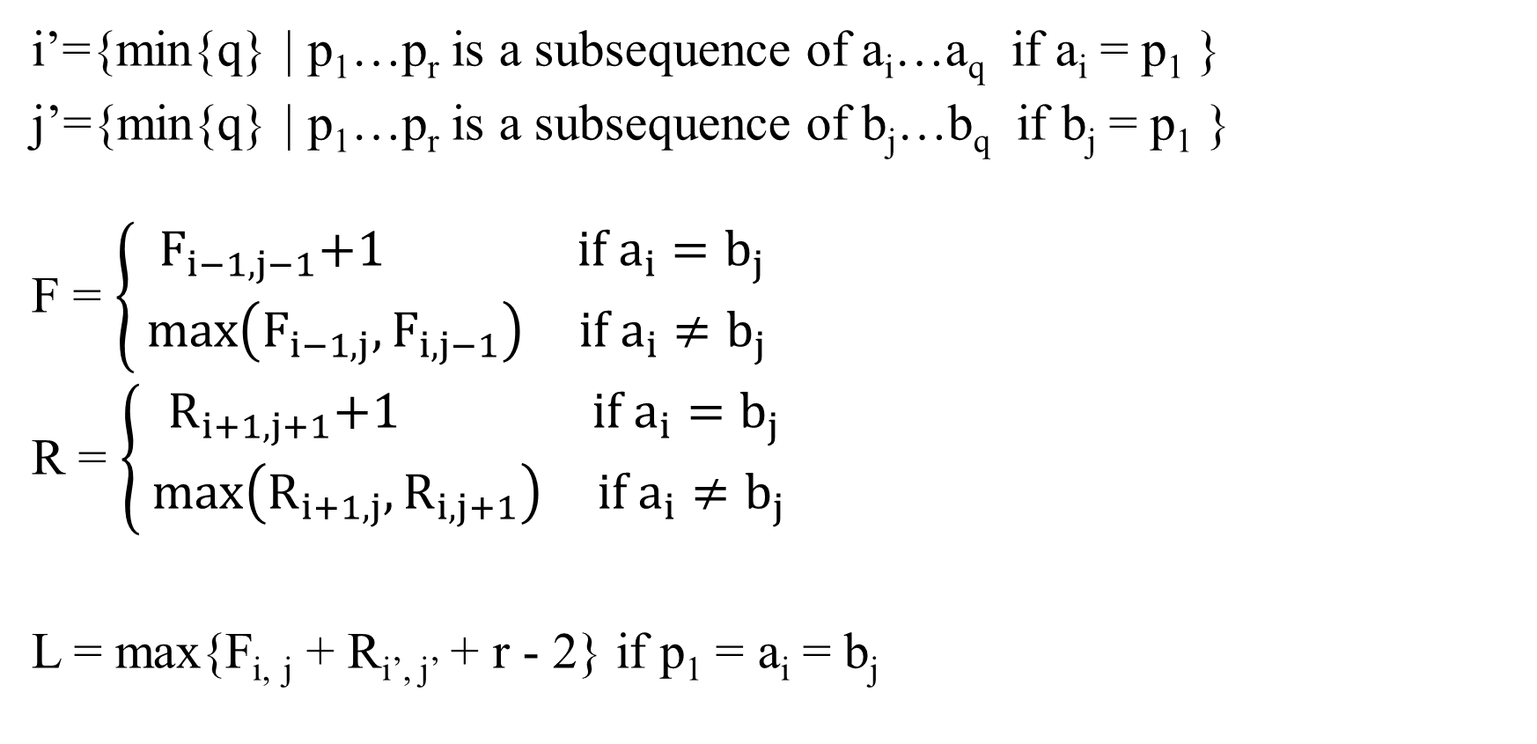
Algorithm
i’={min{q} | p₁…p_{r} is a subsequence of a_{i}…a_{q} if a_{i} = p₁ }
j’={min{q} | p₁…p_{r} is a subsequence of b_{j}…b_{q} if b_{j} = p₁ }
F = $\left\{\begin{aligned}{ F}_{i−1, j−1}+1 if{ a}_{i}=b_{j} \\ \max\left(F_{i−1, j},F_{i, j−1}\right) if{ a}_{i}≠b_{j} \end{aligned}\right.$
R = $\left\{\begin{aligned}{ R}_{i+1, j+1}+1 if{ a}_{i}=b_{j} \\ \max\left(R_{i+1, j},R_{i, j+1}\right) if{ a}_{i}≠b_{j} \end{aligned}\right.$
L = max{F_{i, j} + R_{i’, j’} + r - 2} if p₁ = a_{i} = b_{j}

Slide 8
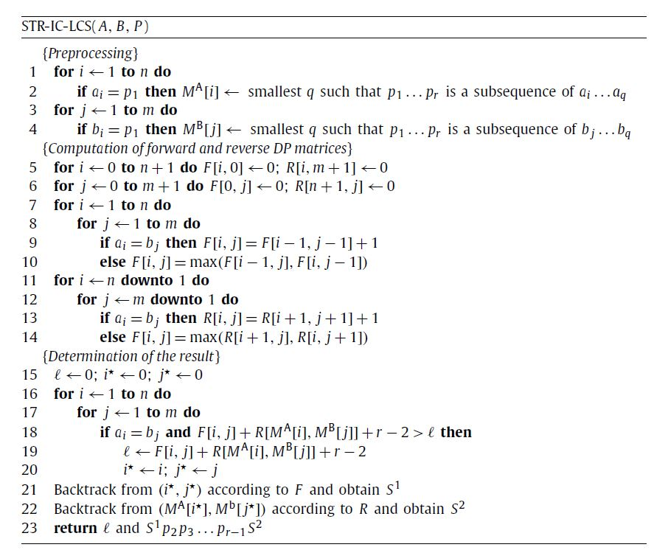
Algorithm

Slide 9
Complexity
Time O(mn)
Space O(mn)

