Slide 1
Real-time PM2.5 mapping and anomaly detection from AirBoxes in Taiwan
G. Huang, L.-J. Chen, W.-H. Hwang,
S. Tzeng, H.-C. Huang
Oct. 11th 2018
Present: Chia-Lin, Chen
Aug. 20th 2019
Notes:
第一位:清大統計系
第二位:中研院資科所
第三位:中興應數系
第四位:中山應數系
第五位:中研院統計所

Slide 2
Abstract(1/2)
Fine particulate matter (PM2.5) has gained increasing attention
due to its adverse health effects to human. In Taiwan,
it was conventionally monitored by large environmental monitoring
stations of the Environmental Protection Administration(EPA).
However, only a small number of 77 monitoring stations
are currently established. Recently, a project using a large number
of small devices, called Air-Boxes, was launched in March 2016
to monitor PM2.5 concentrations. Although thousands of AirBoxes
have been deployed across Taiwan to give a broader coverage,
they are mostly located in big cities and
their measurements are less accurate.

Slide 3
Abstract(2/2)
In this paper, we apply a robust kriging method that provides a
smoothly varied real-time PM2.5 concentration map and
its associated standard error map. In addition, we develop a novel
spatio-temporal control chart that monitors anomalous
measurements by utilizing neighboring AirBox information.
Our method automatically adapts to different neighboring structures
at different AirBox locations without the need to specify
a neighborhood range. The proposed method has abilities to detect
potential emission sources, malfunctioned AirBoxes,
and AirBoxes that are wrongly put indoors.

Slide 4
Table by Contents
Background
Data Collection
AirBox
Mapping PM2.5 by Kriging
Comparing to Different Methods
Conclusion

Slide 5
Background
Notes:
從1950年代開始 人們意識到了空氣污染的問題
例如1952 倫敦霧霾造成的死傷比前一年多3000多人cause more than 3,000 excess deaths compared with previous years
PM2.5 會cause harm to health

Slide 6
Data Collection

Slide 7
1283 AirBoxes across Taiwan
1/1/17 to 2/28/17
from Open Data Portal provided by the LASS community
https://pm25.lass-net.org
Sample rate: 5-6 min

Slide 8
AirBox

Slide 9
+:
+Easy to deploy
-:
-30% of data are missing
-Are mostly placed in big cities (Taipei, Taoyuan,Taichung, Tainan, Kaohsiung)
-locations of the AirBoxes are only given to 3 decimal points (privacy issue)
-less precise compare to large monitoring stations
Notes:
-30% of data are missing ：Due to internet connection error and airboxes are deployed after 1/1/17

Slide 10
Mapping PM2.5 by Kriging
Notes:
https://github.com/LanaChen0/PM25/blob/master/PM25OpenData_useKNN.ipynb

Slide 11

Mapping PM2.5 by kriging with robust model fitting(1/2)
We shall provide a PM2.5 map and its associated standard error map
for each time separately by fitting a separate model.
(Exponential corvariance function)
Notes:
y(s)是某時間下的濃度；某時間可以單位是小時
Beta prond 是迴歸係數
Phi(s)是multiresolution function
Ng(s)是corvarinace取exponention；可得知相關性
透過此kriging公式=>改進model

Slide 12
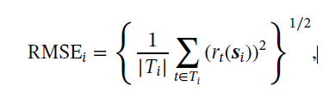
Mapping PM2.5 by kriging with robust model fitting(2/2)
Anomaly detection
Root mean squared error (RMSE)
If RMSE>3, then abnormal.

Slide 13
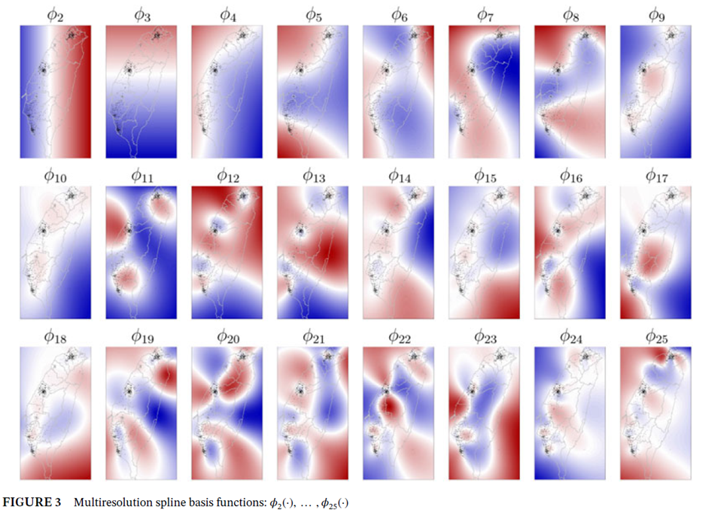
Notes:
Ｋ=25最好

Slide 14
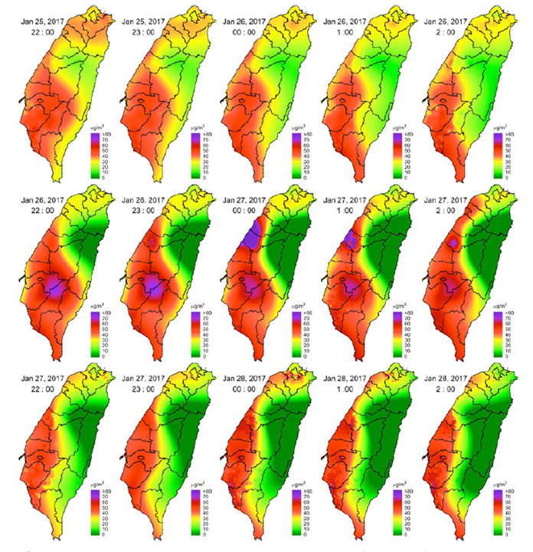
Chinese New Year
1/27 0:00 eve
1/28 first day
Notes:
農曆新年 23:00 證明時間 1/27除夕夜0:00最強 1/28農曆新年當天
南部最為嚴重，北部因為管制而值較低

Slide 15
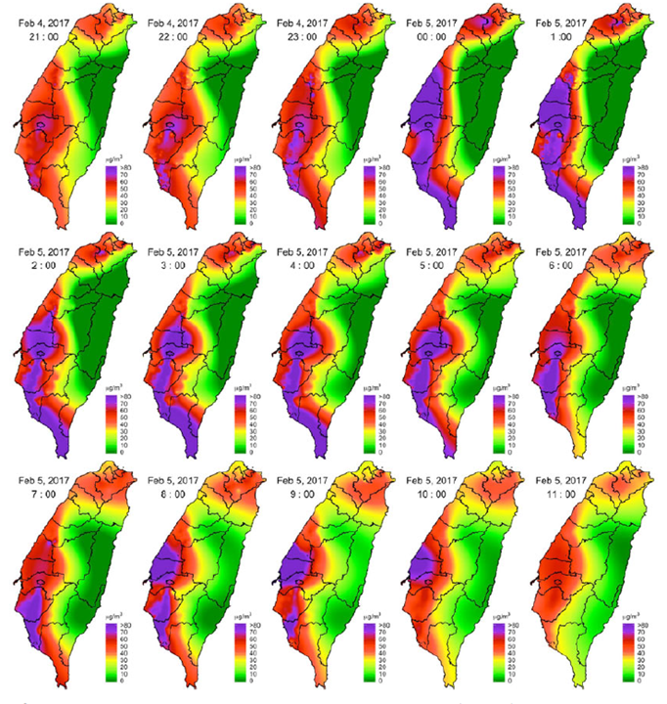
Yu Huang’s Birthday
2/5
Notes:
玉皇大帝誕辰(Feb 04 23:00 - Feb 05 9:00) 初九 鞭炮

Slide 16
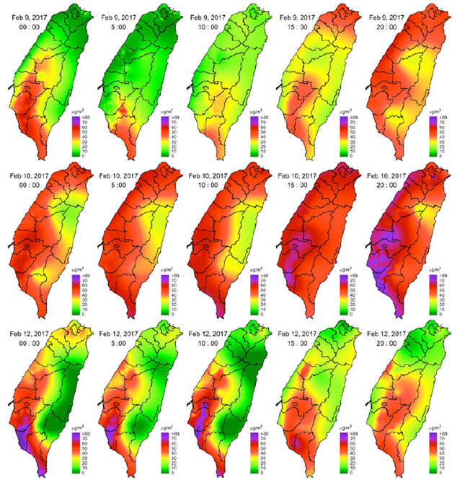
Smog from
Mainland China
Notes:
霧霾 從北開始被影響到南

Slide 17
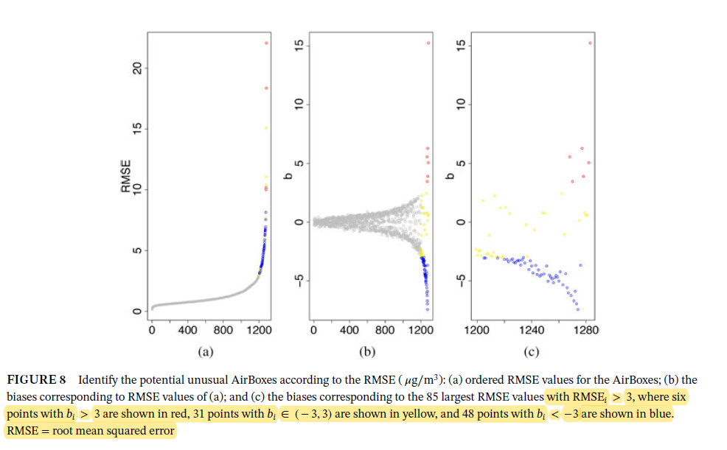
4.Figure and Explain
RMSE>3
and
Red: bias>3
Yellow: bias(-3,3)
Blue: bias<-3
Notes:
有偏差 分散 誤差大
RMSE(85)分佈都大於三 紅： bias >3 紅色6點 bias 介於-3 3 黃色31點 bias<-3藍色48點
縱軸:RMSE/bias
橫軸:時間(毫秒)

Slide 18
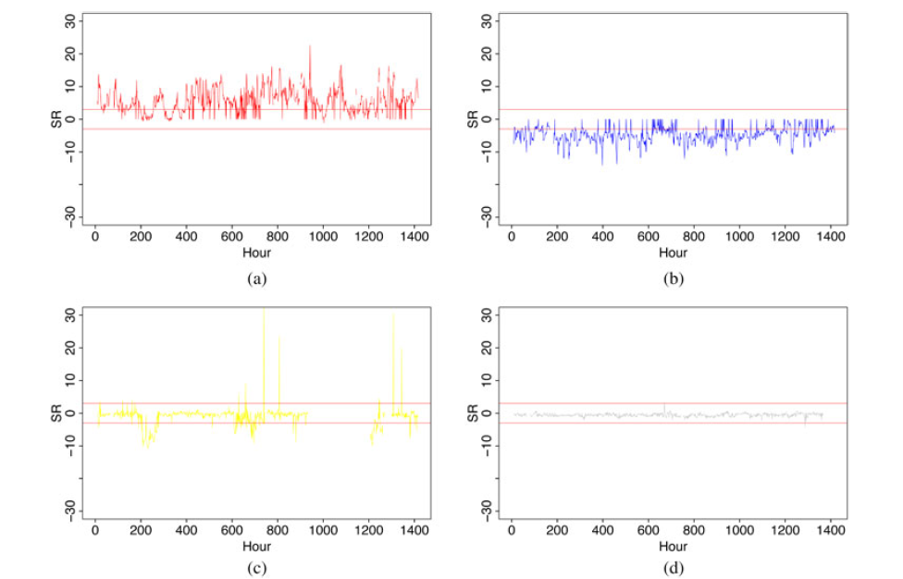
RMSE>3 bias >3
RMSE >3 bias <-3
RMSE >3 bias (-3,3)
RMSE <=3, normal
Notes:
A: RMSE>3 bias >3 長期在放Pm2.5高的地方
B: RMSE >3 bias <-3 放在室內
C: RMSE >3 bias 介於-3 3 放在不穩定區 ex: 餐廳 (有時有油煙由時沒有) abnormal
D: 穩定區域 normal

Slide 19
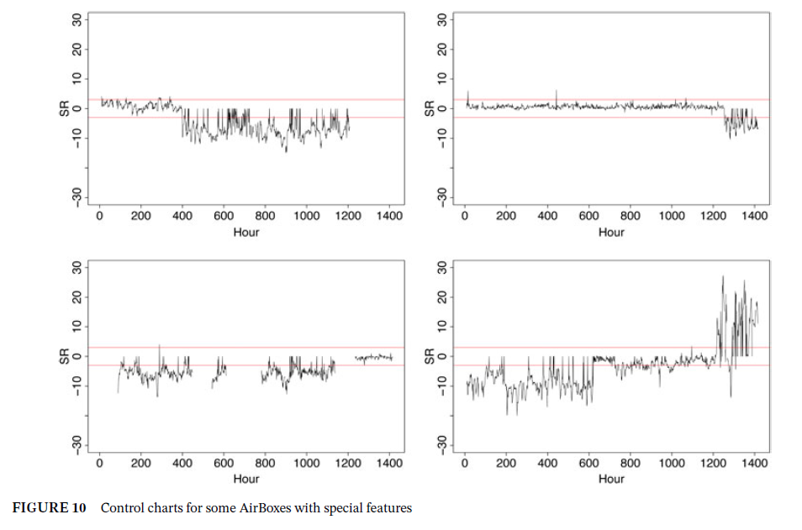
4.Figure and Explain
Notes:
Special features
上面兩圖： 從室外到室內 400, 1250
下面兩圖： 從室內到室外 1200, 625

Slide 20
Comparing to Different Methods

Slide 21
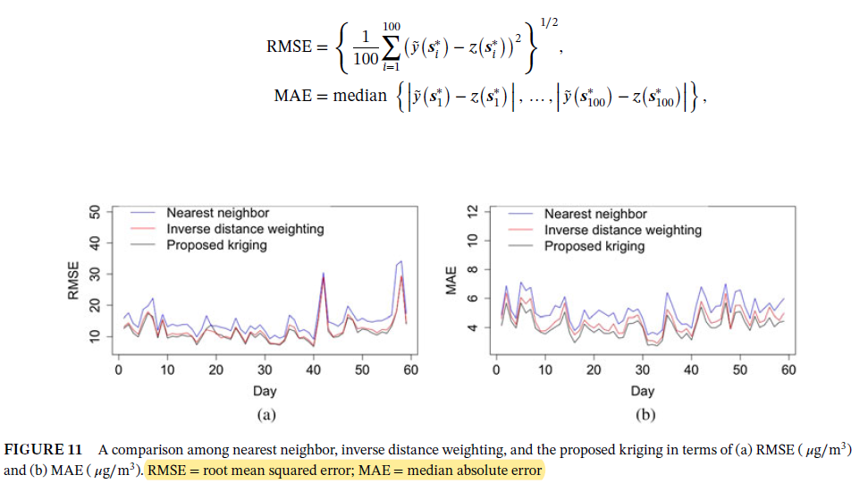
4.Figure and Explain
Notes:
怎麼算RMSE 跟MAE

Slide 22
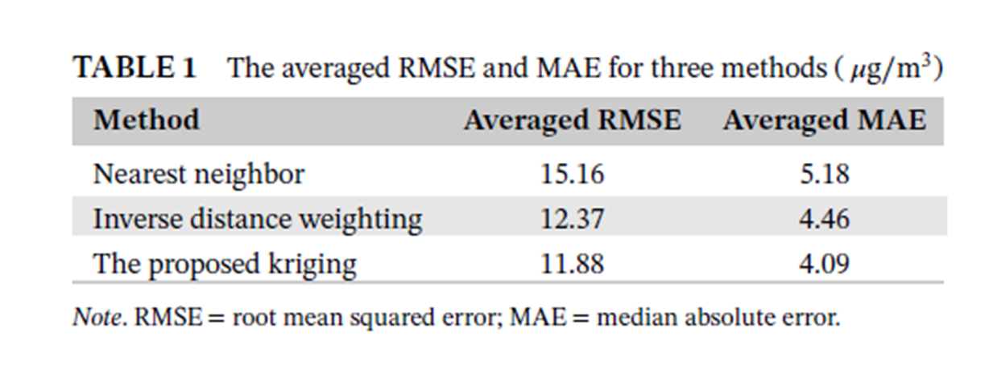
Notes:
下降RMSEerror rates 4% MAE 8.2%

Slide 23
Conclusion

Slide 24
Kriging method has lower average RMSE and average MAE.
Kriging computation becomes slower as more data provided.
AirBoxs still provide higher measurement error than large stations.
Further research is needed (humidity & temperature)

Slide 25
END

