Slide 1
A Cover-Merging-Based Algorithm for the Longest Increasing Subsequence in a Sliding Window Problem
S. Deorowicz
Computing and Informatics, Vol. 31, 2012, 1217–1233
Presenter: Wen-Yu Chang
Date: Jan. 07, 2025
Notes:
奧地利 多瑙河畔克雷姆斯

Slide 2
Abstract
A longest increasing subsequence problem (LIS) is a well-known combinatorial problem with applications mainly in bioinformatics, where it is used in various projects on DNA sequences. Recently, a number of generalizations of this problem were proposed. One of them is to find an LIS among all fixed-size windows of the input sequence (LISW). We propose an algorithm for the LISW problem based on cover representation of the sequence that outperforms the existing methods for some class of the input sequences.

Slide 3
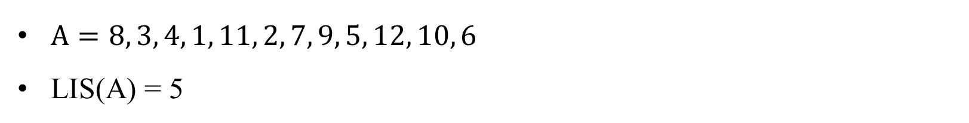
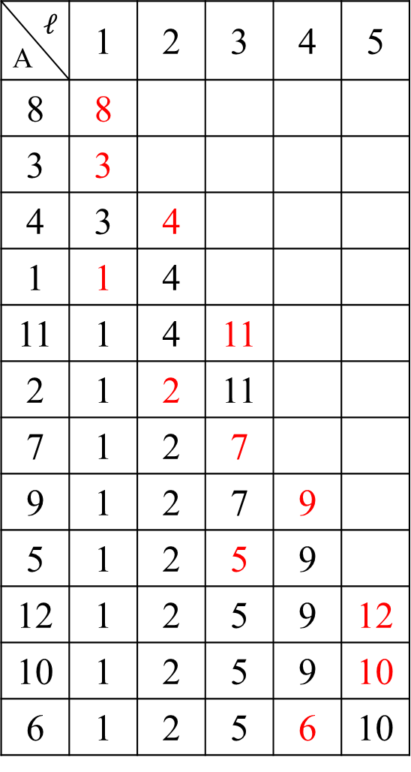
Longest Increasing Subsequence
$$ℓ$$ A | 1 | 2 | 3 | 4 | 5
8 | 8
3 | 3
4 | 3 | 4
1 | 1 | 4
11 | 1 | 4 | 11
2 | 1 | 2 | 11
7 | 1 | 2 | 7
9 | 1 | 2 | 7 | 9
5 | 1 | 2 | 5 | 9
12 | 1 | 2 | 5 | 9 | 12
10 | 1 | 2 | 5 | 9 | 10
6 | 1 | 2 | 5 | 6 | 10
$A=8, 3, 4, 1, 11, 2, 7, 9, 5, 12, 10, 6$
LIS(A) = 5

Slide 4
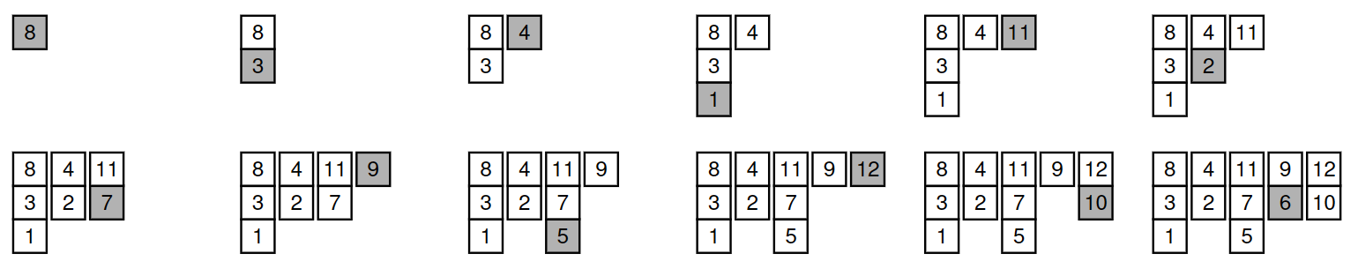
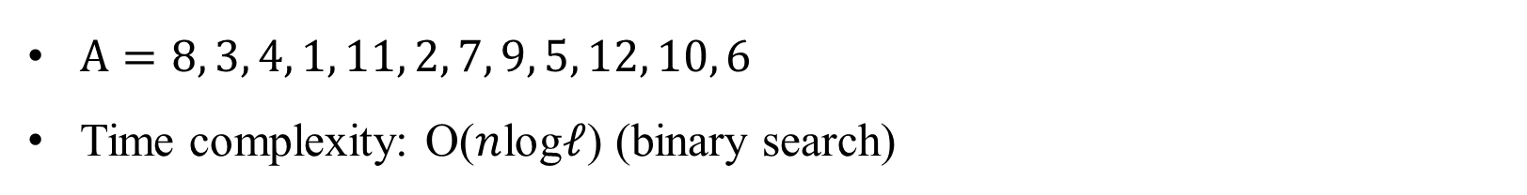
Cover-Make algorithm
$A=8, 3, 4, 1, 11, 2, 7, 9, 5, 12, 10, 6$
Time complexity: O($n$log$ℓ$) (binary search)

Slide 5
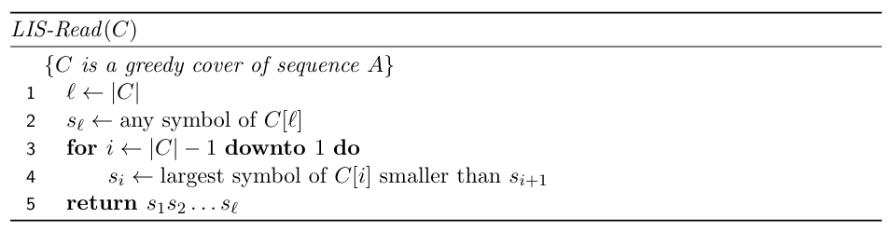
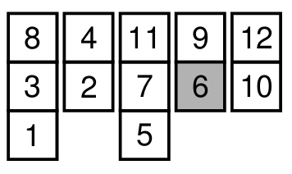
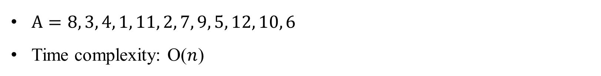
LIS-Read algorithm
$A=8, 3, 4, 1, 11, 2, 7, 9, 5, 12, 10, 6$
Time complexity: O($n$)

Slide 6
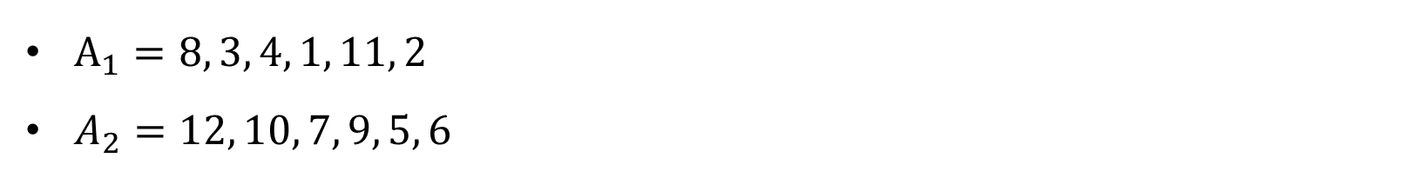
Cover-Merge algorithm (1/3)
$A_{1}=8, 3, 4, 1, 11, 2$
$A_{2}=12, 10, 7, 9, 5, 6$
8
3
1
4
2
11
12
10
7
5
9
6

Slide 7
Cover-Merge algorithm (2/3)
$A_{1}=8, 3, 4, 1, 11, 2$
$A_{2}=12, 10, 7, 9, 5, 6$
8
3
1
4
2
11
10
7
5
12
9
6

Slide 8
Cover-Merge algorithm (3/3)
$A_{1}=8, 3, 4, 1, 11, 2$
$A_{2}=12, 10, 7, 9, 5, 6$
8
3
1
4
2
11
10
7
5
12
9
6

Slide 9
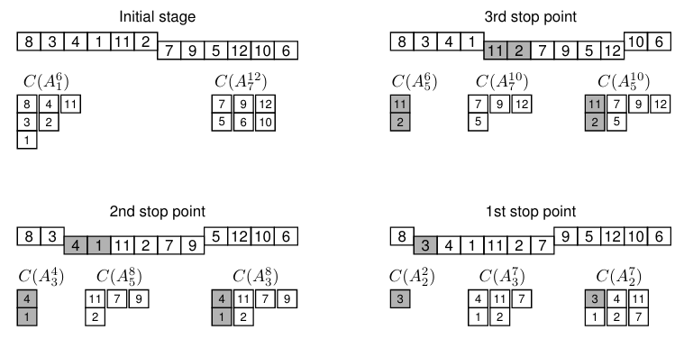
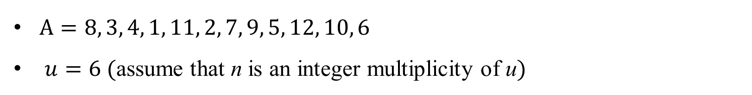
LISW-Range algorithm
$A=8, 3, 4, 1, 11, 2, 7, 9, 5, 12, 10, 6$
$u=6$ (assume that n is an integer multiplicity of u)
Notes:
Because the symbols in lists of the appended cover are decreasing, only a stop point may start a new list in C

Slide 10
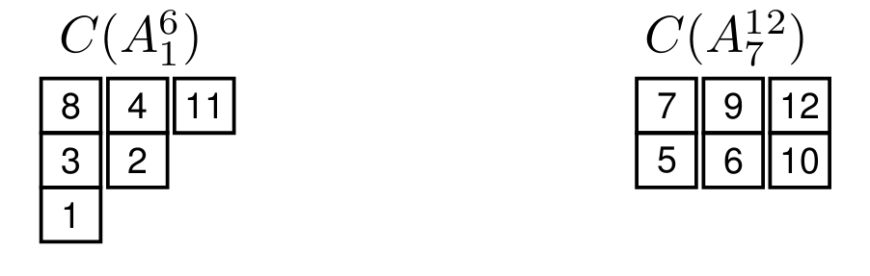

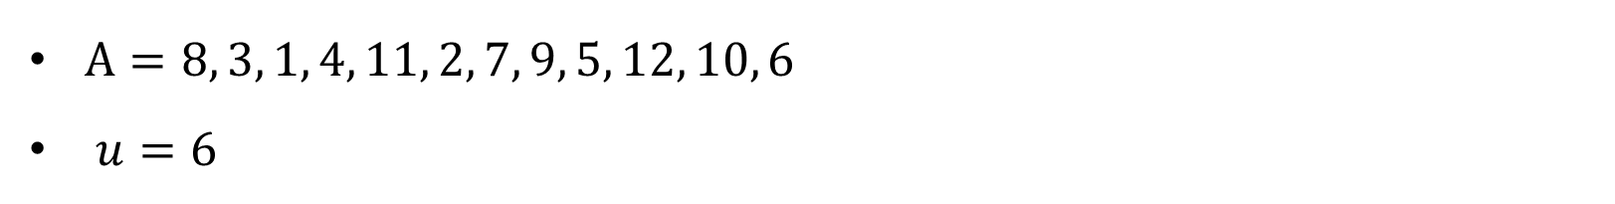

Stop point
$A=8, 3, 1, 4, 11, 2, 7, 9, 5, 12, 10, 6$
$u=6$
$$C(A_{3}^{8})$$
$$C(A_{4}^{9})$$
1
4
2
11
7
9
4
2
11
7
5
9
Notes:
Because the symbols in lists of the appended cover are decreasing, only a stop point may start a new list in C

Slide 11
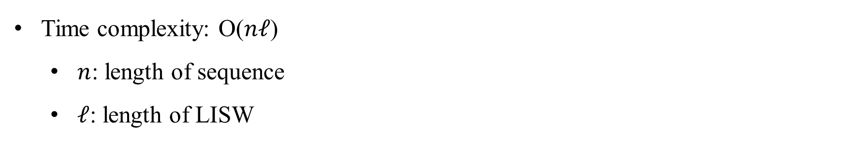
Conclusion
Time complexity: O($nℓ$)
$n$: length of sequence
$ℓ$: length of LISW

