Slide 1
Heuristic Algorithm for Solving Travelling Salesman Problem: Adding the Endpoints of the Longest Edges
Fidan Nuriyeva
2023 5th International Conference on Problems of Cybernetics and Informatics (PCI)
Presenter: Yi-Sheng Chen
Date: Jan. 07, 2025

Slide 2
Abstract
This study proposes a new heuristic algorithm based on insertion heuristic to solve the symmetric Travelling Salesman Problem. In the proposed algorithm, firstly the two longest edges are selected and the starting tour passing through their endpoints is constructed, then the endpoints of the next longest edges are added to this tour and the solution passing through all the vertices is found. This problem is known to be NP-Hard. The proposed method was successfully tested on different-sized problems. The experimental results show that the proposed algorithm outperforms many existing methods.

Slide 3
Problem Definition
G = (V, E)、d(i , j) = d(j , i)
V={1,2,…,n}、E={ (i , j) | i , j ∈ V 且 i != j}

Slide 4
Algorithm
Step 1: Sort the edges by decreasing order.
Step 2: The starting subtour is created by selecting the two longest edges. Delete the vertices from the set V.
Step 3: Select the next longest edge. Find the vertices that is not in the subtour. Let this vertex be Ak.
Step 4: Find the edge (Al, Am) in the tour with endpoints (Al) and (Am). between the endpoints and the length of the edge (Al, Am) is minimized for the city (Ak) to be added. (the vertex Ak is selected from the condition AlAk + AkAm - AlAm = min).
Step 5: Go to Step 2 until there is no more cities.

Slide 5
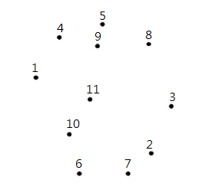
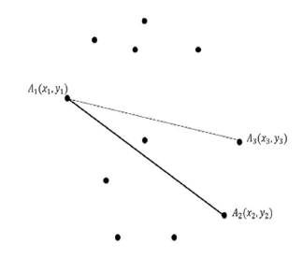
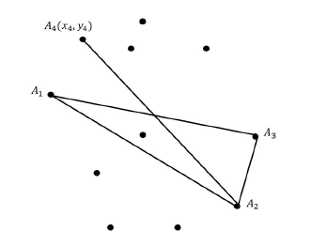
Symmetric TSP Example
V={1,2,3,4,5,6,7,8,9,10,11}
AlAk + AkAm - AlAm = min
→
→
Longest: (A1,A2)、(A1,A3)
Longest: (A2,A4)

Slide 6
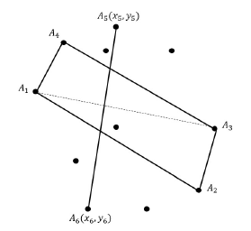
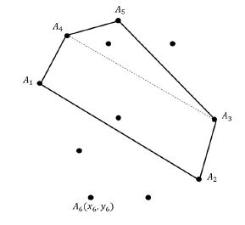
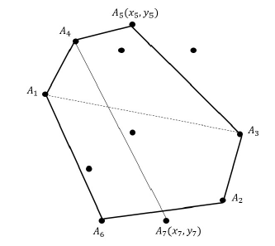
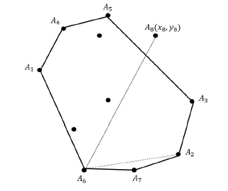
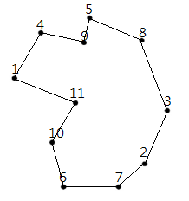
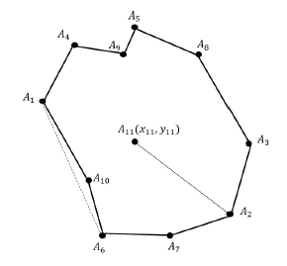
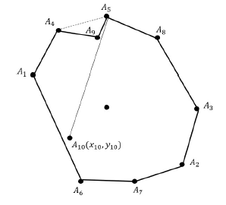
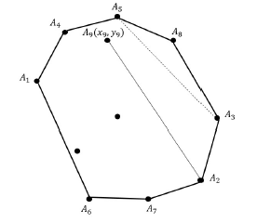
Symmetric TSP Example
V={1,2,3,4,5,6,7,8,9,10,11}
→
→
→
Longest: (A5,A6)
Longest: (A4,A7)
Longest: (A6,A8)
↓
←
←
←
Result:A1 - A4 - A9 - A5 - A8 - A3
- A2 - A7 - A6 - A10 - A11 - A1
Longest: (A2,A11)
Longest: (A5,A10)
Longest: (A2,A9)

Slide 7
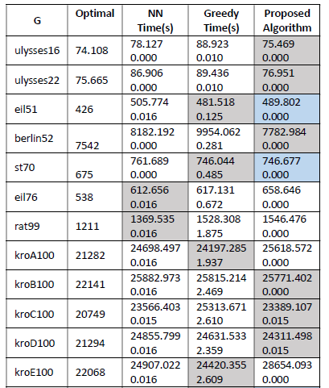

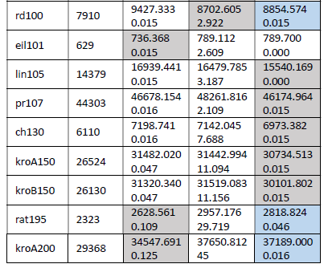
Table(TSPLIB)
Number of tests:21
Best:11
Second best:5

Slide 8
Conclusion
We carried out a sequence of experiments using benchmark instances sourced from the TSPLIB dataset, and conducted a comprehensive evaluation, comparing our findings with results obtained by numerous well known techniques.
The outcomes of our experiments demonstrated the impressive performance of our proposed heuristic, showcasing its efficiency across a range of tested instances. It is worth noting that our heuristic outperforms several established methods in this context.

Slide 9
Thanks

