Slide 1
Algorithmic financial trading with deep convolutional neural networks: Time series to image conversion approach
O. B. Sezer, & A. M. Ozbayoglu (2018).
Applied Soft Computing, 70, 525-538.
Presenter : Jing-Xiang Yang
Date : Jan. 07, 2025

Slide 2
ABSTRACT
Computational intelligence techniques for financial trading systems have always been quite popular. In the last decade, deep learning models start getting more attention, especially within the image processing community. In this study, we propose a novel algorithmic trading model CNN-TA using a 2-D convolutional neural network based on image processing properties. In order to convert financial time series into 2-D images, 15 different technical indicators each with different parameter selections are utilized. Each indicator instance generates data for a 15 day period. As a result, 15 × 15 sized 2-D images are constructed. Each image is then labeled as Buy, Sell or Hold depending on the hills and valleys of the original time series. The results indicate that when compared with the Buy & Hold Strategy and other common trading systems over a long out-of-sample period, the trained model provides better results for stocks and ETFs.

Slide 3
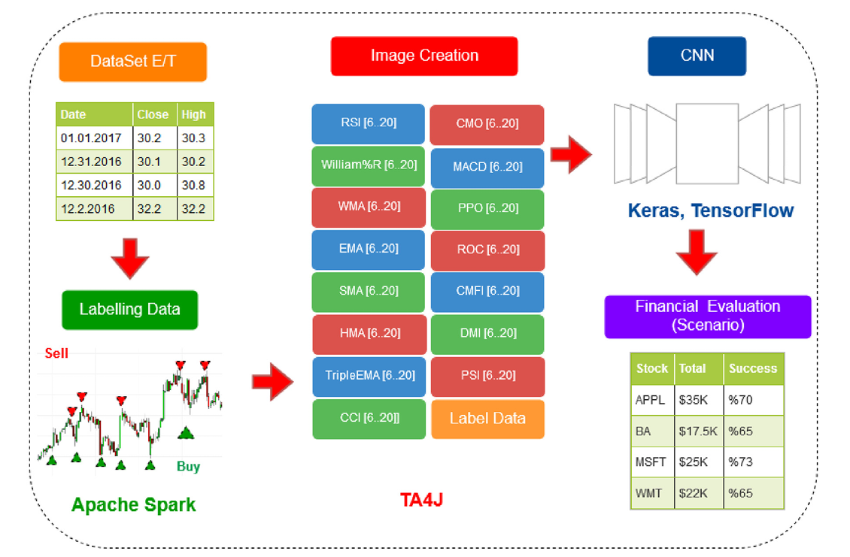
Contribution
Developed an algorithmic trading system using a 2D CNN on stock data and technical indicators. (CNN-TA)

Slide 4
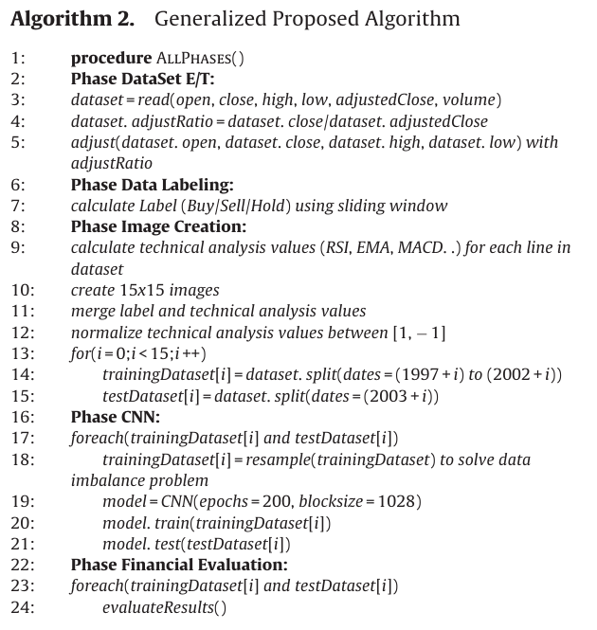
Method

Slide 5
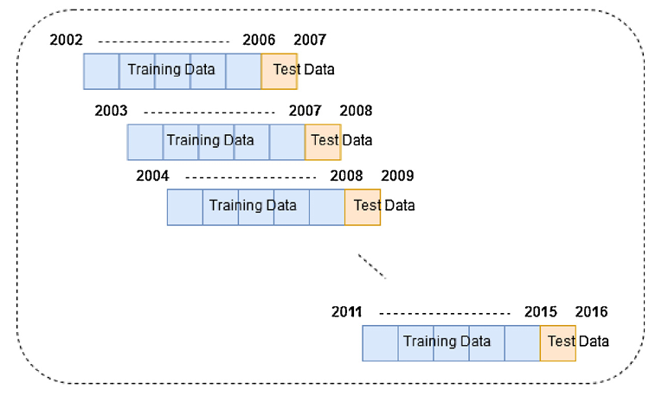
Preprocessing
Daily stock prices of Dow 30 / Exchange-Traded Fund (ETFs) prices are obtained from finance.yahoo.com
Adapted a sliding window with retraining approach (5 year period for training and 1 year for testing) (WFV)

Slide 6
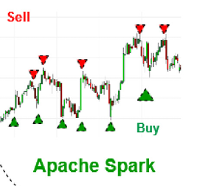
Preprocessing
Daily close prices are labeled as "Buy," "Sell," or "Hold" based on top and bottom points within a sliding window. (window = 11)

Slide 7
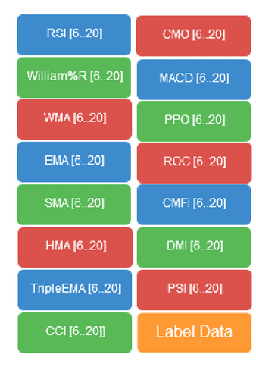
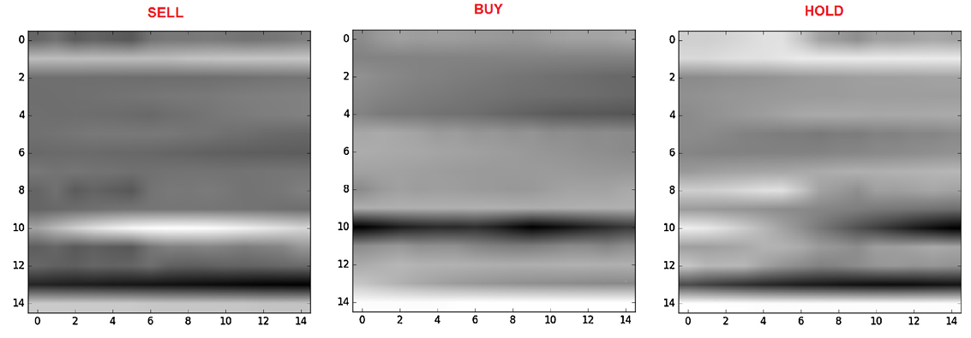
Image creation
A 15×15 image is generated daily using 15 technical indicators across 15 intervals.
Grouped indicators by type (oscillator or trend)
Use Min-Max to normalize
Notes:
趨勢 : 股價會隨趨勢走，可因參與套利 (適用股價趨勢明確的時候)
震盪 : 基於價格存在一個潜在的公允價位，價格會圍繞這個價位震盪。價格下跌到相對低點買入抄底，價格上漲到較高位置拋售做空。

Slide 8
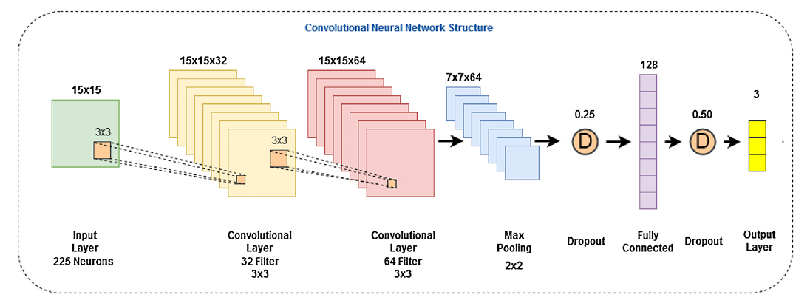
Model Architecture

Slide 9
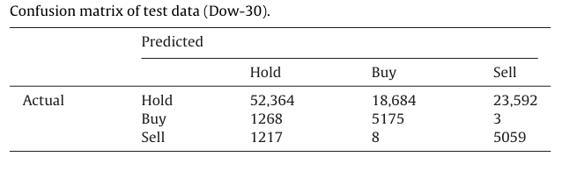
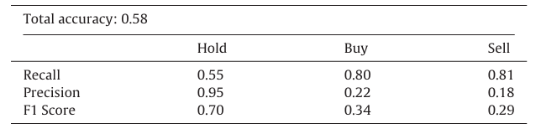
Experiment

Slide 10
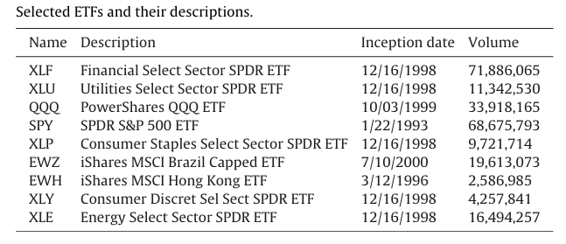
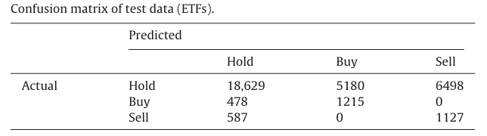
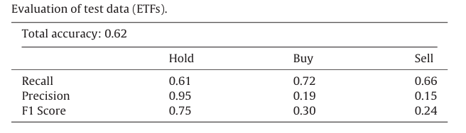
Experiment

Slide 11
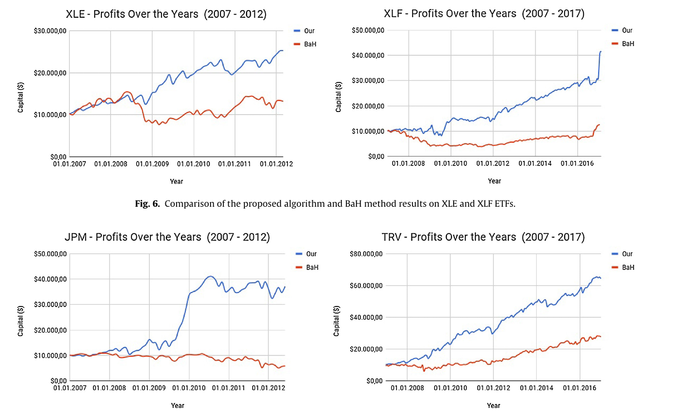
Experiment

Slide 12
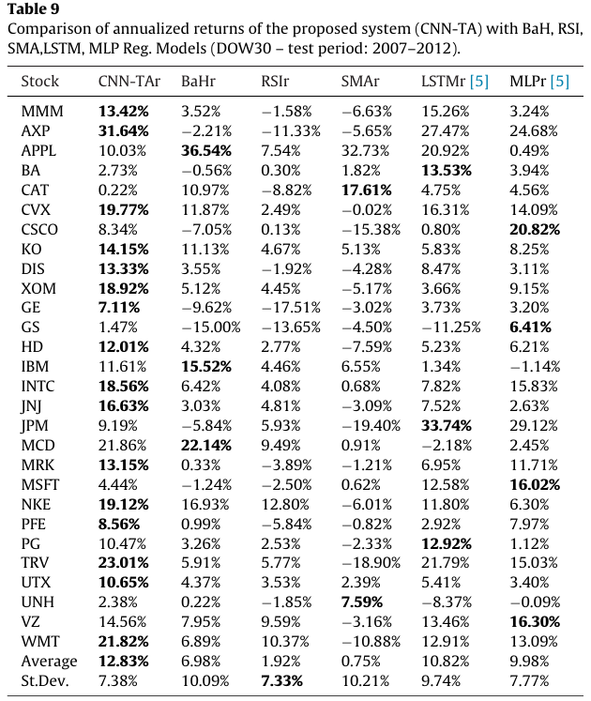
Experiment

Slide 13
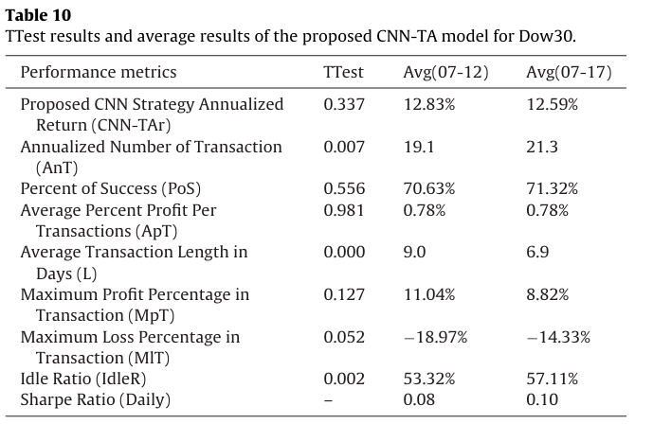
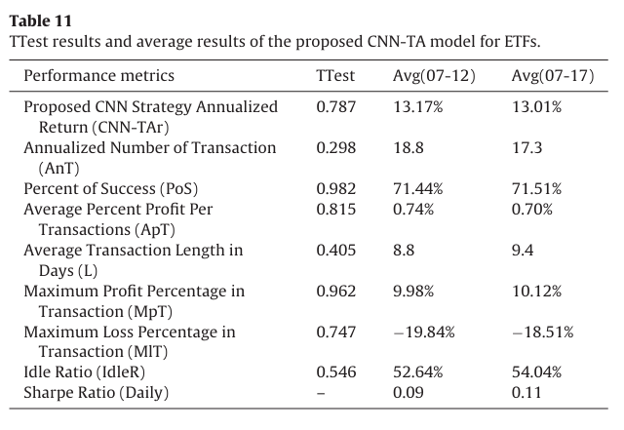
Experiment
The statistical test shows the model's behavior is consistent across asset classes and time periods.

Slide 14
Thanks

