Slide 1
A data structure for substring-substring LCS length queries
Yoshifumi Sakai
Theoretical Computer Science 911 (2022) 41–54
Presenter: Pei-Chian Lee
Date: Jan. 13, 2025

Slide 2
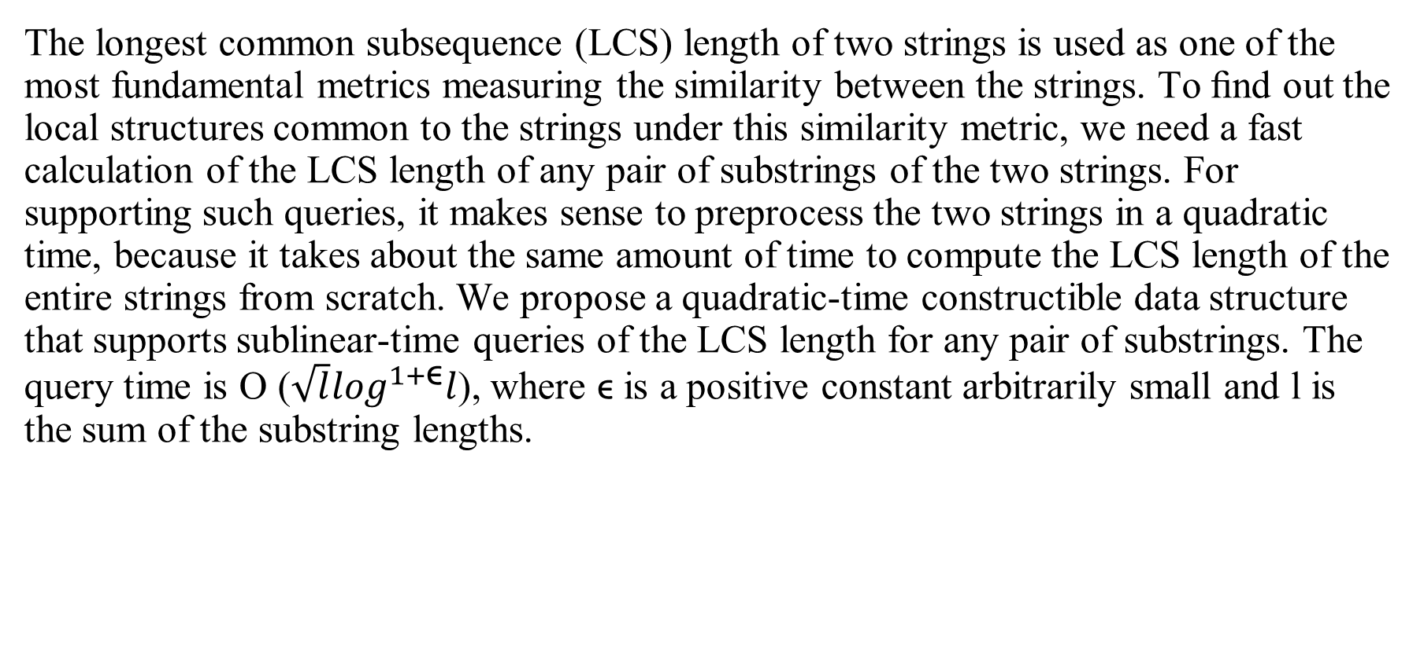
Abstract
The longest common subsequence (LCS) length of two strings is used as one of the most fundamental metrics measuring the similarity between the strings. To ﬁnd out the local structures common to the strings under this similarity metric, we need a fast calculation of the LCS length of any pair of substrings of the two strings. For supporting such queries, it makes sense to preprocess the two strings in a quadratic time, because it takes about the same amount of time to compute the LCS length of the entire strings from scratch. We propose a quadratic-time constructible data structure that supports sublinear-time queries of the LCS length for any pair of substrings. The query time is O ($\sqrt{l}\log^{1+\text{ϵ}}l$), where ϵ is a positive constant arbitrarily small and l is the sum of the substring lengths.

Slide 3
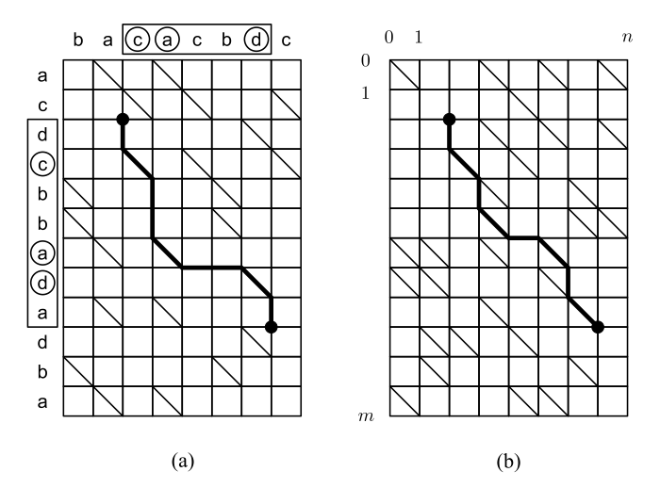
Reducing LCS Length Problem to Shortest Path Computation in a Grid Graph
Notes:
3b

Slide 4
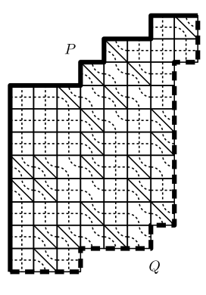
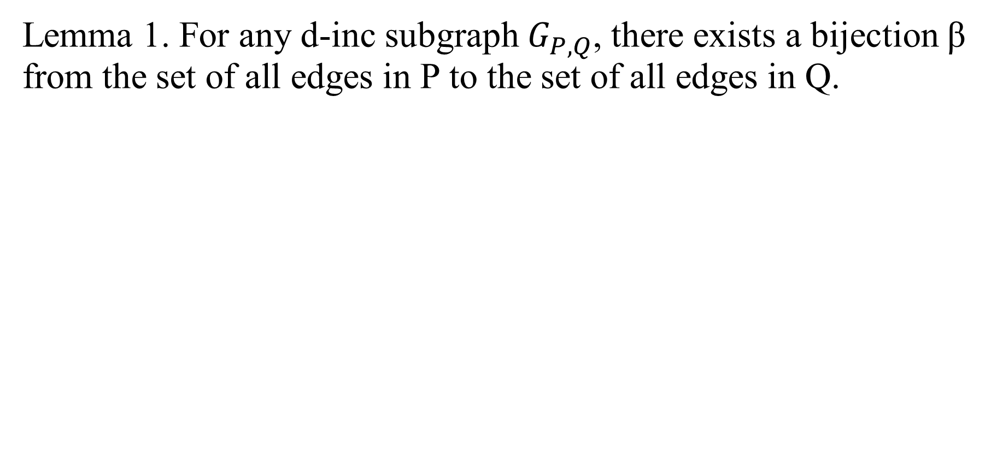
Semi-local LCS length technique of Tiskin
Lemma 1. For any d-inc subgraph $G_{P,Q}$, there exists a bijection β from the set of all edges in P to the set of all edges in Q.
Notes:
3b

Slide 5
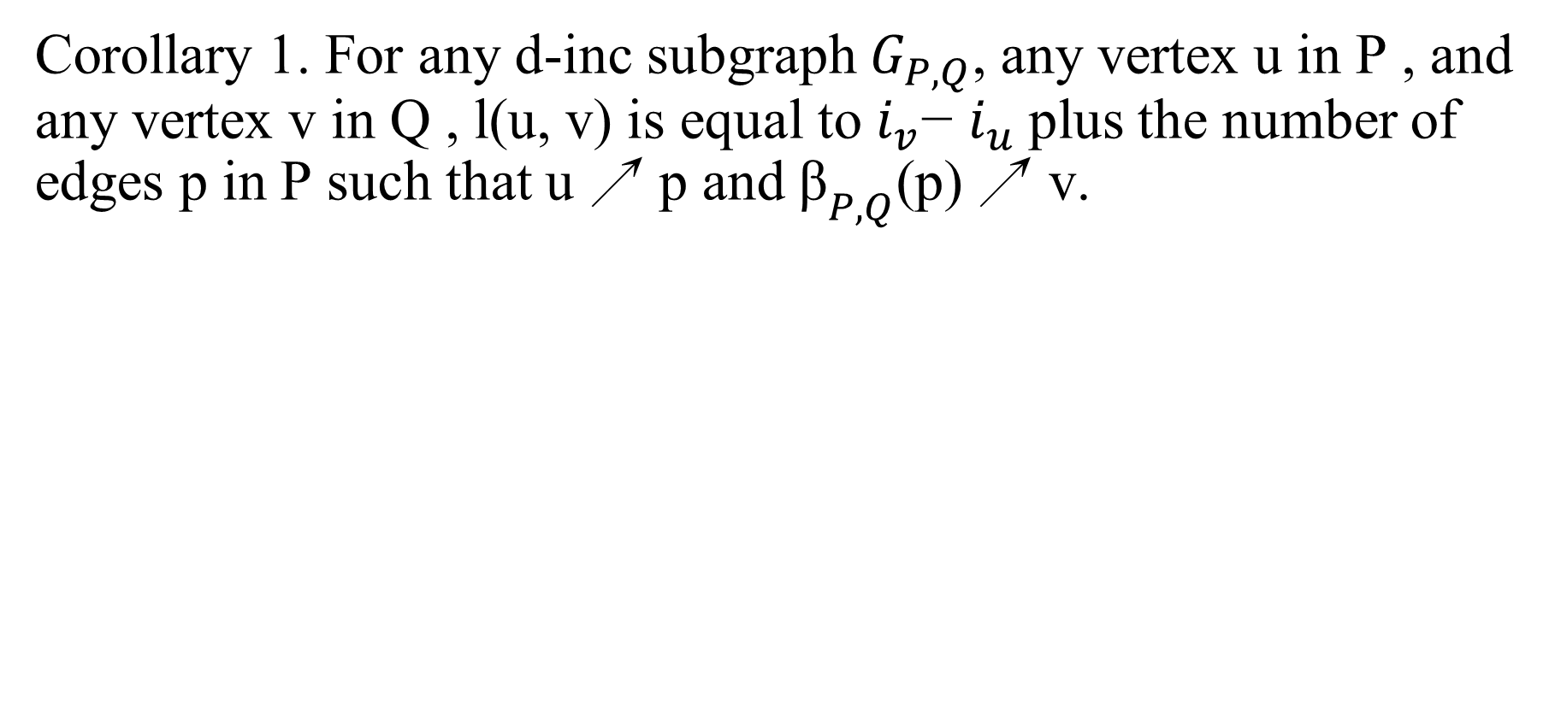
Semi-local LCS length technique of Tiskin
Corollary 1. For any d-inc subgraph $G_{P,Q}$, any vertex u in P , and any vertex v in Q , l(u, v) is equal to $i_{v}$− $i_{u}$plus the number of edges p in P such that u ↗ p and ${\text{β}}_{P,Q}$(p) ↗ v.
Notes:
3b

Slide 6
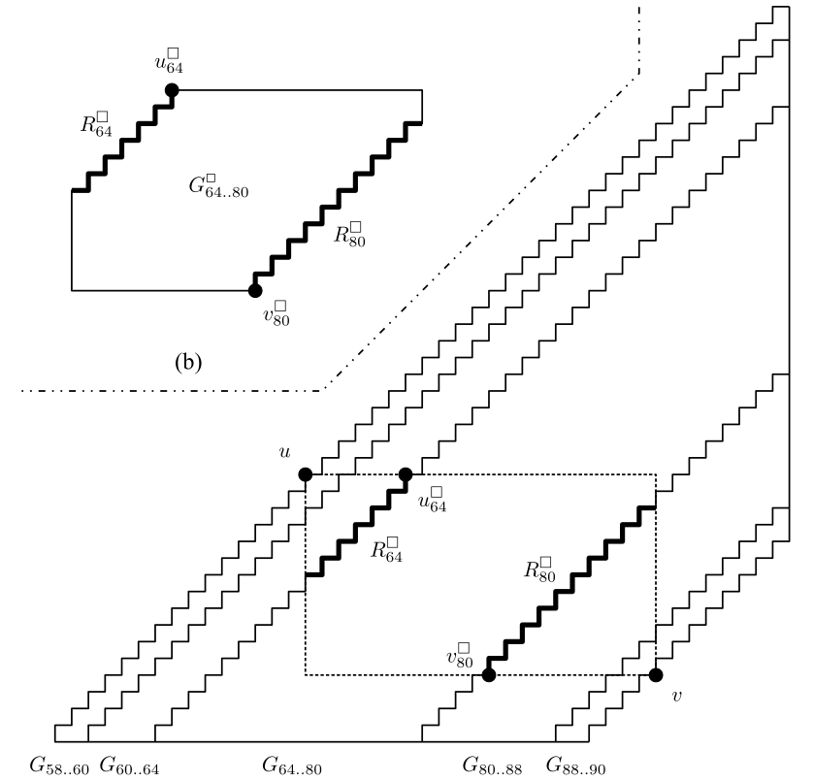

l(u,v)= $i_{v}$− $i_{u}$+ #edges
P such in P such that u ↗ p
and ${\text{β}}_{P,Q}$(p) ↗ v
Notes:
3b

Slide 7
Basic data structure supporting linear-time queries
O(l)-time queries
Notes:
3b

Slide 8
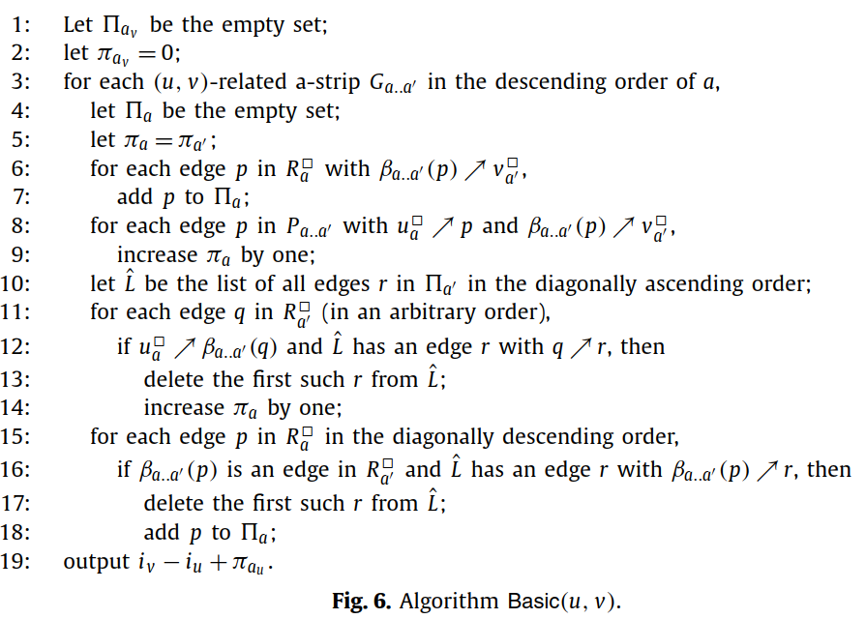
Basic data structure supporting linear-time queries
Notes:
3b

Slide 9
Basic data structure supporting linear-time queries
Step1:
Notes:
Step1: for each (u, v)-related a-strip ${\text{G}}_{a..a′}$in the descending order of a

Slide 10
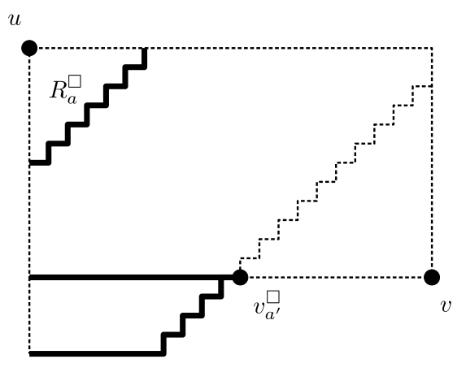

Basic data structure supporting linear-time queries
Step2:
Notes:
:算出$R_{a}^{口}$中的edge p滿足
${\text{β}}_{a..a′}$(p) ↗ $v_{a′}^{口}$的數量，把它
加入π
:for each edge p in $R_{a}^{口}$
with ${\text{β}}_{a..a′}$(p) ↗ $v_{a′}^{口}$, add
P to ${\text{Π}}_{a}$

Slide 11
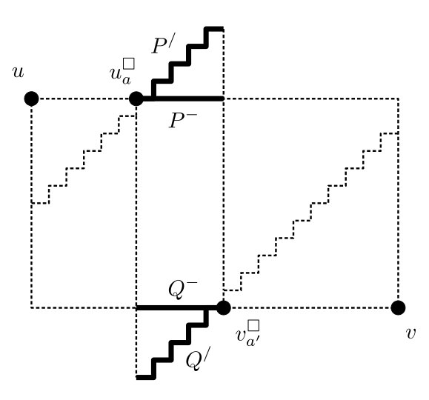
Basic data structure supporting linear-time queries
Step3 :
Notes:
3b

Slide 12
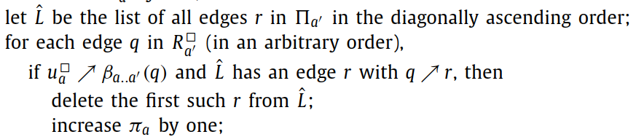
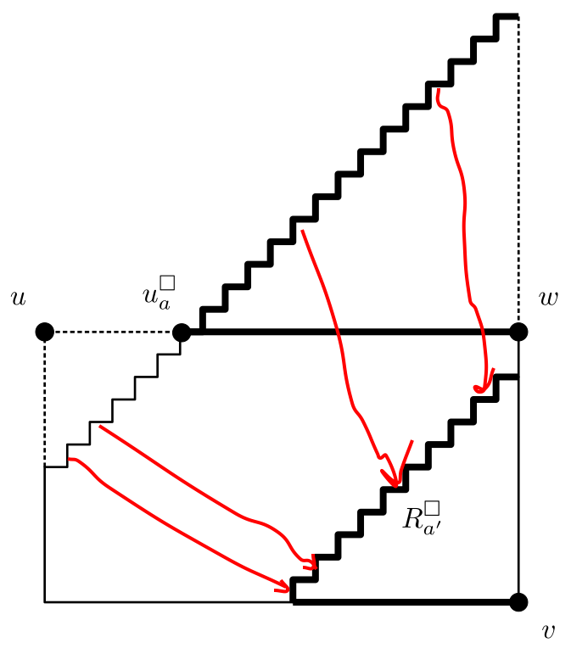
Basic data structure supporting linear-time queries
Step4 :
Notes:
3b

Slide 13
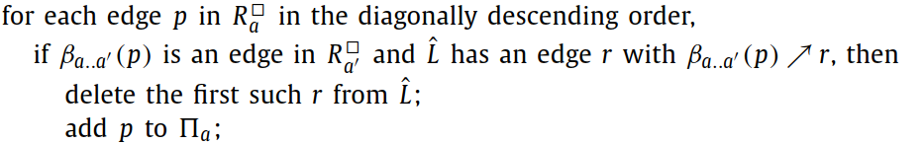
Basic data structure supporting linear-time queries
Step5 :
Notes:
3b

Slide 14

Basic data structure supporting linear-time queries
Step6 : go to step1，做完所有subgraph
Notes:
3b

Slide 15
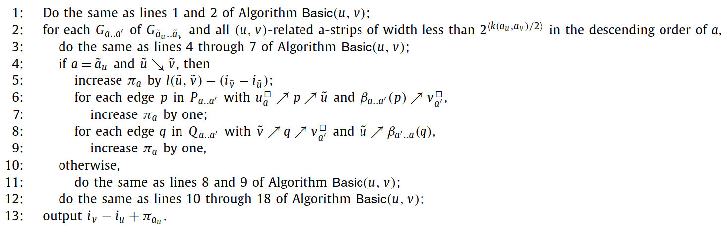
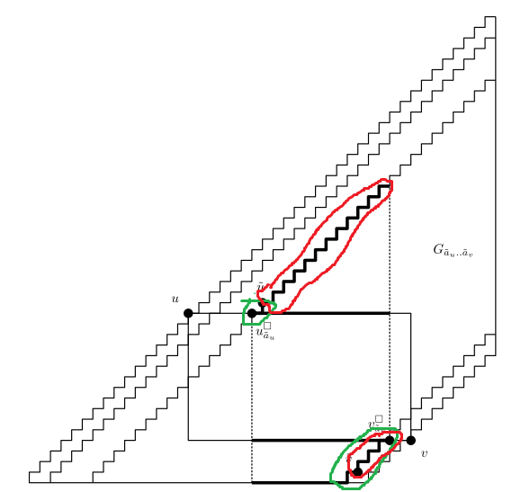

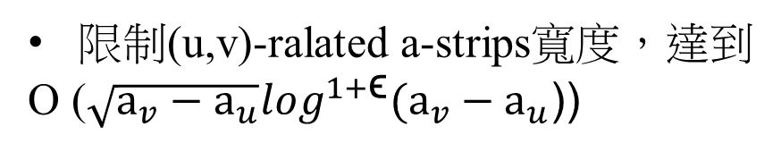

Proposed data structure, supporting fast queries
O ($\sqrt{m^{′}+n^{′}}\log^{1+\text{ϵ}}(m^{′}+n′))$
l(${}_{u}^{\sim }$, ${}_{v}^{\sim }$)
限制(u,v)-ralated a-strips寬度，達到
O ($\sqrt{{\text{a}}_{v}−{\text{a}}_{u}}\log^{1+\text{ϵ}}({\text{a}}_{v}−{\text{a}}_{u}$))
Notes:
Sub
先綠再紅

Slide 16
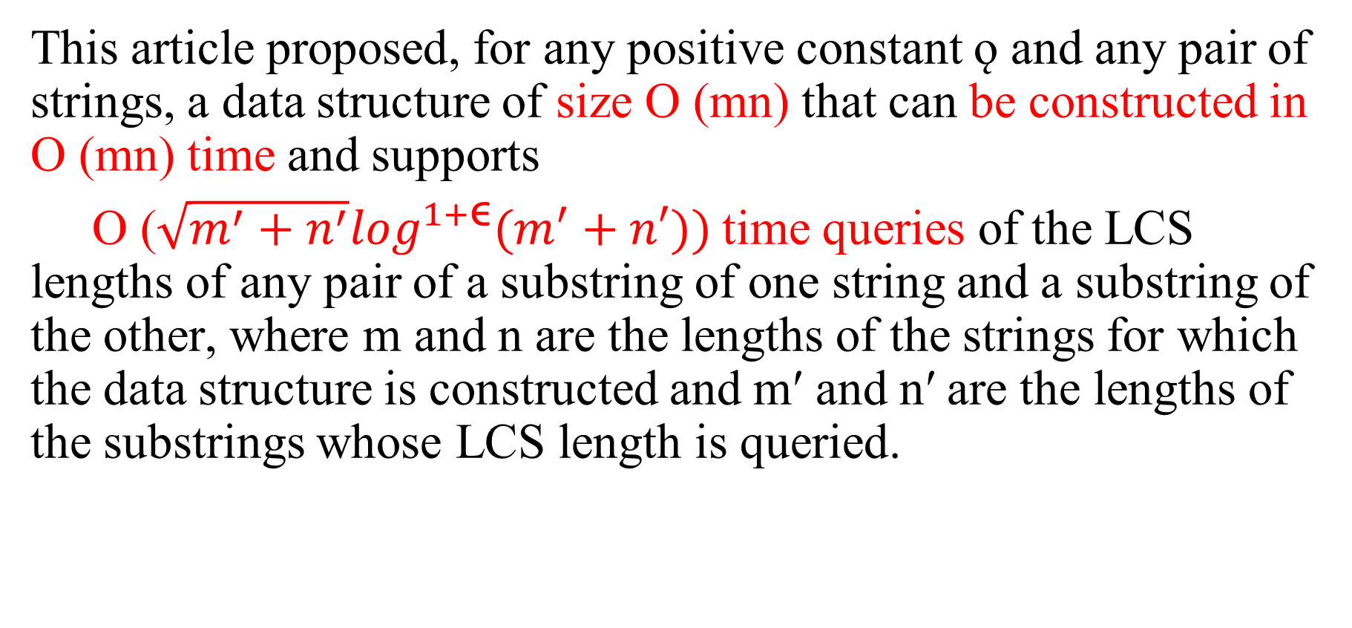
Conclusions
This article proposed, for any positive constant ǫ and any pair of strings, a data structure of size O (mn) that can be constructed in O (mn) time and supports
O ($\sqrt{m^{′}+n^{′}}\log^{1+\text{ϵ}}(m^{′}+n′))$time queries of the LCS lengths of any pair of a substring of one string and a substring of the other, where m and n are the lengths of the strings for which the data structure is constructed and m′ and n′ are the lengths of the substrings whose LCS length is queried.

