Slide 1
Efficient de novo assembly of large genomes using compressed data structures elements
Jared T. Simpson and Richard Durbin
Genome Research 22:549–556, 2012
Speaker: Kuan-Chih Chen
Date: 2018.02.06
Notes:
作者:
劍橋大學博士生
貌似是博士論文

Slide 2
Abstract(1/2)
De novo genome sequence assembly is important both to generate new sequence assemblies for previously uncharacterized genomes and to identify the genome sequence of individuals in a reference-unbiased way. We present memory efficient data structures and algorithms for assembly using the FM-index derived from the compressed Burrows-Wheeler transform, and a new assembler based on these called SGA (String Graph Assembler). We describe algorithms to error-correct, assemble, and scaffold large sets of sequence data. SGA uses the overlap-based string graph model of assembly, unlike most de novo assemblers that rely on de Bruijn graphs, and is simply parallelizable.
Notes:
FM-index : a compressed full-text substring index based on the Burrows-Wheeler transform

Slide 3
Abstract(2/2)
We demonstrate the error correction and assembly performance of SGA on 1.2 billion sequence reads from a human genome, which we are able to assemble using 54 GB of memory. The resulting contigs are highly accurate and contiguous, while covering 95% of the reference genome (excluding contigs < 200 bp in length). Because of the low memory requirements and parallelization without requiring inter-process communication, SGA provides the first practical assembler to our knowledge for a mammalian-sized genome on a low-end computing cluster.

Slide 4
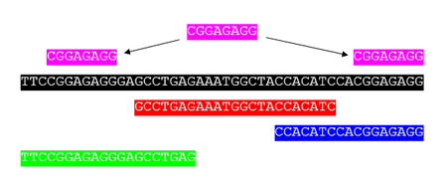
Sequence assembly
DNA fragment
Sequence merging/
Sequence alignment
longer DNA sequence
Bioinformatics的分析方法
依Reference Sequence的有無，分成:
de-novo(新的): 沒有參考序列，僅用fragment本身的資訊進行組裝
mapping: 有參考序列，將fragment align/map至參考序列上
Repeats Problem

Slide 5
De novo assembly(1/7)
以圖形作為輔助，可分成三種:
Overlap graph, or Overlap-layout-consensus(OLC)
De-bruijn-graph(DBG)
String graph
共同特性:
底層genome的結構會反映在圖的結構上

Slide 6
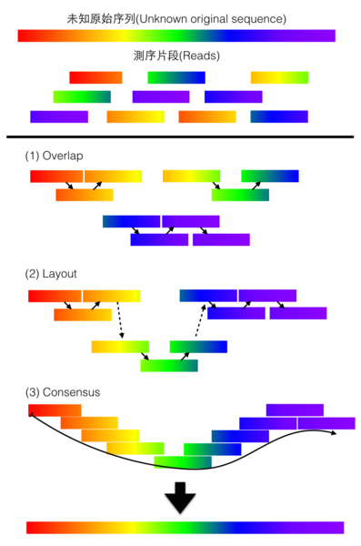
De novo assembly(2/7)
Overlap-layout-consensus(OLC) (Overlap graph)
將reads兩兩比對, 找出重疊(overlap)區域，以圖學的方式呈現(layout)重疊的關係，最後從這些片段中找出一致(consensus)的序列
運算量較大，通常用在資料量不大而測序長度較長的資料
OLC Method

Slide 7
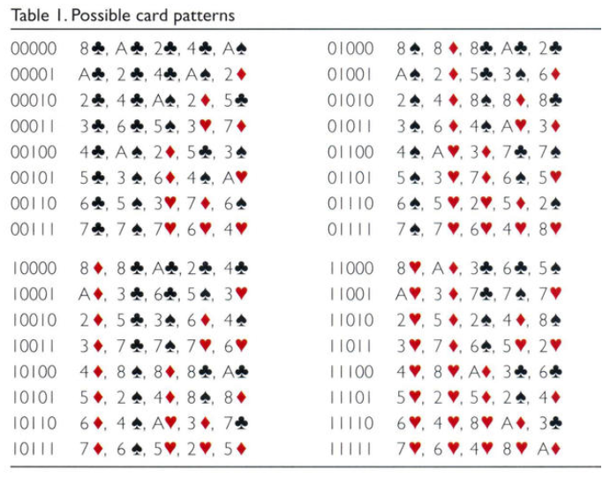


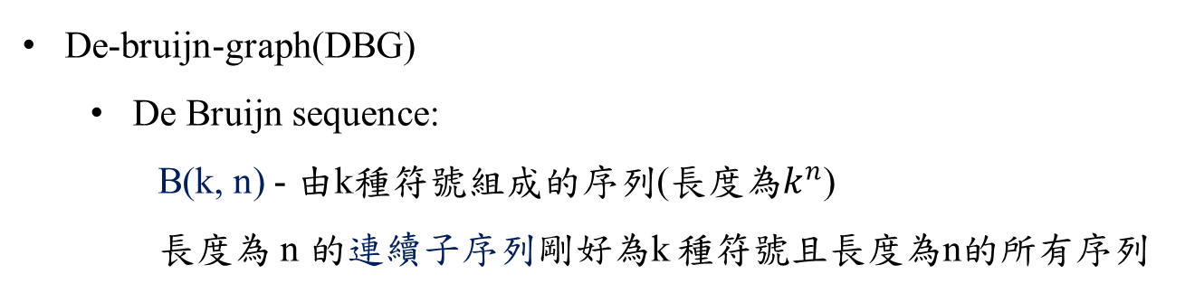
De novo assembly(3/7)
De-bruijn-graph(DBG)
De Bruijn sequence:
B(k, n) - 由k種符號組成的序列(長度為$k^{n}$)
長度為 n 的連續子序列剛好為k 種符號且長度為n的所有序列
Magic show
?
B(2, 2) = 0011 {00, 01, 11, 10}
B(2, 3) = 00010111 {000, 001, 010, 101, 011, 111, 110, 100}
0,0,0,0,0,1,0,0,1,0,1,1,0,0,1,1,1,1,1,0,0,0,1,1,0,1,1,1,0,1,0,1

Slide 8

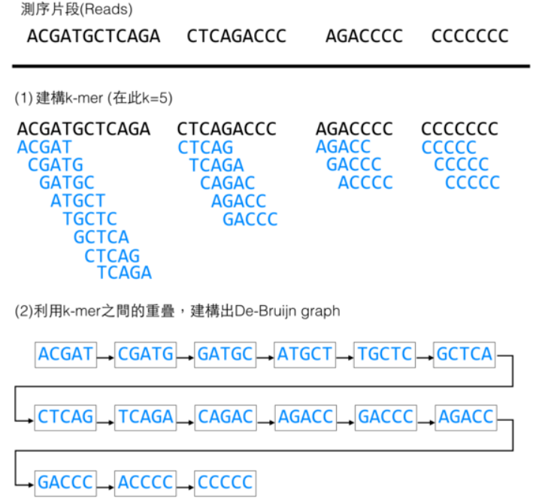
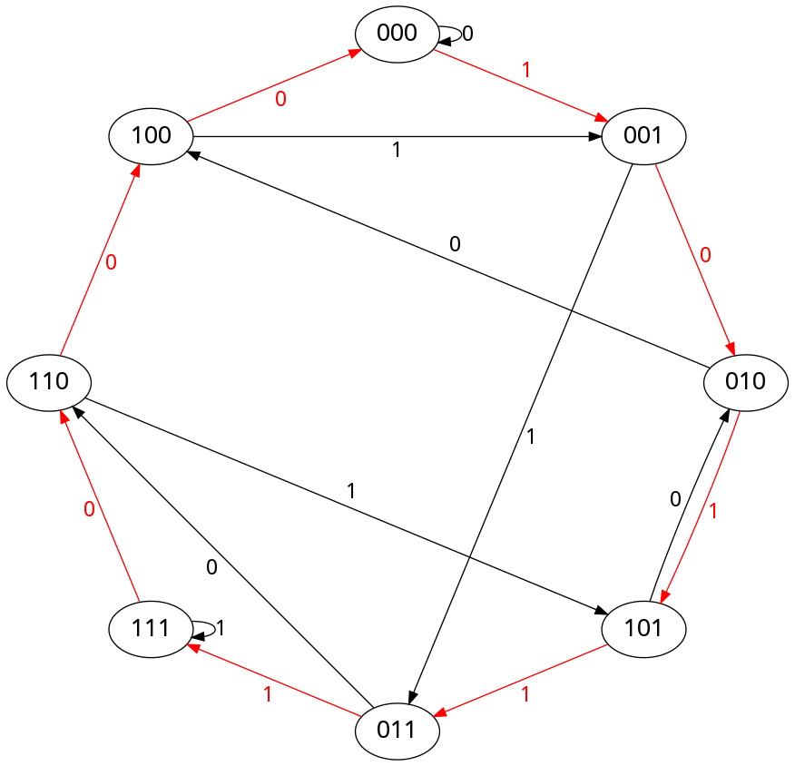
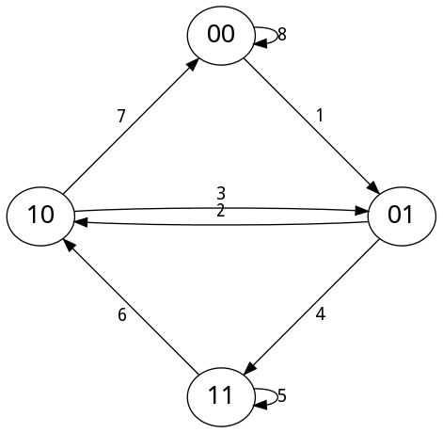
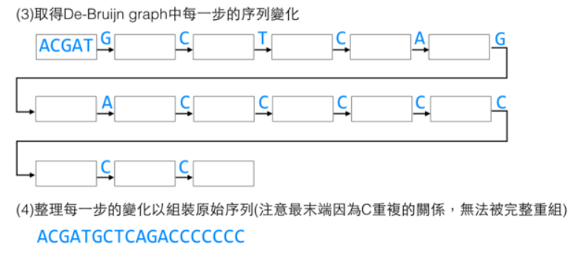
De novo assembly(4/7)
De-bruijn-graph(DBG)
De Bruijn graph:
G(k, n) – k 種符號組成，長度為 n 的所有序列為頂點形成的有向圖
G(2, 3)
10111000
G(2, 2)
無法表現repeat的情況

Slide 9
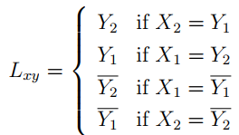


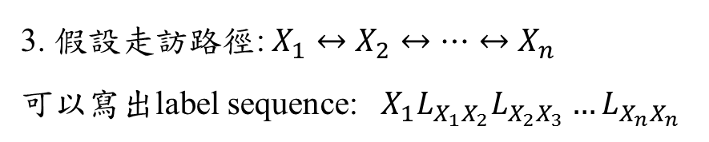





De novo assembly(5/7)
String graph:
1. 刪除 duplicated or contained reads
2. 用unmatched substrings 標註每個edge(Label)
matched substrings
$$ACTCCGAG$$
$$X:$$
$$X=X_{1}X_{2} and Y=Y_{1}Y_{2}$$
$$GAGAATAC$$
$$Y:$$
unmatched substrings
$XY\text{的}\text{assembly}=X+L_{xy}=X$+(Y剩餘)
$$ACTCCGAGAATAC$$
$$X→Y$$
SP-edge
$$Y→X$$
PS-edge
3. 假設走訪路徑: $X_{1}↔X_{2}↔…↔X_{n}$
可以寫出label sequence: $X_{1}L_{X_{1}X_{2}}L_{X_{2}X_{3}}…L_{X_{n}X_{n}}$

Slide 10
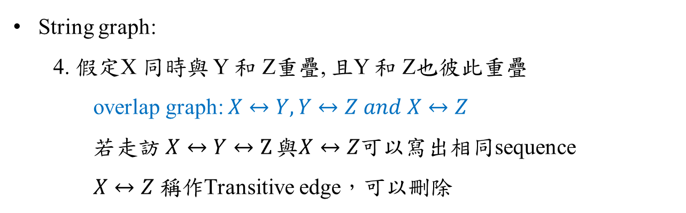

De novo assembly(6/7)
String graph:
4. 假定X 同時與 Y 和 Z重疊, 且Y 和 Z也彼此重疊
overlap graph: $X↔Y,Y↔Z and X↔Z$
若走訪$X↔Y↔Z$ 與$X↔Z$可以寫出相同sequence
$X↔Z$ $稱作$Transitive edge，可以刪除
string graph: $X↔Y,Y↔Z$
Y
Overlap graph
X
GGTCCAG
Y
TCCAGAT
AT
TAG
GG
TCC
Z
AGATTAG
X
ATTAG
Z
GGTCC
String graph

Slide 11

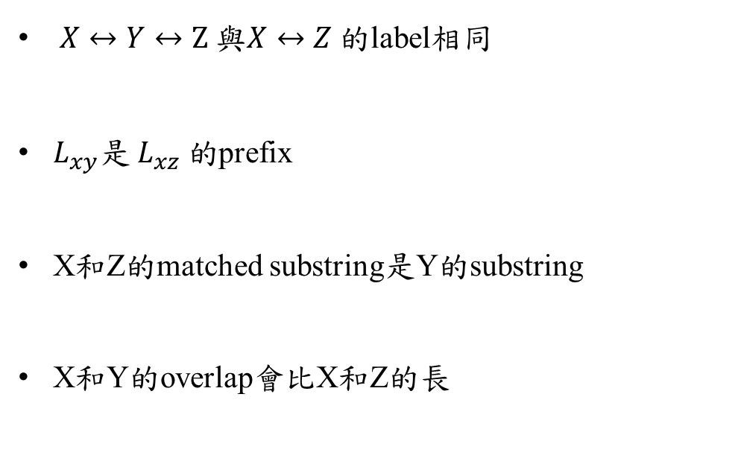





De novo assembly(7/7)
X
GGTCCAG
String graph:
5. 特性
Y
TCCAGAT
Z
AGATTAG
$X↔Y↔Z$ 與$X↔Z 的$label相同
$L_{xy}是 L_{xz} 的$prefix
X和Z的matched substring是Y的substring
X和Y的overlap會比X和Z的長
GGTCCAGATTAG
$L_{xy}$: AT
$L_{xz}$: ATTAG
$matched$: AG
$Y$: TCCAGAT
$X$&Y: TCCAG
$X$&Z: AG
overlap graph → remove duplicated or contained → remove transitive edge

Slide 12
Burrows-Wheeler transform(BWT)
FM-index
Also called block-sorting compression
Rearranging a character string into runs of similar characters
Easy to compress a string that has runs of repeated characters
Input: banana
$ b a n a n a a $ b a n a n n a $ b a n a a n a $ b a n n a n a $ b a a n a n a $ b b a n a n a $
$ b a n a n a a $ b a n a n a n a $ b a n a n a n a $ b b a n a n a $ n a $ b a n a n a n a $ b a
Sort
Output
annb$aa

Slide 13
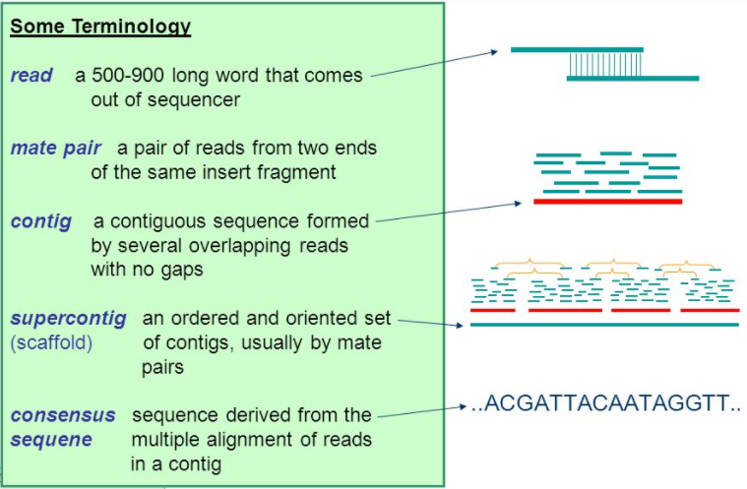
Notion of Sequence Assembly

Slide 14
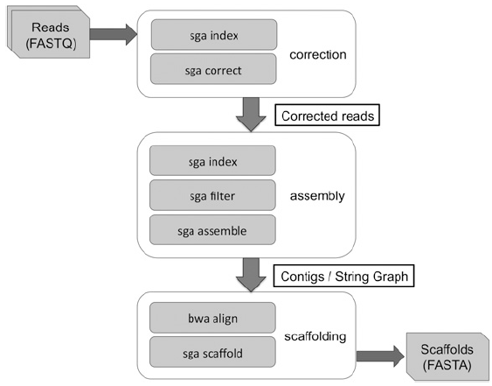
Overview
Error correction → Contig assembly → Scaffolding
FM-index
Error Correction
Remove duplicate and low-quality reads
Construct contigs
Align original reads and contigs
SGA assembly pipeline

Slide 15
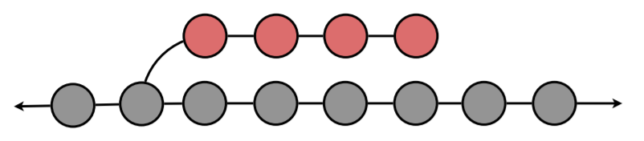
k-mer based error correction algorithm
Errors:
The sequencing instrument incorrectly identifies a symbol (substitution error)
A symbol is incorrectly inserted into, or deleted from, the string (indel error)
A simple tip in an assembly graph

Slide 16
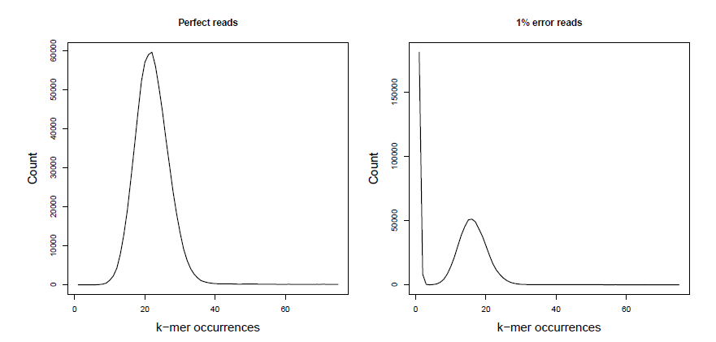
k-mer based error correction algorithm
(frequency)
(frequency)
30X coverage of 100bp reads from the E. coli(大腸桿菌) genome
10,000 random reads
Notes:
k-mer是連續的
圖的橫坐標表示k-mer frequency，縱座標是出現次數
有1%error會出現base極端集中在低frequency的情況

Slide 17
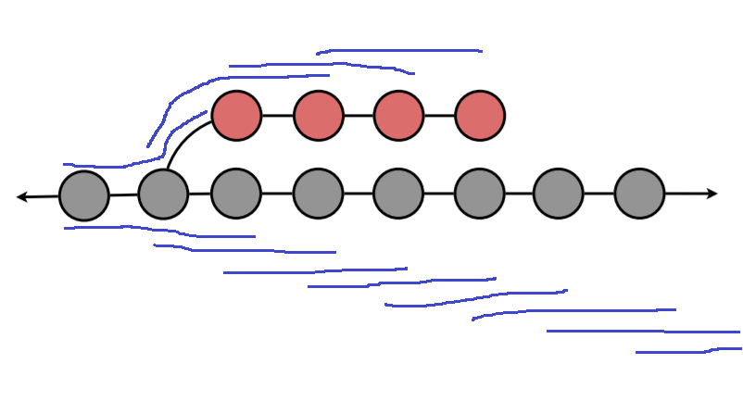
k-mer based error correction algorithm
(frequency)
(frequency)
occurrences, frequency, coverage, depth…?
Notes:
k-mer是連續的
圖的橫坐標表示k-mer frequency，縱座標是出現次數
有1%error會出現base極端集中在低frequency的情況

Slide 18
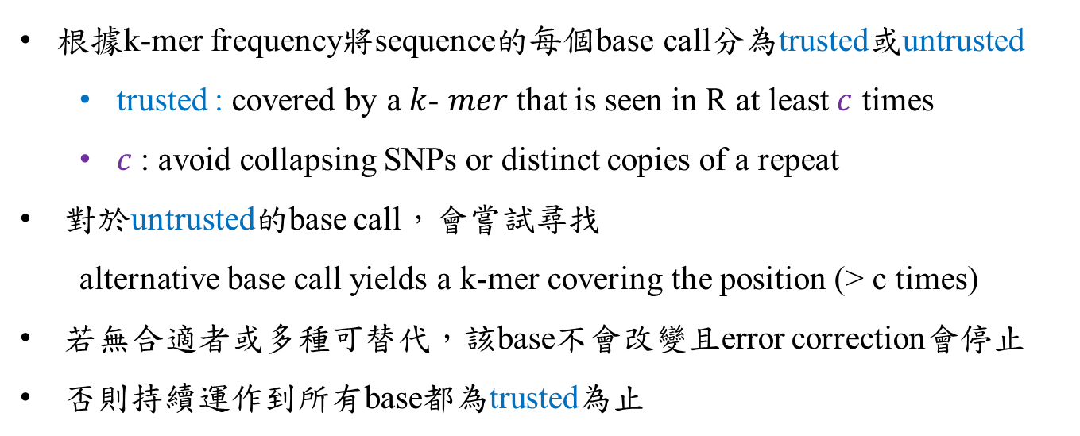
k-mer based error correction algorithm
根據k-mer frequency將sequence的每個base call分為trusted或untrusted
trusted : covered by a $k$- $mer$ that is seen in R at least $c$ times
$c$: avoid collapsing SNPs or distinct copies of a repeat
對於untrusted的base call，會嘗試尋找
alternative base call yields a k-mer covering the position (> c times)
若無合適者或多種可替代，該base不會改變且error correction會停止
否則持續運作到所有base都為trusted為止

Slide 19
Read filtering
Some reads remain uncorrected after error correction
Remove sequences with unique k-mers.

Slide 20
Paired-end reads/scaffolding
Remove ambiguous or likely erroneous edges from the graph
Test whether the linked contigs have an ordering that is consistent with each pairwise distance estimate
If not, break the graph by removing all edges of the affected contigs.

Slide 21
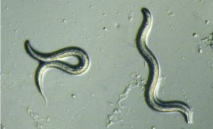
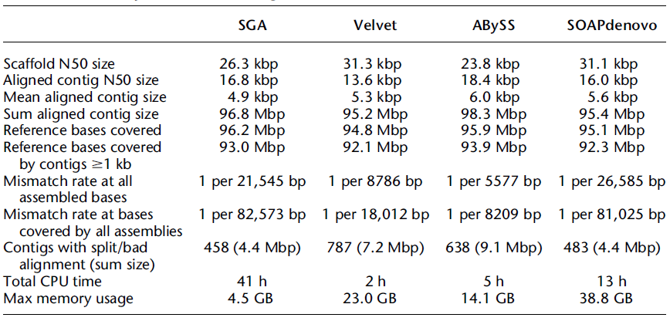
秀麗隱桿線蟲
C. elegans data set (100Mbp)
from the NCBI SRA (accession SRX026594)
Assembly statistics for C. elegans data set
Notes:
秀麗隱桿線蟲
它具有完整和準確的參考序列
它以雌雄同體的形式繁殖，所以個體（或株系）的基因組是純合的，
基本上沒有SNP和結構變異，而且基因組是一個合理的評估尺寸（100 Mbp）
N50: 用來評估de novo assembly效果好壞的方法之一。
當contig或scaffold從大到小排列後，從最大的contig進行長度的累加，累加到全部總長度的50%時，此時所加上的長度，即為N50。數字越大，則評估條件越嚴苛。
Velvet assembler : 第一個基於de Bruijn graph的assemblers (for short reads )，已經成為組裝中小型基因組的標準工具
ABySS assembler為了處理大型的基因組，通過在計算機集群上分佈de Bruijn graph
SOAPdenovo也基於de Bruijn graph並被設計來組裝大型基因組

Slide 22
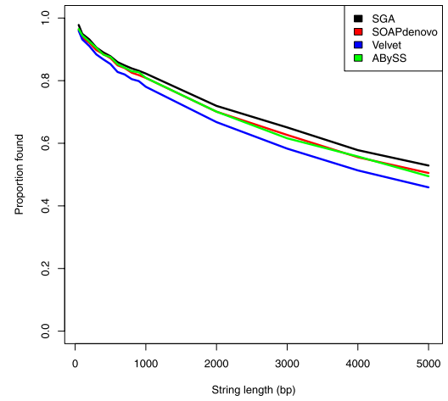
Substring Coverage
Testing whether strings from the consensus sequence were exactly present in the contigs
Contigs must be:
Accurate
Complete
Contiguous
10,000 strings of length from 50 bp up to 5,000 bp
Notes:
Coverage
accurate (as exact matches are required)
complete (as the string must be present in the contig)
contiguous (as strings broken between multiple contigs will not be found)

Slide 23
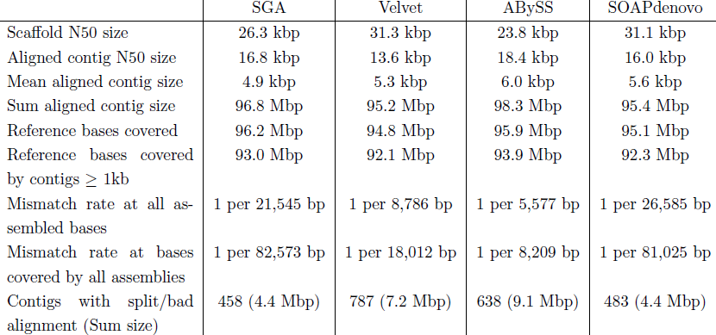
Assembly Accuracy
exact matches
Count the number and total size of contigs with split or bad alignments

Slide 24
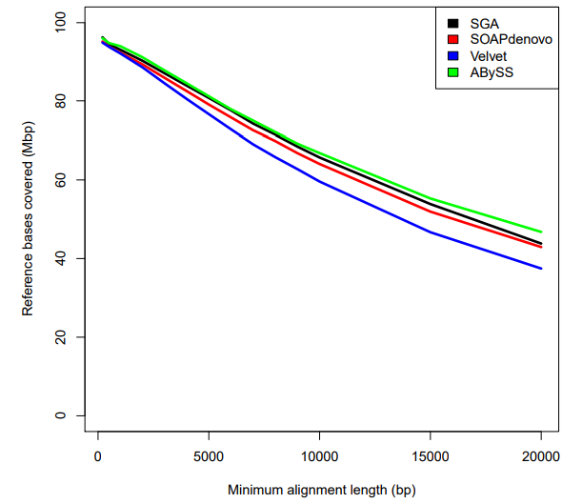
Assembly Completeness
string must be present in the contig
The reference genome coverage as a function of minimum contig alignment length.

Slide 25

Assembly Contiguity
strings broken between multiple contigs will not be found
By calculating the contig alignment length N50
Analyze the contig alignment lengths

Slide 26
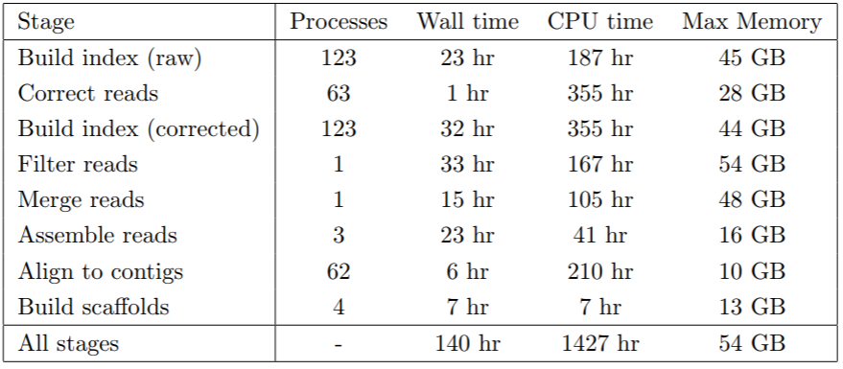
Running time and memory summary
for SGA human genome assembly(about 1.2 billion reads, 140GB)
SOAPdenovo
121hr
479hr
118 GB
Notes:
針對人體: 1.2 billion sequence reads

Slide 27
Reference
Sequence assembly
De Bruijn sequence
The SGA Assembler
SGA – Github(Software)
Efficient sequence assembly and variant calling using compressed data structures, Jared Thomas Simpson, Queens’ College Wellcome Trust Sanger Institute University of Cambridge, September 2012
https://en.wikipedia.org/wiki/Sequence_assembly
https://zhouer.org/DeBruijn/
ftp://ftp.sanger.ac.uk/pub/resources/theses/js18/chapter3.pdf
https://github.com/jts/sga
ftp://ftp.sanger.ac.uk/pub/resources/theses/js18/thesis.pdf

