Slide 1
Fast construction of FM-index for long sequence reads
Heng Li
Oxford Journal, Bioinformatics
Vol. 30, No. 22, 15 Nov, 2014, Pages 3274-3275
Presenter: Shan-Ru Liu
Date: 2018/02/06

Slide 2
Abstract
We present a new method to incrementally construct the FM-index for both short and long sequence reads, up to the size of a genome. It is the first algorithm that can build the index while implicitly sorting the sequences in the reverse (complement) lexicographical order without a separate sorting step. The implementation is among the fastest for indexing short reads and the only one that practically works for reads of averaged kilobases in length.

Slide 3
Suffix array
AAGTA$
AAGTA$ | 0
AGTA$ | 1
GTA$ | 2
TA$ | 3
A$ | 4
$ | 5
$ | 5
A$ | 4
AAGTA$ | 0
AGTA$ | 1
GTA$ | 2
TA$ | 3
S
540123

Slide 4
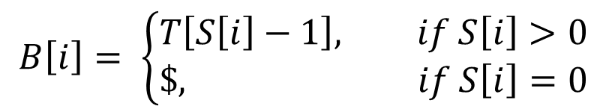
Burrows-Wheeler Transform (BWT)
T
$AAGTA
A$AAGT
TA$AAG
GTA$AA
AGTA$A
AAGTA$
$AAGTA
A$AAGT
AAGTA$
AGTA$A
GTA$AA
TA$AAG
B
AAGTA$
AT$AAG
B[0] = T[5-1]=T[4] = A
B[1] = T[4-1]=T[3] = T
B[2] = $
B[3] = T[1-1]=T[0] = A
B[4] = T[2-1]=T[1] = A
B[5] = T[3-1]=T[2] = G
$$B\left[i\right]= \left\{\begin{aligned}T\left[S\left[i\right]−1\right], if S\left[i\right]>0 \\ \$, if S\left[i\right]=0\end{aligned}\right.$$
S
540123

Slide 5
String Operation
0 1 2 3 4 5
c = A, k = 4, B = AT$AAG
rank(c, k ; B) = rank(A, 4 ; AT$AAG) = 2
insert(c, k ; B) = insert(A, 4; AT$AAG) B = AT$AAAG

Slide 6
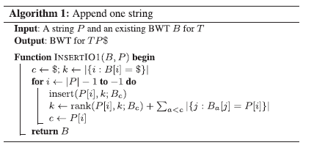
Algorithm1
T=AAGTA$, P=($)AGT
B=AT$AAG
B$=TA
B_{A}=T$$A
B_{G}=AA
B_{T}=GG
TP$=AAGTA$AGT$
B=TAT$$AAAGG
O(nlogn)

Slide 7
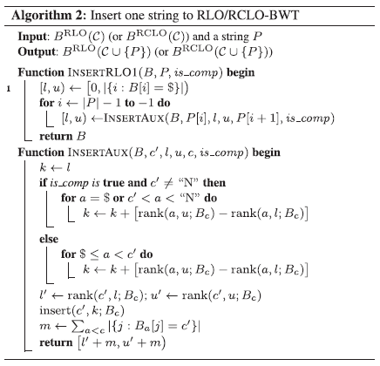
Algorithm2
RLO : Reverse Lexicographical Order
RCLO : Reverse-Complement Lexicographical Order
A < C < G < T < N (unknown)
O(nlogn)

Slide 8
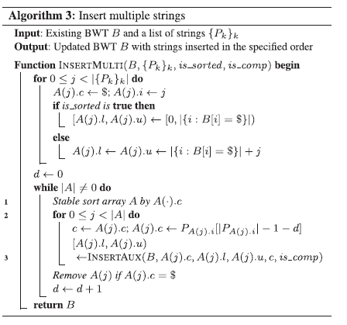
Algorithm3
O(nlogn)

Slide 9
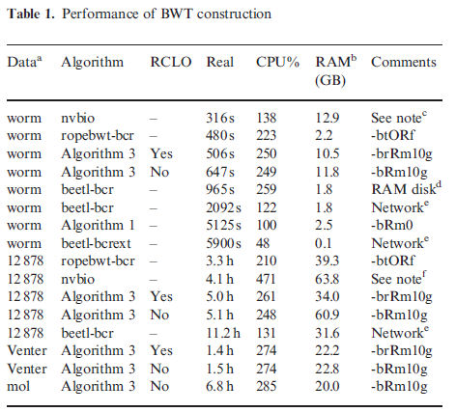
Results
66M*100bp(base pair)
1206M*101bp
32M*875bp
23M*4026bp

