Slide 1
The Longest Filled Common Subsequence Problem
Mauro Castelli, Riccardo Dondi, Giancarlo Mauri, and Italo Zoppis
28th Annual Symposium on Combinatorial Pattern Matching, pp. 14:1–14:13, July, 2017, Warsaw, Poland
Presenter: Kuo-Feng Huang
Date: 2018/02/27

Slide 2
Abstract
Inspired by a recent approach for genome reconstruction from incomplete data, we consider a variant of the longest common subsequence problem for the comparison of two sequences, one of which is incomplete, i.e. it has some missing elements. The new combinatorial problem, called Longest Filled Common Subsequence, given two sequences A and B, and a multiset M of symbols missing in B, asks for a sequence B* obtained by inserting the symbols of M into B so that B* induces a common subsequence with A of maximum length.

Slide 3
Abstract
First, we investigate the computational and approximation complexity of the problem and we show that it is NP-hard and APX-hard when A contains at most two occurrences of each symbol. Then, we give a 3/5−approximation algorithm for the problem. Finally, we present a fixed-parameter algorithm, when the problem is parameterized by the number of symbols inserted in B that “match” symbols of A.

Slide 4
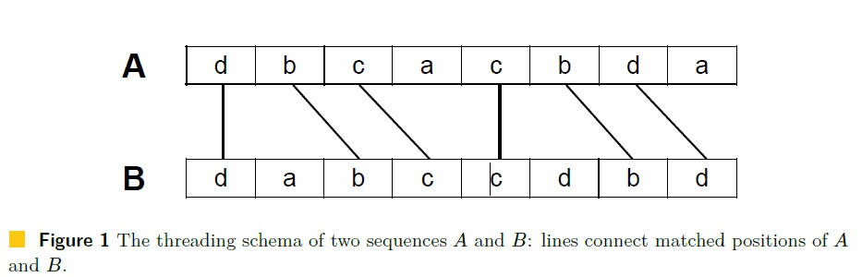
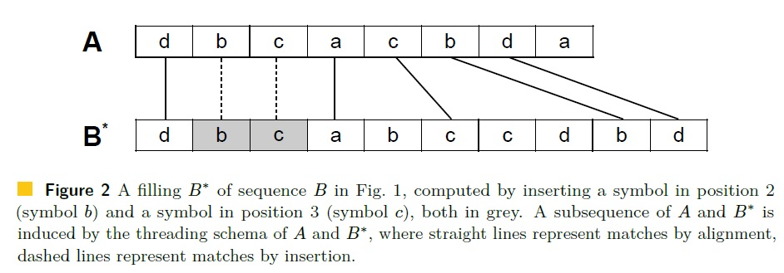
LFCS

Slide 5
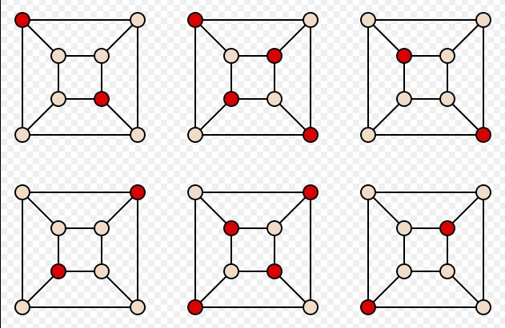
Complexity of LFCS
We prove the result by an L-reduction from the Maximum Independent Set problem on Cubic Graphs (Max-ISC), which is known to be APX-hard [2](see [5] for details on L-reduction). Max-ISC, given a cubic graph G = (V,E), asks for a maximum cardinality subset V 0 V such that given v_{i}, v_{j} 2 V 0 it holds {v_{i}, v_{j}} /2 E.

Slide 6
Approximating LFCS (1/2)
A= dbcacbda
B= dabccdbd
M={b , c}
Approx-Algorithm 1:
(1) R_{1,a}: dbccbd (LCS of A and B)
(2) A‘: aa (A- R_{1,a})
(3) R_{1,i}: ∅ (Algorithm1(A’ , M))
(4) R₁: dbccbd (R_{1,a} ∪ R_{1,i})

Slide 7
Approximating LFCS (2/2)
A= dbcacbda
B= dabccdbd
M={b , c}
Approx-Algorithm 2:
(1) R_{2,i}: bc (Algorithm1(A , M))
(2) A‘’: dacbda (A- R_{2,i})
(3) R_{2,a}: ∅ (LCS of A’’ and B)
(4) R₂: dbcacbd (R_{2,i} ∪ R_{2,a})

Slide 8
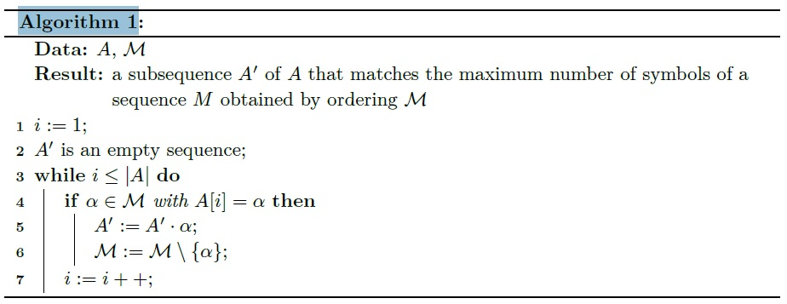
Algorithm 1

Slide 9
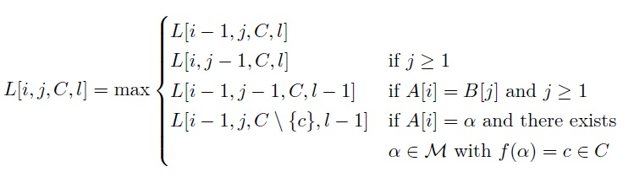
FPT Algorithm
based on the color-coding technique.
Let M be a multiset of positions and let F be a family of hash functions from M to a set {c₁, . . . , c_{k}} of colors.

Slide 10
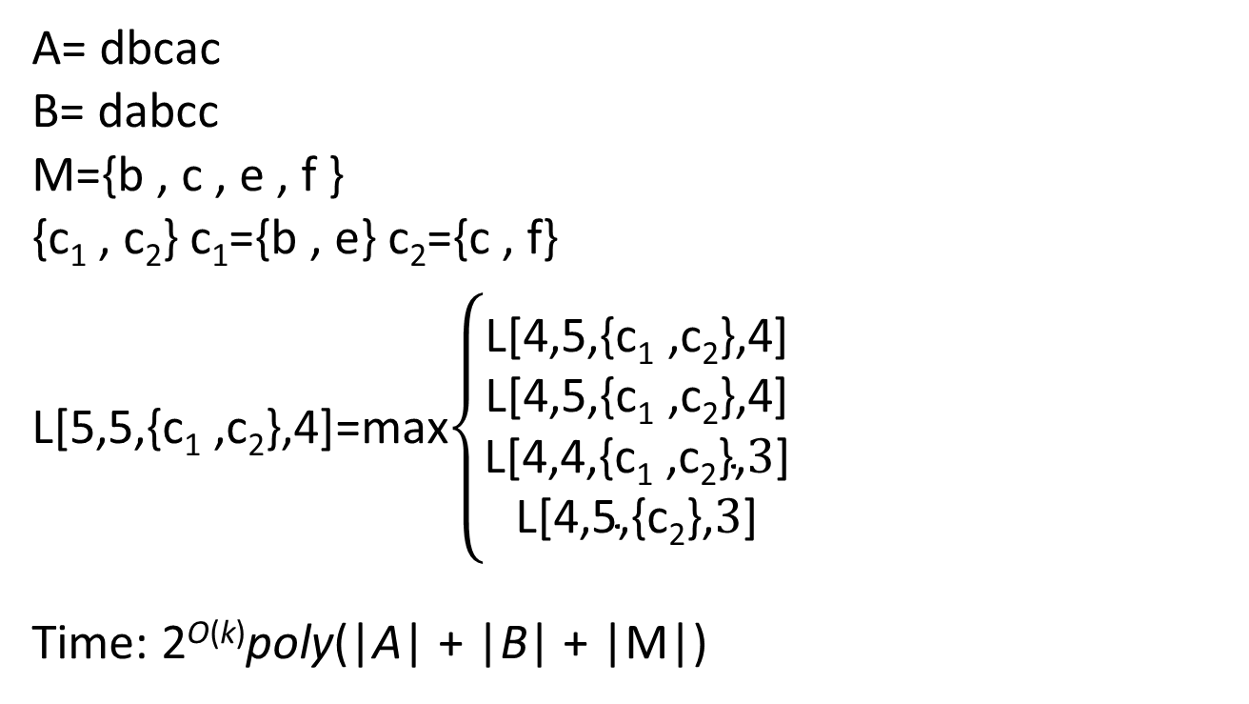
FPT Algorithm
A= dbcac
B= dabcc
M={b , c , e , f }
{c₁ , c₂} c₁={b , e} c₂={c , f}
L[5,5,{c₁ ,c₂},4]=max$\left\{\begin{aligned}\text{L}\text{[4,5,\{}\text{c}\text{1}\text{ ,}\text{c}\text{2}\text{\},4]} \\ \text{L}\text{[4,5,\{}\text{c}\text{1}\text{ ,}\text{c}\text{2}\text{\},4]} \\ \text{L}\text{[4,4,\{}\text{c}\text{1}\text{ ,}\text{c}\text{2}\text{\},}3\text{]} \\ \text{L}\text{[4,5,\{}\text{c}\text{2}\text{\},}3\text{]}\end{aligned}\right.$
Time: 2^{O(k)}poly(|A| + |B| + |M|)

