Slide 1
The longest almost-increasing subsequence
Amr Elmasry
Information Processing Letters 110 (2010) 655–658
Presenter: Shou-Fu Lo
Date: 2018/2/27

Slide 2
Abstract
Given a sequence of n elements, we introduce the notion of an
almost-increasing subsequence as the longest subsequence that
can be converted to an increasing subsequence by possibly
adding a value, that is at most a ﬁxed constant, to each of the
elements. We show how to optimally construct such
subsequence in O (n log k) time, where k is the length of
the output subsequence.

Slide 3

LaIS
Given a sequence $\left\langle \text{x}\text{1}\text{, . . . , }\text{xi}\right\rangle$ and a constant c > 0, our
goal is to construct a longest subsequence $\left\langle \text{y}\text{1}\text{, }\text{y}\text{2}\text{, . . . , }\text{yk}\right\rangle$
such that ∀i y_{i} > $\max_{j=1}^{i−1}$ y _{j} − c.
T = $\left\langle \text{7, 15, 2, 14}\right\rangle$ , c = 2
ans = $\left\langle \text{7, 15, 14}\right\rangle$
14 > 15 - 2

Slide 4
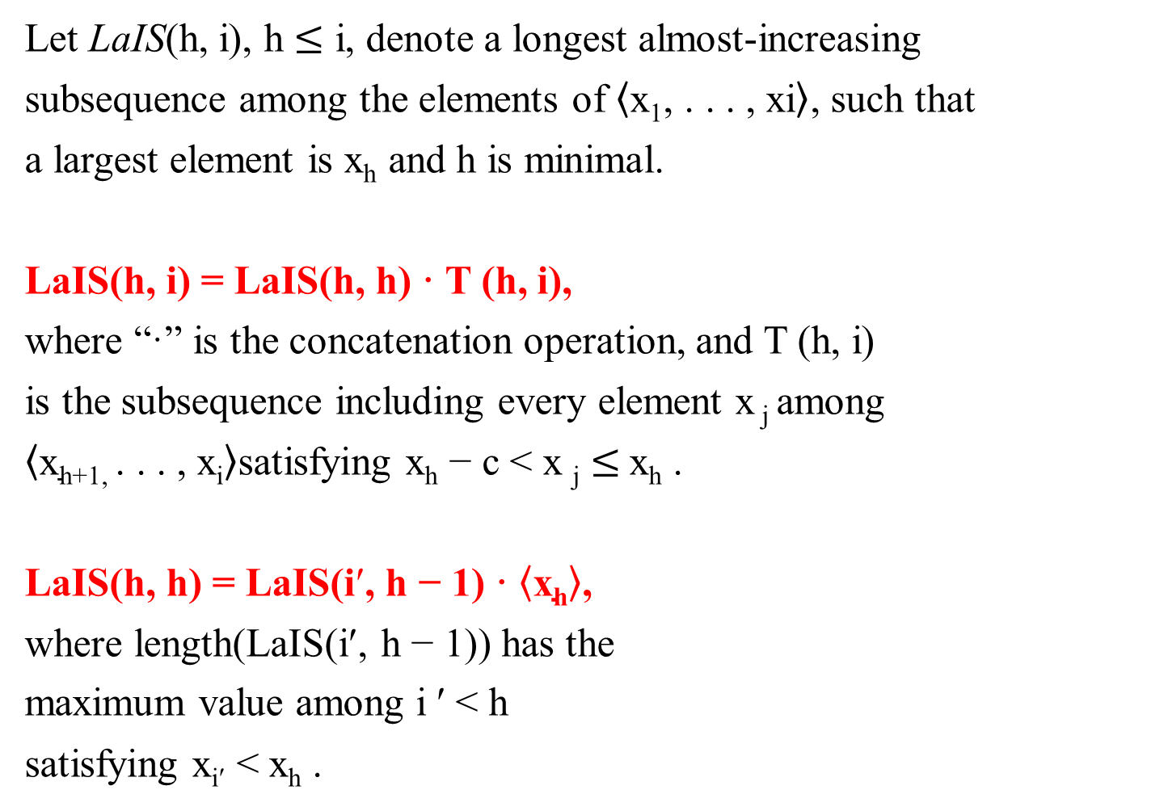
Recursive formulation
Let LaIS(h, i), h $≤$ i, denote a longest almost-increasing
subsequence among the elements of $\left\langle \text{x}\text{1}\text{, . . . , }\text{xi}\right\rangle$, such that
a largest element is x_{h} and h is minimal.
LaIS(h, i) = LaIS(h, h) · T (h, i),
where “·” is the concatenation operation, and T (h, i)
is the subsequence including every element x _{j} among
$\left\langle \text{x}\text{h}\text{+1, . }\text{. . , }\text{xi}\right\rangle$satisfying x_{h} − c < x _{j} $≤$x_{h} .
LaIS(h, h) = LaIS(i$$, h − 1) · $\left\langle \text{x}\text{h}\right\rangle$,
where length(LaIS(i$$, h − 1)) has the
maximum value among i $$ < h
satisfying x_{i}$$ < x_{h} .
x_{h}
T (h, i)
LaIS(h, h)

Slide 5
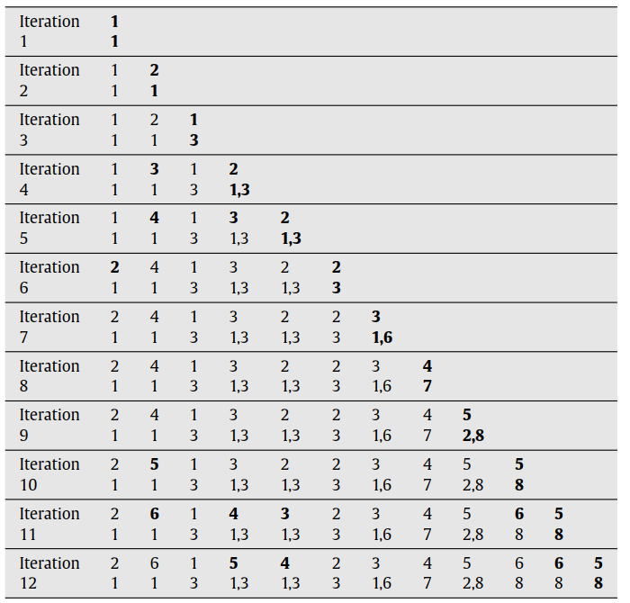

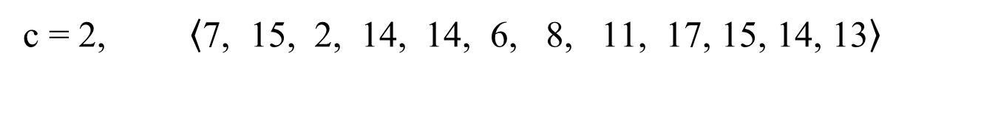
LaIS
c = 2, $\left\langle \text{7, } \text{15, } \text{2,} \text{ 14, } \text{14, } \text{6, } \text{8, } \text{11, } \text{17, 15, 14, 13}\right\rangle$
7, 15, 14, 14, 15, 14,
7, 6, 8, 11, 15, 14,
2, 6, 8, 11, 15, 14,
7, 6, 8, 11, 14, 13 and
2, 6, 8, 11, 14, 13.
O($n^{2}$)

Slide 6
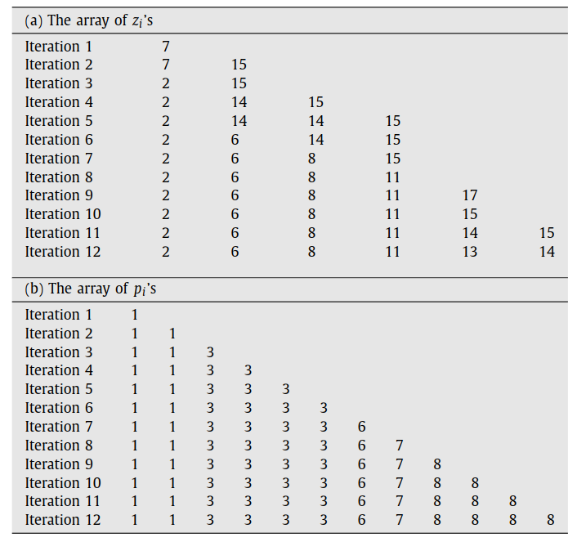
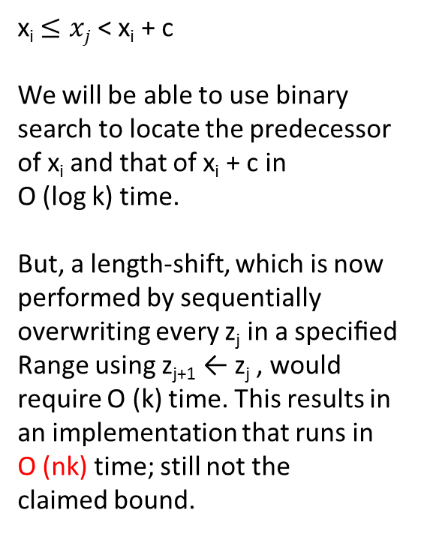
The improved algorithm
c = 2, $\left\langle \text{7, } \text{15, } \text{2,} \text{ 14, } \text{14, } \text{6, } \text{8, } \text{11, } \text{17, 15, 14, 13}\right\rangle$
x_{i} $≤xj$ < x_{i} + c
We will be able to use binary
search to locate the predecessor
of x_{i} and that of x_{i} + c in
O (log k) time.
But, a length-shift, which is now
performed by sequentially
overwriting every z_{j} in a speciﬁed
Range using z_{j+1} ← z_{j} , would
require O (k) time. This results in
an implementation that runs in
O (nk) time; still not the
claimed bound.

Slide 7

The data structure
c = 2, $\left\langle \text{7, } \text{15, } \text{2,} \text{ 14, } \text{14, } \text{6, } \text{8, } \text{11, } \text{17, 15, 14, 13}\right\rangle$
A balanced search structure over
the nodes of the linked list.
We may use, for example, an
AVL tree to achieve O (log k) cost
per operation, or a splay tree for
an amortized O (log k) cost per
operation.
O($nlogk$)

