Slide 1
On finding a longest common palindromic subsequence
Sang Won Bae and Inbok Lee
Department of Computer Science, Kyonggi University, Suwon, 443-760, Republic of Korea
Department of Software and Computer Engineering, Korea Aerospace University, Goyang, 412-791, Republic of Korea
Theoretical Computer Science
Volume 710, 1 February 2018, Pages 29-34
Presenter: Ting-Wei Liang
Date:2018/03/13

Slide 2
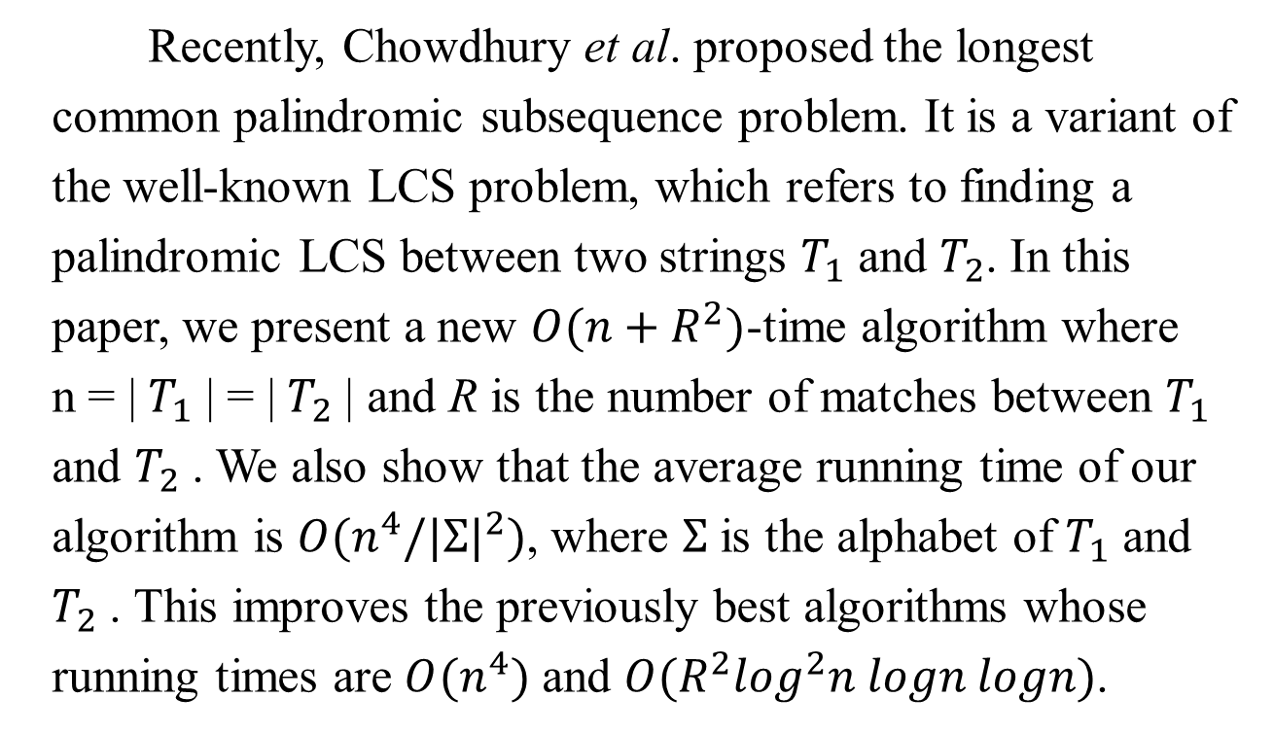
Abstract
Recently, Chowdhury et al. proposed the longest common palindromic subsequence problem. It is a variant of the well-known LCS problem, which refers to finding a palindromic LCS between two strings $T_{1}$ and $T_{2}$. In this paper, we present a new $O(n+R^{2})$-time algorithm where n = | $T_{1}$ | = | $T_{2}$ | and R is the number of matches between $T_{1}$ and $T_{2}$ . We also show that the average running time of our algorithm is $O(n^{4}/{|Σ|}^{2})$, where $Σ$ is the alphabet of $T_{1}$ and $T_{2}$ . This improves the previously best algorithms whose running times are $O(n^{4})$ and $O(R^{2}\log^{2}n logn logn)$.

Slide 3

Longest Common Palindromic Subsequence(LCPS)
$T_{1}$ = adbacbcda
$T_{2}$ = cdabacbdb
LCPS(T1,T2) = dbabd (or dbcbd)

Slide 4
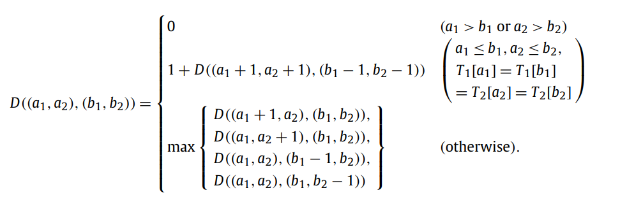

DP method by Chowdhury et al.
Time complexity : $O(n^{4})$

Slide 5
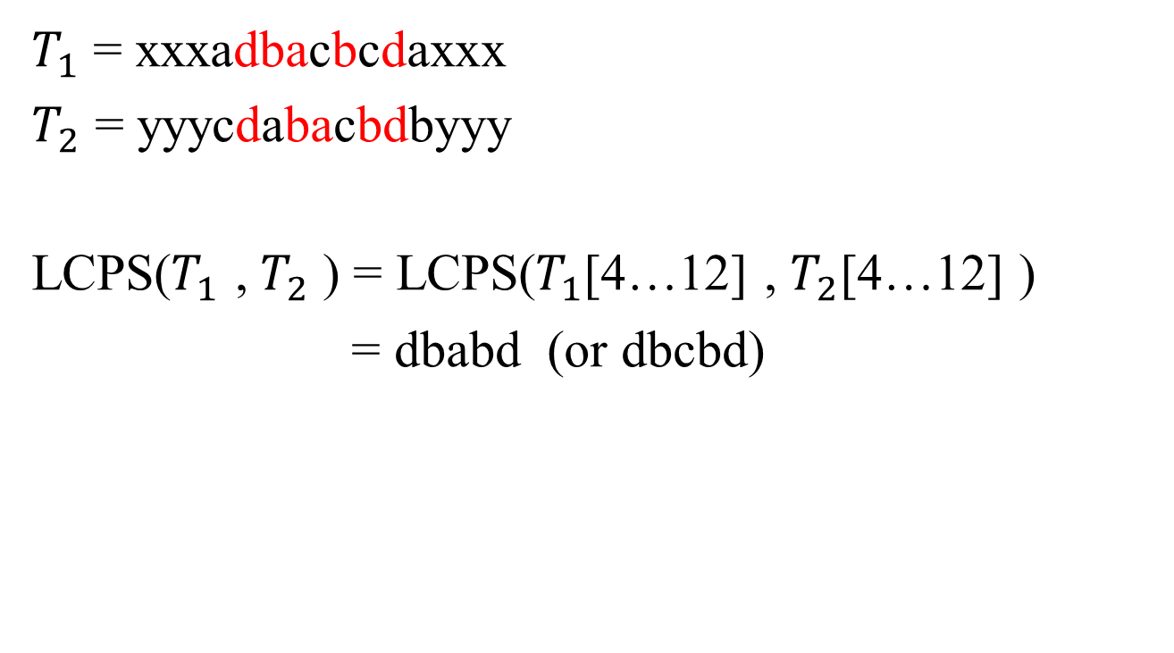
Reducing subproblems to solve
$T_{1}$ = xxxadbacbcdaxxx
$T_{2}$ = yyycdabacbdbyyy
LCPS($T_{1}$ , $T_{2}$ ) = LCPS($T_{1}$[4…12] , $T_{2}$[4…12] )
= dbabd (or dbcbd)

Slide 6
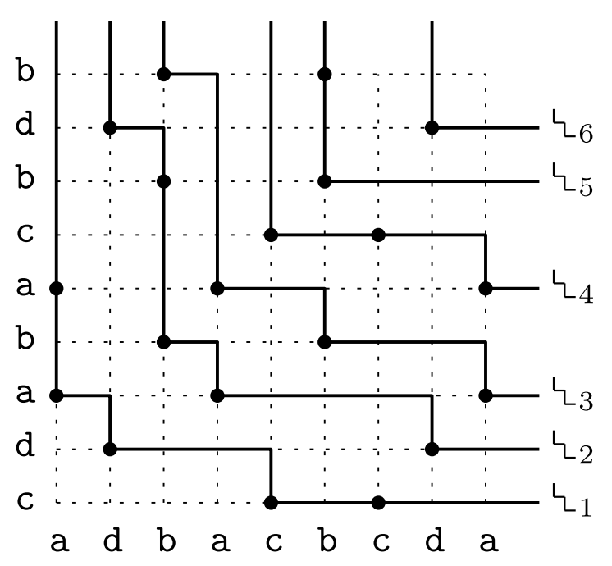
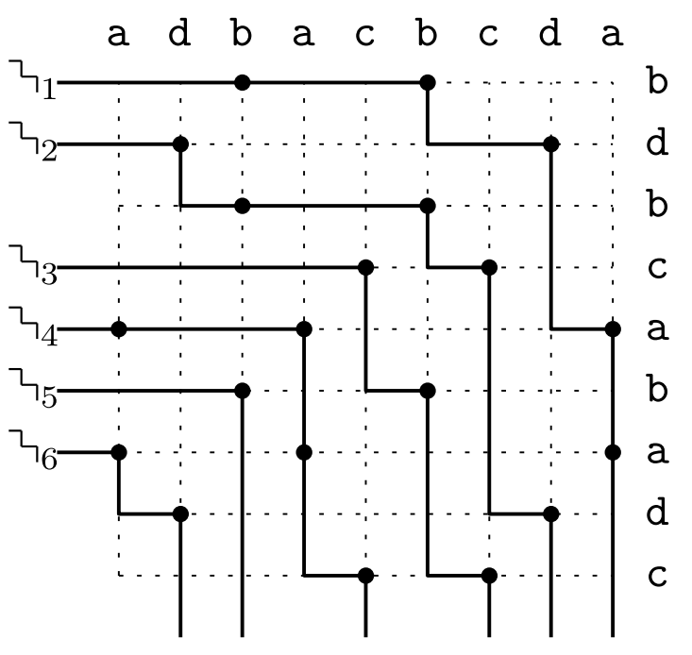
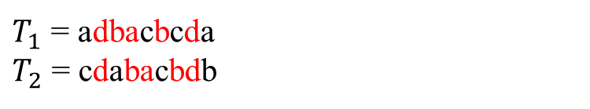
Matches and Partition
$T_{1}$ = adbacbcda
$T_{2}$ = cdabacbdb

Slide 7
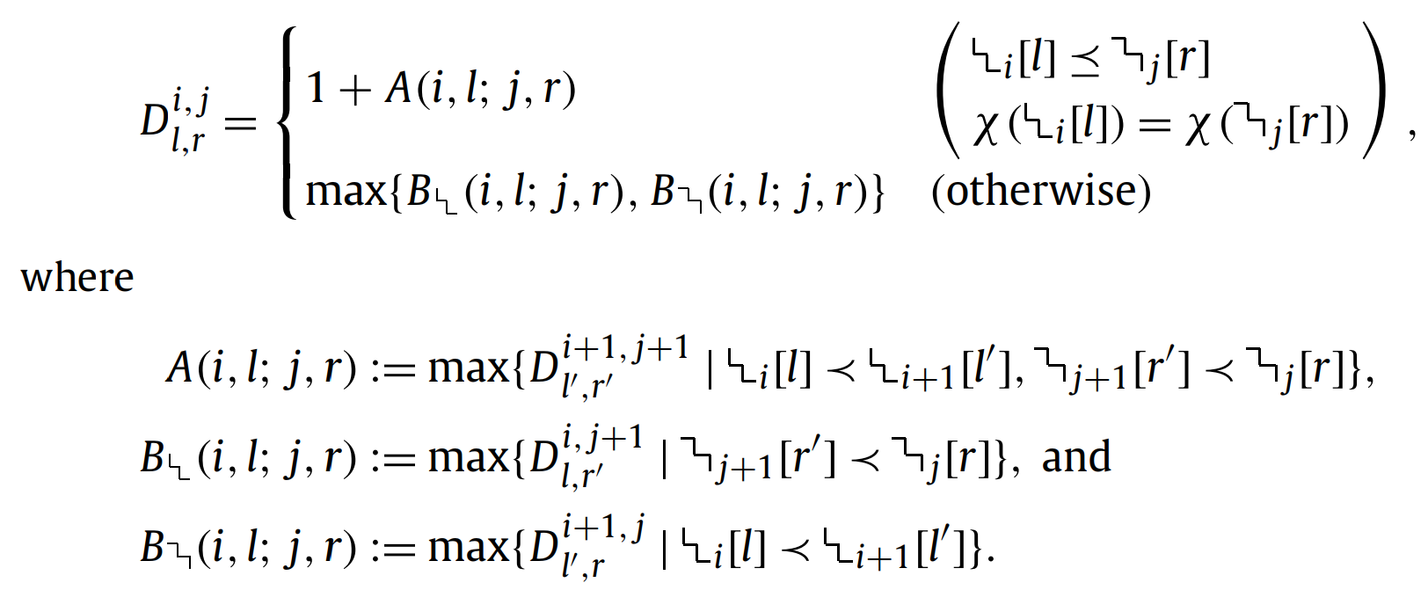



DP method
the problem can be solved via dynamic programming by running four indices:
i from $m_{1}$ down to 1, j from $m_{2}$ down to 1,
l from 1 to , and r from 1 to .
It solves exactly $R^{2}$ subproblems.

Slide 8
Matches and Partition
$T_{1}$ = adbacbcda
$T_{2}$ = cdabacbdb

Slide 9


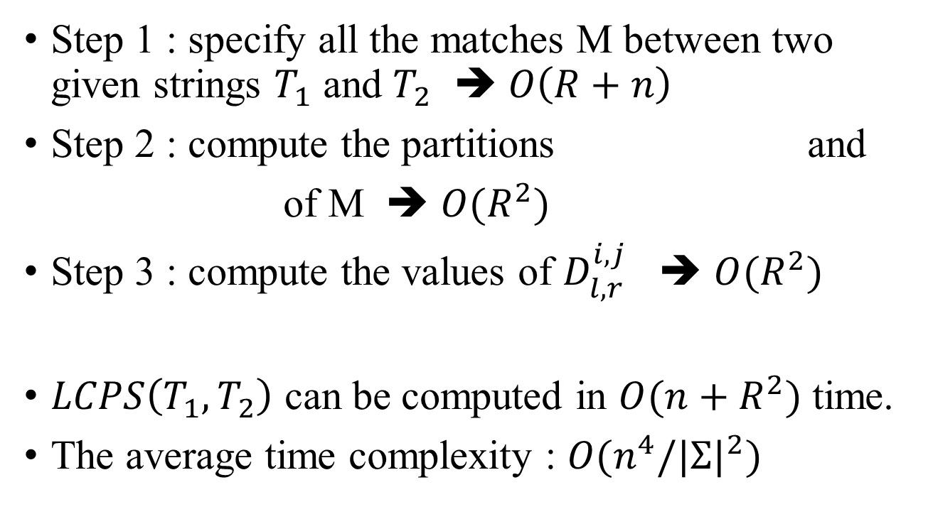
Time Complexity
Step 1 : specify all the matches M between two given strings $T_{1}$ and $T_{2}$ ➔ $O\left(R+n\right)$
Step 2 : compute the partitions and
of M ➔ $O(R^{2})$
Step 3 : compute the values of $D_{l,r}^{i,j}$ ➔ $O(R^{2})$
$LCPS\left(T_{1}, T_{2}\right)$ can be computed in $O(n+R^{2})$ time.
The average time complexity : $O(n^{4}/{|Σ|}^{2})$

