Slide 1
HybridFTW: Hybrid Computation of Dynamic Time Warping Distances
Minwoo Lee, Sanghun Lee, Mi-Jung Choi, Yang-Sae Moon,
and Hyo-Sang Lim
IEEE Access
Vol. 6, 08 Dec, 2017, Pages 2085-2096
Presenter: Shan-Ru Liu
Date: 2018/03/13

Slide 2
Abstract (1/2)
In this paper, we propose an efficient approach that computes the dynamic time warping (DTW) distance in time-series similarity search. The DTW distance is known to offer the high accuracy in similarity search, but it has difficulty in supporting the large database due to its high computational complexity. Recently, FastDTW and FTW have been proposed for efficient computation of DTW distances, but they have still performance limitations. In this paper, we propose a hybrid approach, called HybridFTW, which combines the advantages of both FastDTW and FTW. First, HybridFTW takes the advantage of FastDTW that provides fast computation through the limitation of allowable ranges.

Slide 3
Abstract (2/2)
We call these allowable ranges dynamic (warping) bands, which reduce the computation spaces on the fly, and we reanalyze previous FastDTW and FTW in the viewpoint of static and dynamic bands. Second, HybridFTW also takes the advantage of FTW that exploits the early abandon effect by using the segment-based tight lower bound. To maximize the synergy of combining two methods, we obtain the dynamic band of FastDTW during the process of computing the lower bound in FTW. Using HybridFTW, we next propose range search and k -NN search algorithms and prove their correctness through formal theorems. Experimental results on real and synthetic data sets show that HybridFTW improves the search performance by up to 38 times over FastDTW and by up to 12 times over FTW.

Slide 4
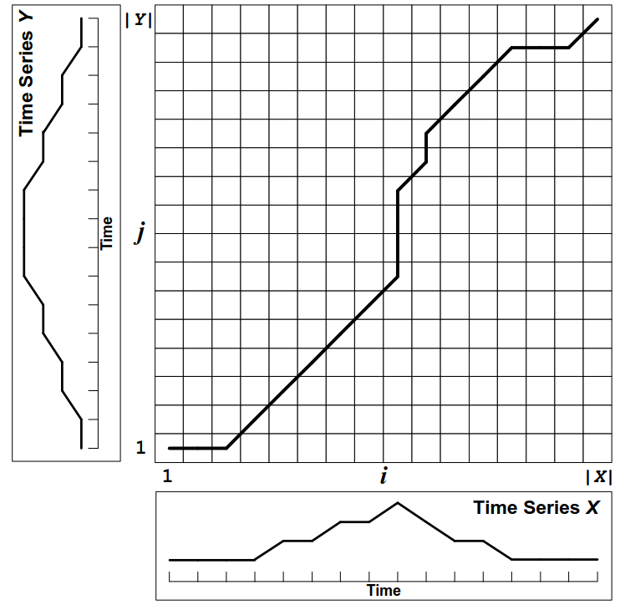
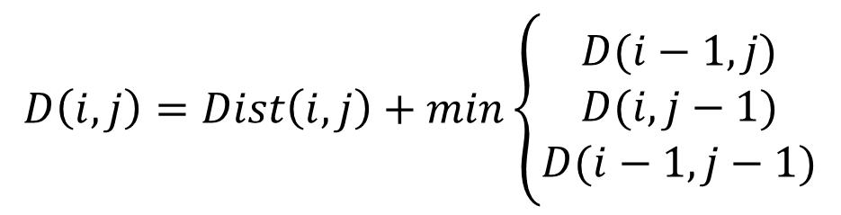
DTW
$$D\left(i,j\right)=Dist\left(i,j\right)+min\left\{\begin{aligned}D(i−1,j) \\ D(i,j−1) \\ D(i−1,j−1)\end{aligned}\right.$$
Time Complexity : O(N²)

Slide 5
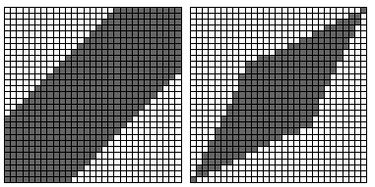
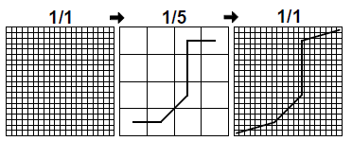
Speeding up DTW
1) Constraints – Limit the number of cells that are
evaluated in the cost matrix.
2) Data Abstraction – Perform DTW on a reduced
representation of the data.
3) Indexing – Use lower bounding functions to reduce the number of times DTW must be run during time series classification or clustering.
Sakoe-Chuba Band Itakura Parallelogram
Width = 5

Slide 6
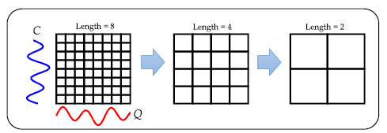
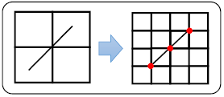
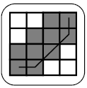
FastDTW (1/2)
1) Coarsening – Shrink a time series into a smaller time series that represents the same curve as accurately as possible with fewer data points.
2) Projection – Find a minimum-distance warp path at a lower resolution, and use that warp path as an initial guess for a higher resolution’s minimum-distance warp path.
3) Refinement – Refine the warp path projected from a lower resolution through local adjustments of the warp path.

Slide 7
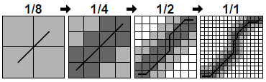
FastDTW (2/2)
Radius = 1
FastDTW is not always to find an optimal warp path. However, the path found is usually very close to optimal. The larger the value of the radius parameter, the more accurate the warp path will be.
Time Complexity : O(N)

Slide 8
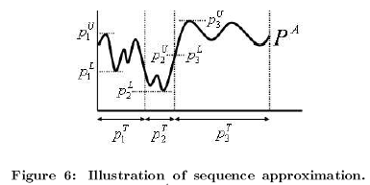
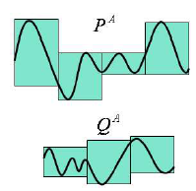
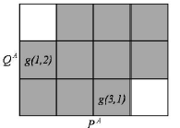
FTW (1/3)
LBS (Lower Bounding distance measure with Segmentation)

Slide 9
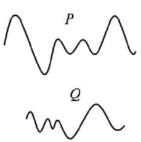
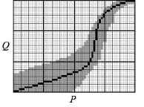
FTW (2/3)
2) EarlyStopping

Slide 10
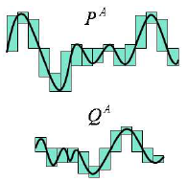
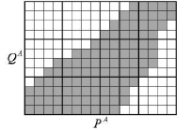
FTW (3/3)
3) Refinement – Indexing + kNN Search Algorithm

Slide 11
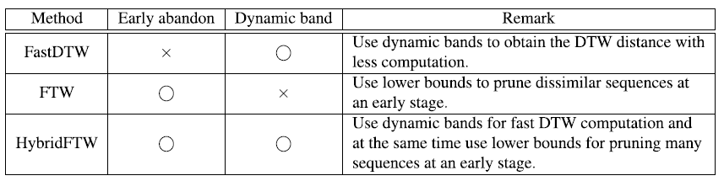
Comparison of existing and proposed methods

Slide 12
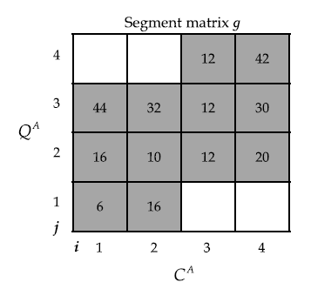
HybridFTW (1/4)
1) Hybrid-Stopping
Tolerance = 30

Slide 13
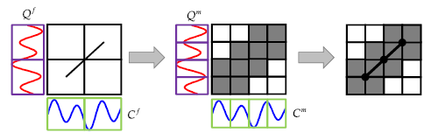
HybridFTW (2/4)
2) Hybrid-Projection

Slide 14
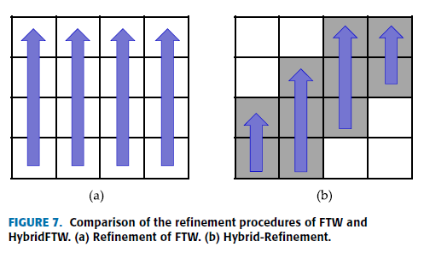
HybridFTW (3/4)
3) Hybrid-Refinement

Slide 15
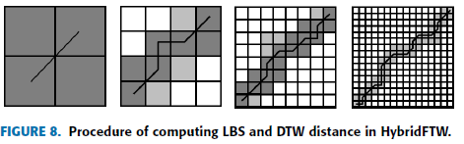
HybridFTW (4/4)

Slide 16
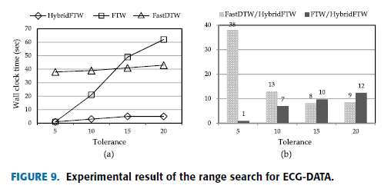
Experimental Result (1/4)

Slide 17
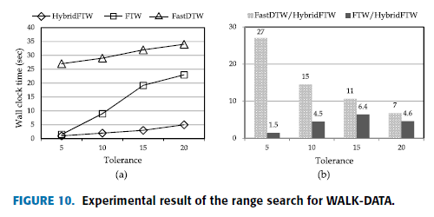
Experimental Result (2/4)

Slide 18
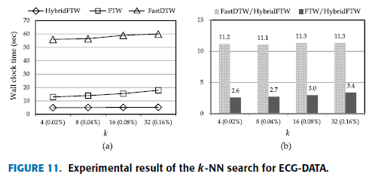
Experimental Result (3/4)

Slide 19
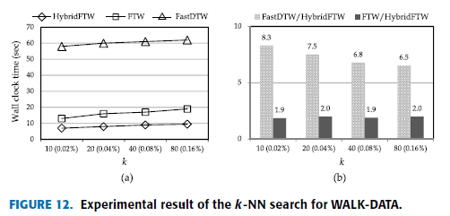
Experimental Result (4/4)

