Slide 1
Adaptive cost dynamic time warping distance in time series analysis for classification
Yuan Wan, Xiao-Li Chen, Ying Shi
Journal of Computational and Applied Mathematics
Volume 319, 1 August 2017, Pages 514-520
Presenter: Shan-Ru Liu
Date: 2018/05/08

Slide 2
Abstract
Dynamic time warping (DTW) distance is commonly used in measuring similarity between time series for classification. In order to obtain the minimum cumulative distance, however, DTW distance may map multiple points on one time series to one point on another, and this makes time series over stretched and compressed, resulting in missing important feature information thus influence the classification accuracy. In this paper, we propose a method called adaptive cost dynamic time warping distance (AC-DTW), which adjusts the number of points on one time series mapped to the points on another. AC-DTW records the trajectories of all points and then adaptively allocates the cost rate to each point by calculating cost function at the next step. The results of the experiments implemented on 17 UCR datasets by using nearest neighbor classifier demonstrate that AC-DTW prevails in criterion of higher accuracy rate in comparison with some existing methods.

Slide 3

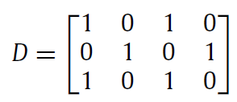
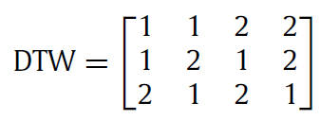
Original DTW
Two time series S₁ = [2,1,2,1], S₂ = [1,2,1]

Slide 4
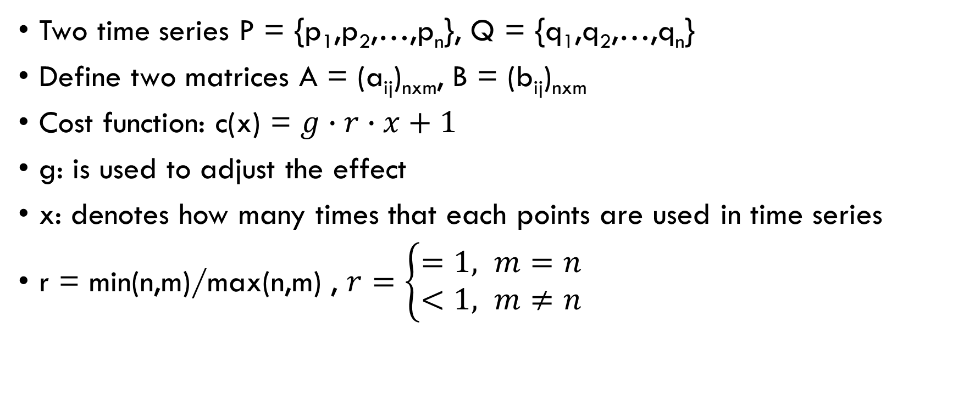
Adaptive cost dynamic time warping
Two time series P = {p₁,p₂,…,p_{n}}, Q = {q₁,q₂,…,q_{n}}
Define two matrices A = (a_{ij})_{nxm}, B = (b_{ij})_{nxm}
Cost function: c(x) = $g∙r∙x+1$
g: is used to adjust the effect
x: denotes how many times that each points are used in time series
r = min(n,m)/max(n,m) , $r=\left\{\begin{aligned}=1, m=n \\ <1, m≠n\end{aligned}\right.$

Slide 5

Adaptive cost dynamic time warping
i : point q_{j} is reused, set a_{i,j} = 1, b_{i,j} = b_{i-1,j} +1
ii: there is no reused point, set a_{i,j} = 1, b_{i,j} = 1
iii: point p_{i} is reused, set a_{i,j} = a_{i,j-1} +1, b_{i,j} = 1

Slide 6
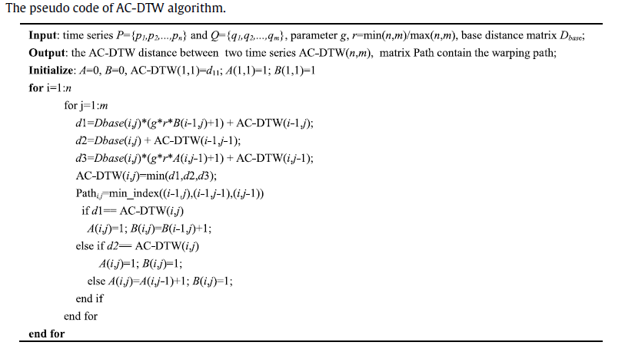
Adaptive cost dynamic time warping

Slide 7
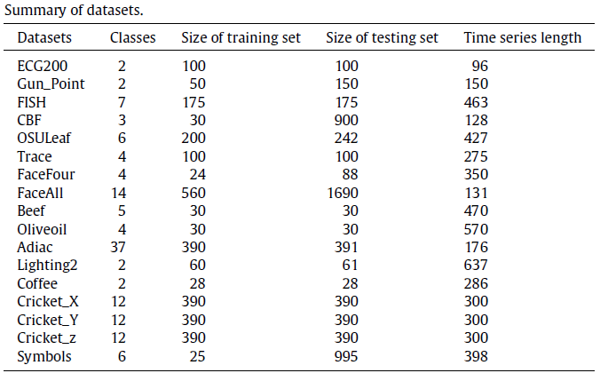
Experiments (1/4)

Slide 8
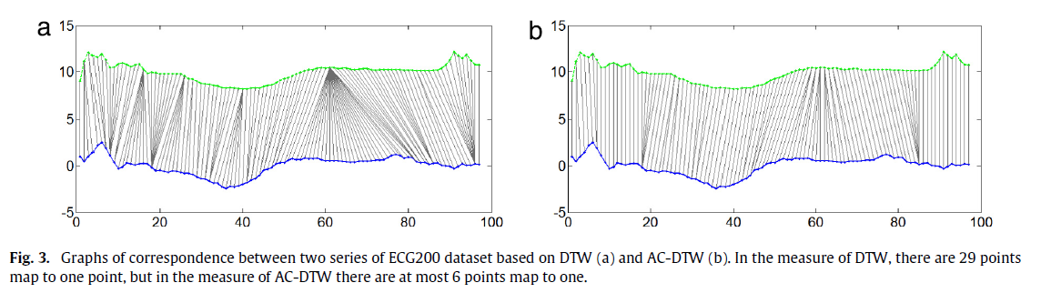
Experiments (2/4)

Slide 9
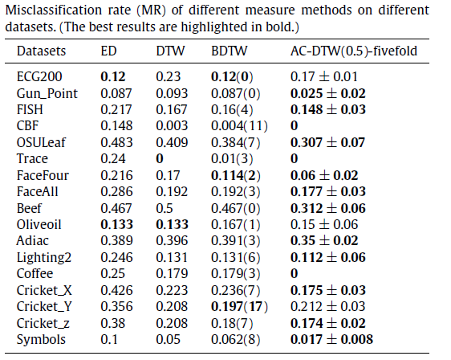
Experiments (3/4)

Slide 10
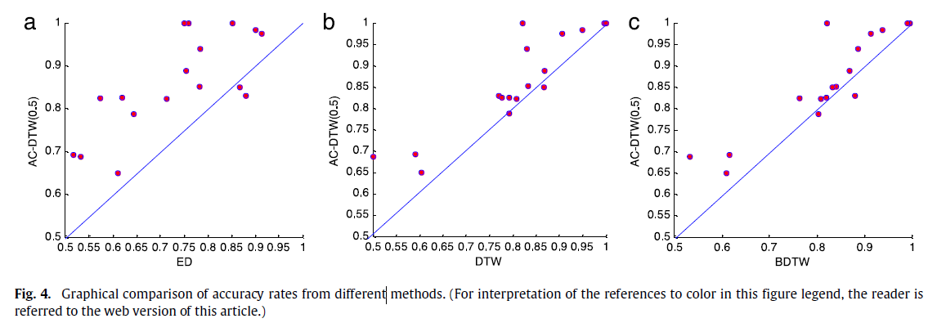
Experiments (4/4)

