Slide 1
Algorithms for Subsequence Combinatorics
Cees Elzinga , Sven Rahmann and Hui Wang
Department of Social Science Research Methods, VU University Amsterdam, The Netherlands
Bioinformatics for High-throughput Technologies, Computer Science 11, TU Dortmund, Germany
School of Computing and Mathematics, University of Ulster, Northern Ireland, UK
Theoretical Computer Science 409 (2008) , 394–404
Presenter: Ting-Wei Liang
Date: 2018/05/23

Slide 2
Abstract(1/2)
A subsequence is obtained from a string by deleting any number of characters; thus in contrast to a substring, a subsequence is not necessarily a contiguous part of the string. Counting subsequences under various constraints has become relevant to biological sequence analysis, to machine learning, to coding theory, to the analysis of categorical time series in the social sciences, and to the theory of word complexity.

Slide 3
Abstract(2/2)
We present theorems that lead to efficient dynamic programming algorithms to count (1) distinct subsequences in a string, (2) distinct common subsequences of two strings, (3) matching joint embeddings in two strings, (4) distinct subsequences with a given minimum span, and (5) sequences generated by a string allowing characters to come in runs of a length that is bounded from above.

Slide 4
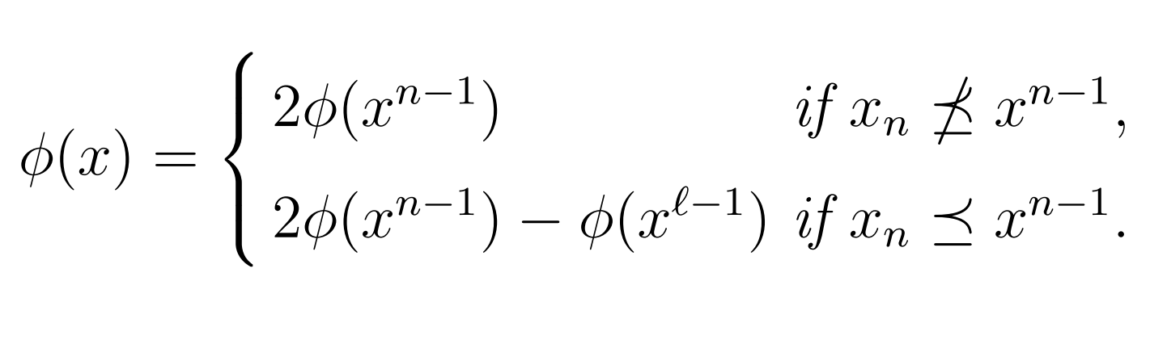
Count distinct Subsequences in a String

Slide 5

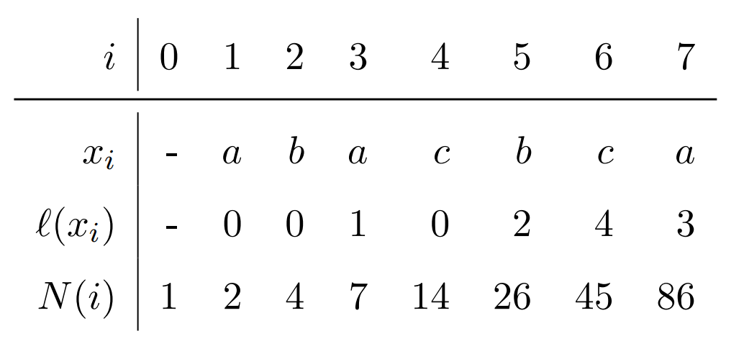
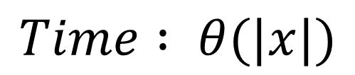
Count distinct Subsequences in a String
$$Time : θ(|x|)$$

Slide 6
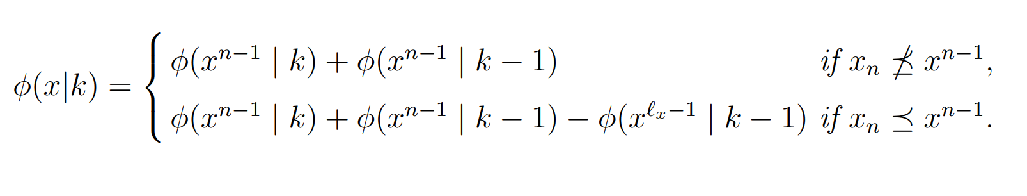
Count distinct Subsequences with k-length in a String

Slide 7
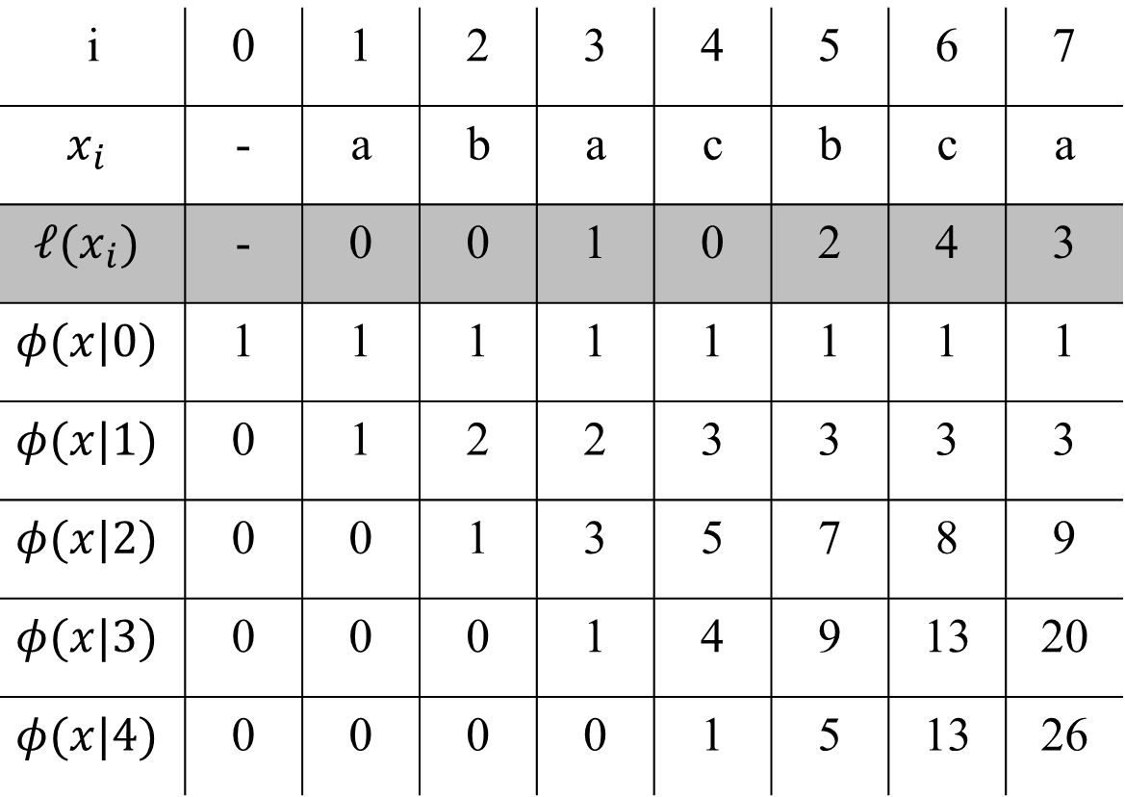

i | 0 | 1 | 2 | 3 | 4 | 5 | 6 | 7
$$x_{i}$$ | - | a | b | a | c | b | c | a
$$ℓ(x_{i})$$ | - | 0 | 0 | 1 | 0 | 2 | 4 | 3
$$φ(x|0)$$ | 1 | 1 | 1 | 1 | 1 | 1 | 1 | 1
$$φ(x|1)$$ | 0 | 1 | 2 | 2 | 3 | 3 | 3 | 3
$$φ(x|2)$$ | 0 | 0 | 1 | 3 | 5 | 7 | 8 | 9
$$φ(x|3)$$ | 0 | 0 | 0 | 1 | 4 | 9 | 13 | 20
$$φ(x|4)$$ | 0 | 0 | 0 | 0 | 1 | 5 | 13 | 26
$$Time : θ(|k||x|)$$

Slide 8
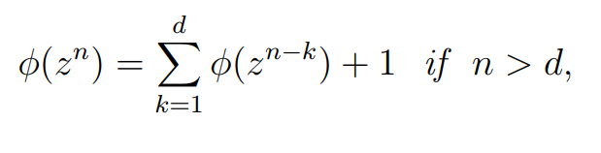
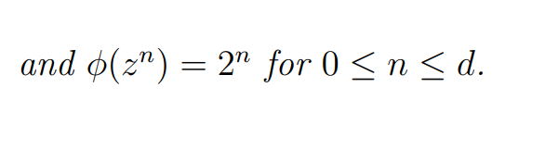

Maximum of distinct subseqeunce
If $Σ=\left\{a,b,c,d\right\}$
$x=abcd abcd abcd abc$

Slide 9
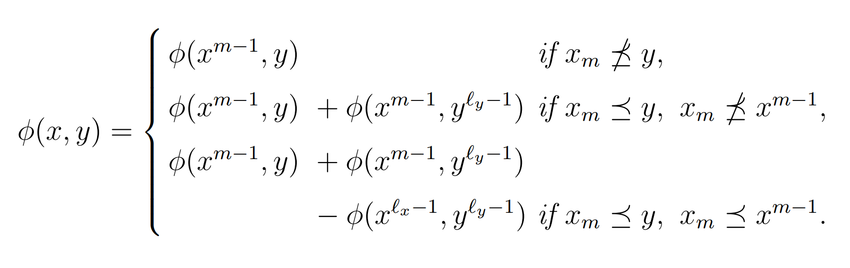


Count distinct common subsequence of two strings
$$ℓ_{x}$$
x
a | b | a | c | c
y
a | b | a | b | a
$$Time : θ(|x||y|)$$

Slide 10

Count distinct common subsequence of two strings
x
a | b | a | a | c
y
a | b | c | b | a
$$ℓ_{y}$$
$$Time : θ(|x||y|)$$

Slide 11


Count distinct common subsequence of two strings
$$ℓ_{x}$$
x
a | b | c | a | c
y
a | b | c | b | a
$$ℓ_{y}$$
$$Time : θ(|x||y|)$$

Slide 12
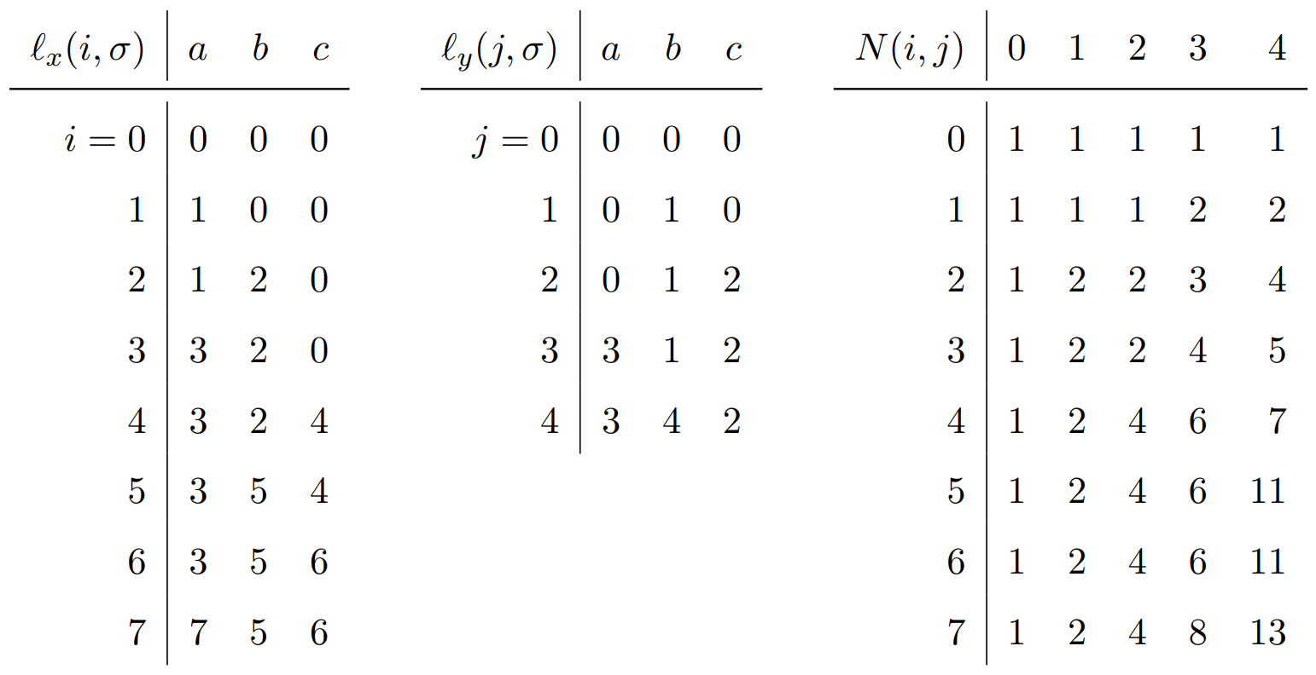
Count distinct common subsequence of two strings
b c a b
a
b
a
c
b
c
a
N(3,2) = N(2,2) = 2
N(4,3) = N(3,3) + N(3,1) = 4 + 2 = 6
N(5,4) = N(4,4) + N(4,3) – N(1,3) = 7 + 6 – 2 = 11

Slide 13
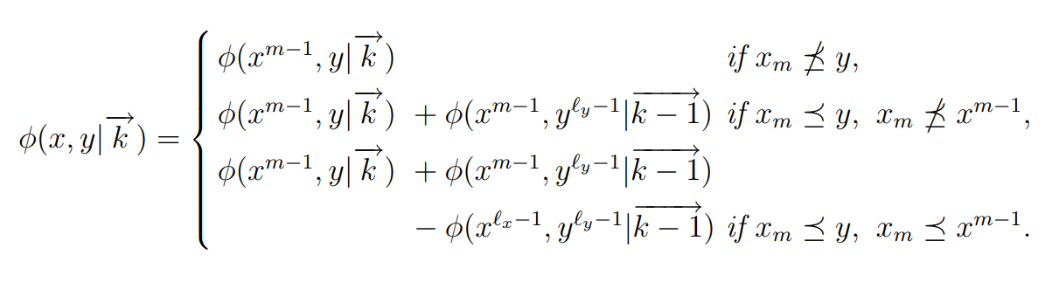
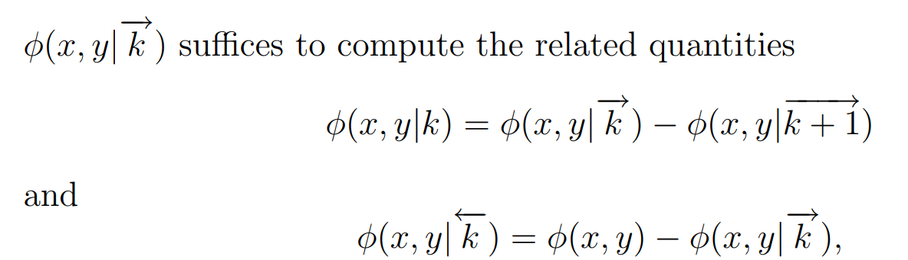

Count distinct k⁺ length common subsequence of two strings
$$Time : θ(k|x||y|)$$

Slide 14
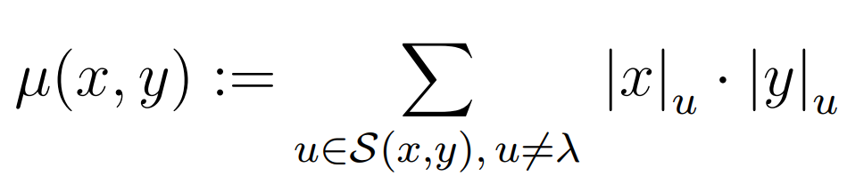

Counting matching joint embeddings
x = TEUTEUTEU , y = TEUU , u = TEU
Embeddings of u in x, ${|x|}_{u}$ = 10
Embeddings of u in y, ${|y|}_{u}$ = 2

Slide 15
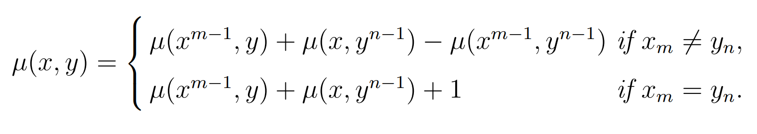
Counting matching joint embeddings

Slide 16
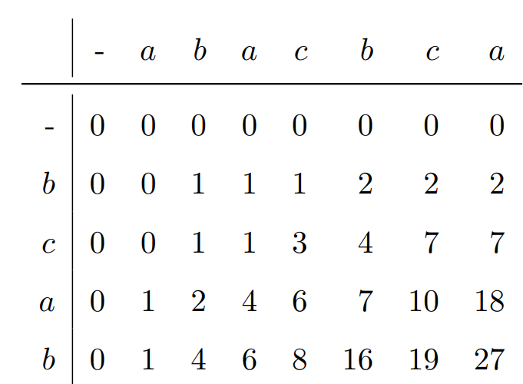
Counting matching joint embeddings
x = bcab
y = abacbca

Slide 17
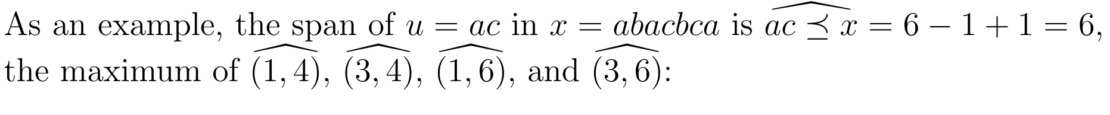
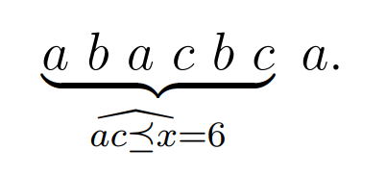
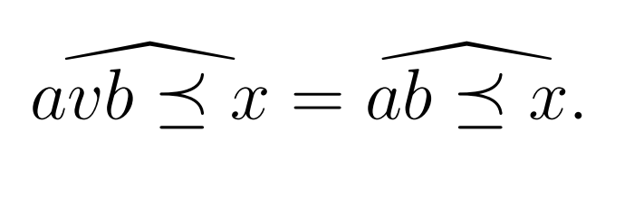
Span of subsequences
Lemma:

Slide 18
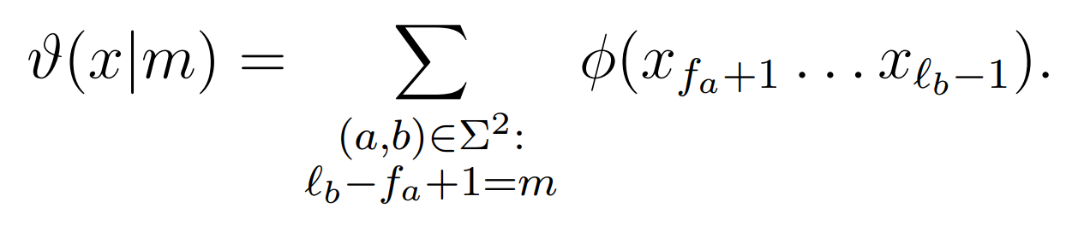

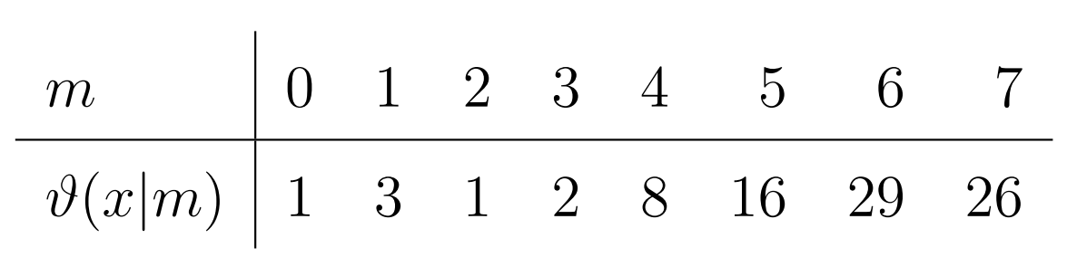
Distinct subsequences with a given minimum span

Slide 19

Sequences generated by length-restricted runs
$$x=x_{1}…x_{n}$$
$y= x_{1}^{(r_{1})}$ $x_{2}^{(r_{2})}…$ $x_{n}^{(r_{n})} , for{ r}_{i} ∈\{0, 1,…ρ\}$
Ex:
$x=aba$ ,$ρ=2$
$⇒a^{(2)}b^{(1)}a^{(1)} ∈y$
$⇒a^{(2)}b^{(0)}a^{(1)}= a^{(3)} ∈y$

Slide 20
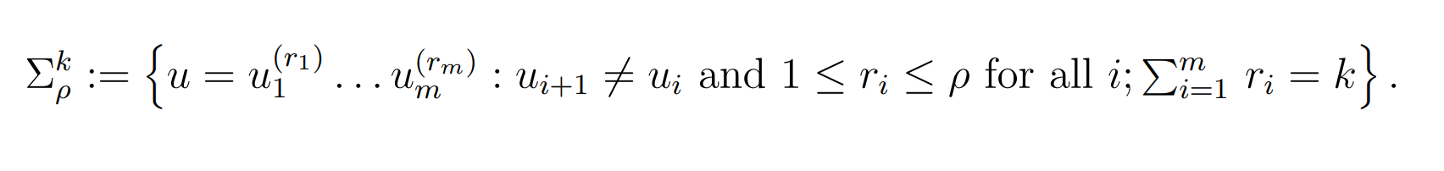
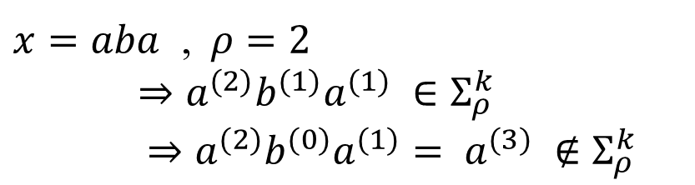
Sequences generated by length-restricted runs
Problem : k-long ρ-restricted sequences
Ex:
$x=aba$ ,$ρ=2$
$⇒a^{(2)}b^{(1)}a^{(1)} ∈Σ_{ρ}^{k}$
$⇒a^{(2)}b^{(0)}a^{(1)}= a^{(3)} ∉Σ_{ρ}^{k}$

Slide 21
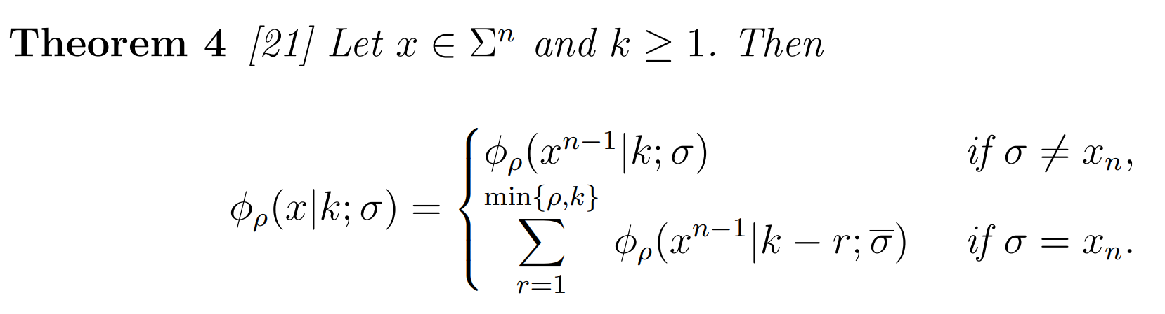
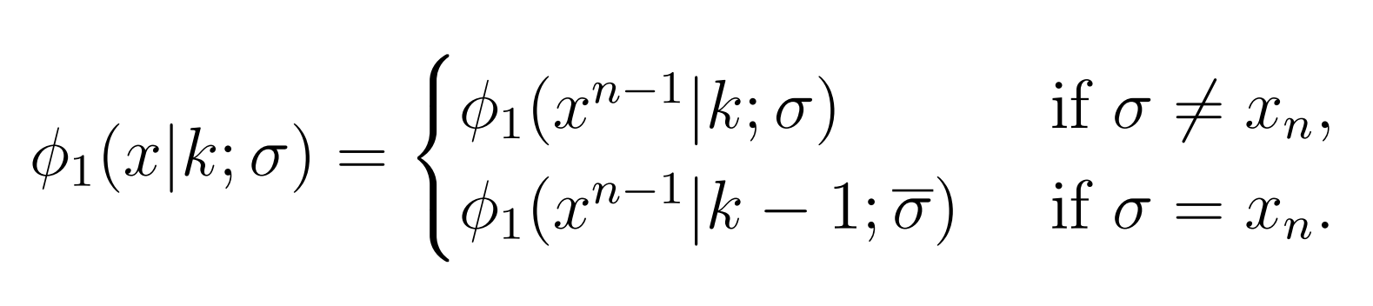
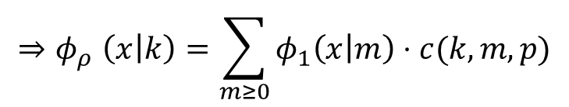

Sequences generated by length-restricted runs
$$ρ=1,$$
$${⇒φ}_{ρ}\left(x | k\right)=\sum_{m≥0}{φ_{1}\left(x | m\right)⋅c(k,m,p)}$$
, c(k,m,p) denotes the number of compositions of k with m summands that do not exceed$ρ$

