Slide 1
A hybrid financial trading support system using multi-category classifiers and random forest
Manoj Thakur, Deepak Kumar
Indian Institute of Technology-Mandi, Mandi 175001, Himachal Pradesh, India
Applied Soft Computing 67 (2018) 337–349
Presenter: Cheng-Han Wu
Date:2018/5/23

Slide 2
Abstract(1/2)
This study presents a decision support system for algorithmic trading in the financial market that uses a new hybrid approach for making automatic trading decision. The hybrid approach integrates weighted multicategory generalized eigenvalue support vector machine (WMGEPSVM) and random forest (RF) algorithms (named RF-WMGEPSVM) to generate “Buy/Hold/Sell” signals. The WMGEPSVM technique has an advantage of handling the unbalanced data set effectively. The input variables are generated from a number of technical indicators and oscillators that are widely used in industry by professional financial experts. Selection of relevant input variables can enhance the predictive capability of the prediction algorithms. RF technique is employed to discover the optimal feature subset from a large set of technical indicators.

Slide 3
Abstract(2/2)
The proposed hybrid system is tested using “walk forward” approach for its capability of taking an automatic trading decision on daily data of five index futures, viz., NASDAQ, DOW JONES, S&P 500, NIFTY 50 and NIFTY BANK. RF-WMGEPSVM achieves the notable improvement over the buy/hold strategy and other predictive models contemplated in this study. It is also observed that combining WMGEPSVM with RF further improves the results. Empirical results confirm the effectiveness of RF-WMGEPSVM in the real market scenarios having bullish, bearish or flat trend.

Slide 4
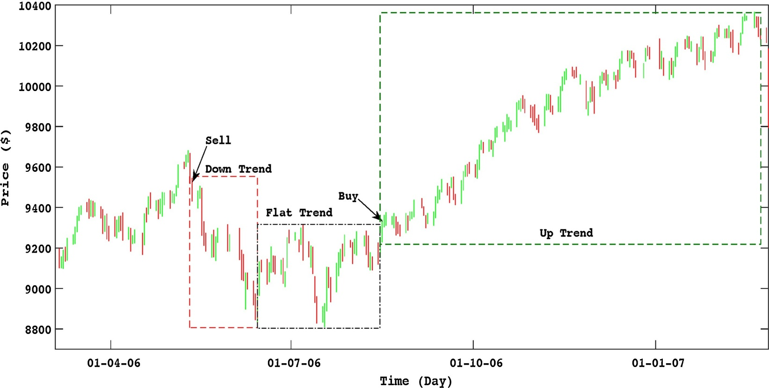

Trading strategy
$S_{t}=\left\{\begin{aligned}BUY, ifC_{(t+1)}>H_{(t)} and L_{\left(t+1\right)}>L_{(t)} \\ SELL, if C_{(t+1)}<L_{(t)} and H_{(t+1)}<H_{(t)} \\ HOLD, otherwise \end{aligned}\right.$
Notes:
Day t, O open high low close volume

Slide 5
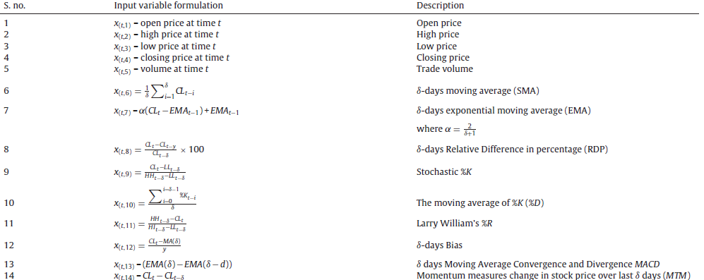
Input feature(1/2)

Slide 6
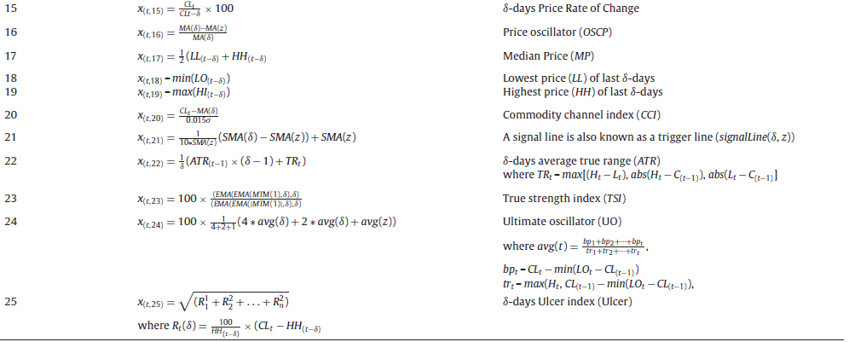
Input feature(2/2)

Slide 7

Random forests
$Γ_{i}(∀i=1, 2, …., η)$
$IS_{f}^{RF}=\frac{1}{η}\sum_{Γ_{i}}{(ρ_{Γ_{i}}−}$ $ρ_{Γ_{i}}^{′})$
2/3
1/3
Average
Testing
Notes:
X features , y which class, prediction error rate , n : DT number, OOB

Slide 8
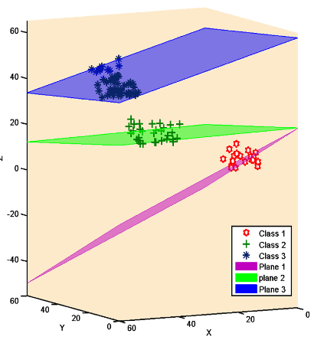
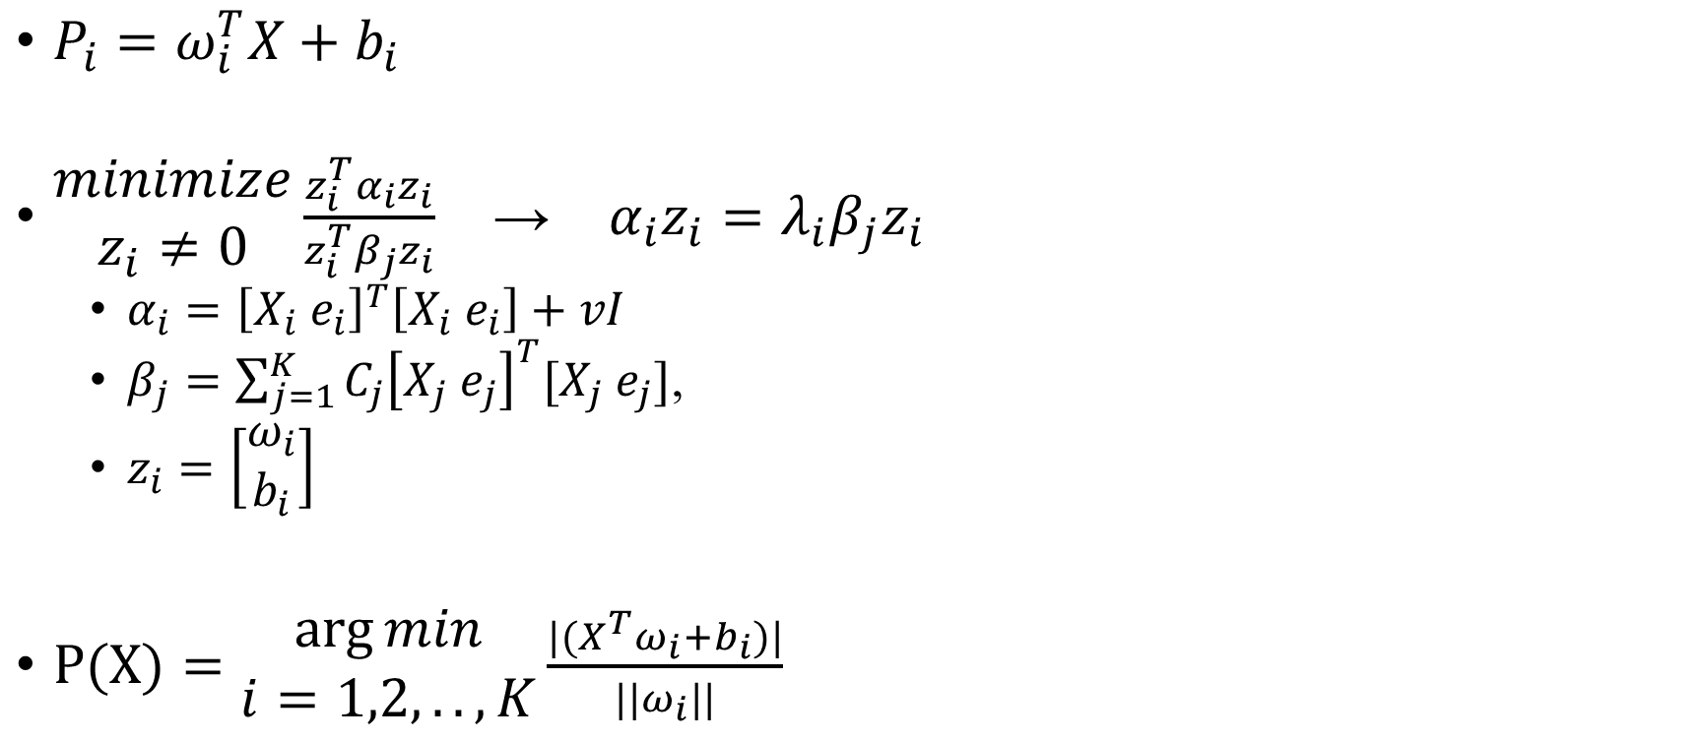
Weighted multicategory generalized eigenvalue proximal SVM(WMGEPSVM)
$P_{i}=ω_{i}^{T}X+b_{i}$
$\begin{matrix}minimize \\ z_{i}≠0\end{matrix}\frac{z_{i}^{T}α_{i}z_{i}}{z_{i}^{T}β_{j}z_{i}}$ → $α_{i}z_{i}=λ_{i}β_{j}z_{i}$
$α_{i}={\left[X_{i} e_{i}\right]}^{T}\left[X_{i} e_{i}\right]+vI$
$β_{j}=\sum_{j=1}^{K}{C_{j}{\left[X_{j} e_{j}\right]}^{T}[X_{j} e_{j}]}$,
$z_{i}=\left[\begin{matrix}ω_{i} \\ b_{i}\end{matrix}\right]$
$P(X)=\begin{matrix}\arg{min} \\ i=1,2,..,K\end{matrix}\frac{{|(X}^{T}ω_{i}+b_{i})|}{||ω_{i}||}$
Notes:
v

Slide 9
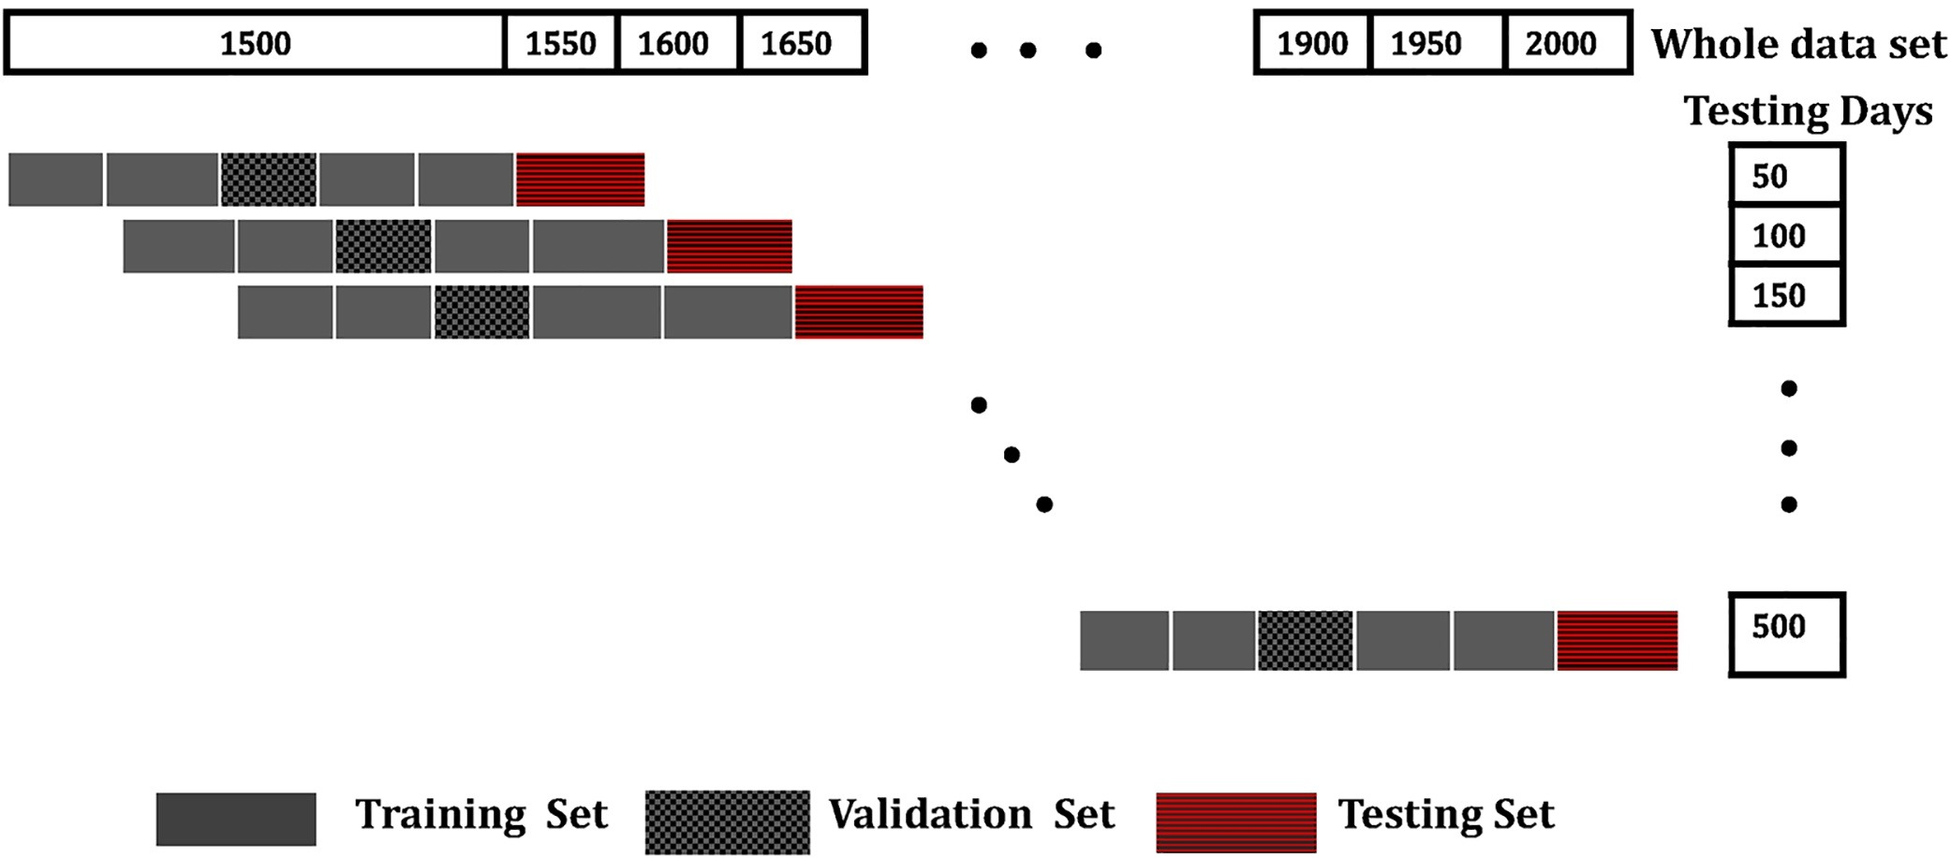
Model selection and testing scheme
Notes:
Validation set to adjust v

Slide 10
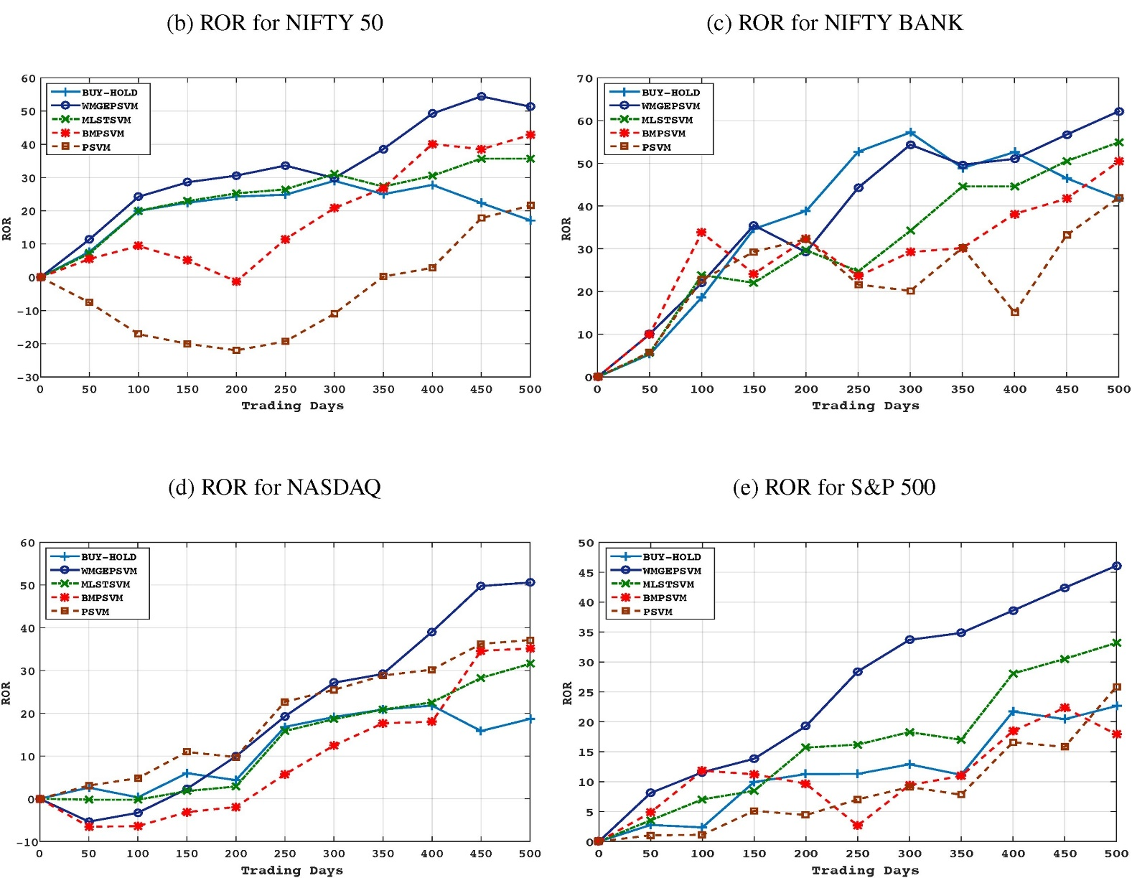
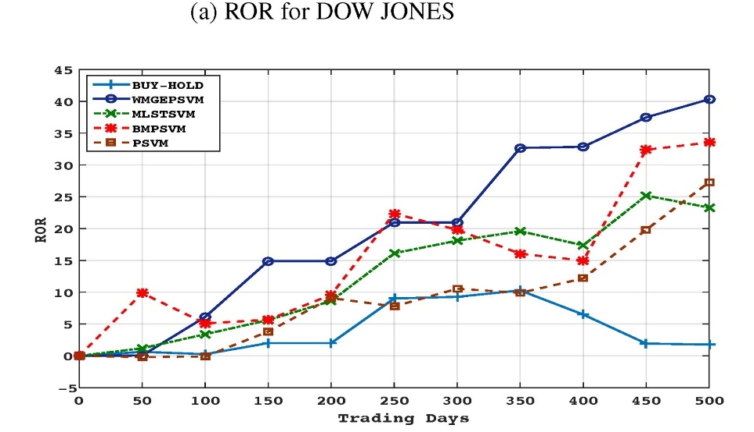
Experimental result
Notes:
Transaction cost=0.05%

Slide 11
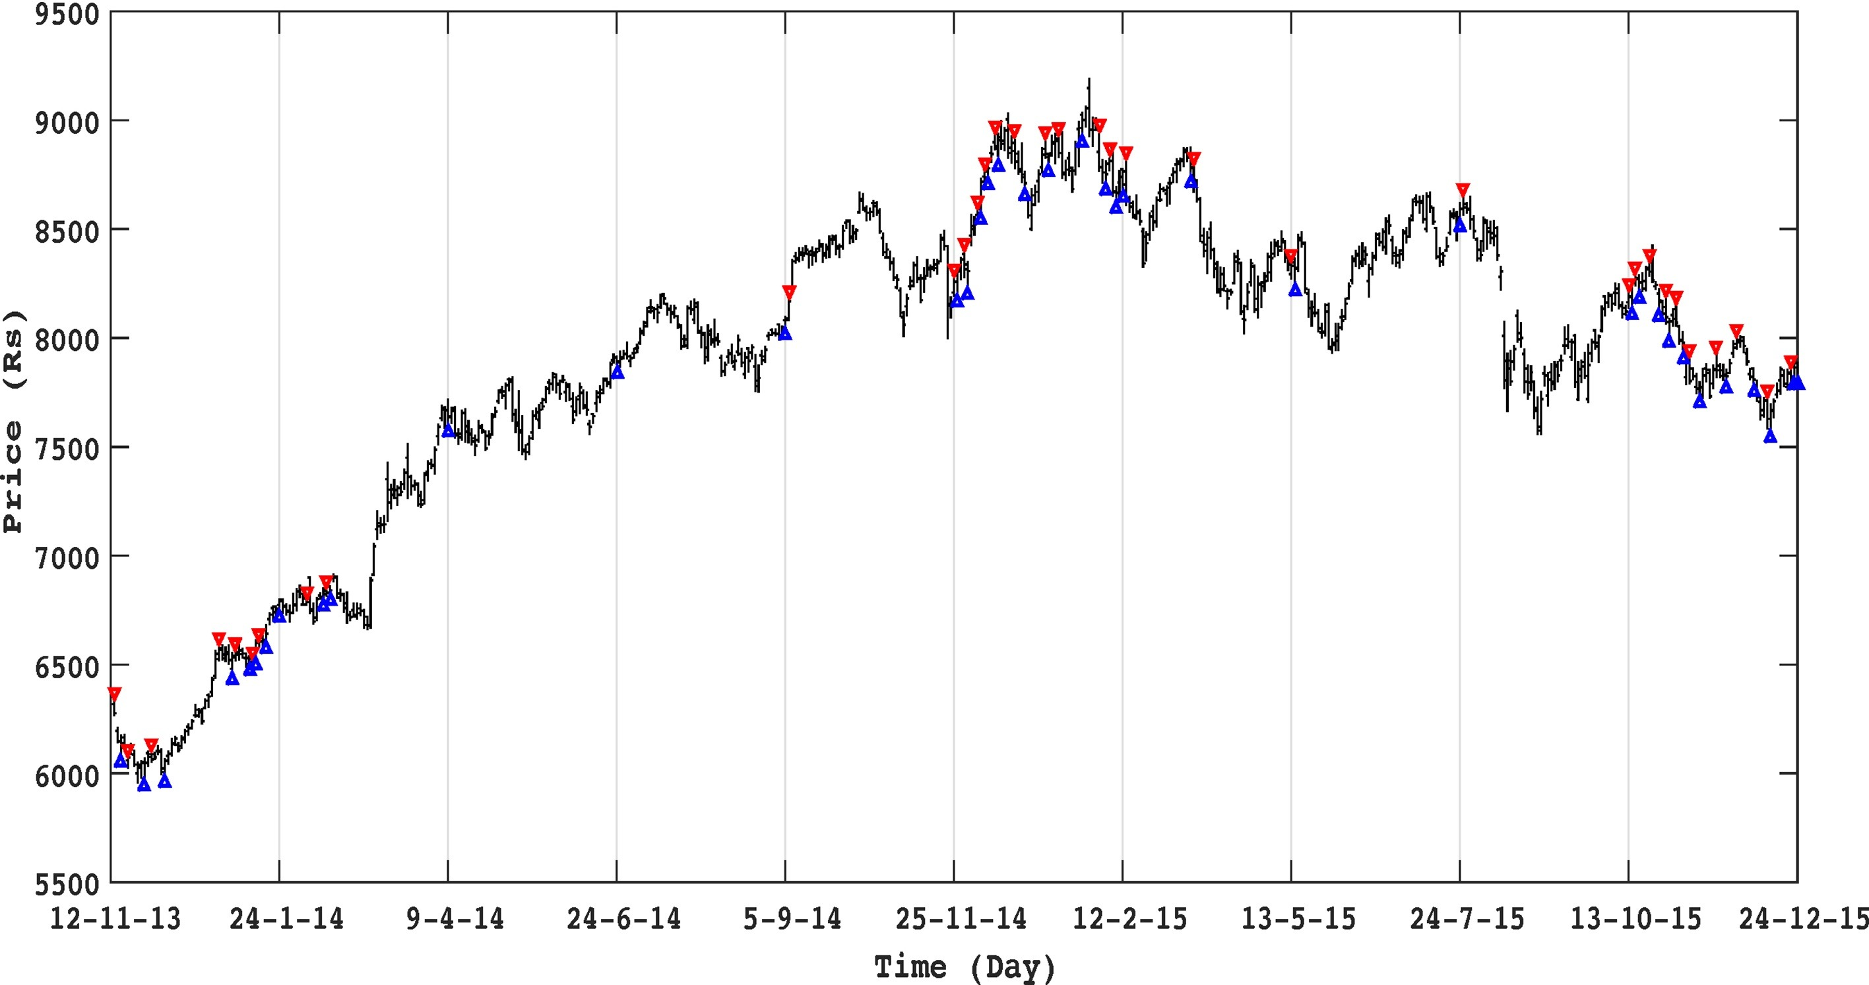

Slide 12
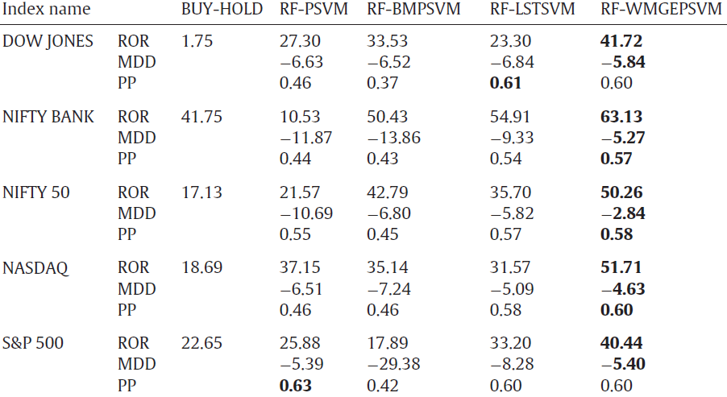
Notes:
Rate of return, Maximum drawdown, percent probability : number of winning trades/total trades

