Slide 1
SOAP2: an improved ultrafast tool for short read alignment
Ruiqiang Li(李瑞強), Chang Yu(), et. al. Beijing Genomics Institute at Shenzhen
Bioinformatics (2009) 25 (15): 1966-1967.
Reporter : 陳慶耀 2013/6/13
Notes:
Ruiqiang Li1,2,†, Chang Yu1,†, Yingrui Li1, Tak-Wah Lam3, Siu-Ming Yiu3,
Karsten Kristiansen2 and Jun Wang1,2,∗
1Beijing Genomics Institute at Shenzhen, Shenzhen, 518083, China, 2Department of Biochemistry and Molecular
Biology, University of Southern Denmark, Odense M, DK-5230, Denmark and 3Department of Computer Science,
University of Hong Kong, Hong Kong, China
Received on January 23, 2009; revised on April 27, 2009; accepted on May 24, 2009
Advance Access publication June 3, 2009
Associate Editor: Joaquin Dopazo

Slide 2
ABSTRACT
SOAP2 is a significantly improved version of the short oligonucleotide alignment program that both reduces computer memory usage and increases alignment speed at an unprecedented rate. We used a Burrows Wheeler Transformation (BWT) compression index to substitute the seed strategy for indexing the reference sequence in the main memory. We tested it on the whole human genome and found that this new algorithm reduced memory usage from 14.7 to 5.4GB and improved alignment speed by 20–30 times. SOAP2 is compatible with both single- and paired-end reads. Additionally, this tool now supports multiple text and compressed file formats. A consensus builder has also been developed for consensus assembly and SNP detection from alignment of short reads on a reference genome.

Slide 3
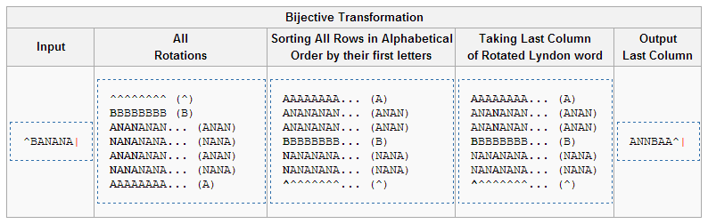
BWT

Slide 4
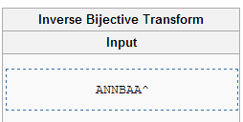
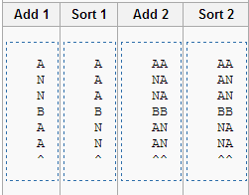
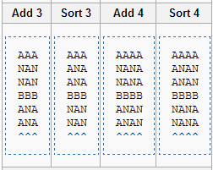
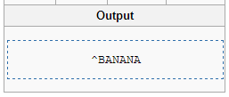
BWT

Slide 5
BWT
增加壓縮效率
14.7G ➔ 5.4G (記憶體使用量)
12 times slower than building the seed index that was implemented in SOAP
Prebuild the index on a hard disk, and then load it into RAM directly when starting a new alignment job for that genome.

Slide 6
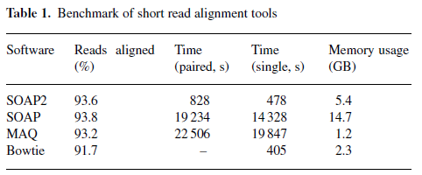
BWT
BWT

