Slide 1
Stock selection, prediction and asset allocation
June 18, 2013
Hung-Hsin Chen (陳紘昕)

Slide 2
Related topics
Programming language: python
Stock selection (stock ranking)
Asset allocation (portfolio problem)
Portfolio rebalancing (multi-period optimization)
Trading rule
Statistics (time series)
ARMA, ARIMA, GARCH,….
Technical analysis
Technical indicator (MA, MACD, RSI,…)
Machine learning
Evolutionary method (GA, GP, PSO,…)
Discriminating model (SVM, SVR, Neural network,…)
Generative model (HMM, deep learning,…)
Performance measure
Return, risk, Sharpe ratio, Sortino ratio,…

Slide 3

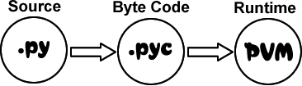
Python
PyPI - the Python Package Index
PVM:
Python or CPython
JPython (for Java)
Iron Python (for .Net)
PyPy (PVM implemented by python, high performance)

Slide 4

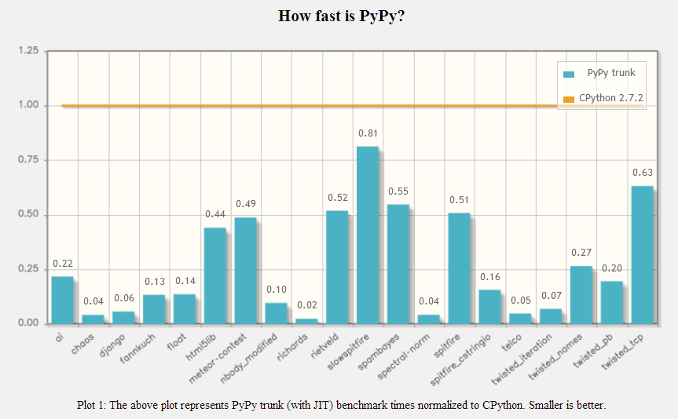
High performance !!
http://speed.pypy.org/

Slide 5
Numpy, Scipy (with Intel MKL)
Numpy is an extension to the Python programming language, adding support for large, multi-dimensional arrays and matrices.
Scipy contains modules for optimization, linear algebra, integration, interpolation, special functions, FFT, signal and image processing, ODE solvers and other tasks common in science and engineering.
BLAS: a de facto application programming interface standard for publishing libraries to perform basic linear algebra operations such as vector and matrix multiplication.
LAPACK: provides routines for solving systems of linear equations and linear least squares, eigenvalue problems, and singular value decomposition.

Slide 6
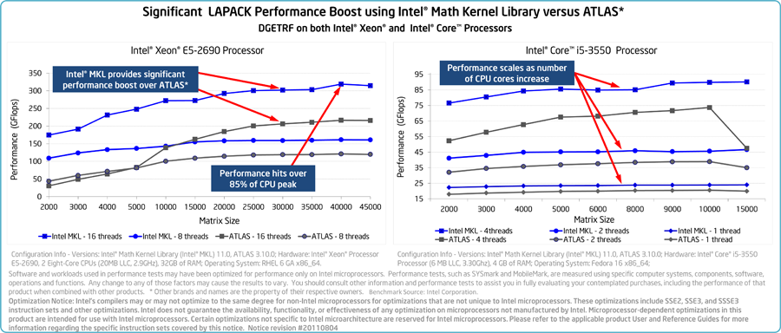
Intel® Math Kernel Library (MKL)
Provide BLAS, LAPACK and a wealth of routines to accelerate application performance and reduce development time.
Free for Non-Commercial Software Development
LU decomposition:

Slide 7
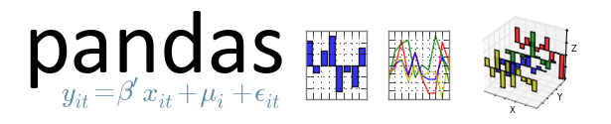
Official site
Time series data structure based on numpy
Three main data structure
Series
DataFrame
Panel

Slide 8

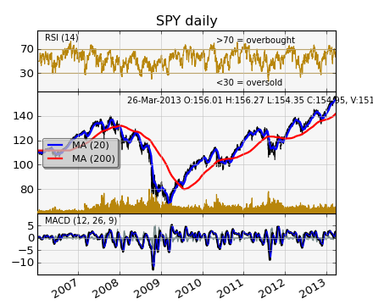
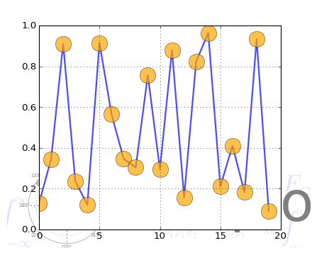
Python plotting library
Similar to matlab API interface

Slide 9
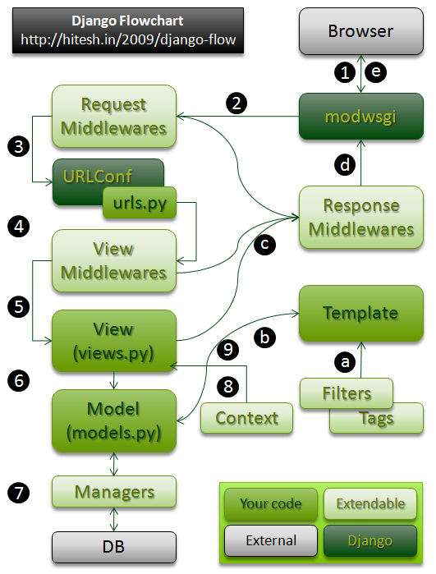
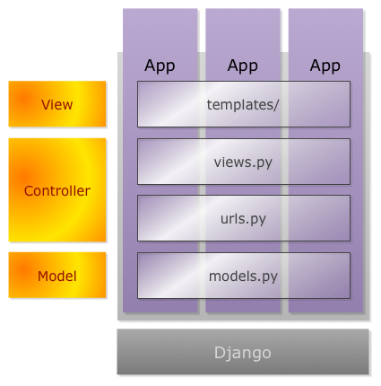
Django
Django is a high-level Python Web framework that encourages rapid development and clean, pragmatic design

Slide 10
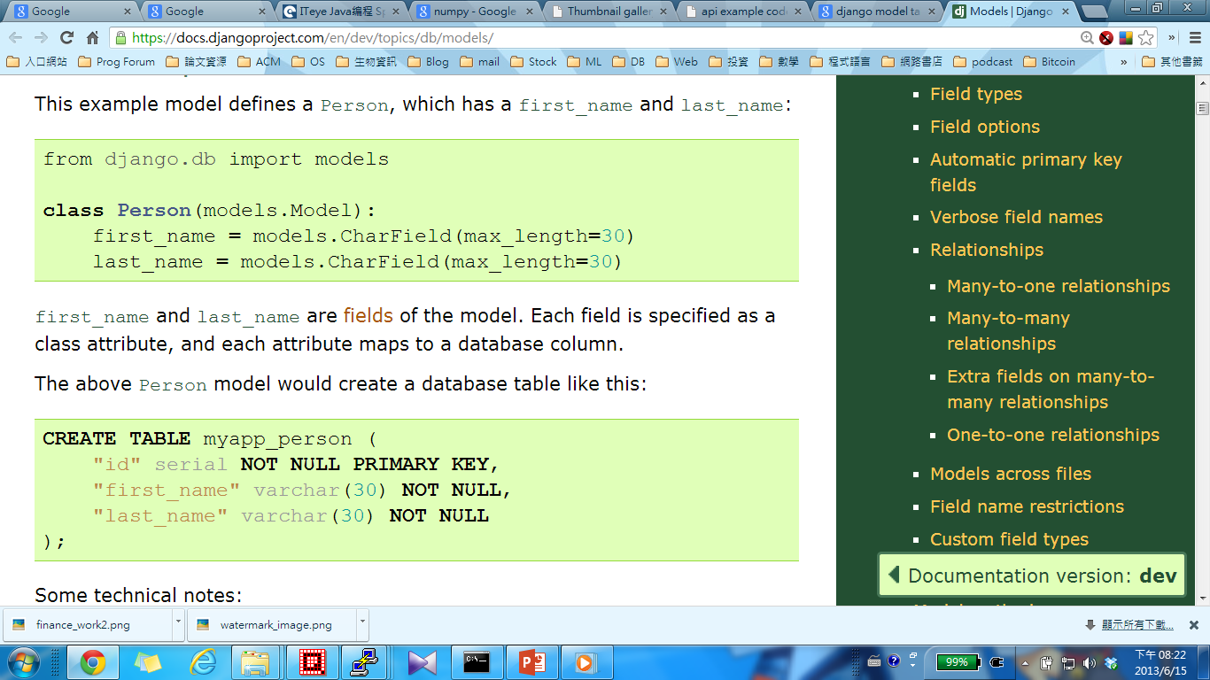
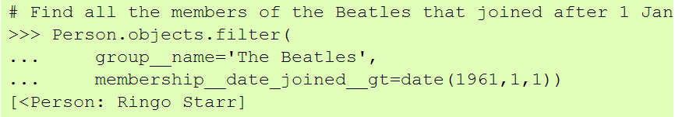
Django Object-relational mapping (ORM)
object
relational
query

Slide 11
My program
Django (view)
Django (template)
Django ORM (model)
Query, write
Database
All steps are connected with the database by Django
Fetching
Preprocessing
Stock selection
Asset allocation
Trading rule
Performance measure

Slide 12
Fetching
Stock price (daily)
TEJ (台灣經濟新報，學校只有買台灣股市的資料)
Yahoo U.S.->Finance (free, 不保証資料正確性, 美國股市資料)
Google finance (free, 不保証資料正確性，各國股市資料)
基本資料 (free)
公開資訊觀測站 (free, 台灣)
The Global Financial Database 全球金融資料庫 (GFD) (學校只有買部份資料)
台灣經濟統計資料庫網路版(Aremos精華版) (總體經濟資料)

Slide 13

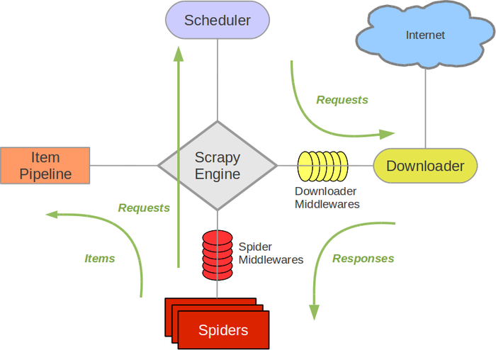
Scrapy: An open source web scraping framework for Python
Scrapy is a fast high-level screen scraping and web crawling framework, used to crawl websites and extract structured data from their pages. It can be used for a wide range of purposes, from data mining to monitoring and automated testing.

Slide 14
Machine learning tools
Scikits: based on numpy and scipy
Scikit-learn (提供了大部份所需要機器學習資料處理函數、分類器)
Scikit.statsmodels (基礎統計模型，以及時間序列統計模型)
Other scikits
MDP (modular toolkit for data processing) (提供許多機器學習分類器)
mlpy (machine learning python)
Neurolab (neural network library)
Orange
Theano (for deep learning, support GPU)
Rpy2 (interface for R, CRAN)

Slide 15
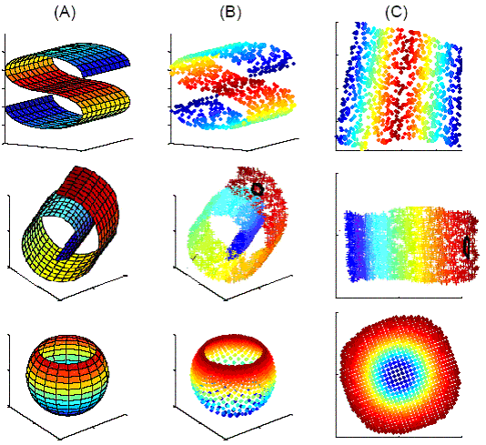
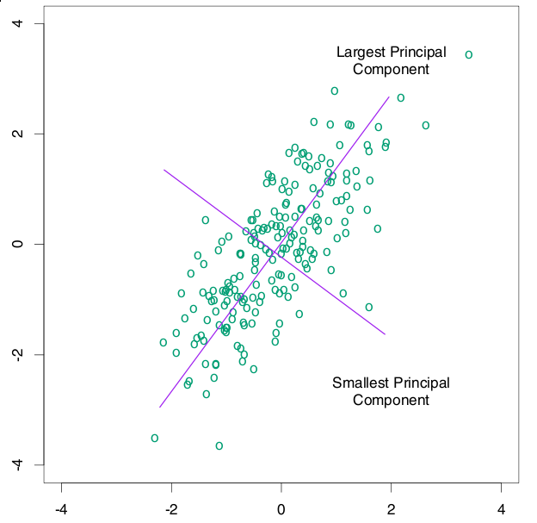
preprocessing
確認本日可用之股票代號(TWSE->產品與服務->證券編碼公告->上市公司證券編碼)
抓取本日交易資料(yahoo, google, TEJ, ….)
確認資料可靠性
計算技術指標(TA-Lib, python-wrapper)
Normalization: (norm of each data = 1)
MinMax scale: (0<=feature[i]<=1)
PCA (找出資料變異數最大的線性組合)
Manifold (非線性投影, LLE, eigen-face)

Slide 16
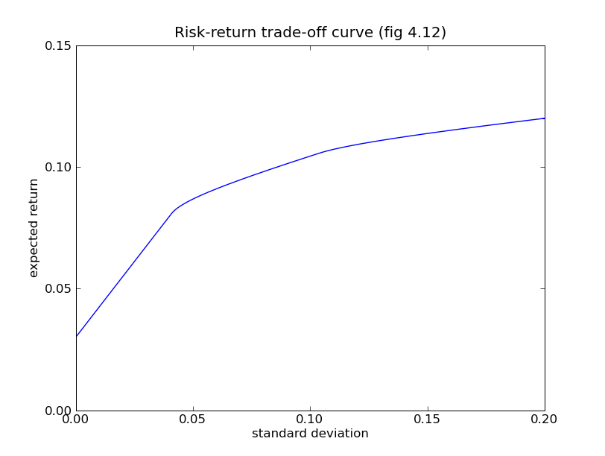
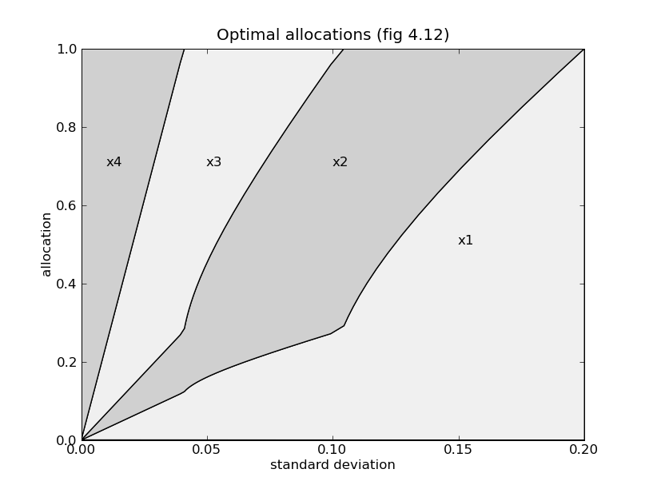
Asset allocation
Linear optimization, robust optimization….
CVXOPT: python software for convex optimization
Mean-variance model

Slide 17
Trading rule
Scikit-learn, mdp, Neurolab…
Pyevolve (GA and GP, stop development)
Pygep (GEP, stop development)->PyMOGEP (自行改寫)
DEAP (distributed GA, MOEA, PSO)
Zipline (Pythonic Algorithmic Trading Library)
R:
PerformanceAnalytics
TTR, ttrTests
pairTrading

Slide 18
Performance measure
Basic statistics (mean, stdev., skewness, kurtosis): numpy, scipy
VaR (value at risk), ES or CVaR (expected shortfall or condition value at risk): R-performanceanalysis
Confusion matrix, AUC, ROC: scikit-learn

Slide 19
Experiment
Feature sets: {adjROI, closePrice, highPrice, lowPrice, openPrice, tradeValue, tradeVolume, AD, ADOSC, ADX, ADXR, APO, ATR, AroonDown, AroonOSC, AroonUp, BOP, CCI, CMO, DEMA10, DEMA120, DEMA20, DEMA240, DEMA30, DEMA40, DEMA5, DEMA60, DX, EMA10, EMA120, EMA20, EMA240, EMA30, EMA40, EMA5, EMA60, FAMA, FastD, FastK, KAMA10, KAMA120, KAMA20, KAMA240, KAMA30, KAMA40, KAMA5, KAMA60, MACD, MACDSignal, MAMA, MFI, MINUSDI, MINUSDM, MOM, NATR, OBV, PLUSDI, PLUSDM, PPO, ROC, RSI, RSIFastD, RSIFastK, SAR, SAREXT, SMA10, SMA120, SMA20, SMA240, SMA30, SMA40, SMA5, SMA60, SlowD, SlowK, ULTOSC, Williams} 77個特徵
Weekly sliding window
100隻股票, from 2000/1/1~2012/12/31

Slide 20
預測明日漲跌(1)
使用scikit-learn classifier的預設參數, 所有特徵正規化為0~1, 且在實驗中均不更換參數
Method | trainSet: 20 | 40 | 60 | 120 | 240
Decision tree | 57.49%/0.88% | 56.19%/0.89% | 55.61%/0.95% | 54.59%/1.16% | 54.10%/0.87%
Extended tree | 62.02%/0.94% | 61.92%/0.89% | 61.52%/0.91% | 61.13%/0.97% | 60.51%/1.13%
Random forest | 61.64%/0.87% | 61.31%/1.04% | 60.75%/0.88% | 60.00%/1.06% | 59.06%/1.09%
LDA | 58.50%/0.93% | 54.57%/0.99% | 51.30%/0.87% | 51.14%/1.02% | 50.99%/1.06%
zRidge reg. | 64.43%/0.85% | 63.82%/0.89% | 63.30%/0.91% | 61.99%/1.10% | 60.25%/1.42%
Logistic reg. | 62.62%/0.89% | 62.92%/0.91% | 62.80%/1.07% | 61.88%/0.96% | 60.78%/1.46%
SGD | 62.63%/1.02% | 63.92%/0.87% | 64.22%/0.76% | 64.17%/0.91% | 63.90%/1.03%
Grad. Boost | 57.91%/0.89% | 59.59%/0.94% | 60.88%/1.09% | 60.88%/1.26% | 61.23%/1.47%
Gauss Naïve Bayes | 59.48%/0.93% | 60.84%/1.17% | 60.52%/1.45% | 59.30%/2.04% | 57.96%/2.64%
Passive-aggressive | 63.92%//0.88% | 64.46%/0.78% | 64.04%/0.78% | 63.00%/0.94% | 61.79%/1.19%
SVM | 53.57%/0.95% | 53.93%/0.93% | 54.45%/0.96% | 54.64%/1.02% | 54.49%/1.36%
Percetron | 62.59%/0.96% | 63.77%/0.89% | 64.13%/0.78% | 64.06%/0.90% | 63.86%/1.01%
RBM | 49.27%/0.69% | 48.70%/0.88% | 48.97%/0.74% | 49.17%/0.82%

Slide 21
預測明日漲跌(2)
使用scikit-learn classifier的預設參數, 所有特徵正規化為0~1, 在實驗中每期使用grid search找acc.最高的參數
Method | trainSet: 20 | 40 | 60 | 120
Decision tree | 57.58%/0.90% | 56.89%/0.94% | 56.54%/0.99% | 55.79%/1.15%
Extended tree | untest | Untest | Untest | Untest
Random forest | 62.56%/0.87% | 62.40%/0.89% | 62.40%/0.92% | 61.99%/0.93%
LDA | untest | untest | untest | untest
Ridge reg. | 63.11%/0.90% | 62.99%/0.83% | 62.25%/0.95% | 60.53%/1.04%
Logistic reg. | 60.60%/0.90% | 61.54%/0.91% | 61.57%/0.99% | 60.82%/1.04%
SGD | untest | untest | untest | untest
Grad. Boost | untest | untest | untest | untest
Gauss Naïve Bayes | untest | untest | untest | untest
Passive-aggressive | 63.83%/0.81% | 64.44%/0.82% | 64.38%/0.90% | 64.17%/0.98%
SVM | 62.11%/0.95% | 62.46%/0.93% | 61.93%/0.96% | 59.98%/1.02%
Percetron | untest | untest | untest | untest
RBM | untest | untest | untest | untest

Slide 22
Kalman filter for real-time tracking
KF能夠從一系列的不完全及包含雜訊的測量中，估計動態系統的狀態
KF是限制在狀態變化為線性，且系統與量測誤差均為高斯白噪音的假設

Slide 23
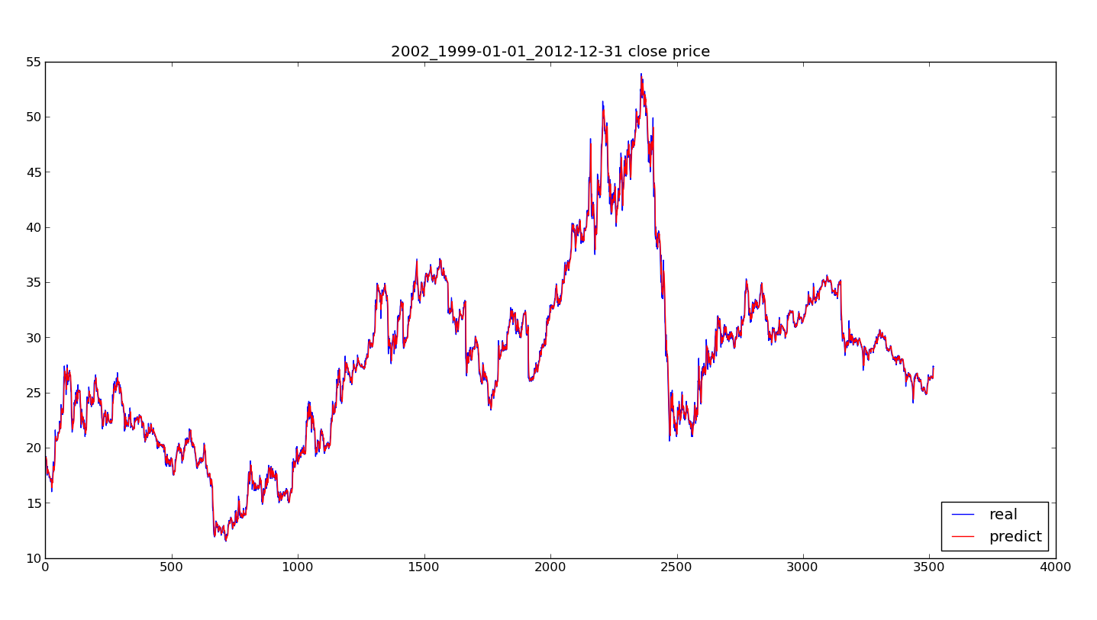
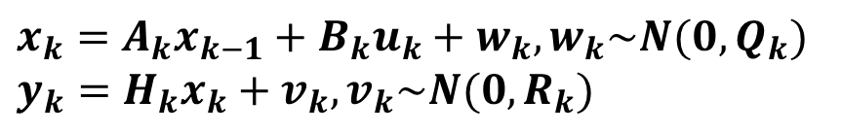
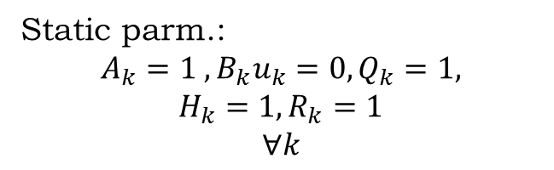
$x_{k}=A_{k}x_{k−1}+B_{k}u_{k}+w_{k}, w_{k}\sim N(0,Q_{k})$
$$y_{k}=H_{k}x_{k}+v_{k}, v_{k}\sim N(0, R_{k})$$
Method | MAE
Kalman (static param.) | 0.37
Naïve | 0.34
Static parm.:
$$A_{k}=1 , B_{k}u_{k}=0, Q_{k}=1,$$
$$H_{k}=1,R_{k}=1$$
$$∀k$$

Slide 24
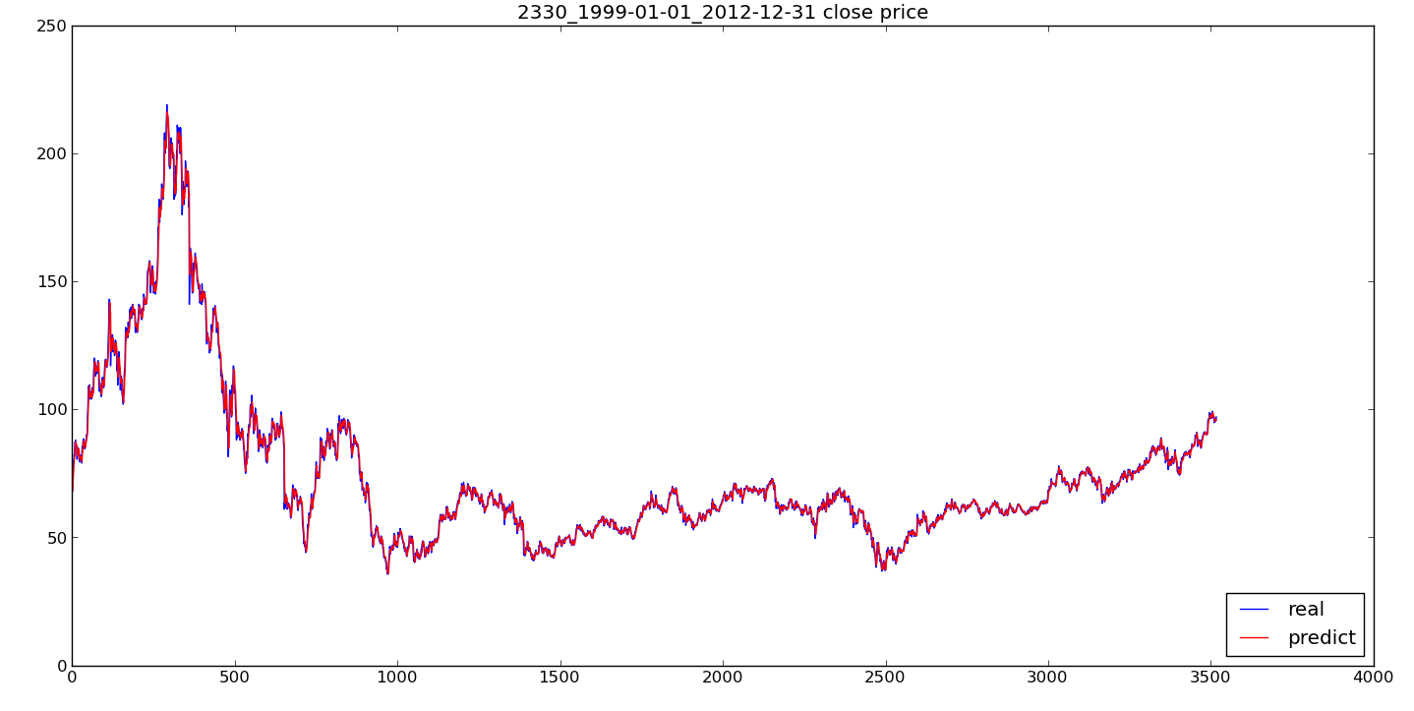
Method | MAE
Kalman (static param) | 1.38
Naïve | 1.27

Slide 25
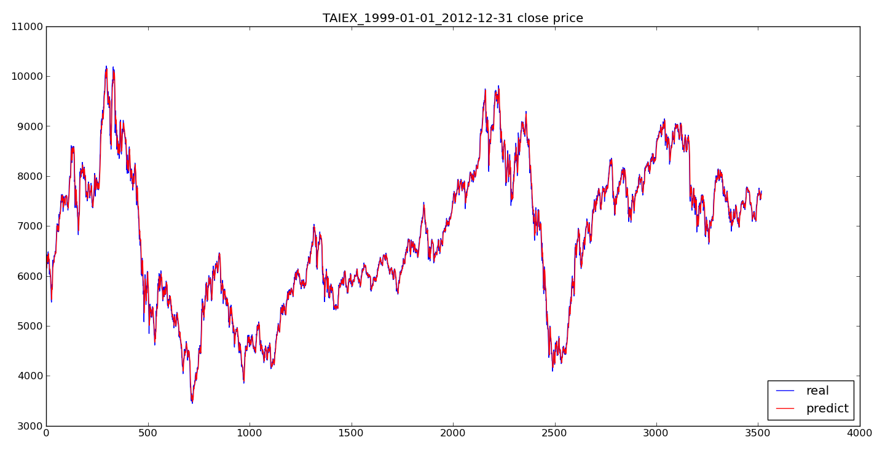
Method | MAE
Kalman (static param.) | 81.96
Naive | 72.40

Slide 26
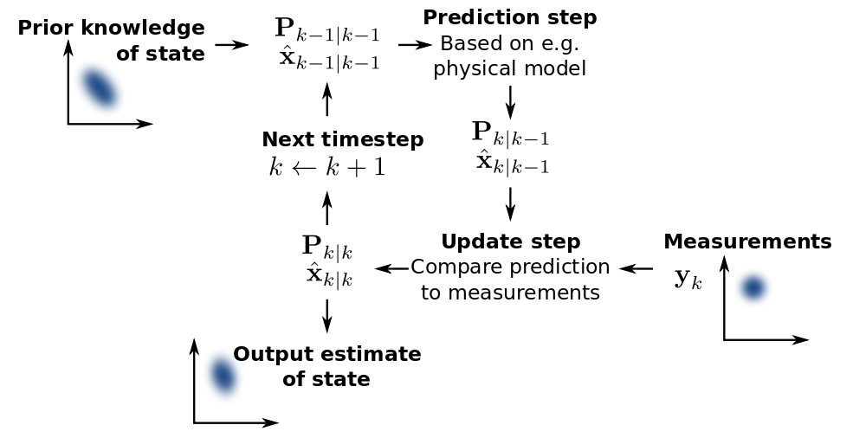
Kalman filter flow chart
t時刻得到訊號y前對y做預測
t時刻得到訊號y後對y的狀態做修正

Slide 27
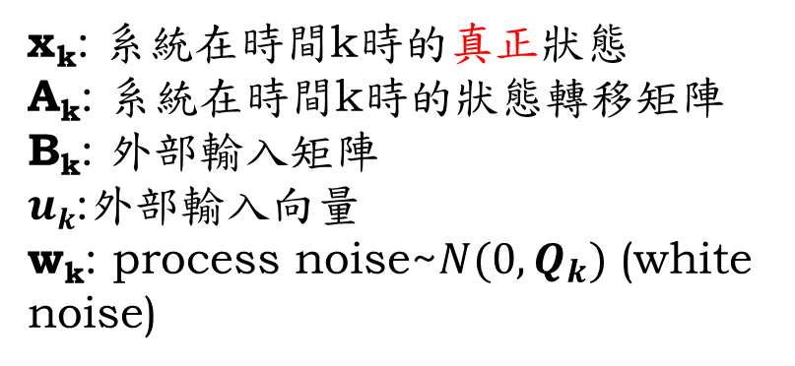
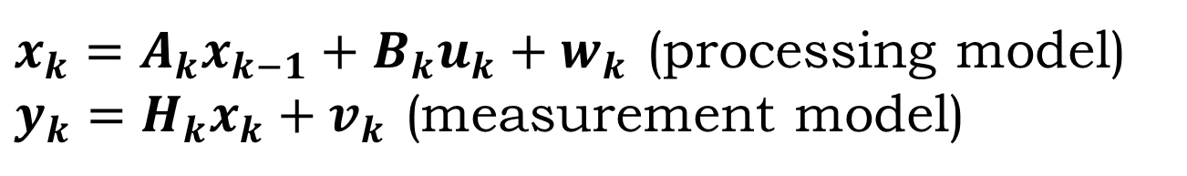
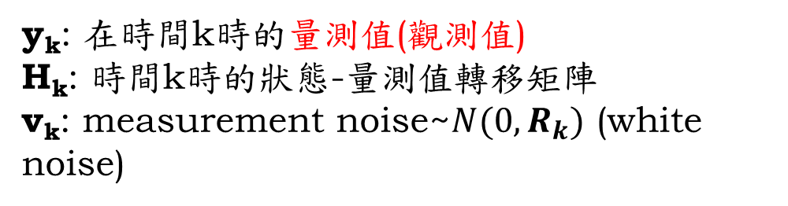
State-space model
$x_{k}=A_{k}x_{k−1}+B_{k}u_{k}+w_{k}$ (processing model)
$y_{k}=H_{k}x_{k}+v_{k}$ (measurement model)
x_{k}: 系統在時間k時的真正狀態
A_{k}: 系統在時間k時的狀態轉移矩陣
B_{k}: 外部輸入矩陣
$uk$:外部輸入向量
w_{k}: process noise~$N(0, Q_{k})$ (white noise)
y_{k}: 在時間k時的量測值(觀測值)
H_{k}: 時間k時的狀態-量測值轉移矩陣
v_{k}: measurement noise~$N(0, R_{k})$ (white noise)
系統在狀態轉移時會受到系統雜訊(w_{k})的影響。
量測資料時，也會受到量測誤差(v_{k})的影響。
Goal: 如何估計出系統真正的狀態x_{k}, k=12,…

Slide 28
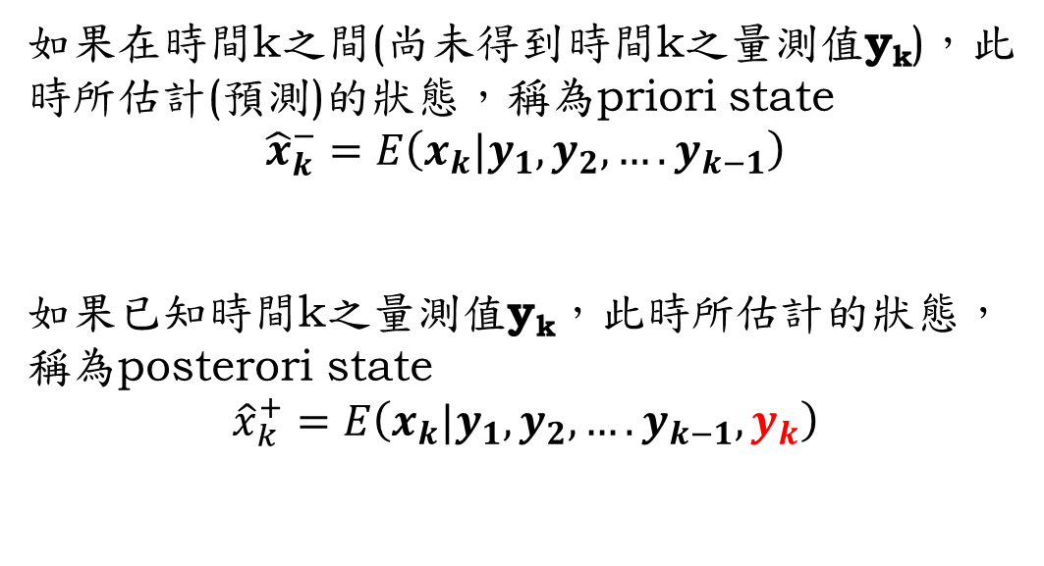
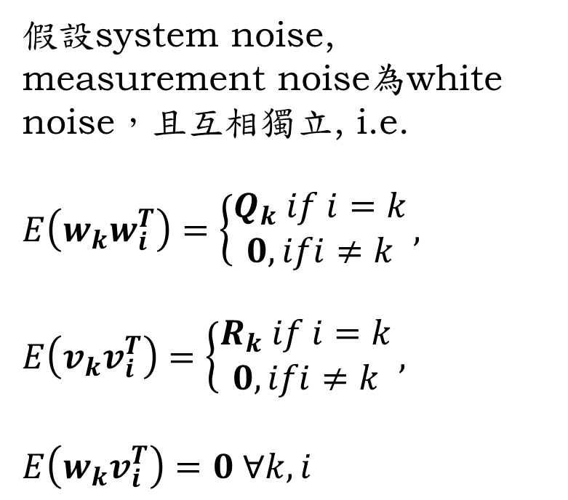
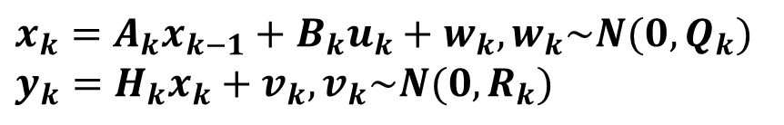
Kalman filter (1)
$x_{k}=A_{k}x_{k−1}+B_{k}u_{k}+w_{k}, w_{k}\sim N(0,Q_{k})$
$$y_{k}=H_{k}x_{k}+v_{k}, v_{k}\sim N(0, R_{k})$$
假設system noise, measurement noise為white noise，且互相獨立, i.e.
$$E\left(w_{k}w_{i}^{T}\right)=\left\{\begin{matrix}Q_{k} if i=k \\ 0, ifi≠k\end{matrix}\right.,$$
$$E\left(v_{k}v_{i}^{T}\right)=\left\{\begin{matrix}R_{k} if i=k \\ 0, ifi≠k\end{matrix}\right.,$$
$$E\left(w_{k}v_{i}^{T}\right)=0 ∀k, i$$
如果在時間k之間(尚未得到時間k之量測值y_{k})，此時所估計(預測)的狀態，稱為priori state
$${\hat{x}}_{k}^{−}=E\left(x_{k}|y_{1},y_{2},….y_{k−1}\right)$$
如果已知時間k之量測值y_{k}，此時所估計的狀態，稱為posterori state
$${\hat{x}}_{k}^{+}=E\left(x_{k}|y_{1},y_{2},….y_{k−1}, y_{k}\right)$$

Slide 29
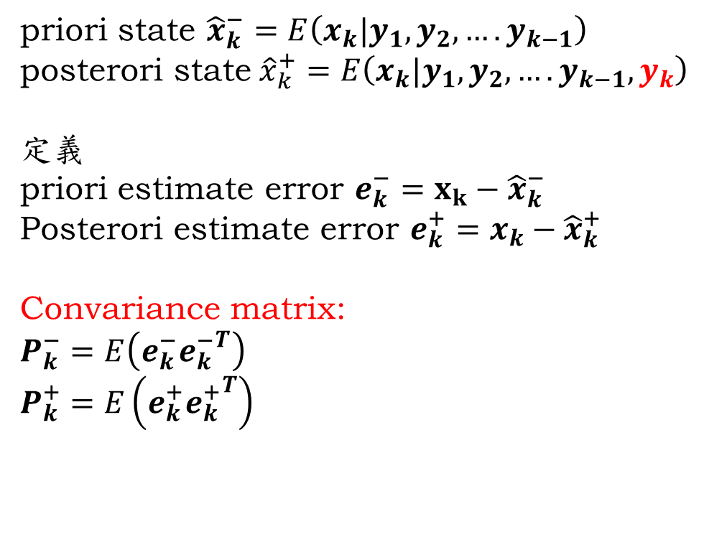
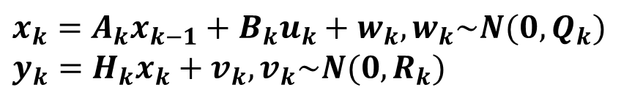
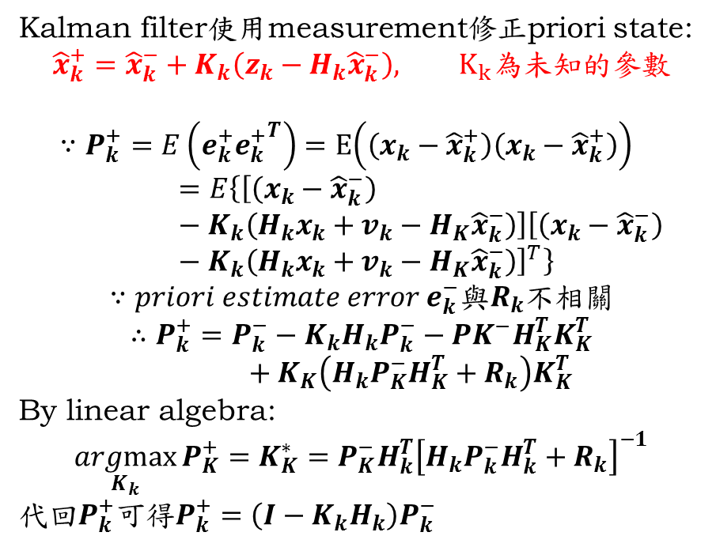
Kalman filter (2)
$x_{k}=A_{k}x_{k−1}+B_{k}u_{k}+w_{k}, w_{k}\sim N(0,Q_{k})$
$$y_{k}=H_{k}x_{k}+v_{k}, v_{k}\sim N(0, R_{k})$$
priori state ${\hat{x}}_{k}^{−}=E\left(x_{k}|y_{1},y_{2},….y_{k−1}\right)$
posterori state${\hat{x}}_{k}^{+}=E\left(x_{k}|y_{1},y_{2},….y_{k−1}, y_{k}\right)$
定義
priori estimate error $e_{k}^{−}=x_{k}−{\hat{x}}_{k}^{−}$
Posterori estimate error $e_{k}^{+}=x_{k}−{\hat{x}}_{k}^{+}$
Convariance matrix:
$$P_{k}^{−}=E\left(e_{k}^{−}{e_{k}^{−}}^{T}\right)$$
$$P_{k}^{+}=E\left(e_{k}^{+}{e_{k}^{+}}^{T}\right)$$
Kalman filter使用measurement修正priori state:
$${\hat{x}}_{k}^{+}={\hat{x}}_{k}^{−}+K_{k}\left(z_{k}−H_{k}{\hat{x}}_{k}^{−}\right), K_{k}為未知的參數$$
$$∵P_{k}^{+}=E\left(e_{k}^{+}{e_{k}^{+}}^{T}\right)=E\left(\left(x_{k}−{\hat{x}}_{k}^{+}\right)\left(x_{k}−{\hat{x}}_{k}^{+}\right)\right)=E\left\{\left[\left(x_{k}−{\hat{x}}_{k}^{−}\right)−K_{k}\left(H_{k}x_{k}+v_{k}−H_{K}{\hat{x}}_{k}^{−}\right)\right]{\left[\left(x_{k}−{\hat{x}}_{k}^{−}\right)−K_{k}\left(H_{k}x_{k}+v_{k}−H_{K}{\hat{x}}_{k}^{−}\right)\right]}^{T}\right\}$$
$$∵priori estimate error e_{k}^{−}與R_{k}不相關$$
$$∴P_{k}^{+}=P_{k}^{−}−K_{k}H_{k}P_{k}^{−}−PK^{−}H_{K}^{T}K_{K}^{T}+K_{K}\left(H_{k}P_{K}^{−}H_{K}^{T}+R_{k}\right)K_{K}^{T}$$
By linear algebra:
$$\underset{K_{k}}{argmax}{P_{K}^{+}}=K_{K}^{∗}=P_{K}^{−}H_{k}^{T}{\left[H_{k}P_{k}^{−}H_{k}^{T}+R_{k}\right]}^{−1}$$
代回$P_{k}^{+}可得P_{k}^{+}=\left(I−K_{k}H_{k}\right)P_{k}^{−}$

Slide 30
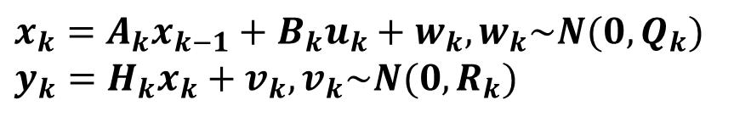
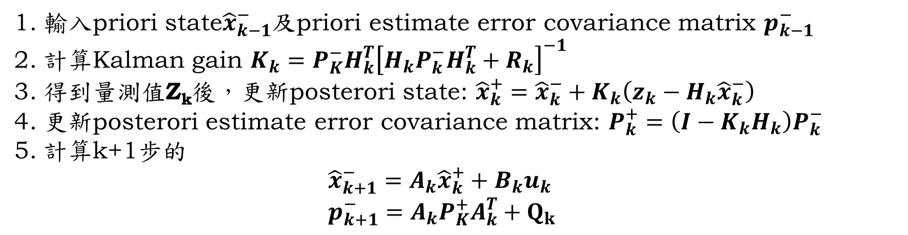
Kalman filter 整理
$x_{k}=A_{k}x_{k−1}+B_{k}u_{k}+w_{k}, w_{k}\sim N(0,Q_{k})$
$$y_{k}=H_{k}x_{k}+v_{k}, v_{k}\sim N(0, R_{k})$$
輸入priori state${\hat{x}}_{k−1}^{−}$及priori estimate error covariance matrix $p_{k−1}^{−}$
計算Kalman gain $K_{k}=P_{K}^{−}H_{k}^{T}{\left[H_{k}P_{k}^{−}H_{k}^{T}+R_{k}\right]}^{−1}$
得到量測值Z_{k}後，更新posterori state: ${\hat{x}}_{k}^{+}={\hat{x}}_{k}^{−}+K_{k}\left(z_{k}−H_{k}{\hat{x}}_{k}^{−}\right)$
更新posterori estimate error covariance matrix: $P_{k}^{+}=\left(I−K_{k}H_{k}\right)P_{k}^{−}$
計算k+1步的 ${\hat{x}}_{k+1}^{−}=A_{k}{\hat{x}}_{k}^{+}+B_{k}u_{k}$ $p_{k+1}^{−}=A_{k}P_{K}^{+}A_{k}^{T}+Q_{k}$

Slide 31

Thanks for your listening!

